Slide 1


Getting Started With
Microsoft Access
Database
5
Manager of Information Center
Tendering Department
Arab Contractors
Said Fawzy

Slide 2
Getting Started With
Microsoft Access
Database
5
Building Tables
Manager of Information Center
Tendering Department
Arab Contractors
Said Fawzy

Slide 3

1
5
Create Table in Datasheet View
Data types Pros and Cons
2
6
Create a Table in Design View Mode
Creating table using template
3
Defining fields and data types
4
All Data Types available in MS Access

Slide 4


Lab 2A:
Creating Table in Datasheet view

Slide 5

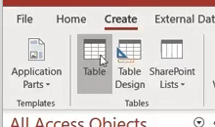
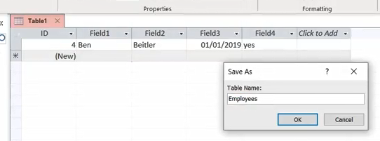
Lab 2A

Slide 6
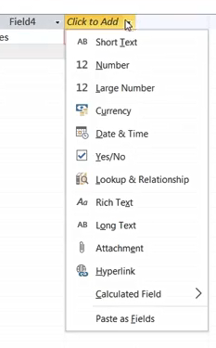
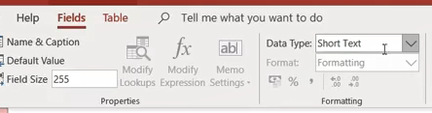
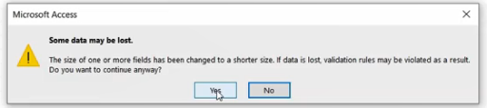
Lab 2A

Slide 7
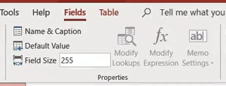
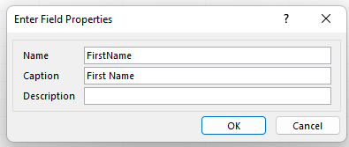
Lab 2A

Slide 8
Lab 2B:
Creating a table
Using Design view

Slide 9

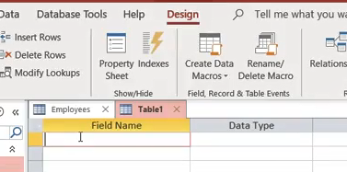
Lab 2B

Slide 10
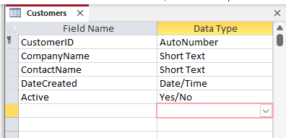

Lab 2B

Slide 11
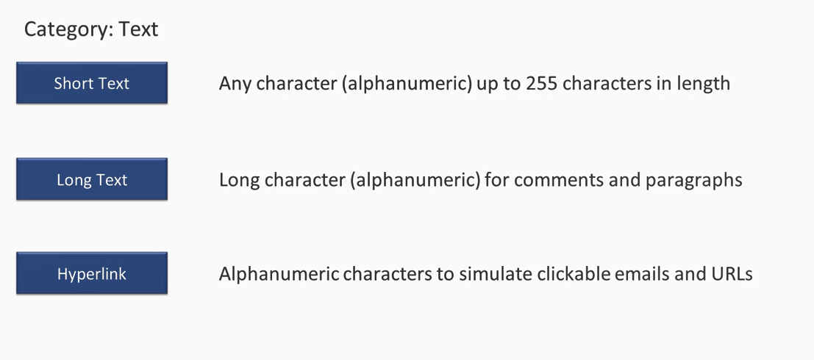
Access Data Types

Slide 12
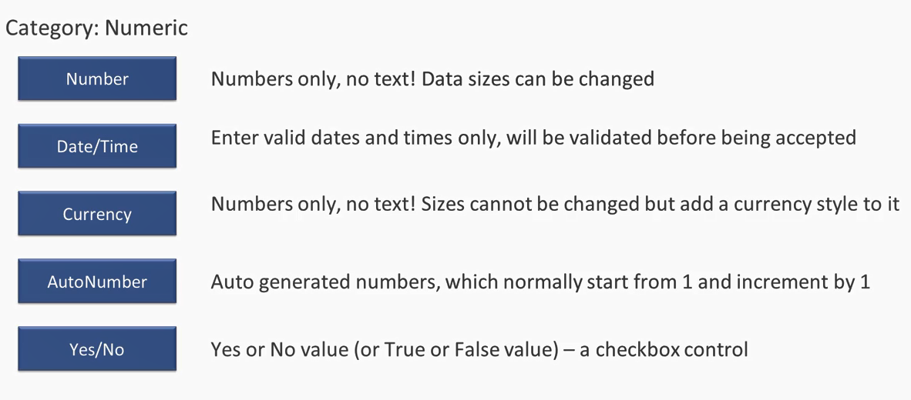
Access Data Types

Slide 13
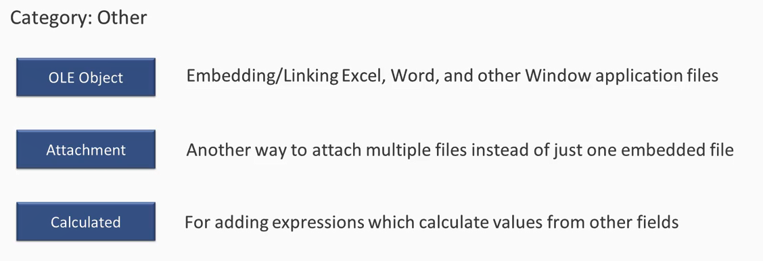
Access Data Types

Slide 14
Lab 2C:
Creating Table from Table Template

Slide 15
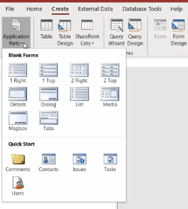
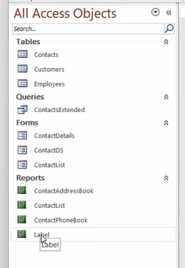
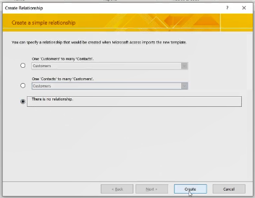
Lab 2C

Slide 16
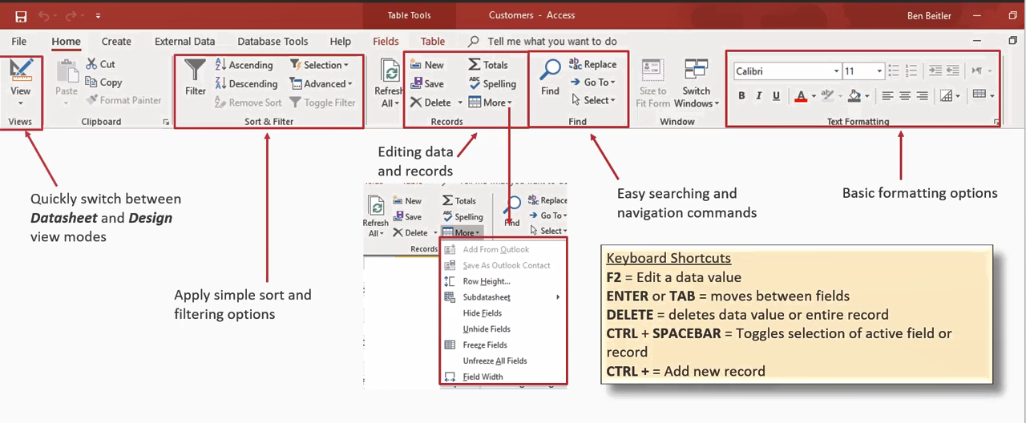
Table Datasheet view

Slide 17
Lab 2D:
Working with table datasheet view

Slide 18
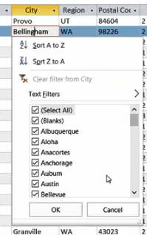
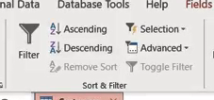
Lab 2D

Slide 19
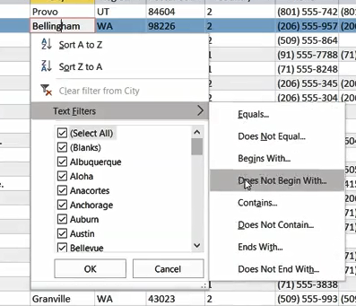
Lab 2D

Slide 20
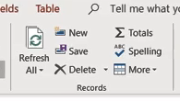
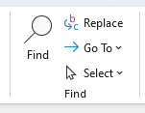
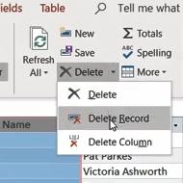
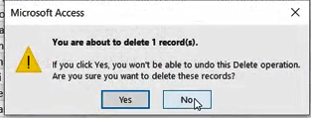
Lab 2D

Slide 21
Lab 2E:
Change Fields Properties

Slide 22
Lab 2E

Slide 23
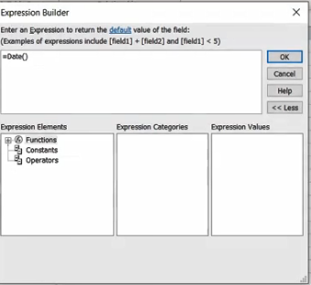
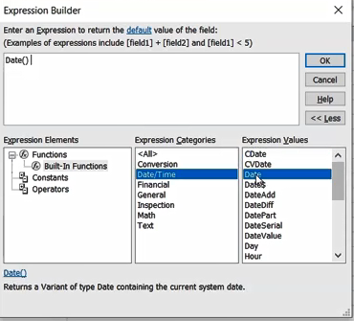

Lab 2E

Slide 24
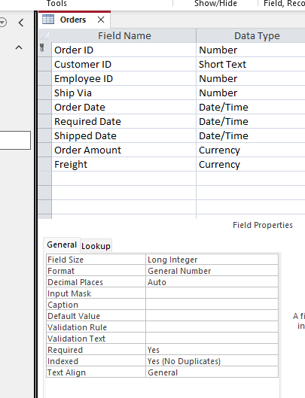
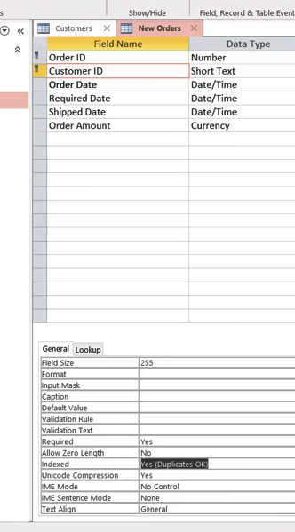
Lab 2E

Slide 25
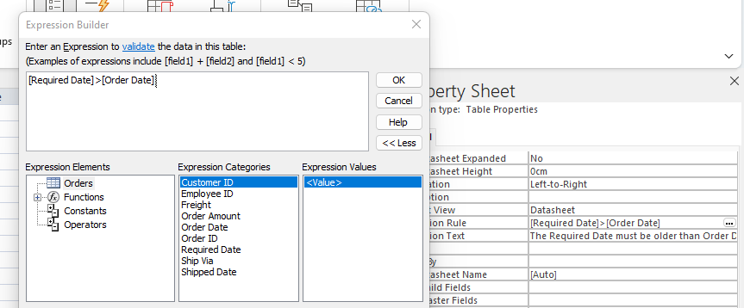
Lab 2E

Slide 26



Said Fawzy

