Slide 1


Getting Started With
Microsoft Access
Database
6
Manager of Information Center
Tendering Department
Arab Contractors
Said Fawzy

Slide 2
Getting Started With
Microsoft Access
Database
6
Tables Relationship
Manager of Information Center
Tendering Department
Arab Contractors
Said Fawzy

Slide 3

1
5
Primary Key
Cascade Options
2
6
Setting Primary and Secondary Keys
Build Your Project Par 1 (Creating Tables)
3
The relationship Window
4
Define Relationship between Tables

Slide 4
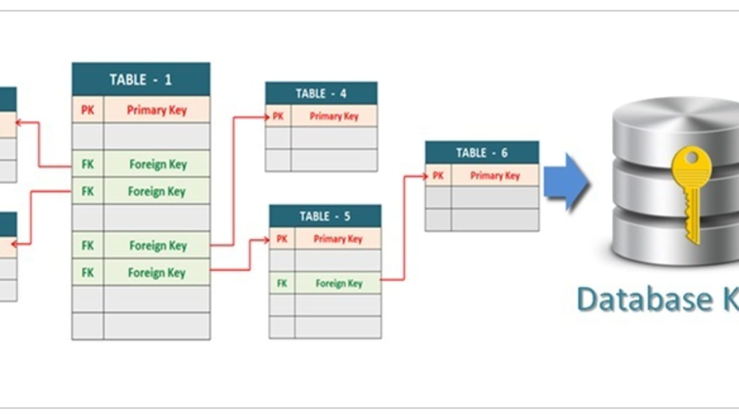
Primary Key
It is a key field that contains a unique value in a table.
Used to join the table with other tables.
A primary Key cannot be left blank (Mandatory) (is NOT NULL).
Secondary key is a field used to connect to other table but allow duplicate values.
Keys are used to speed up the queries.

Slide 5


Lab 3A:
Setting Primary and Secondary Keys

Slide 6

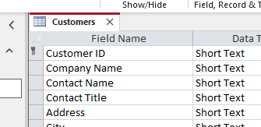

Lab 3A

Slide 7
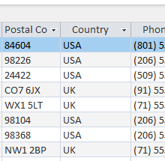
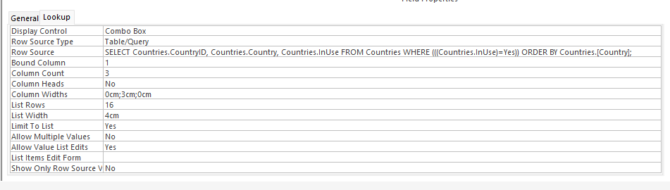
Lab 3A

Slide 8
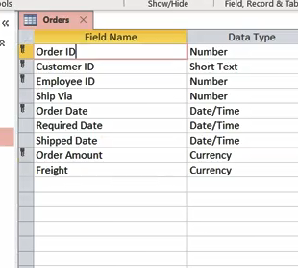
Lab 3A

Slide 9
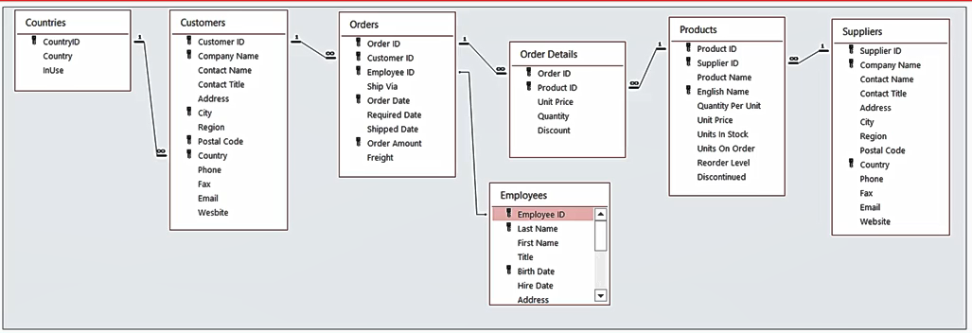
The relationship Window

Slide 10
Lab 3B:
Define Relationship between Tables

Slide 11
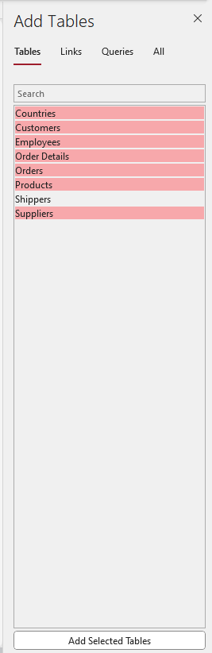
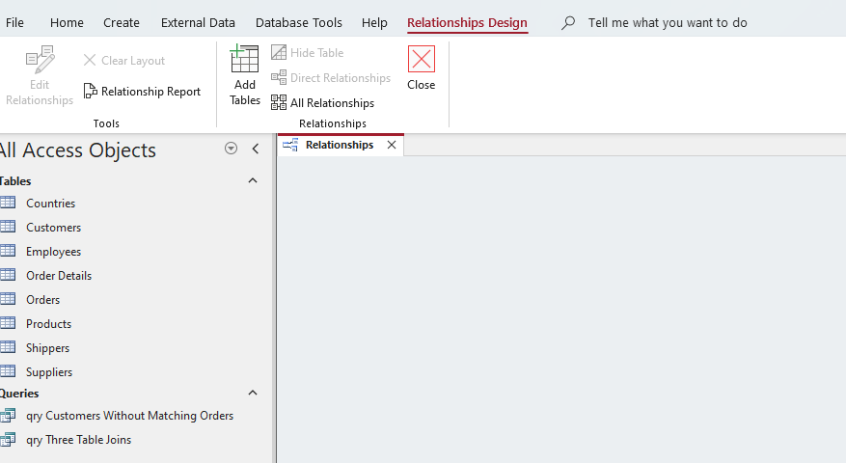
Lab 3B

Slide 12
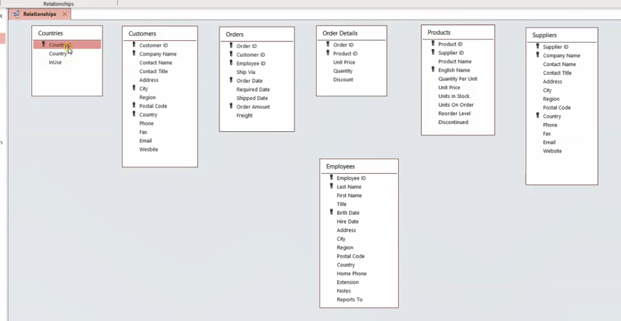
Lab 3B

Slide 13
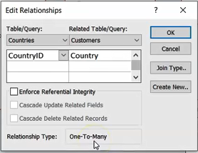
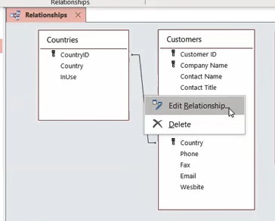
Lab 3B

Slide 14

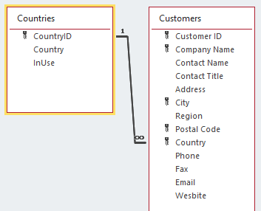
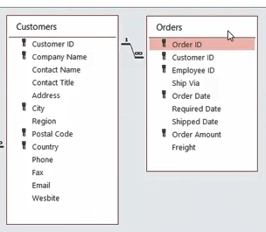
Lab 3B

Slide 15
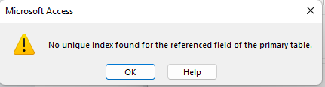
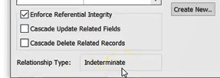
Lab 3B

Slide 16
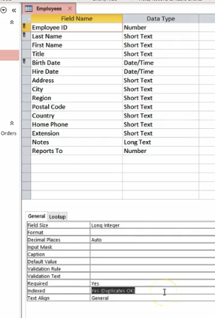
Lab 3B

Slide 17
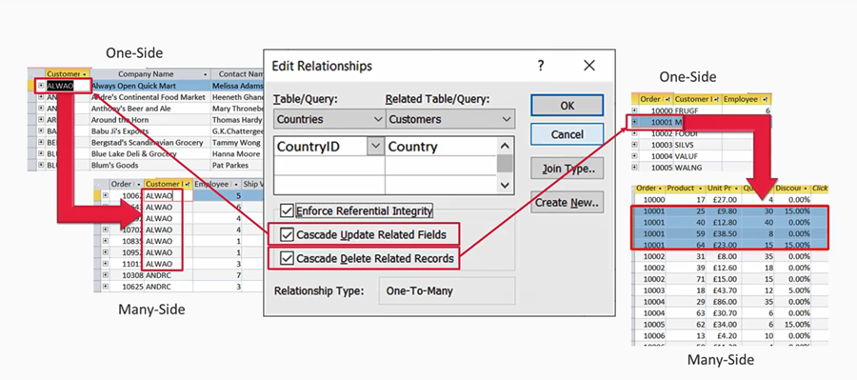
Cascade Options

Slide 18



Said Fawzy

