Slide 1


Getting Started With
Microsoft Access
Database
7
Manager of Information Center
Tendering Department
Arab Contractors
Said Fawzy

Slide 2
Getting Started With
Microsoft Access
Database
7
Query Basics
Manager of Information Center
Tendering Department
Arab Contractors
Said Fawzy

Slide 3

1
Create Query Using Query Wizard
2
Query View Modes
3
Create Query Using Design View
4
Customize Query with Criteria

Slide 4
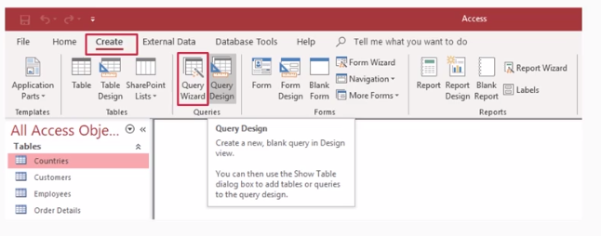
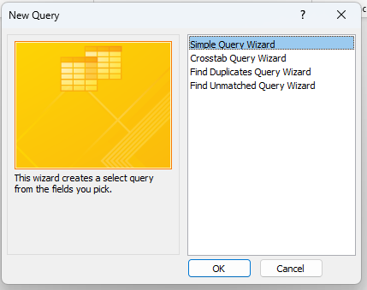
How to Create Query
You can Use:
Query Wizard

Slide 5


Lab 4A:
Creating Query
Using Wizard

Slide 6

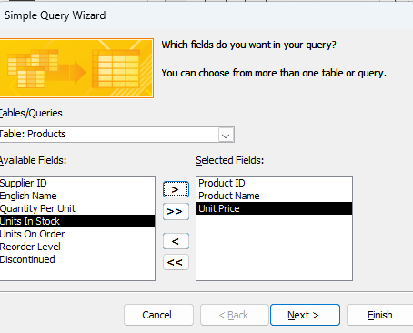
Lab 4A

Slide 7
How to Create Query
You can Use:
Query Design

Slide 8
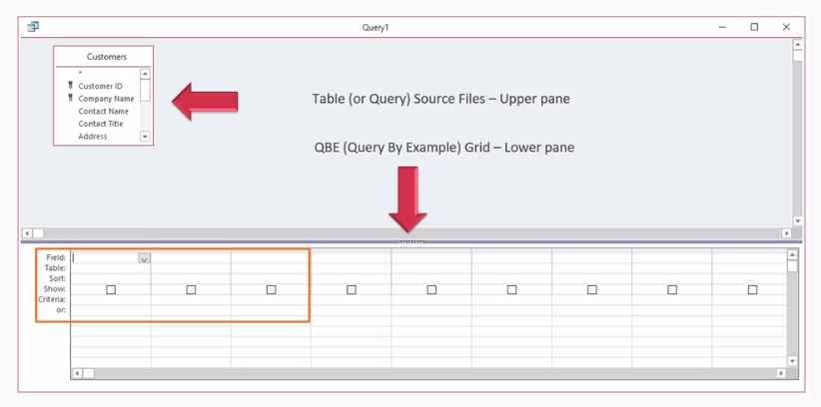
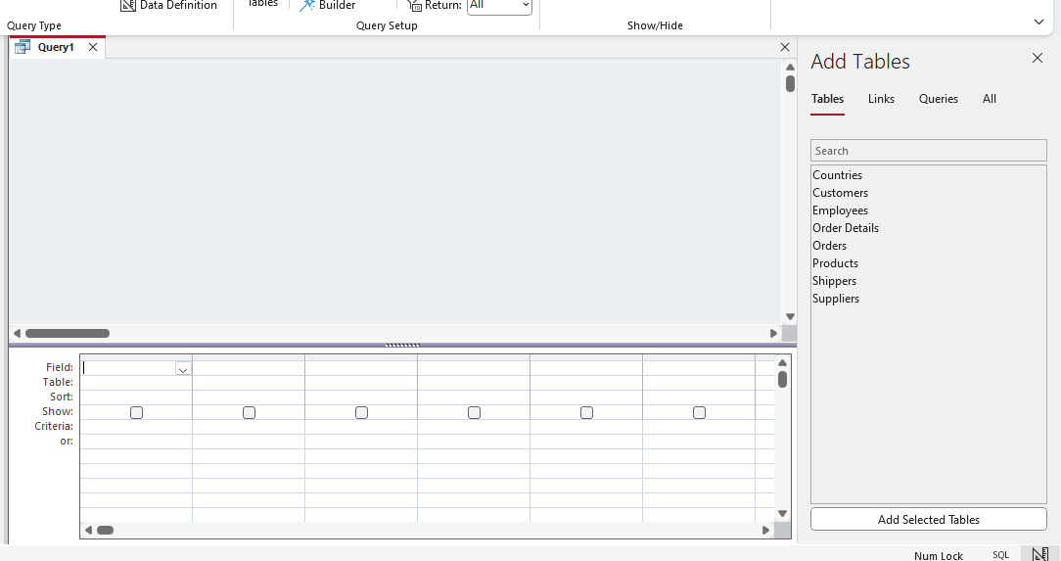
How to Create Query

Slide 9
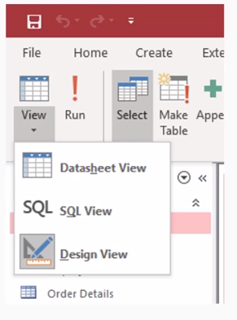
Query View Modes

Slide 10
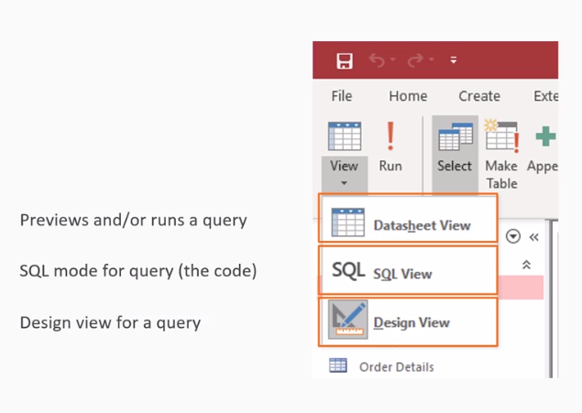
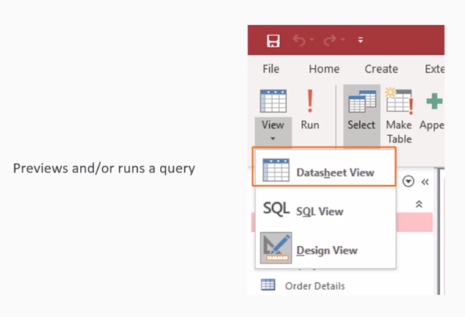
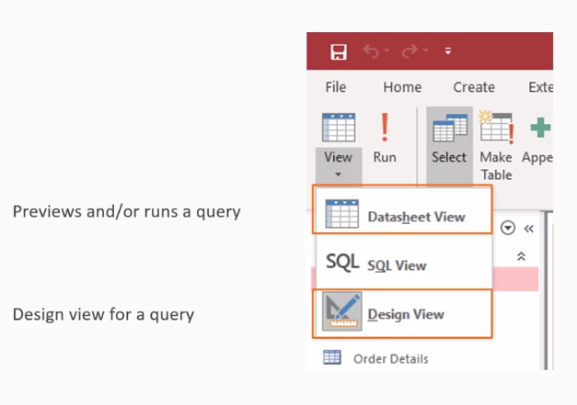
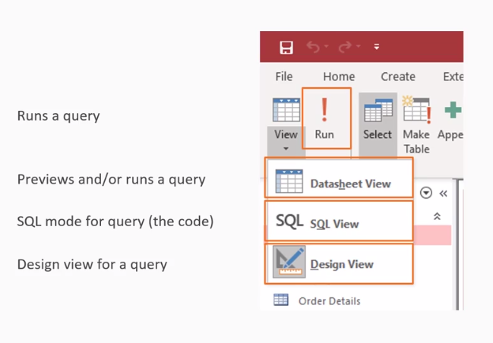

Slide 11
Lab 4B:
Create Query using design view

Slide 12
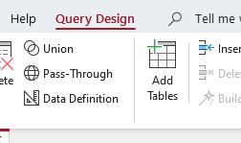
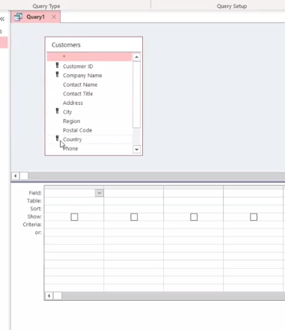
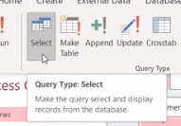
Lab 4B

Slide 13
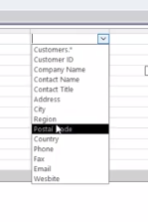
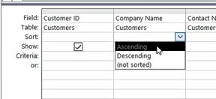
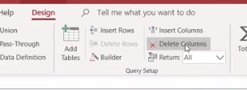
Lab 4B

Slide 14
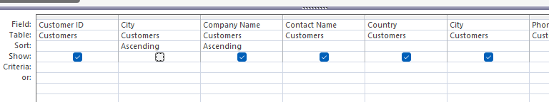
Lab 4B

Slide 15
Lab 4C:
Customize Query with Criteria

Slide 16
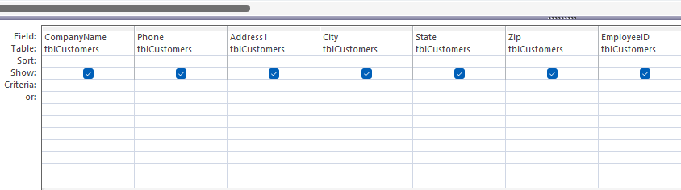
Lab 4C

Slide 17
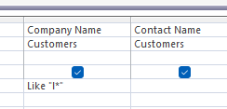
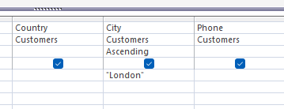
Lab 4C

Slide 18



Said Fawzy

