Slide 1


Getting Started With
Microsoft Access
Database
8
Manager of Information Center
Tendering Department
Arab Contractors
Said Fawzy

Slide 2
Getting Started With
Microsoft Access
Database
8
Form Basics
Manager of Information Center
Tendering Department
Arab Contractors
Said Fawzy

Slide 3

1
Benefits of Using forms
2
Creating a Form
3
Form Three View Modes

Slide 4
4
Form Ribbon Tabs
5
Form Record Management
6
Form Record Management

Slide 5
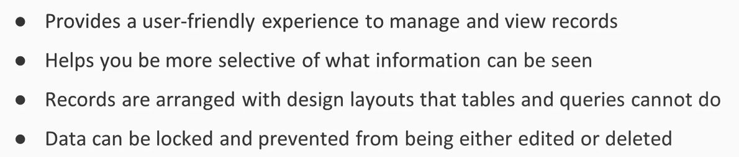
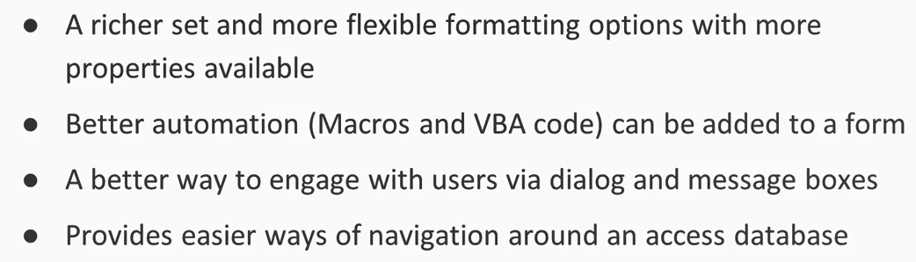
Benefits of Using Forms

Slide 6


Lab 9A: Creating a Form

Slide 7

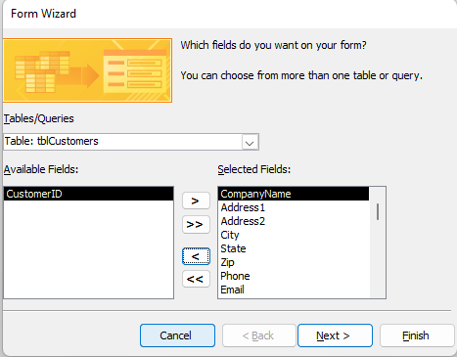
Lab 9A

Slide 8
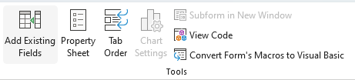
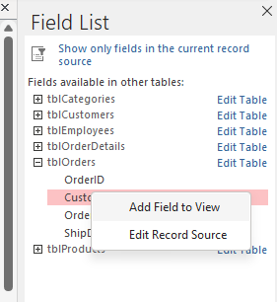

Lab 9A

Slide 9
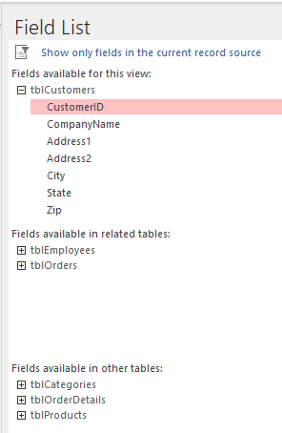
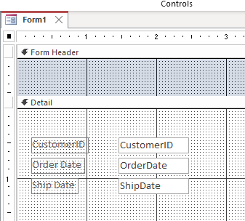
Lab 9A

Slide 10
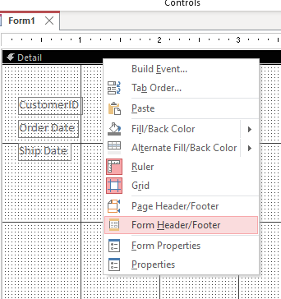
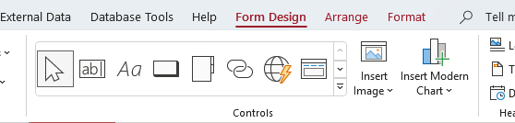
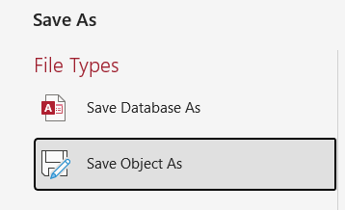
Lab 9A

Slide 11
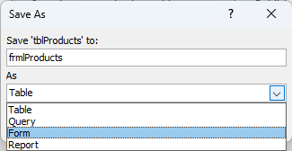
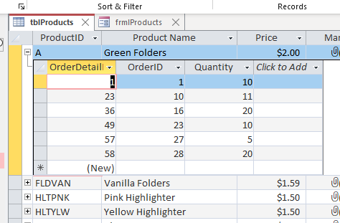
Lab 9A

Slide 12
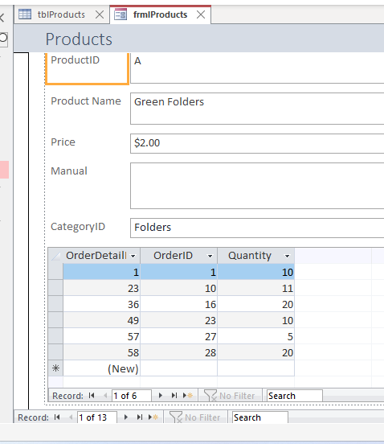
Lab 9A

Slide 13
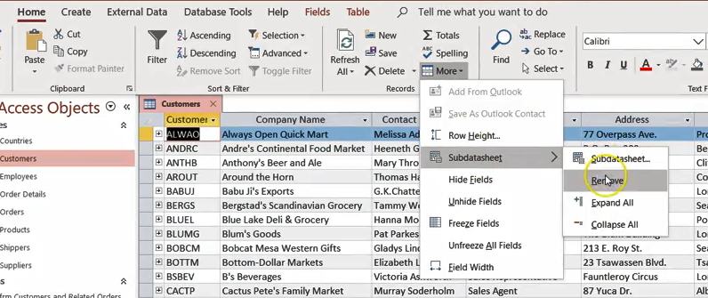
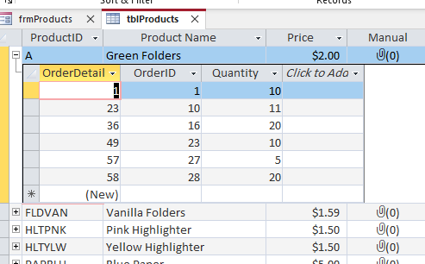
Lab 9A

Slide 14
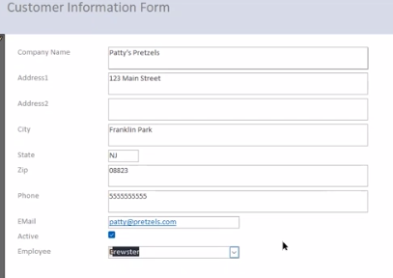

Lab 9A

Slide 15
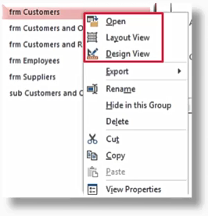
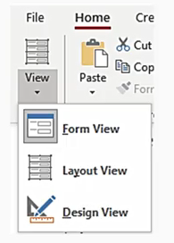
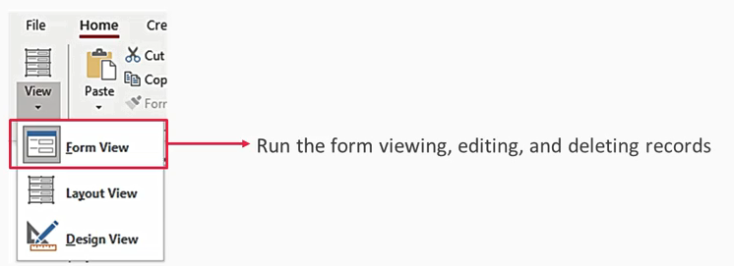
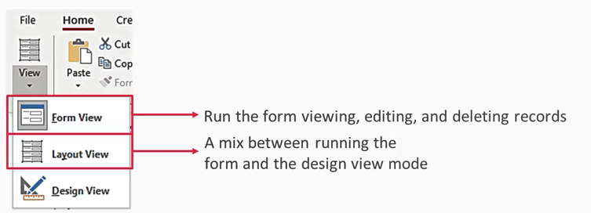
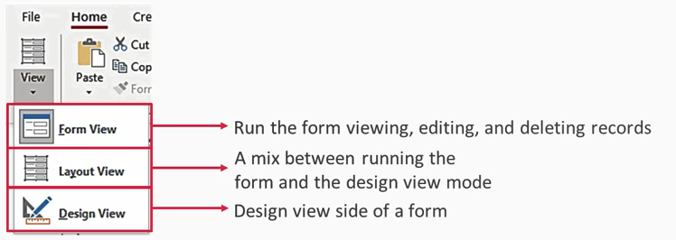
Form View Modes

Slide 16
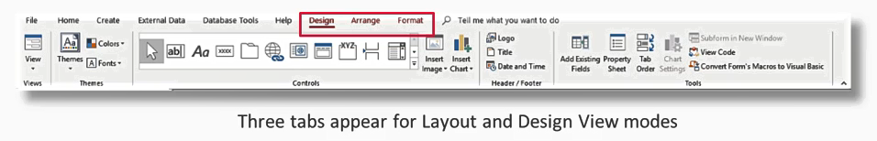
Form Ribbon Tabs

Slide 17
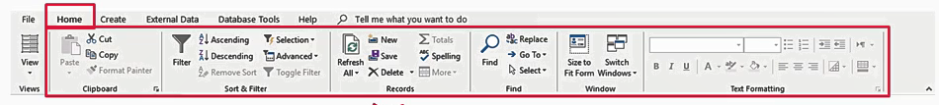
Form Record Management
You will have the same ribbon option on Home tab to mange the record s in the table datasheet view

Slide 18



Said Fawzy

