Slide 1


Getting Started With
Microsoft Access
Database
9
Manager of Information Center
Tendering Department
Arab Contractors
Said Fawzy

Slide 2
Getting Started With
Microsoft Access
Database
9
Report Basics
Manager of Information Center
Tendering Department
Arab Contractors
Said Fawzy

Slide 3

1
Creating Simple Report
2
Exploring Report Design View
3
Creating Form Using Blank Form

Slide 4
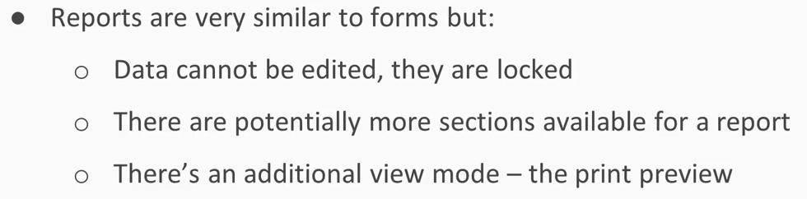
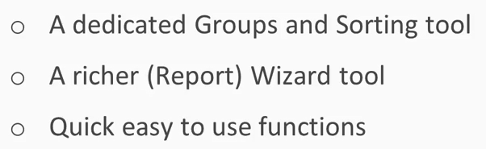
What is Report?

Slide 5


Lab 13A:
Creating Simple Report

Slide 6
Lab 13B:
Exploring Report Design View

Slide 7

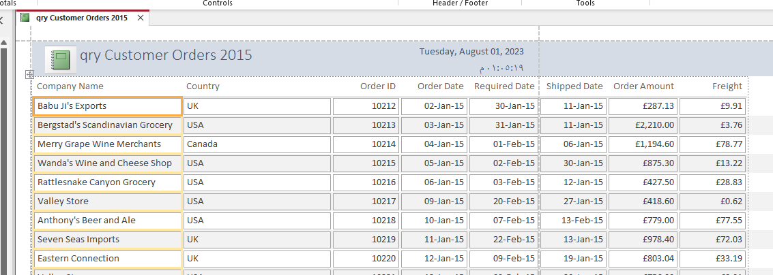
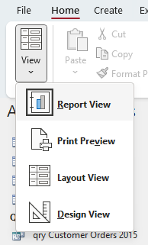
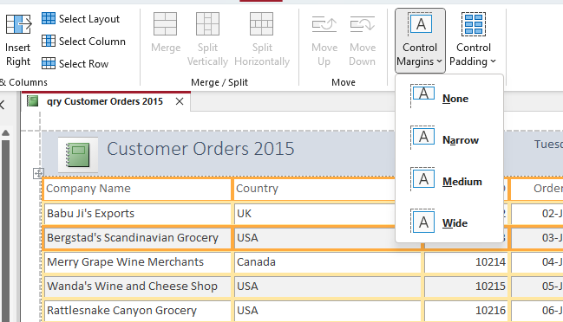
Lab 13B

Slide 8
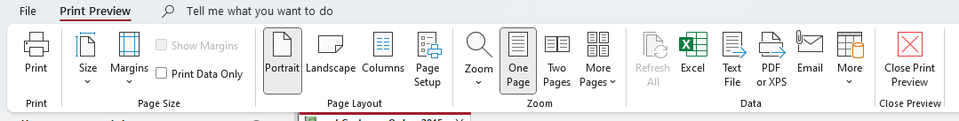
Lab 13B

Slide 9



Said Fawzy

