Slide 1
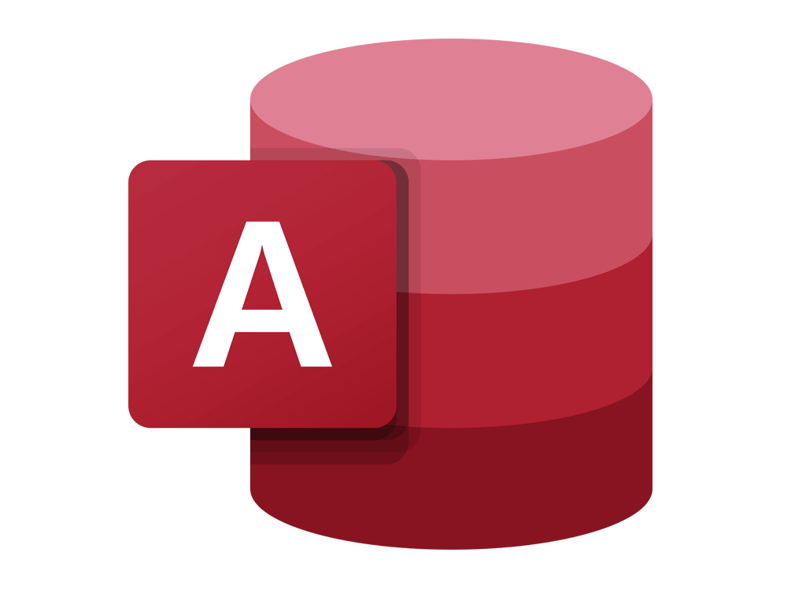

Getting Started With
Microsoft Access
Database
11
Manager of Information Center
Tendering Department
Arab Contractors
Said Fawzy

Slide 2
Getting Started With
Microsoft Access
Database
11
Automating Queries with Parameters
Manager of Information Center
Tendering Department
Arab Contractors
Said Fawzy

Slide 3

1
What Are Parameter Query
Controlling Query Results with Join Types
2
3
Syntax for a Parameter Query

Slide 4
4
Query with multiple parameters
5
Build your Project Part 2

Slide 5
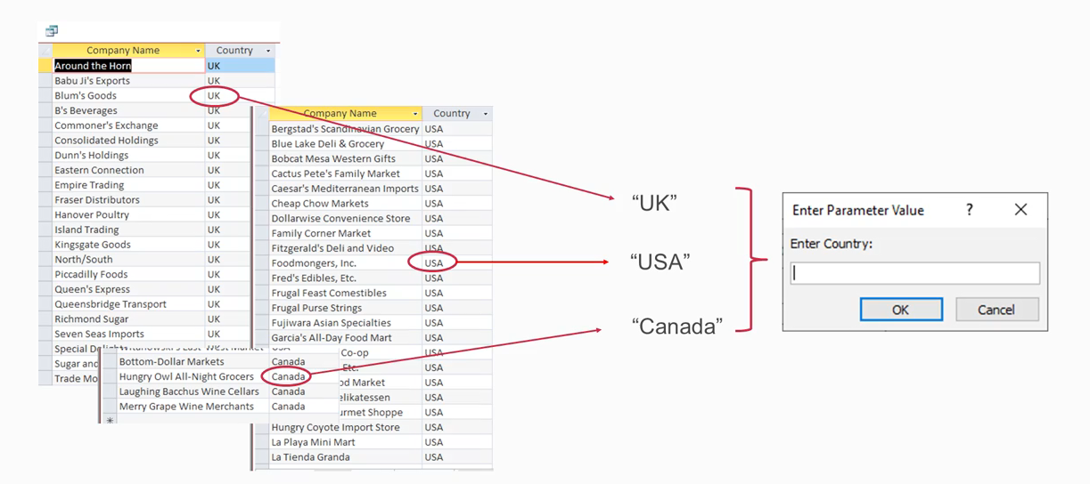
What Are Parameter Query?

Slide 6


Lab 6A:
Creating Automated Requests for Criteria

Slide 7

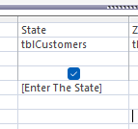
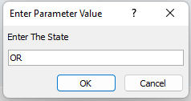
Lab 6A

Slide 8
Lab 6A

Slide 9
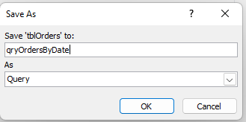
Lab 6A

Slide 10
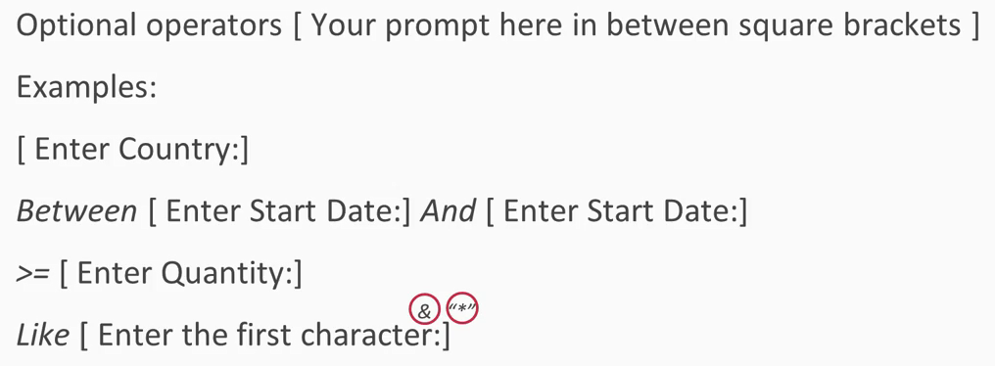
Syntax for a Parameter Query

Slide 11
Lab 6B:
Query with multiple parameters

Slide 12
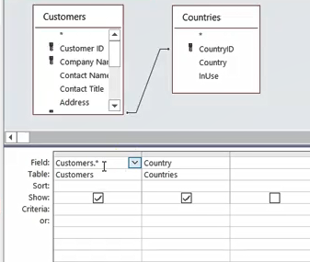
Lab 6B

Slide 13
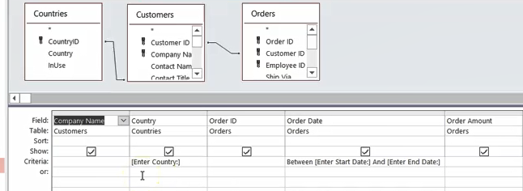
Lab 6B

Slide 14

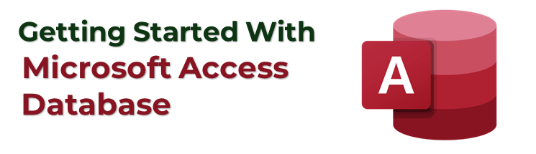

Said Fawzy

