Slide 1
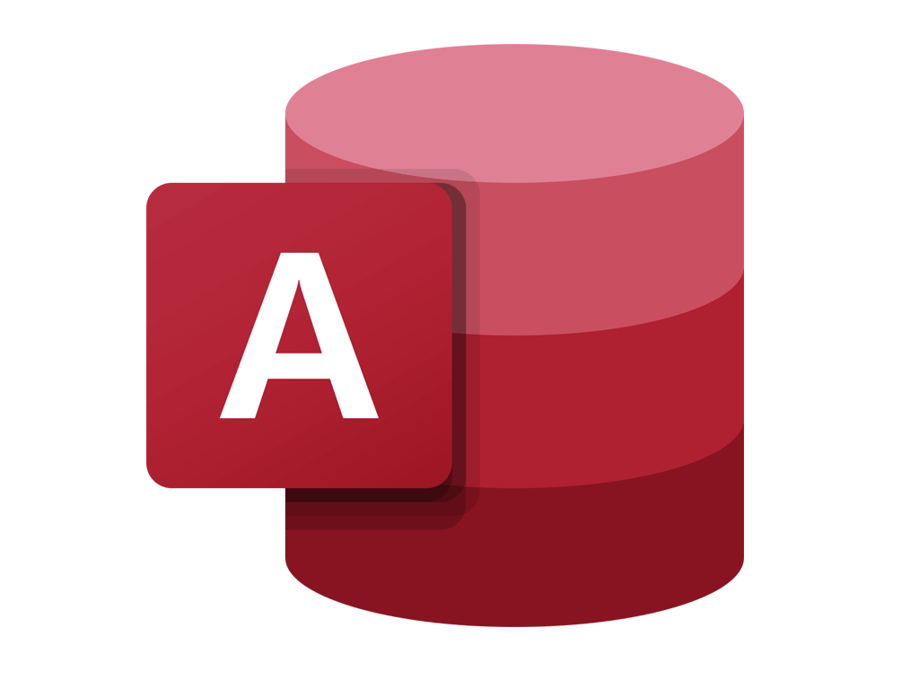

Getting Started With
Microsoft Access
Database
12
Manager of Information Center
Tendering Department
Arab Contractors
Said Fawzy

Slide 2
Getting Started With
Microsoft Access
Database
12
Action Queries
Manager of Information Center
Tendering Department
Arab Contractors
Said Fawzy

Slide 3

1
What is Action Queries
2
Type Of Action Queries
3
Creating Action Queries

Slide 4

Action Queries
Action queries are a category of query that changes the table Data

Slide 5
We have
Make table query: they create new table
Append Query: Append data to a table.
Update Query: Update Data in a table.
Delete Query: Delete Data from a table.

Slide 6

Be Careful
You cannot reverse the action of the action queries

Slide 7


Lab 7A: Action Queries

Slide 8

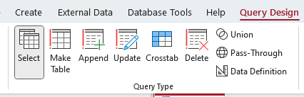
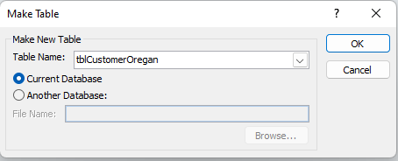
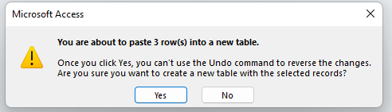
Lab 7A

Slide 9

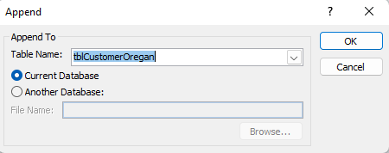
Lab 7A

Slide 10
Lab 7A

Slide 11
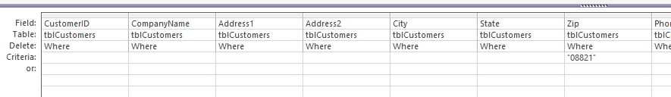
Lab 7A

Slide 12



Said Fawzy

