Slide 1


Getting Started With
Microsoft Access
Database
14
Manager of Information Center
Tendering Department
Arab Contractors
Said Fawzy

Slide 2
Getting Started With
Microsoft Access
Database
14
Navigation and Switchboard Forms
Manager of Information Center
Tendering Department
Arab Contractors
Said Fawzy

Slide 3

1
Navigation Form
2
Switchboard Form
3
Creating Form Using Blank Form

Slide 4
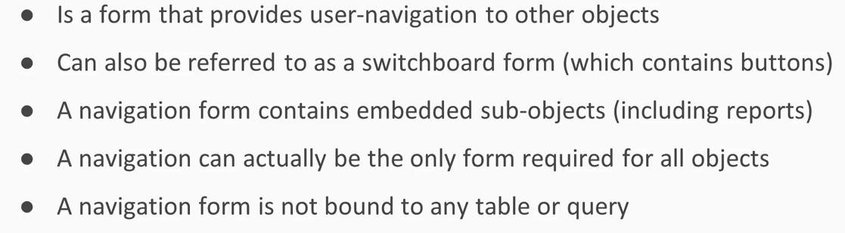
Navigation Form

Slide 5
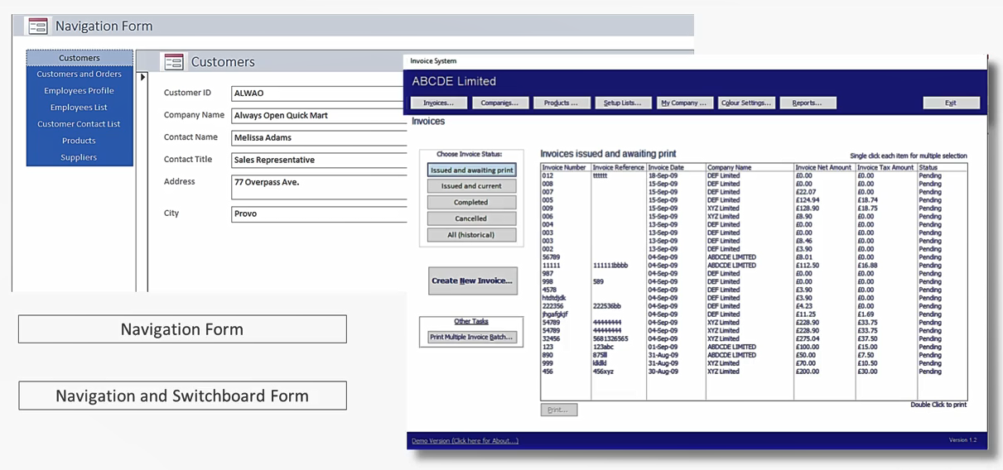
Navigation Form

Slide 6


Lab 11A:
Creating a Navigation Form

Slide 7

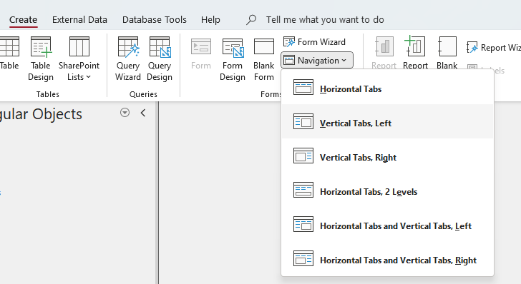
Lab 11A

Slide 8
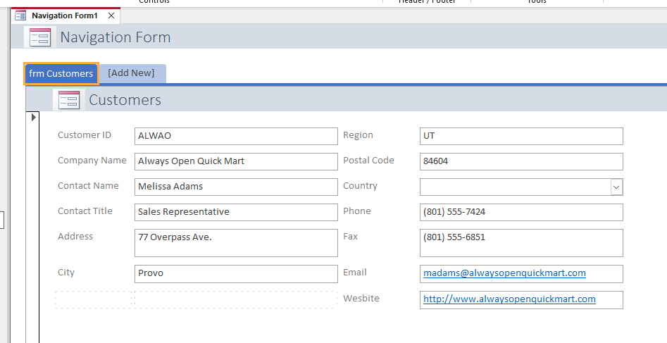
Lab 11A

Slide 9
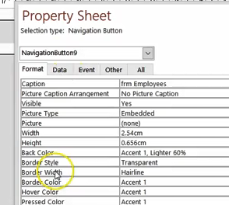
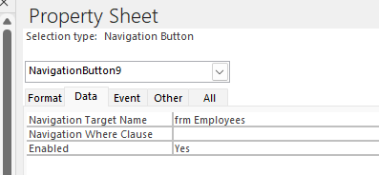
Lab 11A

Slide 10
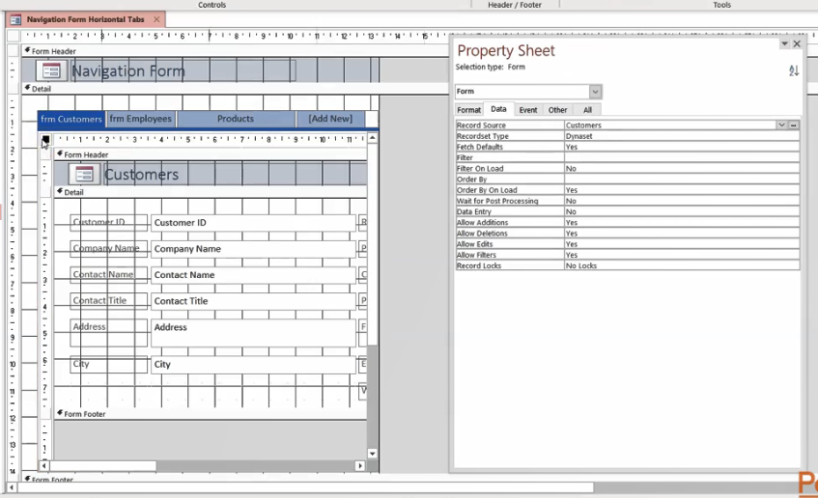
Lab 11A

Slide 11
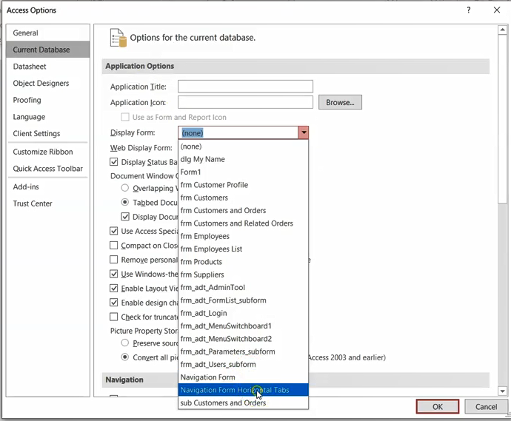
Lab 11A

Slide 12
Switchboard
Switchboards are used to navigate database Objects.
To create a switchboard, you use switchboard Manager.
Switchboard manager doesn’t show up in access by default.
You have to add it to your Quick Access Toolbar

Slide 13
Lab 11B:
Creating a Switchboard Form

Slide 14
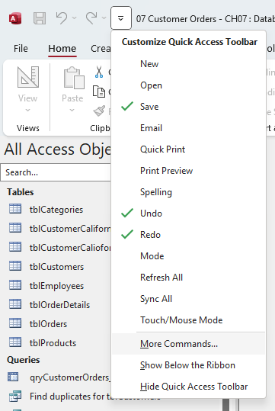
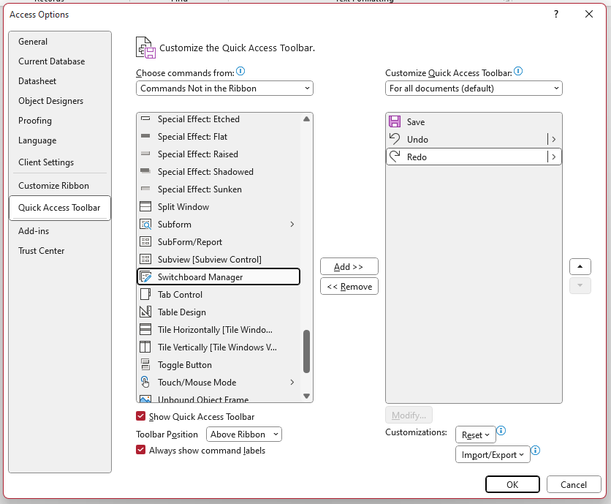
Lab 11B

Slide 15
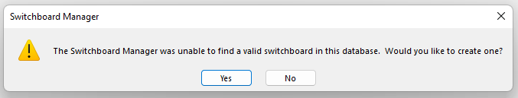
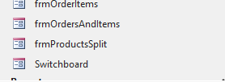
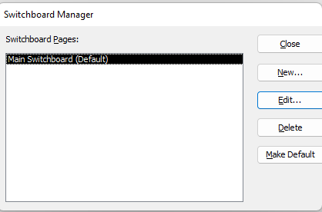
Lab 11B

Slide 16
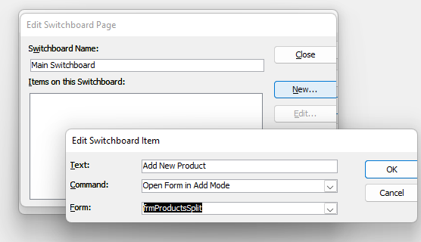
Lab 11B

Slide 17



Said Fawzy

