Slide 1


Getting Started With
Microsoft Access
Database
15
Manager of Information Center
Tendering Department
Arab Contractors
Said Fawzy

Slide 2
Getting Started With
Microsoft Access
Database
15
Advanced Report Design Techniques
Manager of Information Center
Tendering Department
Arab Contractors
Said Fawzy

Slide 3

1
Report Design Canvas
2
Report Sections
3
Creating a Report from Scratch

Slide 4
Report Groups, Sorting and Totals
4
Grouping Report Data
Using Wizard
5
6
Sub Reports

Slide 5
7
Building Reports Using Wizard
8
Build Your Project Part IV
Using Where and Having in Grouping
9

Slide 6
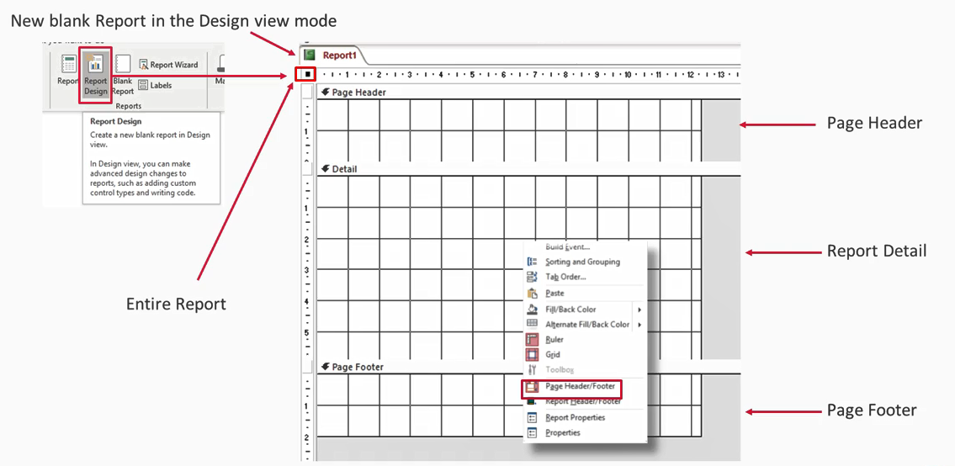
Report Design Canvas

Slide 7
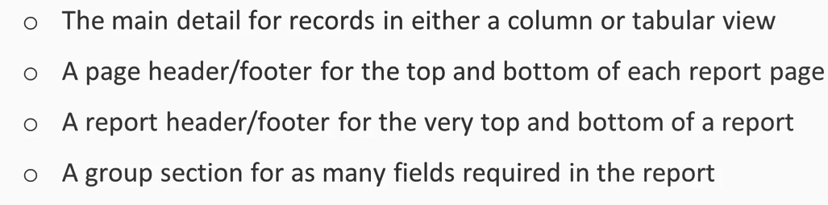
Report Sections

Slide 8


Lab 14A:
Creating a Report from Scratch

Slide 9

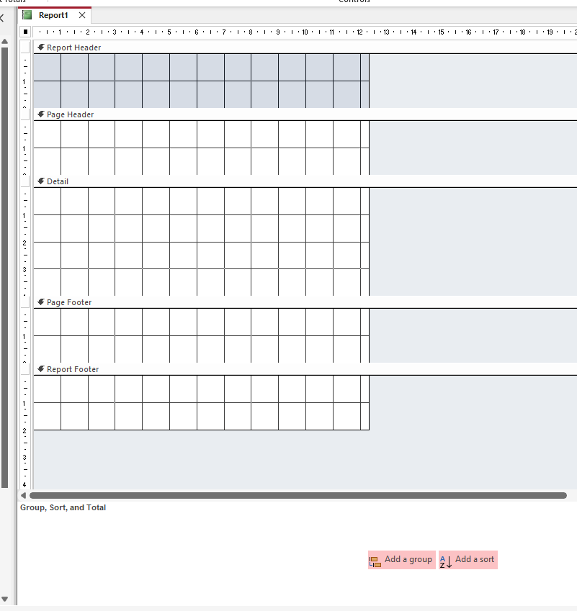
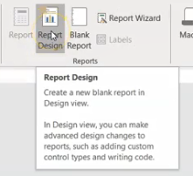
Lab 14A

Slide 10
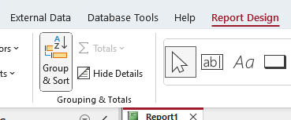
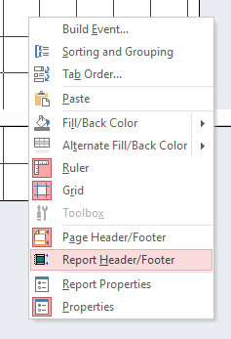
Lab 14A

Slide 11

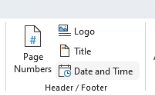
Lab 14A

Slide 12
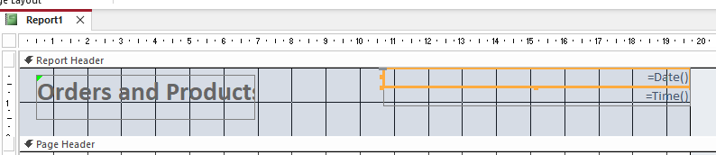
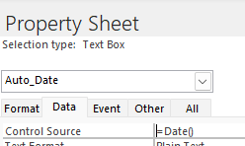
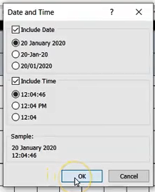
Lab 14A

Slide 13

Lab 14A

Slide 14
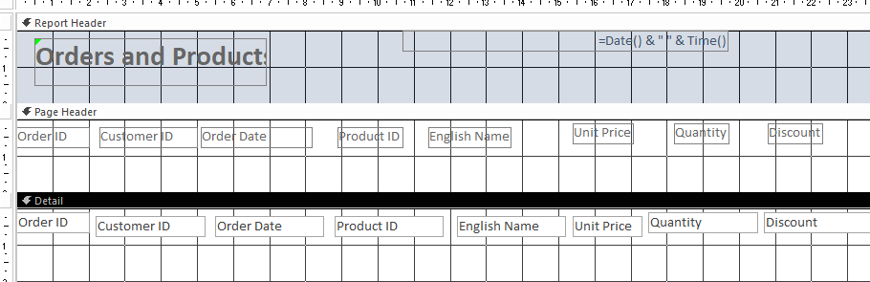
Lab 14A

Slide 15

Lab 14A

Slide 16

Lab 14A

Slide 17
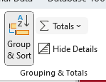
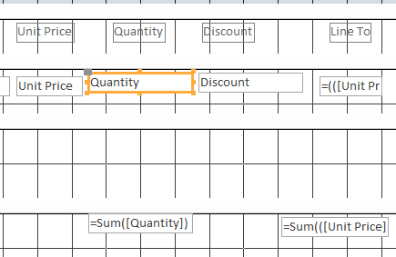
Lab 14A

Slide 18
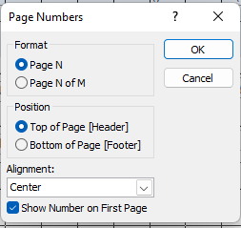
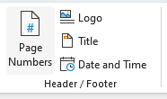

Lab 14A

Slide 19
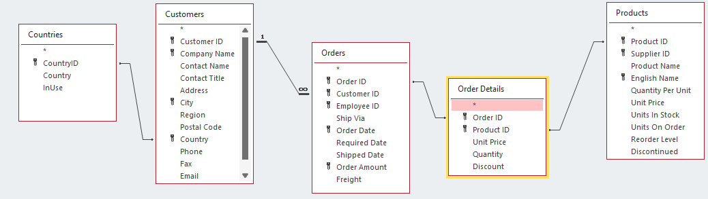
Lab 14A

Slide 20
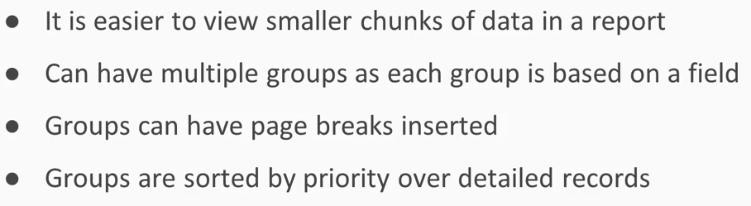
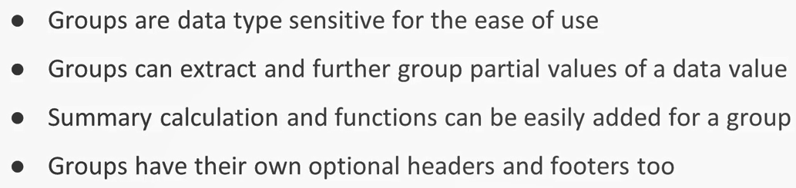
Report Groups, Sorting and Totals

Slide 21
Lab 14B:
Report Grouping,
Sorting and Totals

Slide 22
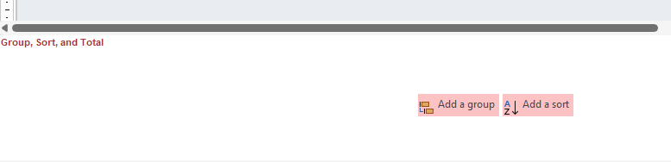
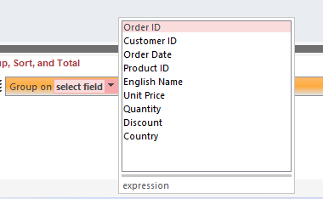
Lab 14B

Slide 23

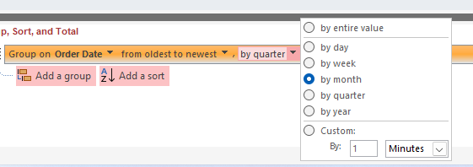
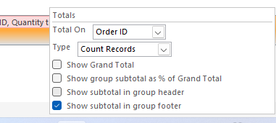
Lab 14B

Slide 24
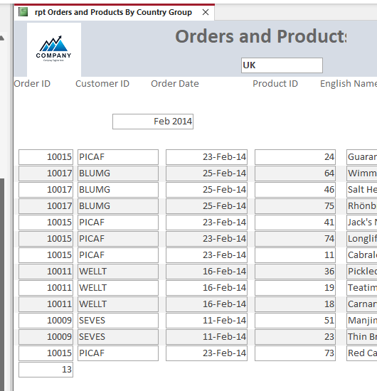
Lab 14B

Slide 25
Lab 14C:
Grouping Report Data
Using Wizard

Slide 26
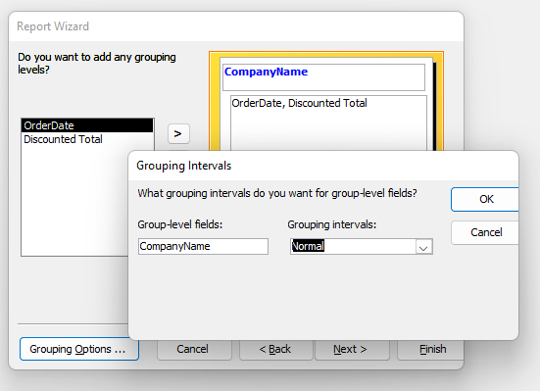
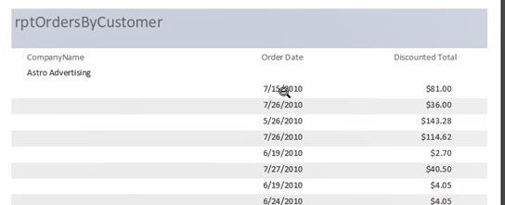
Lab 14C

Slide 27
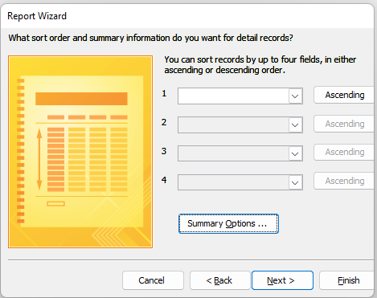
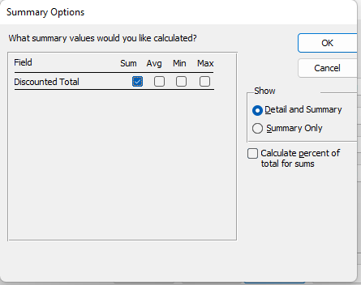
Lab 14C

Slide 28

Lab 14C

Slide 29

Lab 14C

Slide 30
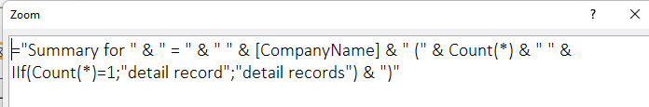
Lab 14C

Slide 31
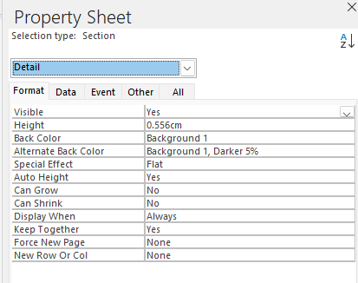
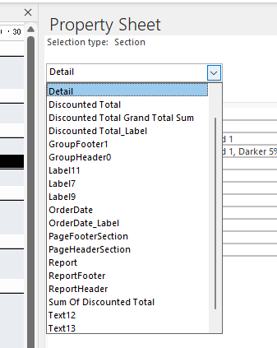
Lab 14C

Slide 32

Lab 14C

Slide 33
Lab 14C

Slide 34
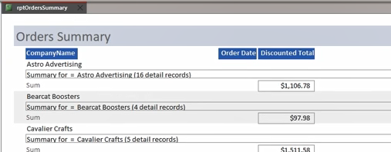
Lab 14C

Slide 35
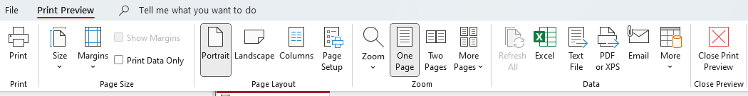
Lab 14C

Slide 36
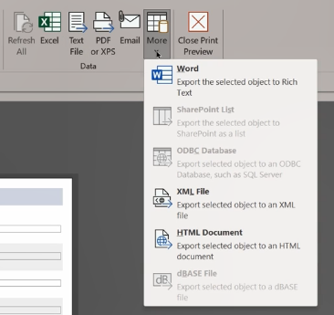
Lab 14C

Slide 37
Sub Reports
Sub report (Child) is a report that is embedded in another report (Parent).
Most of the time there is linked field between the two reports.
The field link is used to filter records between two reports

Slide 38
Lab 14D:
Sub Reports

Slide 39
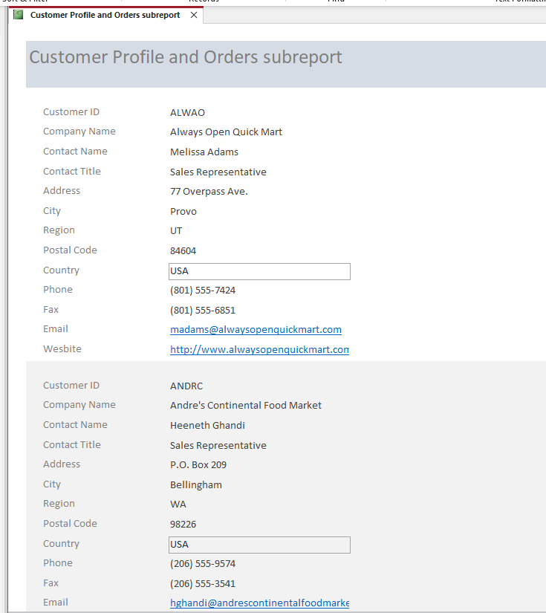
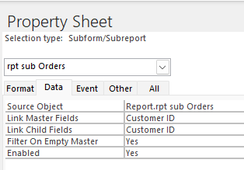
Lab 14D

Slide 40
Report Wizard
Access has a rich report wizard that makes it easier to have a quick report.
You can use it to create reports and then customize the result.

Slide 41
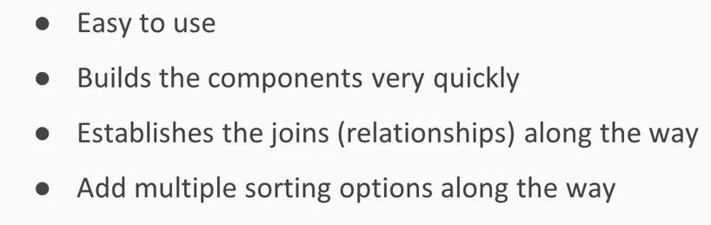
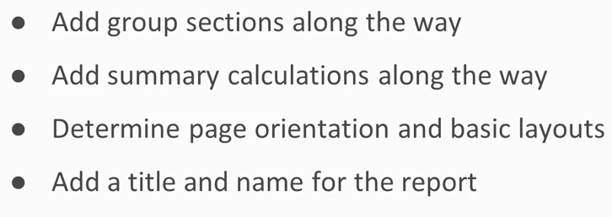
Report Wizard Advantages

Slide 42
Lab 14E:
Building Reports Using Wizard

Slide 43
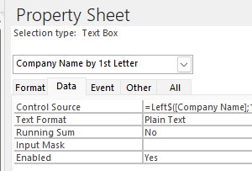
Lab 14E

Slide 44
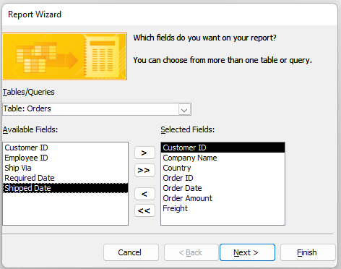
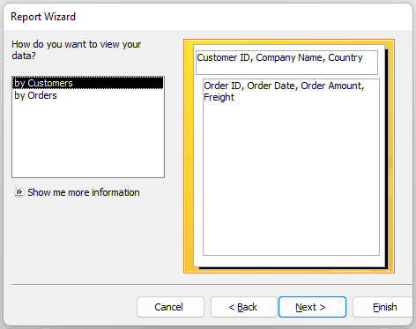
Lab 14E

Slide 45
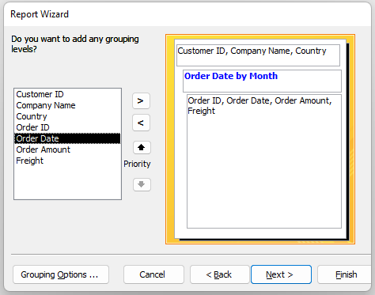
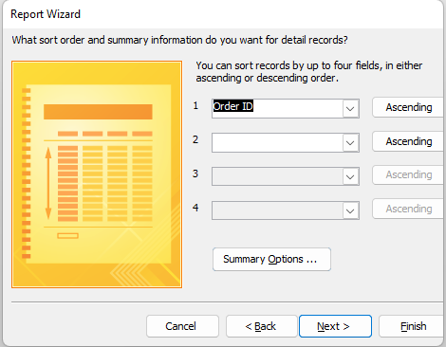
Lab 14E

Slide 46
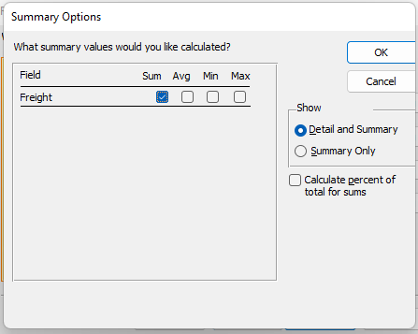
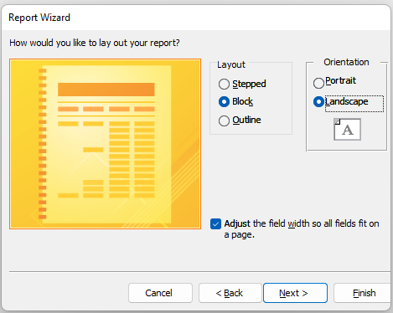
Lab 14E

Slide 47
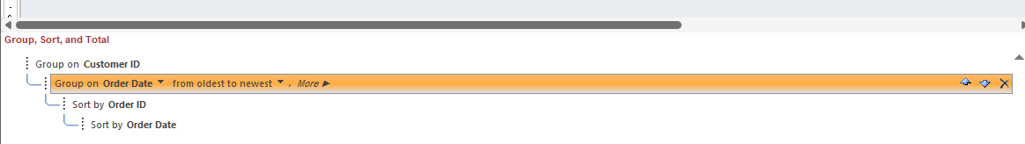
Lab 14E

Slide 48

Build Your Project Part IV
Create Reports

Slide 49
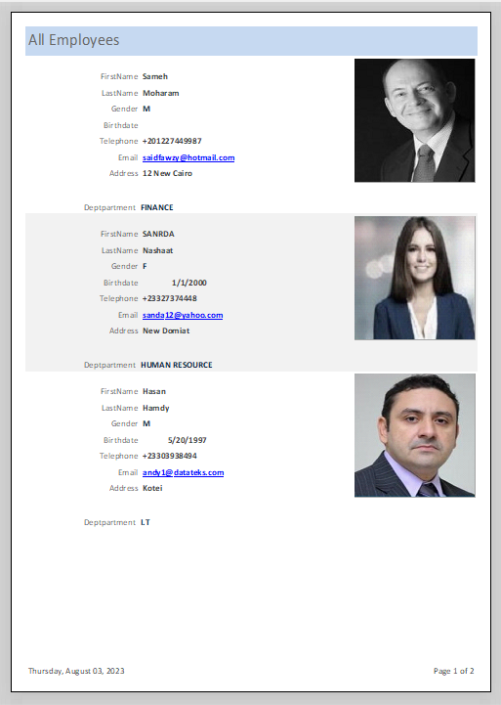
Create All Employees Report

Slide 50
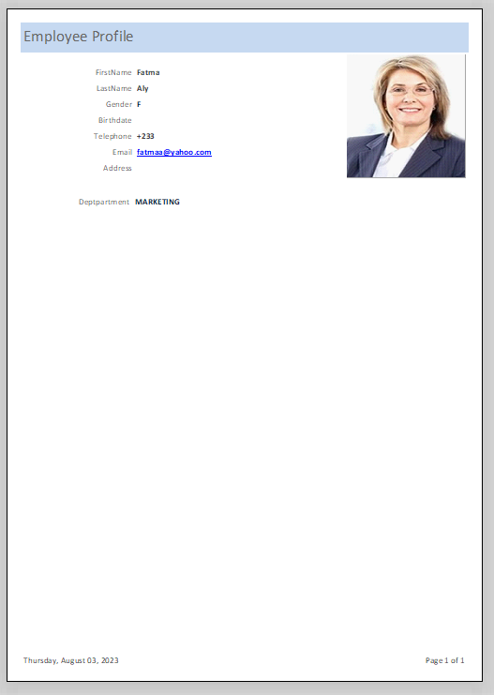
Create An Employee Profile

Slide 51
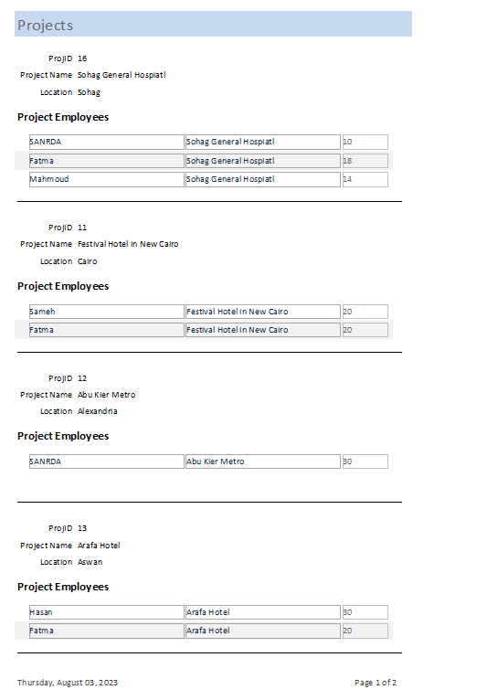
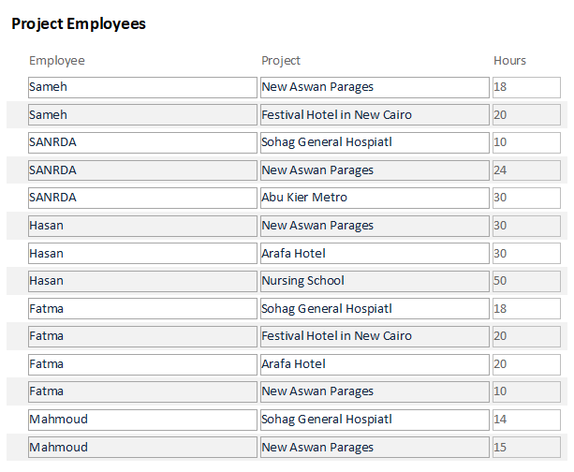
Create Project Employees Report

Slide 52
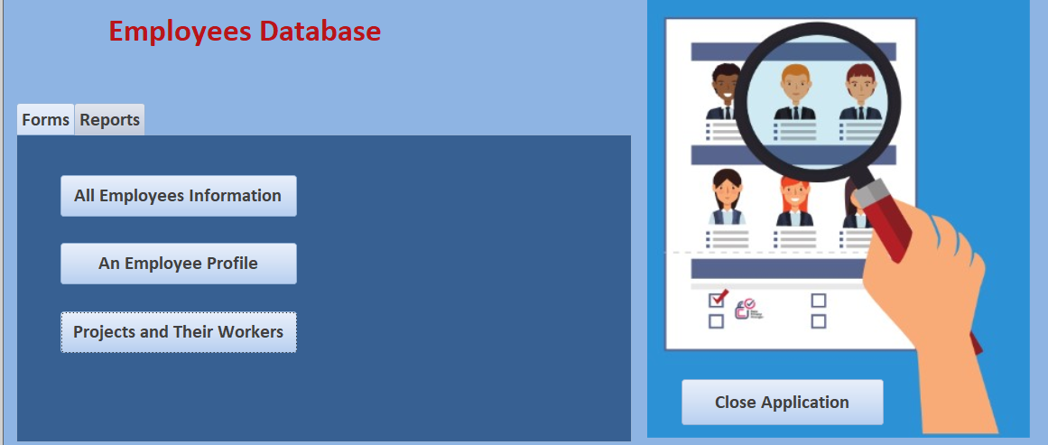
Create Report Buttons In Main Form

Slide 53



Said Fawzy

