Slide 1


Getting Started With
Microsoft Access
Database
16
Manager of Information Center
Tendering Department
Arab Contractors
Said Fawzy

Slide 2
Getting Started With
Microsoft Access
Database
16
Final Project
Manager of Information Center
Tendering Department
Arab Contractors
Said Fawzy

Slide 3

Build Your Project Part I
Create Tables

Slide 4
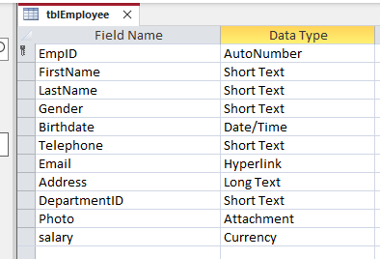
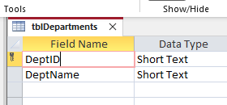
Create Tables

Slide 5
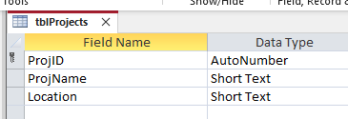
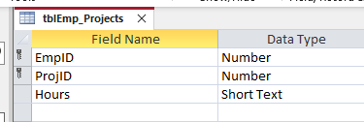
Create Tables

Slide 6
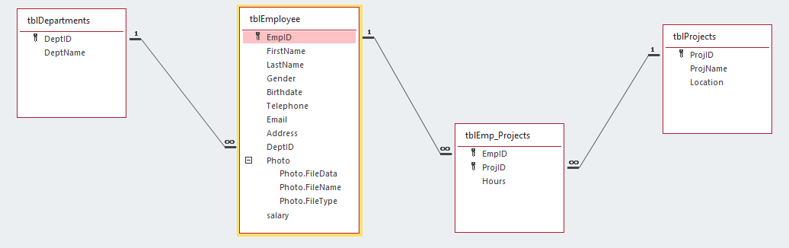
Table Relationship

Slide 7
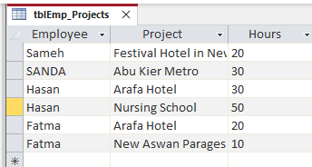
Table Relationship

Slide 8
Build Your Project Part II
Create Queries

Slide 9
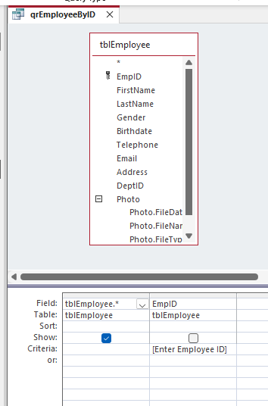
Create Queries

Slide 10
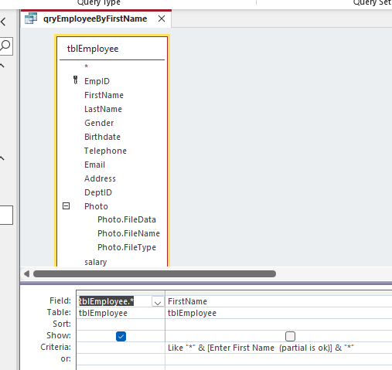
Create Queries

Slide 11
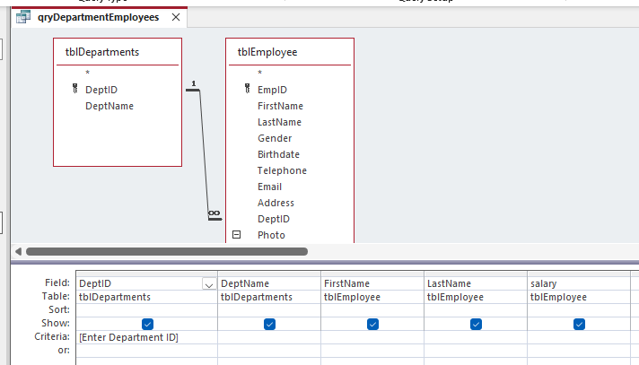
Create Queries

Slide 12
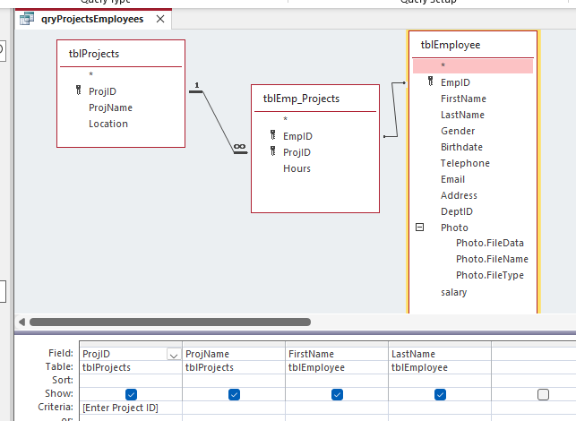
Create Queries

Slide 13
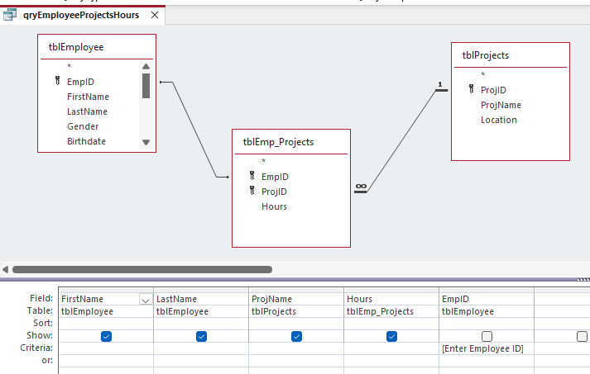
Create Queries

Slide 14
Build Your Project Part III
Create Forms

Slide 15
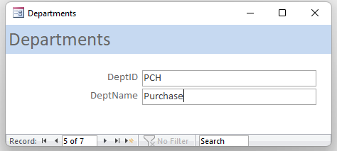
Create Departments Form

Slide 16
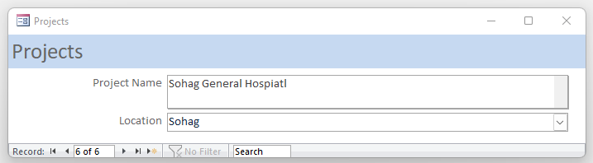
Create Projects Form

Slide 17
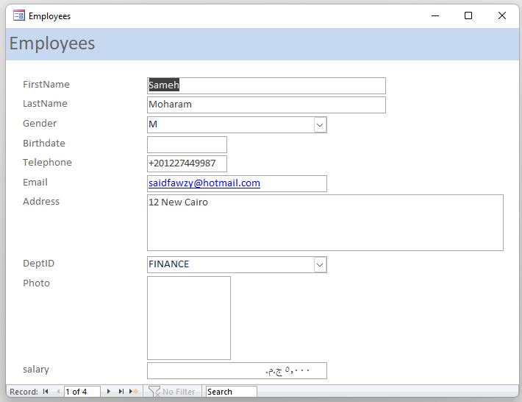
Create Employees Form

Slide 18
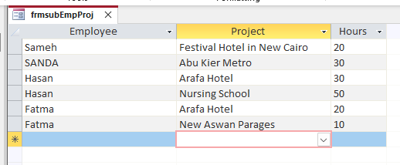
Create Projects Employees Form

Slide 19
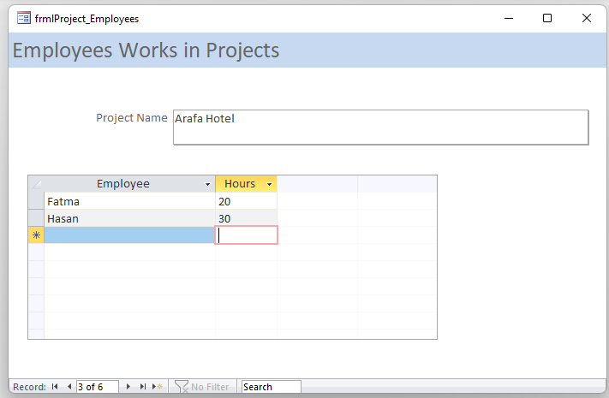
Create Projects Employees Form

Slide 20
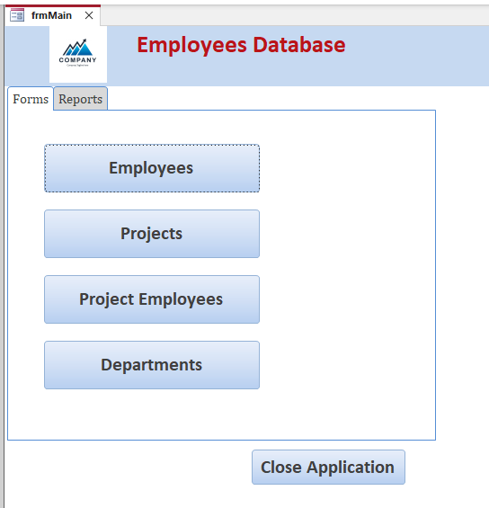
Create Main Form

Slide 21
Design Employee Form in Details

Slide 22
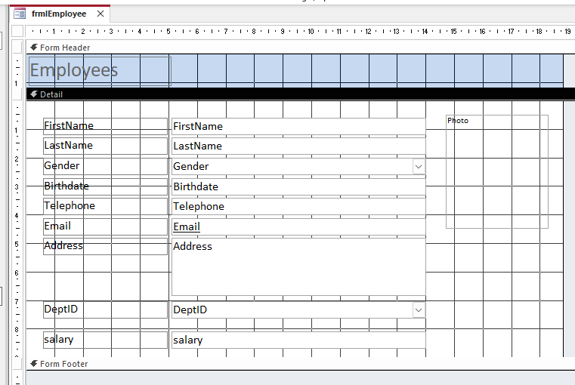
Arrange Controls

Slide 23
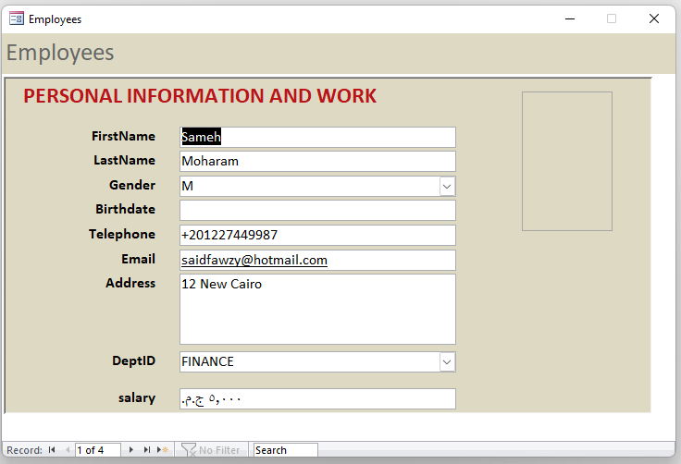
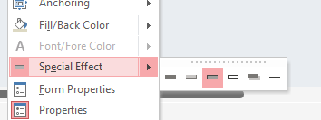
Add Rectangle as Background

Slide 24
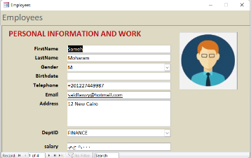
Adjust the Photo Control

Slide 25
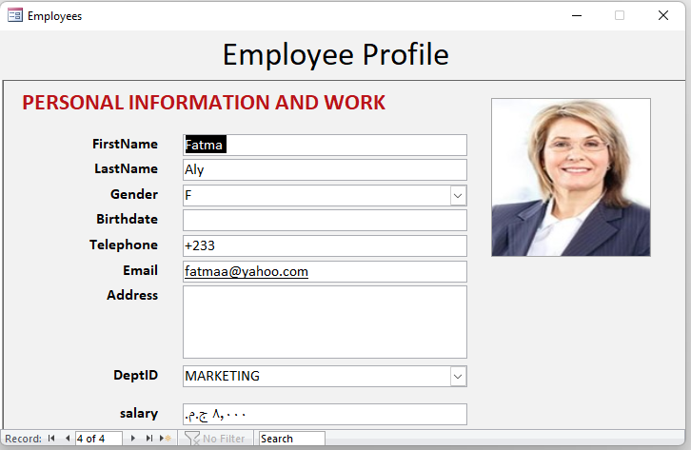
Adjust the Photo Control

Slide 26
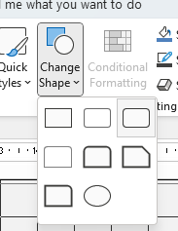
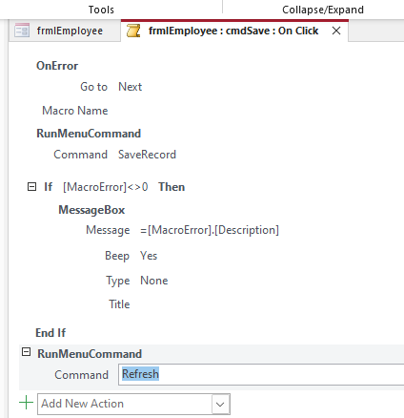
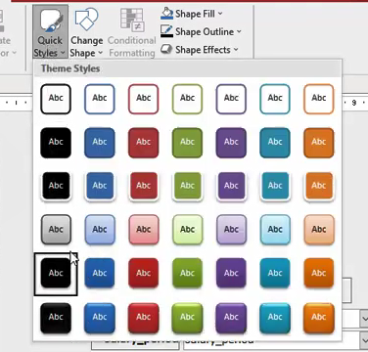
Adding Buttons

Slide 27
Save Button

Slide 28
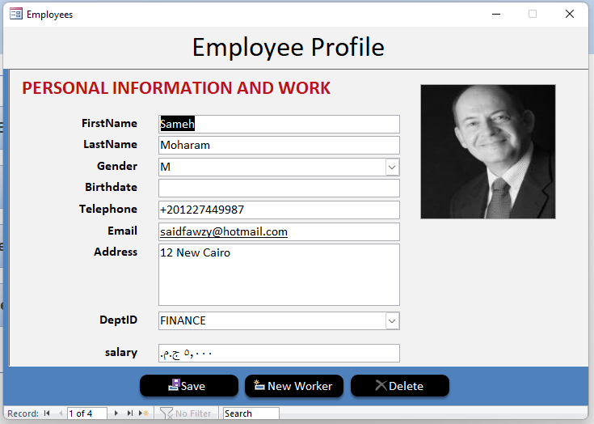
Adding Buttons

Slide 29
Adding Buttons

Slide 30
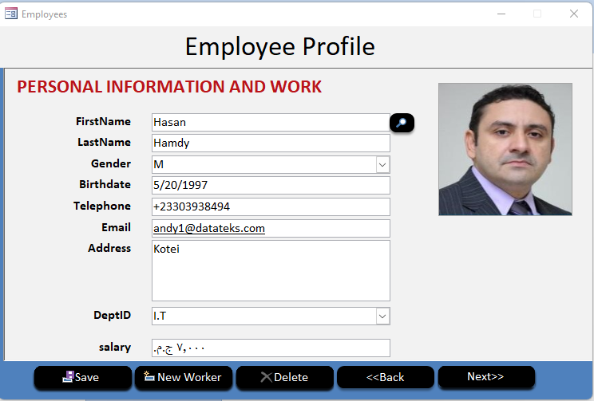
Final Employee Form

Slide 31
Build Your Project Part IV
Create Reports

Slide 32
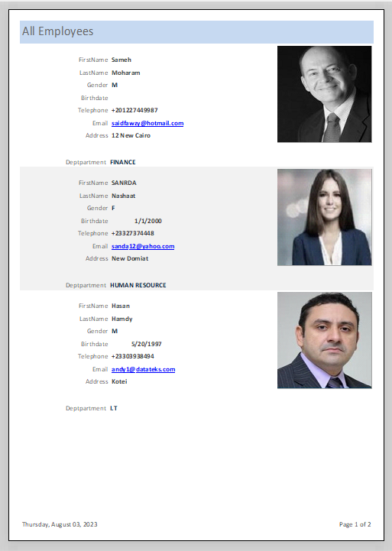
Create All Employees Report

Slide 33
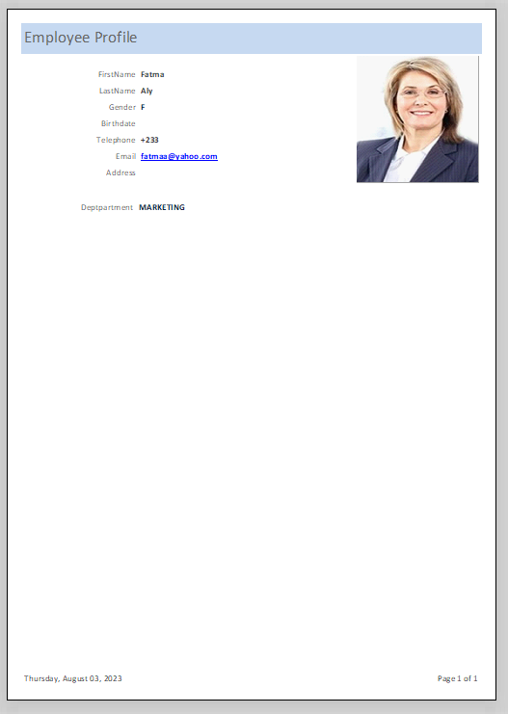
Create An Employee Profile

Slide 34
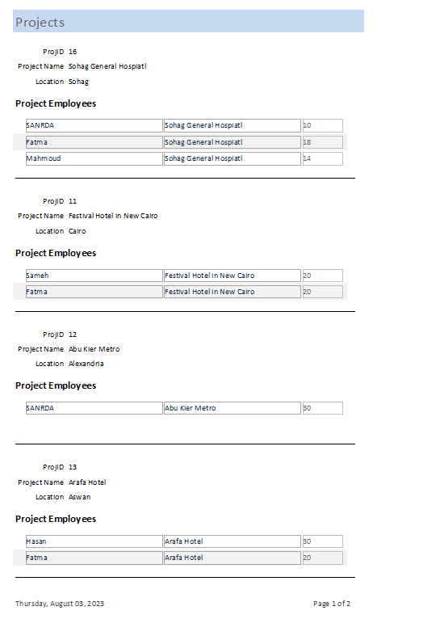
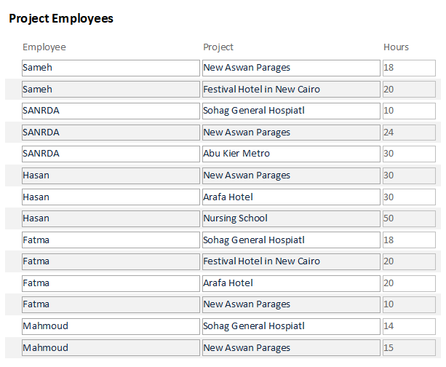
Create Project Employees Report

Slide 35
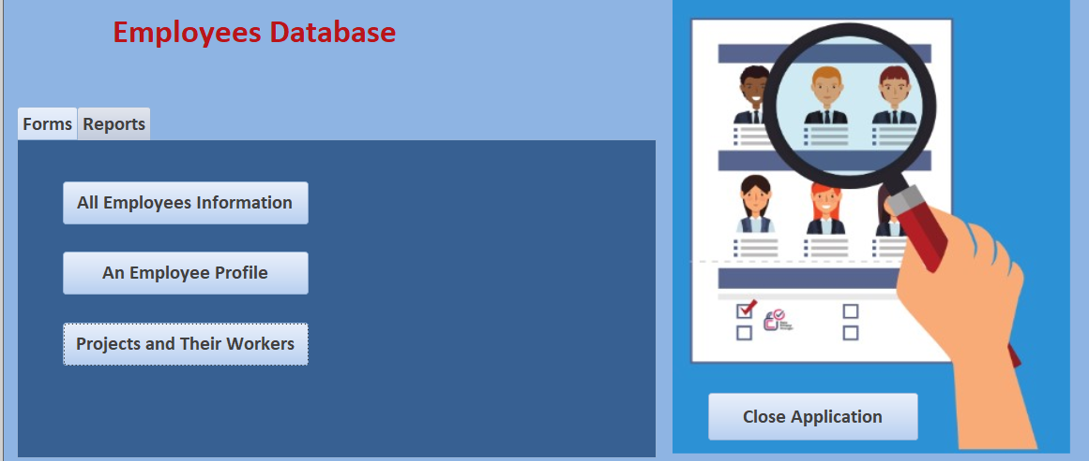
Create Report Buttons In Main Form

Slide 36



Said Fawzy

