Slide 1

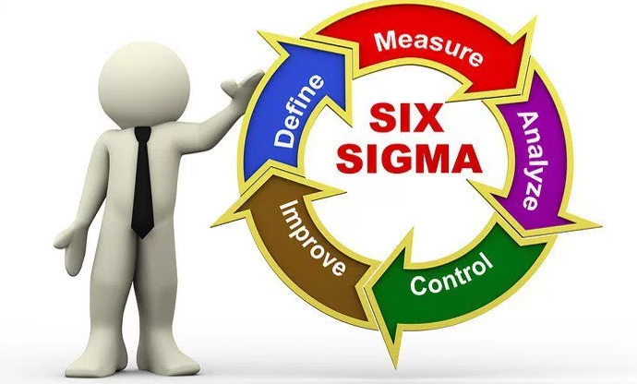

Introduction to Six Sigma
المعهد التكنولوجى لهندسة التشييد و الإدارة
Prepared By:
Said Fawzy
Manager of Information Center –Quality manager
Tendering Department
Arab Contractors

Slide 2


About Me
B.SC In Civil Engineering ..Alex University …………….........................………………..1987.
High Diploma in Construction Project Management ……Eien Shams University..................................….1988.

Slide 3

About Me (cont.)
Microsoft Certified Professional (MCP) ……………………..…………………...1999.
Certified InternetWebmaster(CIW)..2000.
Oracle Certified Master (OCM)……2001.
Microsoft Certified Technology Specialist(MCTS) …………………………………………...2006.

Slide 4



About Me (cont.)
Quality Management Systems ………..2009 ISO 9001:2008
Quality Management Systems ………..2016 ISO 9001:2015

Slide 5
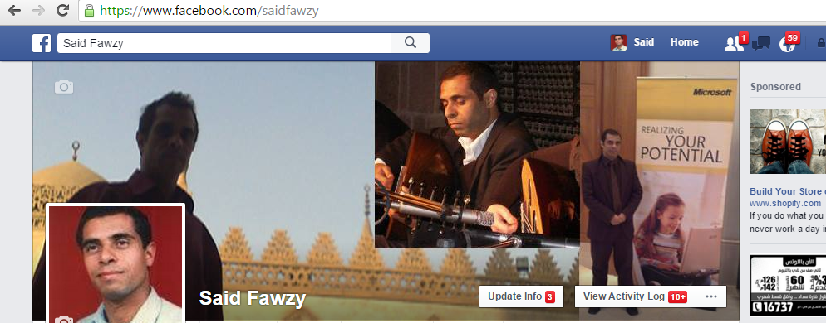
https://www.facebook.com/saidfawzy

Slide 6
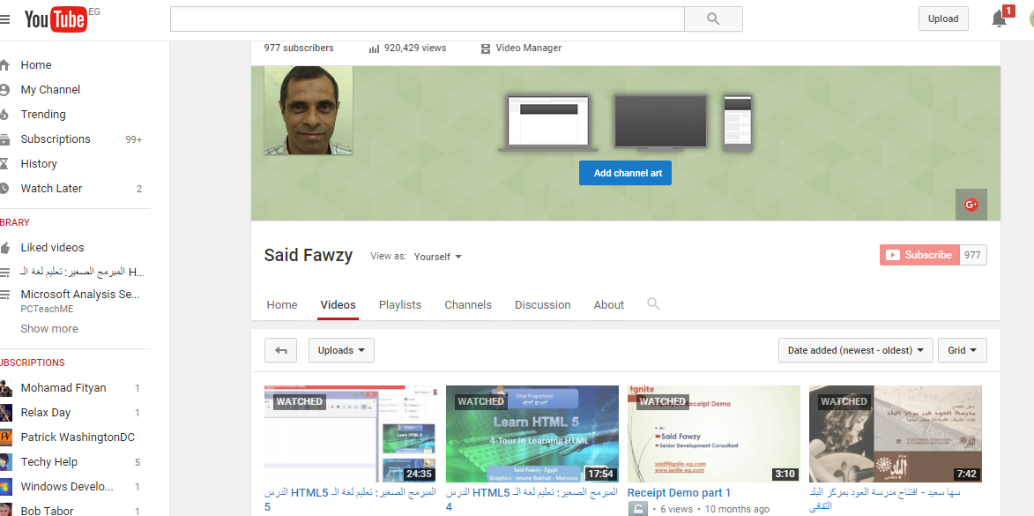
https://www.youtube.com/user/saidfawzy

Slide 7



Happy to hear from you
Said Fawzy
0122 744 99 87
Said_fawzy@hotmail.com
https://www.facebook.com/saidfawzy
@saidfawzy

Slide 8
What we will cover :
Chapter 01: Introduction
Chapter 02: Background and Meaning of Six Sigma
Chapter 03 : DMAIC Process Improvement Cycle
Chapter 04 : Impact of Defects / Measuring Defect Levels
Chapter 05: Defining Quality
Chapter 06: Kano Model Theory
Chapter 07: Problem Definition
Chapter 08: SIPOC Diagram

Slide 9

Training
Tell me I will forget.
Show me I might remember something.
Let me do it I will understand.

Slide 10



You are Allowed to Talk
about anything except
Religion
Soccer
Policy

