Slide 1

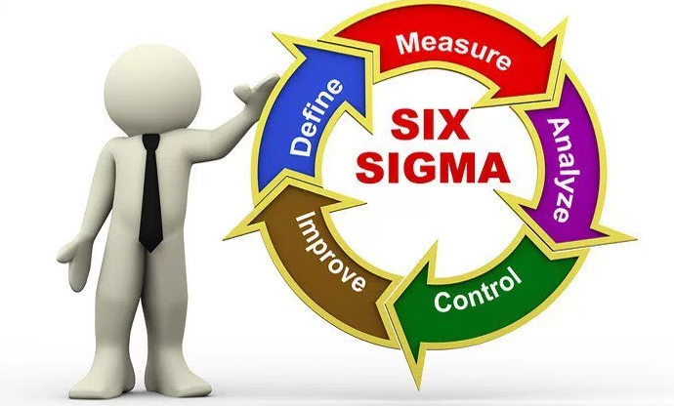

Introduction to Six Sigma
المعهد التكنولوجى لهندسة التشييد و الإدارة
Prepared By:
Said Fawzy
Manager of Information Center –Quality manager
Tendering Department
Arab Contractors

Slide 2

Chapter 05 :

Slide 3
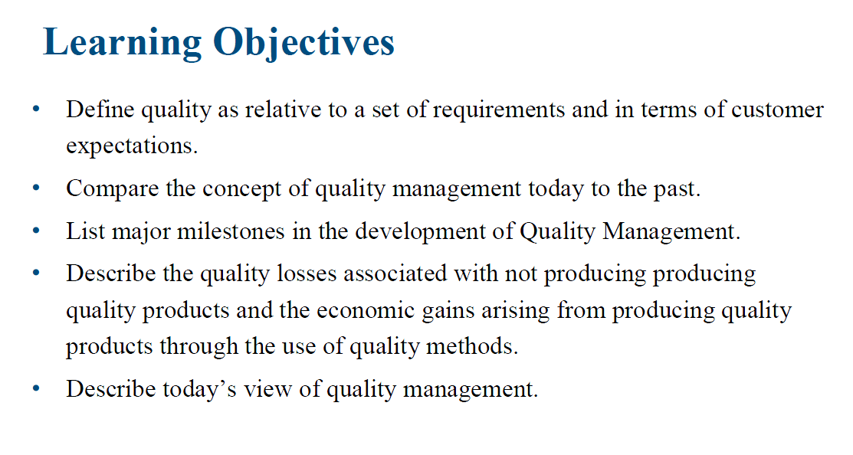

Slide 4
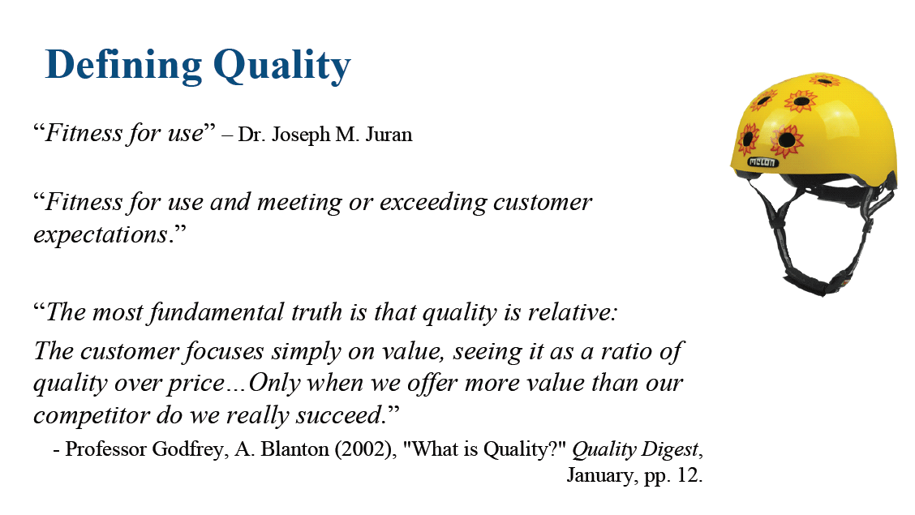

Slide 5
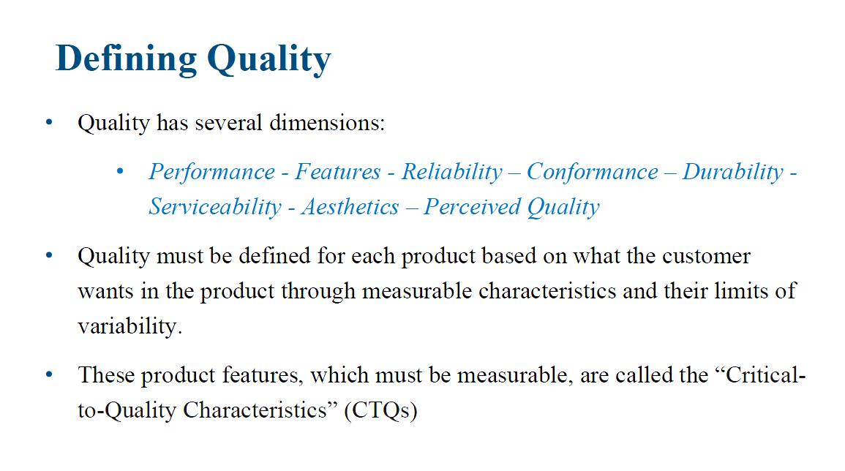

Slide 6
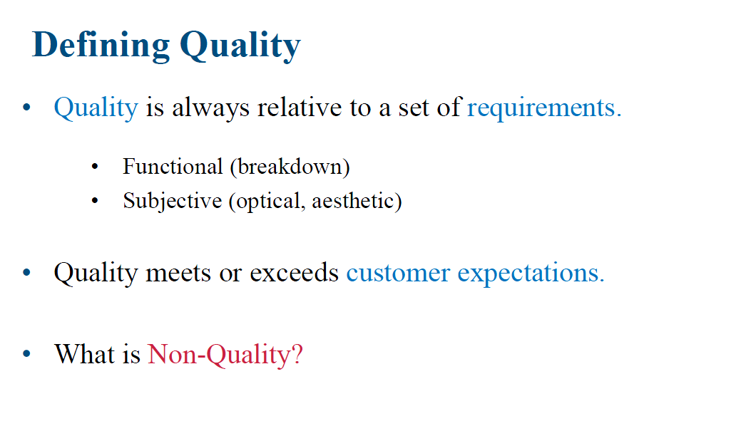

Slide 7
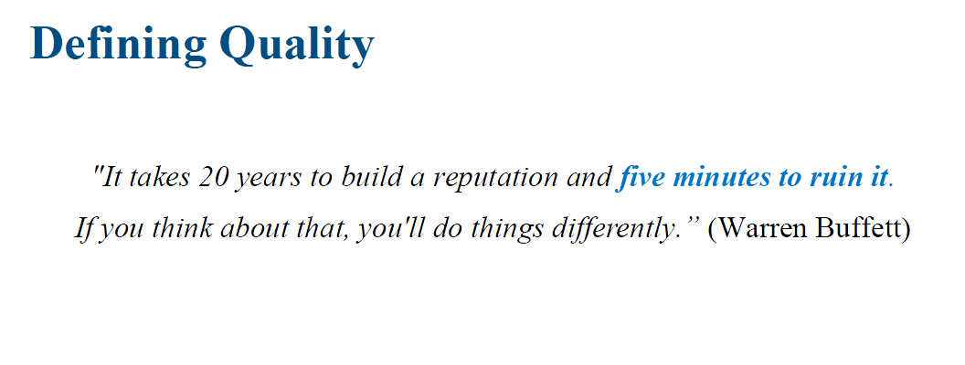

Slide 8
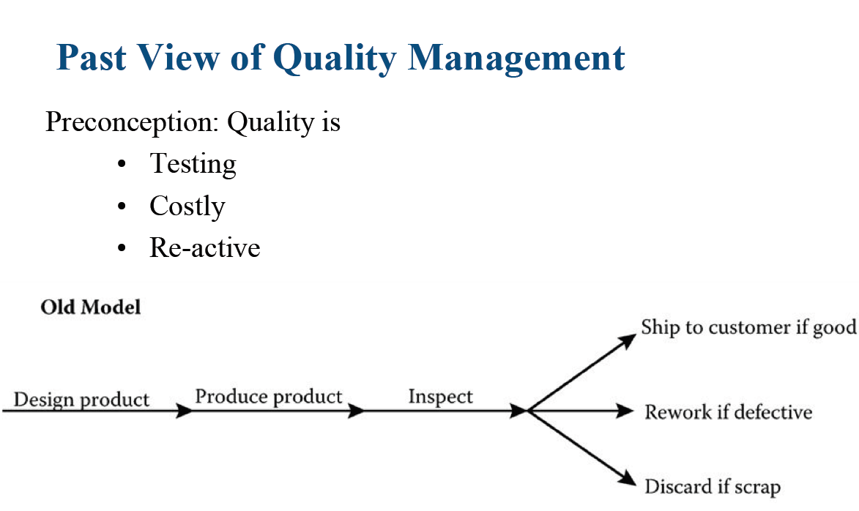

Slide 9
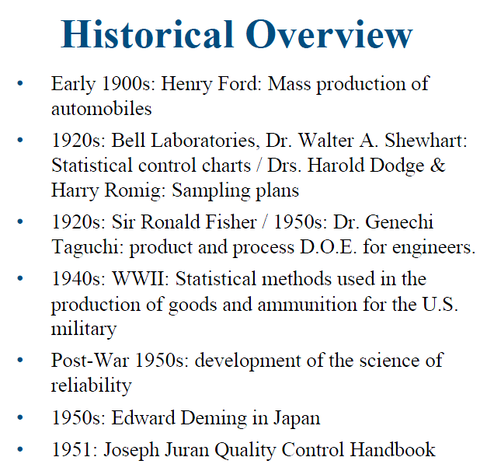

Slide 10
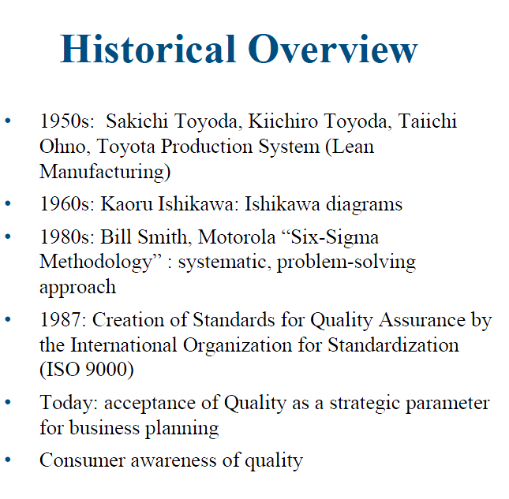

Slide 11
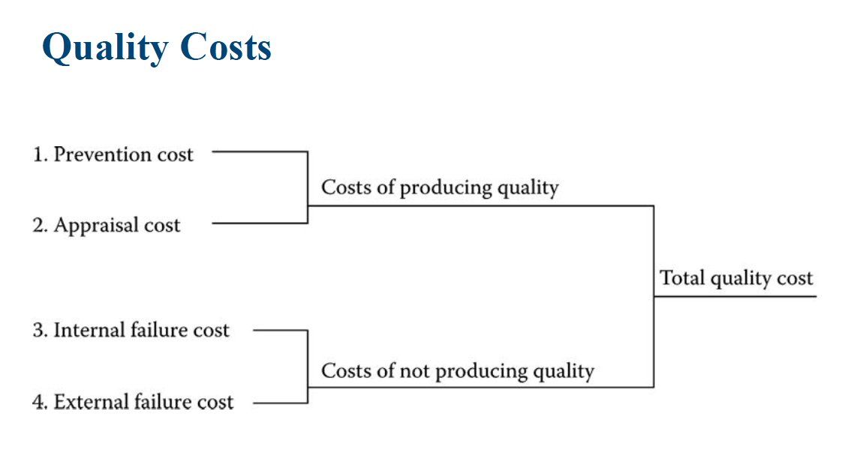

Slide 12
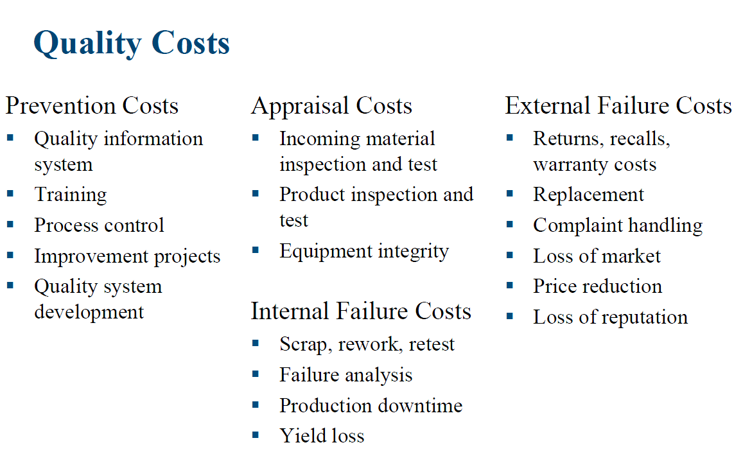

Slide 13
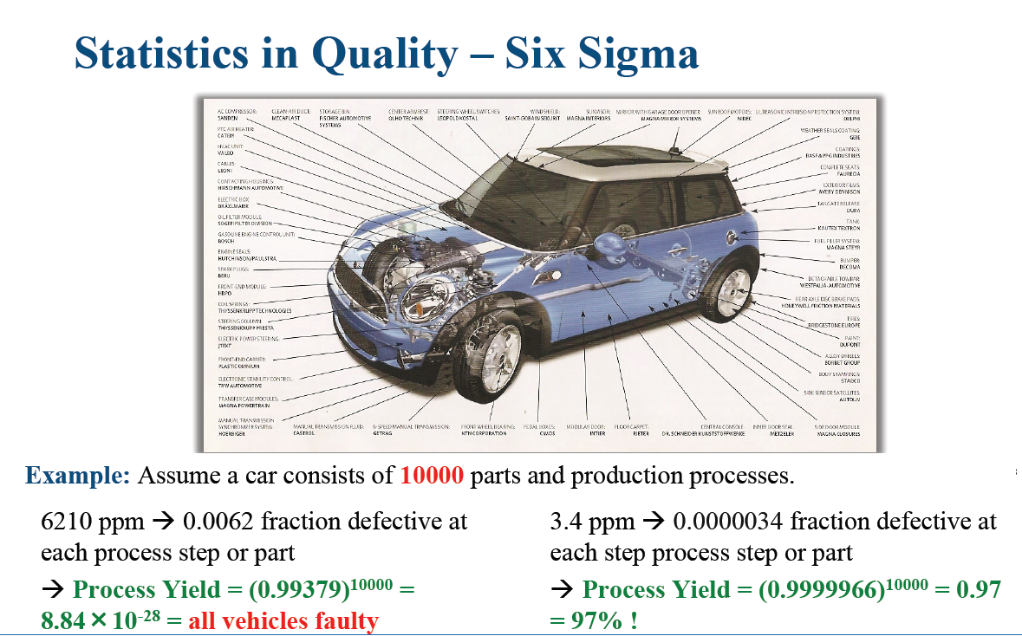

Slide 14
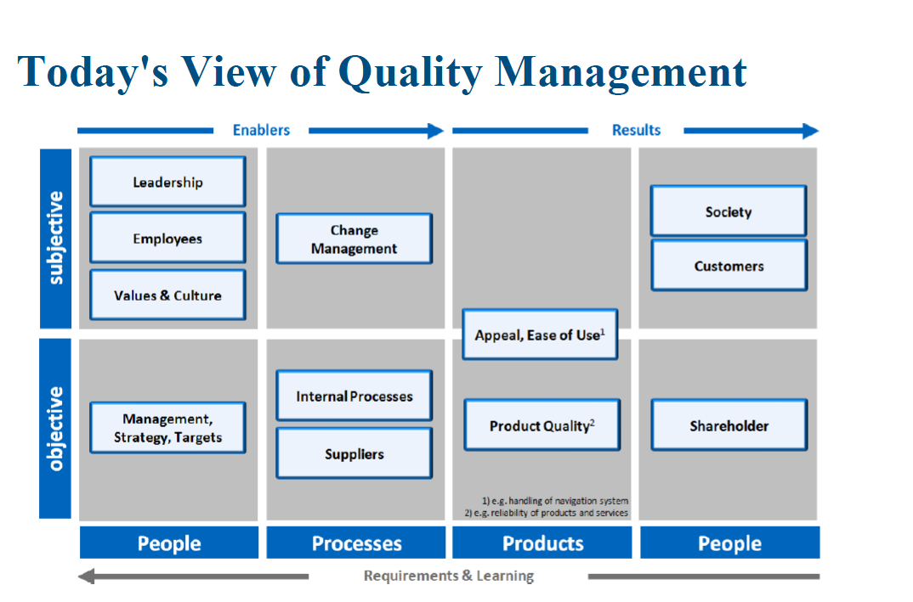

Slide 15
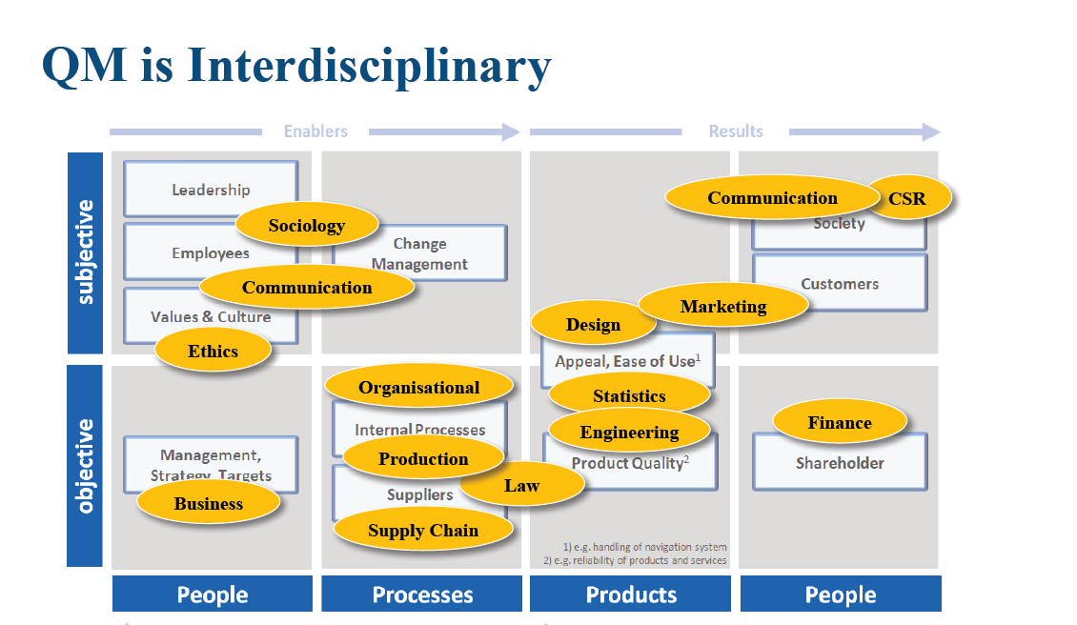

Slide 16
What does Quality means for you ?

Slide 17
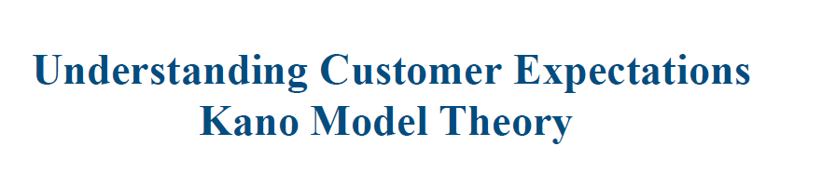
Chapter 06 :

Slide 18
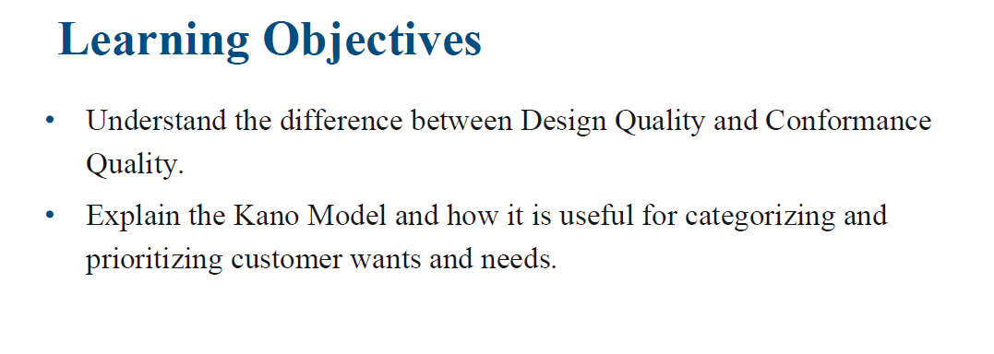

Slide 19
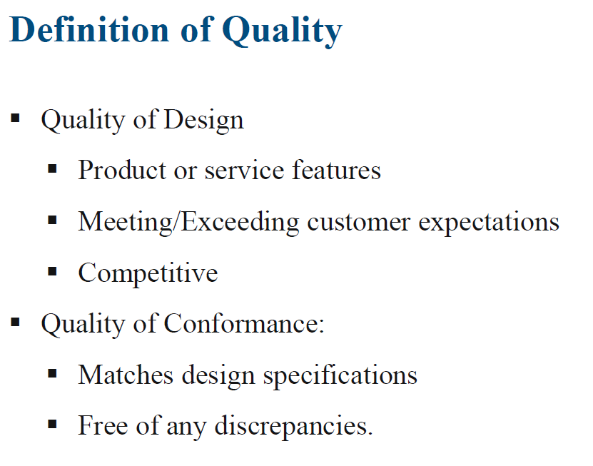

Slide 20
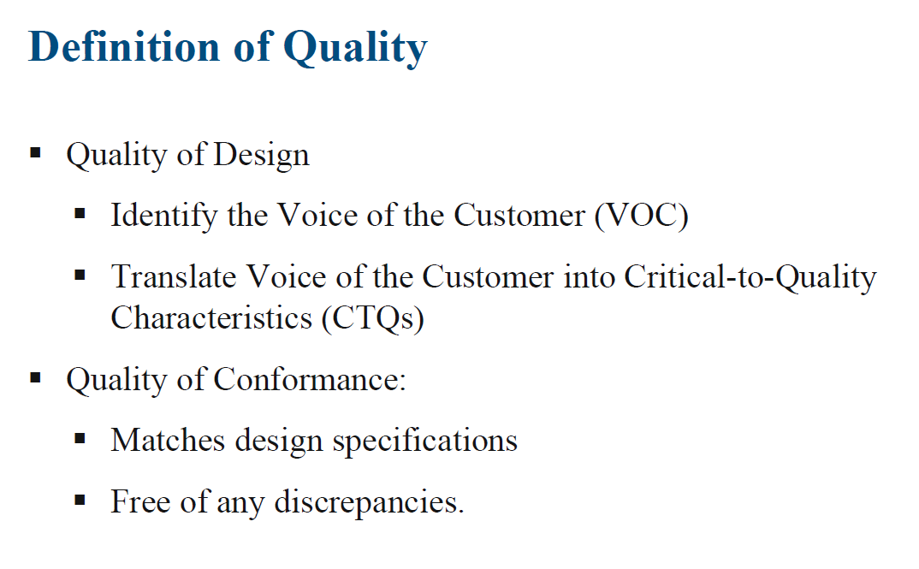

Slide 21
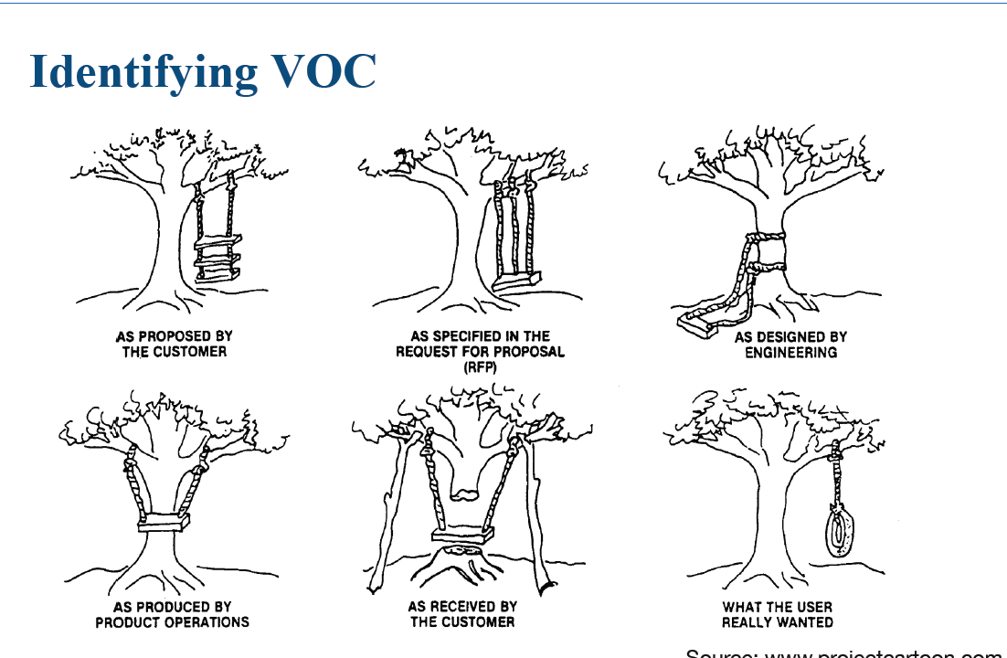

Slide 22
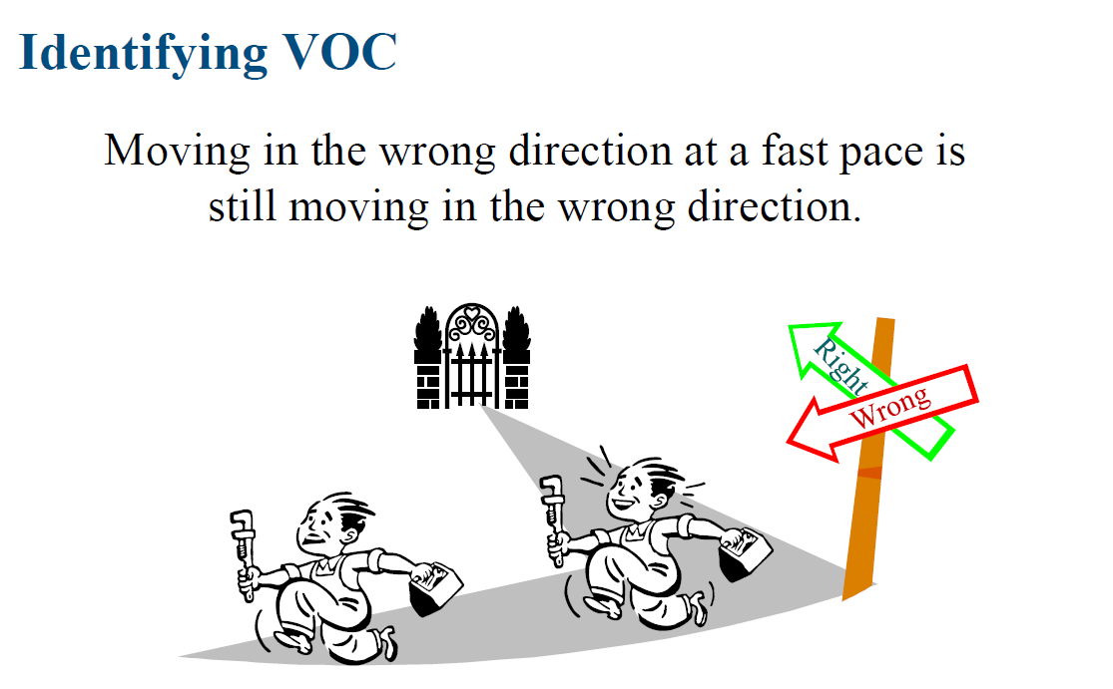

Slide 23
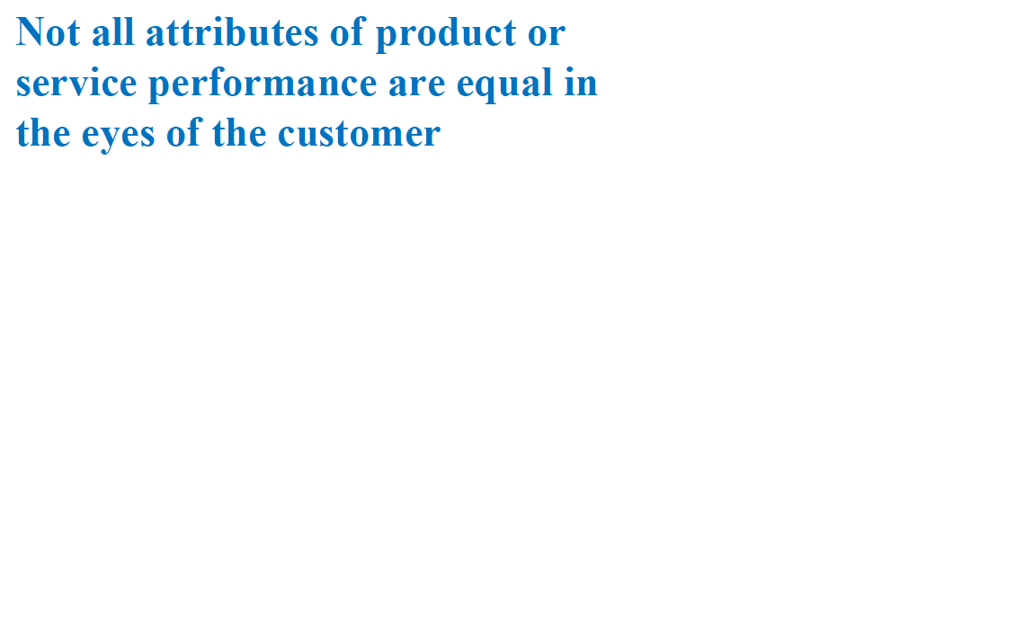

Slide 24
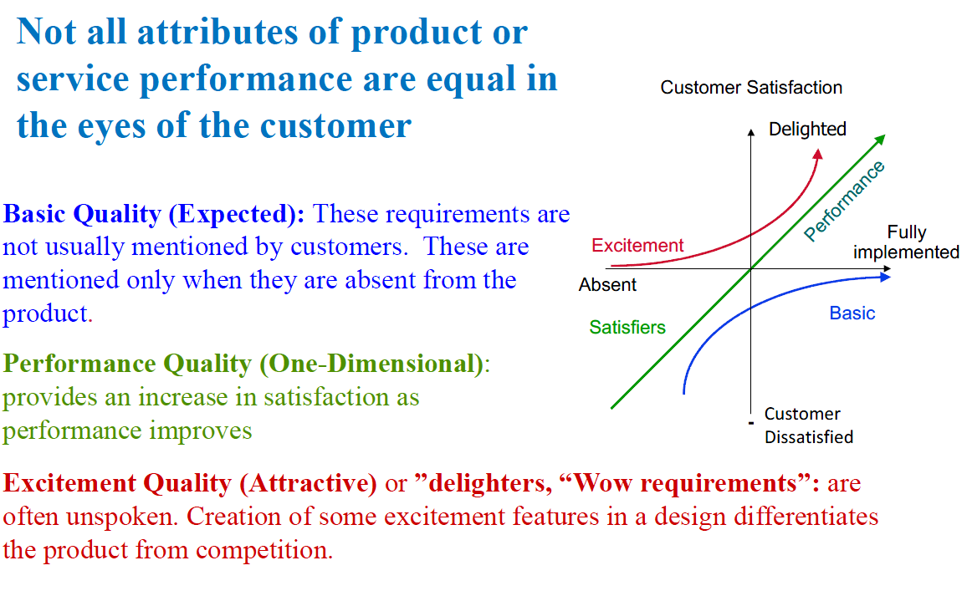

Slide 25
Another two Categories:
Indifferent Quality
Reverse Quality

Slide 26
An attribute will drift over time from excitements to performance, and then finally to basic
Example :mobile phone batteries

Slide 27
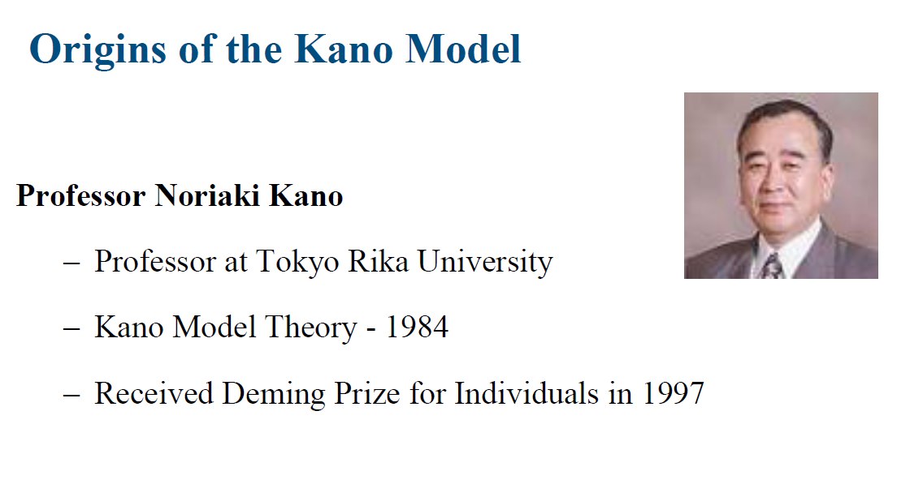

Slide 28
Application on Kano Diagram

Slide 29
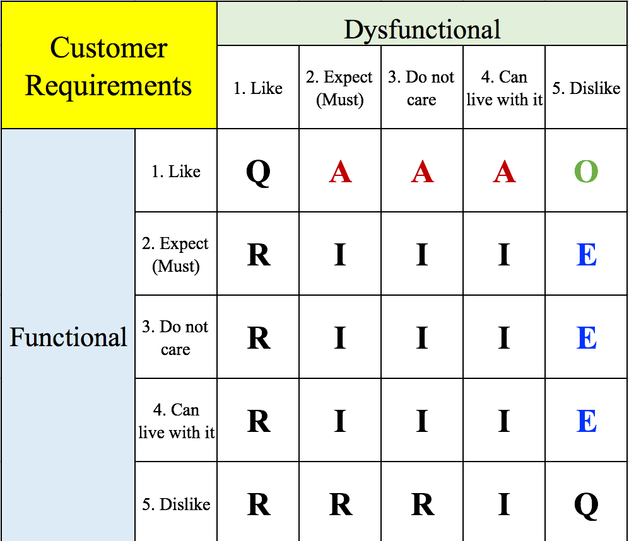
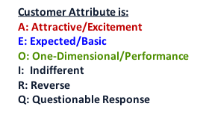

Slide 30
Practice :
A popular Airline in your city is having problem meeting the sales target on their First-class flights from and to some destinations that they believe is critical to meeting their overall profit target for the year.
Several of their clients have complained about the quality of services they get on these routes on the business and first class categories of this airline and are ready to switch to another competitor that in their view offers better service quality.
Your company have just been contracted to come up with a solution on how they could improve the quality of service on this route.
During one of your brainstorming sessions in your company, your group have come up with a list of all possible features on how to improve the quality of services on this route but doesn’t know which of these ideas to prioritize.

Slide 31
We did two questions for each category.. for example :
Function Question: If the suites have an On-board shower spa
Dysfunctional question: If the suites does not have an On-board shower spa

Slide 32
Survey results :
Categorize them by using the Kano Evaluation Table
And then make recommondation

Slide 33
Possible Feature | Functional question | Dysfunctional question | Category
Complimentary Chauffeur-drive service. | Like | Dislike
Additional legroom. Response | Expect/Must, | Do not care
Expedited baggage service. | Like, | Can live with it
LED mood lighting. | Do not care, | Dislike
Social seating arrangement. | Can live with it, | Dislike

Slide 34
Possible Feature | Functional question | Dysfunctional question | Category
New selection of wine, beer, spirit and cocktail. | Like, | Do not care
Live events with fellow travelers on the 55-inch LCD TV screen. | Do not care, | Can live with it
Complimentary gift package on board. | Like, | Do not care
Privacy suite doors. | Can live with it, | Dislike
Private cinema. | Like, | Can live with it
Personal dining service. | Like, | Dislike

Slide 35
Answer

Slide 36
Possible Feature | Functional question | Dysfunctional question | Category
Complimentary Chauffeur-drive service. | Like | Dislike | O
Additional legroom. Response | Expect/Must, | Do not care | I
Expedited baggage service. | Like, | Can live with it | A
LED mood lighting. | Do not care, | Dislike | E
Social seating arrangement. | Can live with it, | Dislike | E

Slide 37
Possible Feature | Functional question | Dysfunctional question | Category
New selection of wine, beer, spirit and cocktail. | Like, | Do not care | A
Live events with fellow travelers on the 55-inch LCD TV screen. | Do not care, | Can live with it | I
Complimentary gift package on board. | Like, | Do not care | A
Privacy suite doors. | Can live with it, | Dislike | E
Private cinema. | Like, | Can live with it | A
Personal dining service. | Like, | Dislike | O

Slide 38
Questions

Slide 39

Question 1 - Kano Model
The Kano model describes four types of quality characteristics:
1. Basic Quality
2. Performance Quality
3. Visionary Quality
4. Excitement ("Wow") Quality.
TRUE
FALSE
Explanation
The Kano Model describes 3 types of quality characteristics
(1) Basic or essential Quality
(2) Performance Quality
(3) Excitement Quality or Wow requirements

Slide 40
Question 2-Basic Quality
When determining the Voice of the Customer for a product (customer needs analysis), the customer may not even mention the basic qualities to be included in a product or service because they simply expect them to be included.
TRUE
FALSE
Explanation
Correct:Usually customers will assume that basic qualities will be included.

Slide 41
Question 3-Excitement Quality
Excitement qualities are known as the "WOW factors".
TRUE
FALSE
Explanation
Correct:These are the qualities that will give a product or service the competitive edge, known as the WOW! qualities

Slide 42
Question 4-Kano model
If you get longer battery life than expected from your laptop battery, which category of quality does this belong?
Cost saving feature
Basic feature
Excitement feature
Performance feature

Slide 43
Question 5-Performance Quality
When determining the Voice of the Customer for a product (through, for example, a "customer needs analysis"), the analyst's aim is only to discover basic qualities that customers want.
TRUE
FALSE
Explanation
Correct:One of the analyst's task in the analysis is to identify the customers' needs and determine the performance qualities to meet these needs

Slide 44
Question 6-Excitement Quality
Excitement features are normally identified through customer's interviews.
TRUE
FALSE
Explanation
Correct:The customers often are unaware of the excitement quality that can be added to the product or service, the analyst's job will be to find these qualities out from research

Slide 45
Question 7-Quality Management
Identifying the voice of the customer (VOC), translating the voice of the customer into critical-to-quality characeristics (CTQs) and evaluating or improving current performance for CTQ's are fundamental aspects in quality management.
TRUE
FALSE
Explanation
Correct:See Lecture Defining Quality Slide 4.

Slide 46
Question 8-Voice of Customer
Evaluation and Translation of the voice of the customer can be carried out using one of the following models.
Regression Analysis
Control Charts
Kano Model
Design Team

Slide 47
Question 9-Critical to Quality
Critical-to-Quality characteristics are translated from
Regression analysis
Data dispersion diagrams
Voice of Customer
None of the above

Slide 48
Question 10-Kano Model
_ _ _ _ _ _ _ _ _ _ _ _ characteristics provide a linear increase in customer's satisfaction as performance improves.
Basic Quality
Performance Quality
Excitement (Wow) Quality

Slide 49
Question 11-Kano Model
Nowadays, you would usually expect a smart phone to have a built-in camera. To which category of quality does this belong?
Cost saving feature
Basic feature
Excitement feature
Performance feature

Slide 50
Question 12-Kano Model
These requirements are not usually mentioned by customers. These are mentioned only when they are absent from the product.
Basic Quality
Performance Quality
Attractive Quality

Slide 51
Question 13-Kano Model
You recently bought a car which has a self-cleaning and polishing function. You never have to wash your car or go to the car wash again! Which category of quality does the car-wash feature belong?
Cost saving feature
Basic feature
Excitement feature
Performance feature
Explanation
Correct:This is an excitement feature because you don't even expect this when you buy a car and it is (according to the above statement) really a great help!

Slide 52
Question 14-Critical to Quality
Not all attributes of product or service performance are equal in the eyes of the customer.
TRUE
FALSE

Slide 53
Question 15-Voice of Customer
Various ways to capture the voice of customer include the following except
Customer Surveys
Focus Groups
Customer Interviews
Speculation

Slide 54

Chapter 07 :

Slide 55
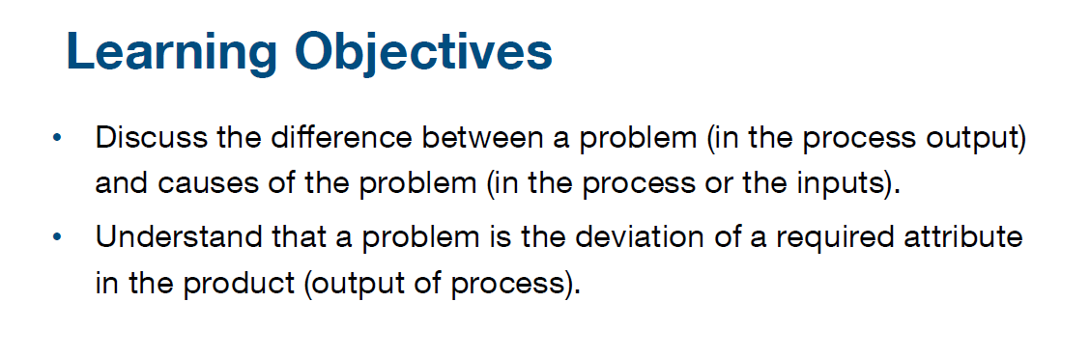

Slide 56
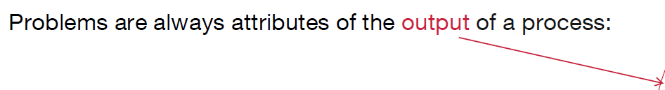
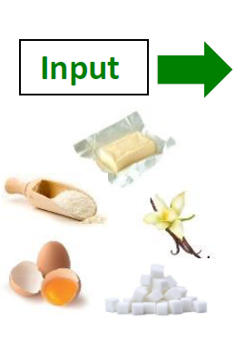
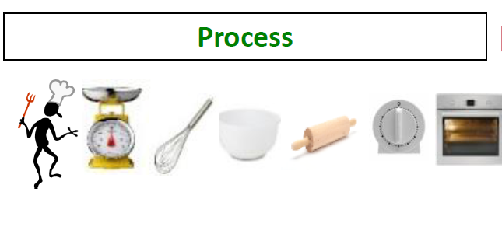
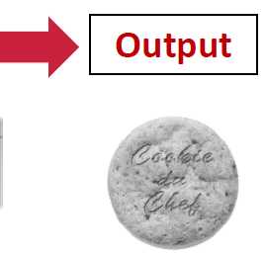



From Course: 6 Sigma definition
Customer complain of burnt cookies. So where is the problem ?

Slide 57
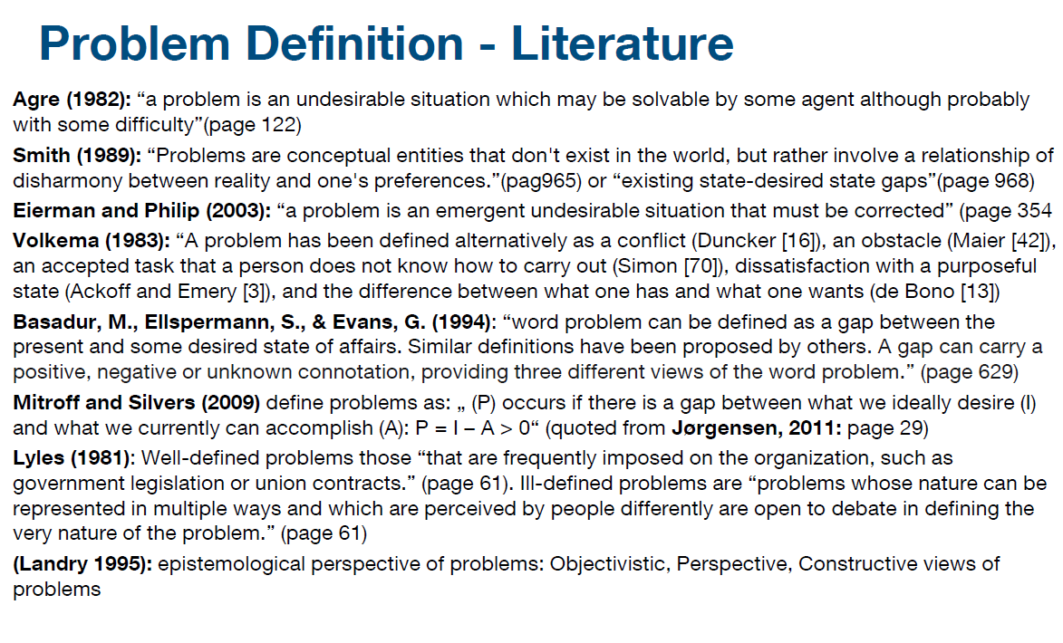

Slide 58
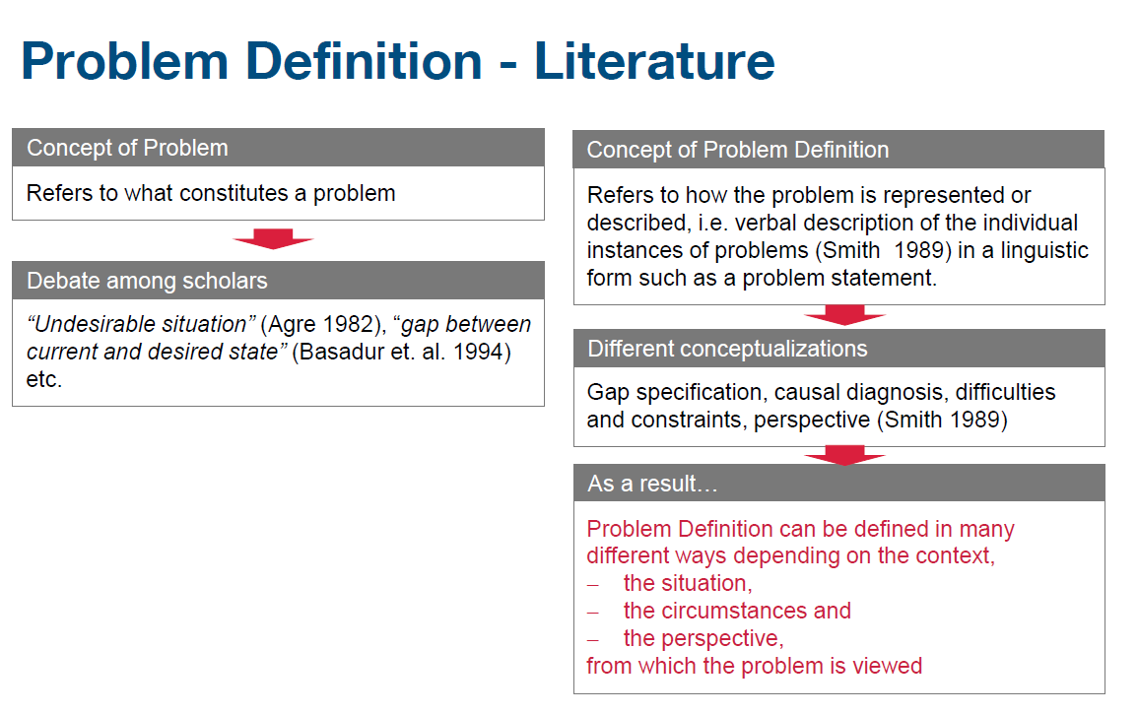

Slide 59
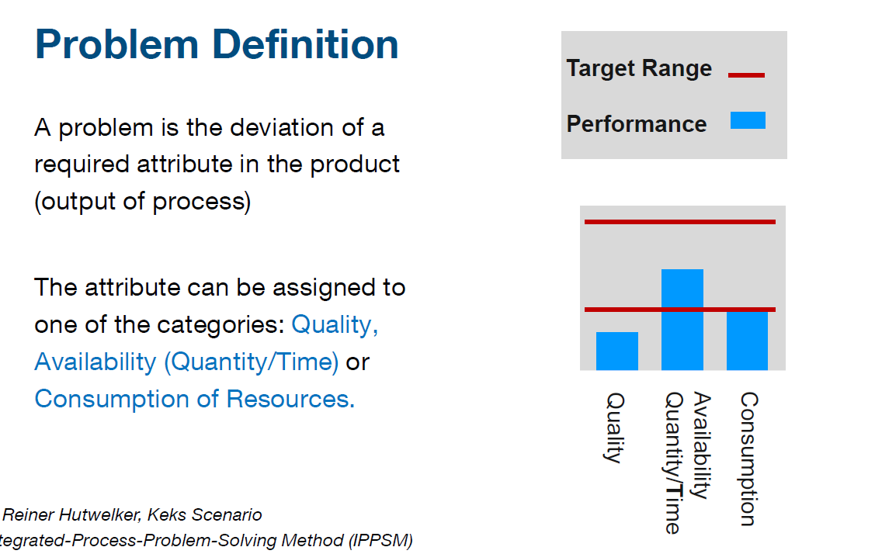

Slide 60


