Slide 1



Introduction to Six Sigma
المعهد التكنولوجى لهندسة التشييد و الإدارة
Prepared By:
Said Fawzy
Manager of Information Center –Quality manager
Tendering Department
Arab Contractors

Slide 2

Chapter 08 :

Slide 3
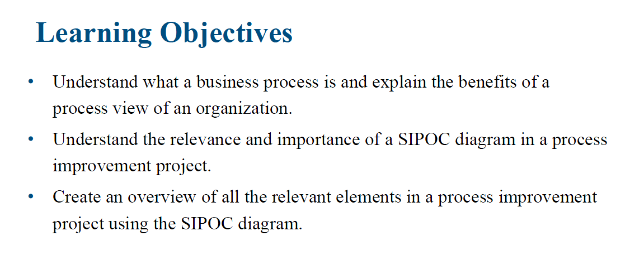

Slide 4
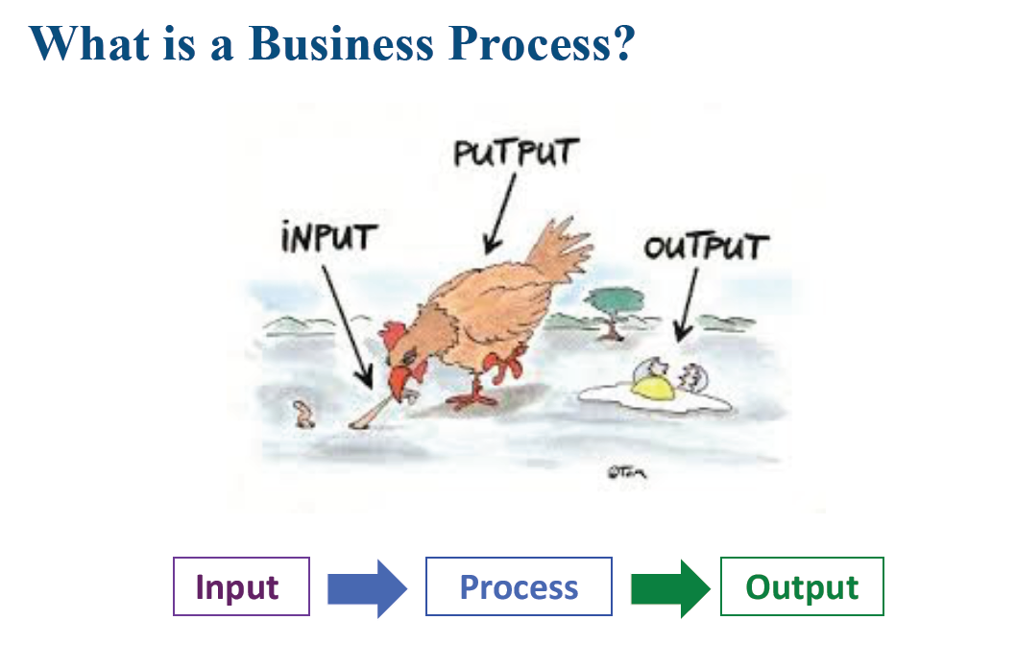

Slide 5
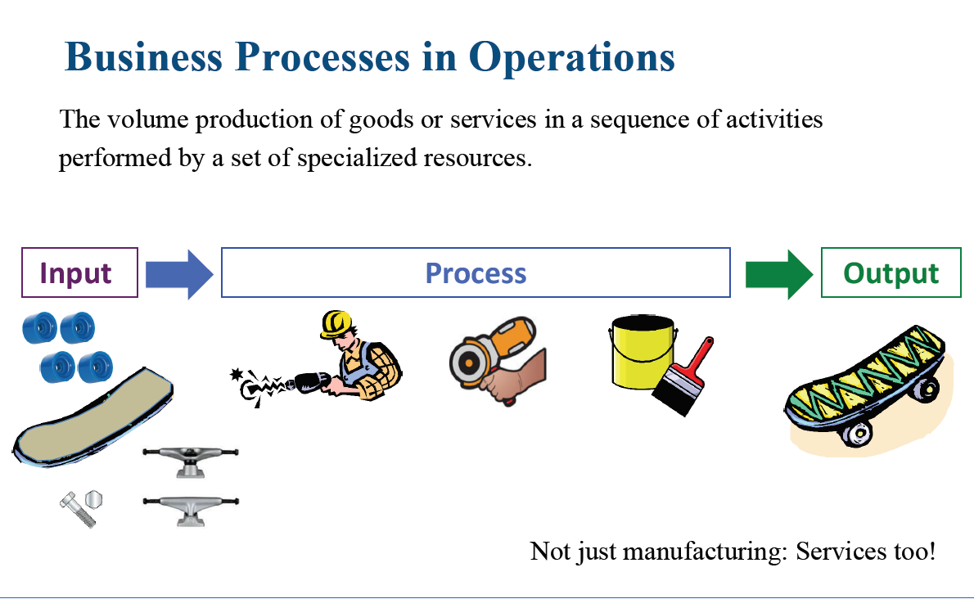

Slide 6
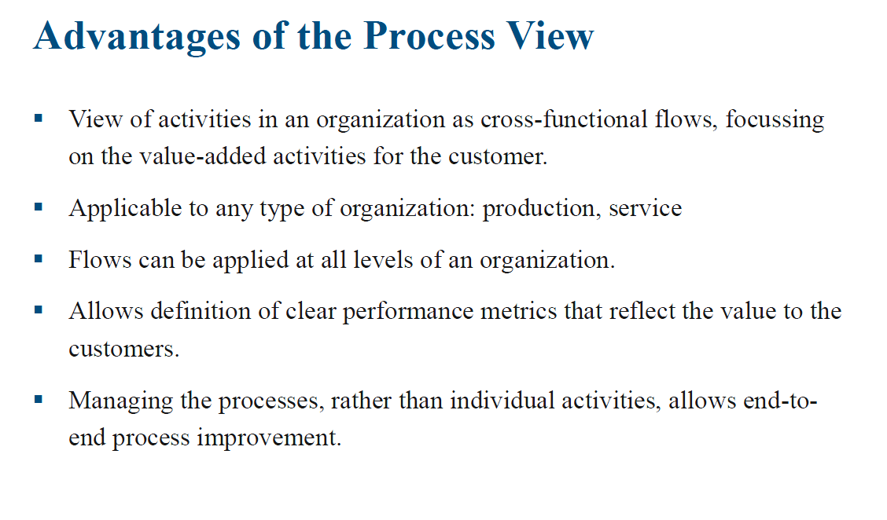

Slide 7
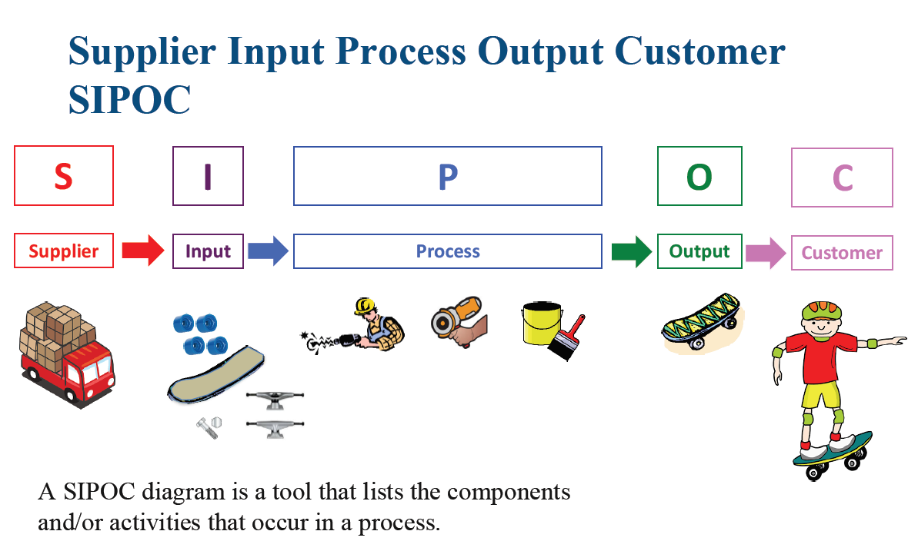

Slide 8
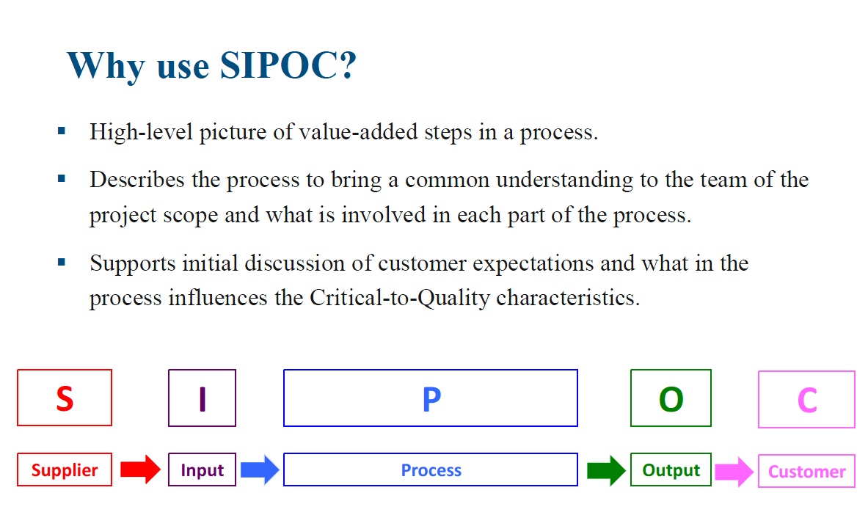

Slide 9
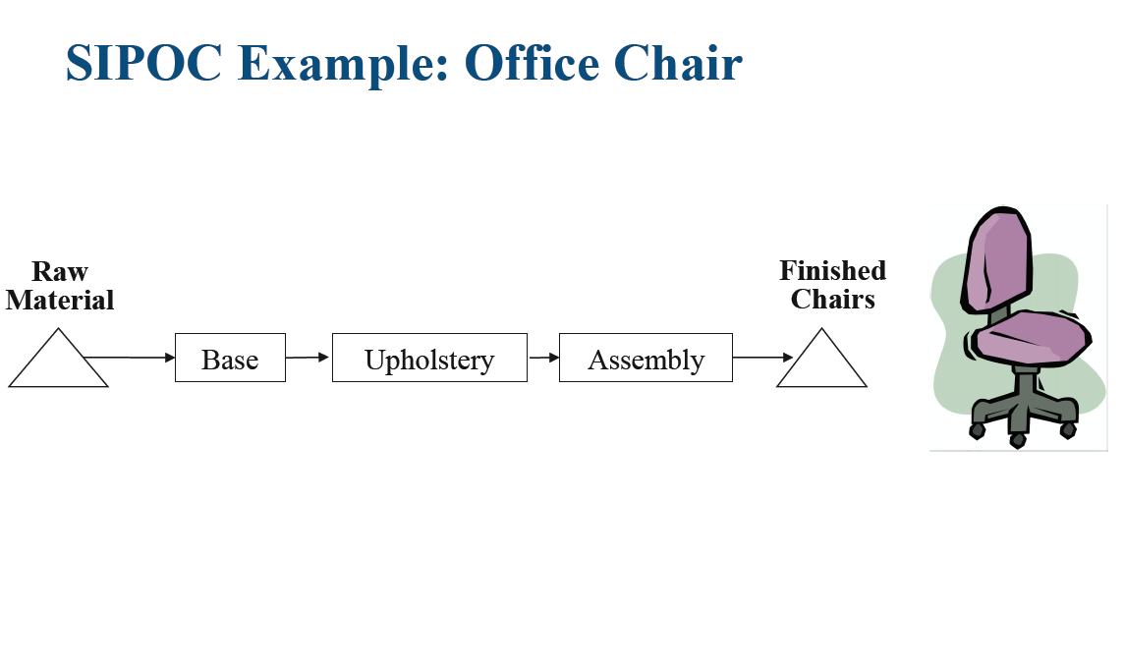

Slide 10
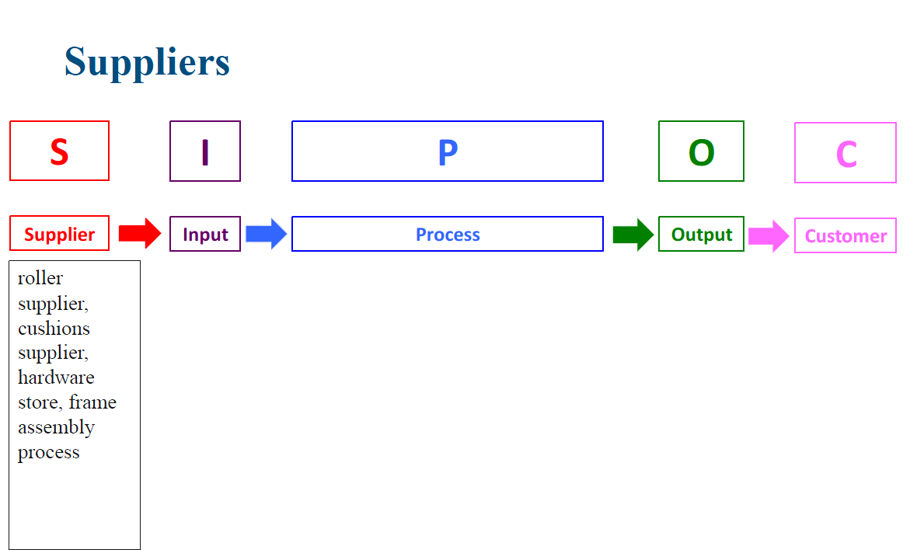

Slide 11
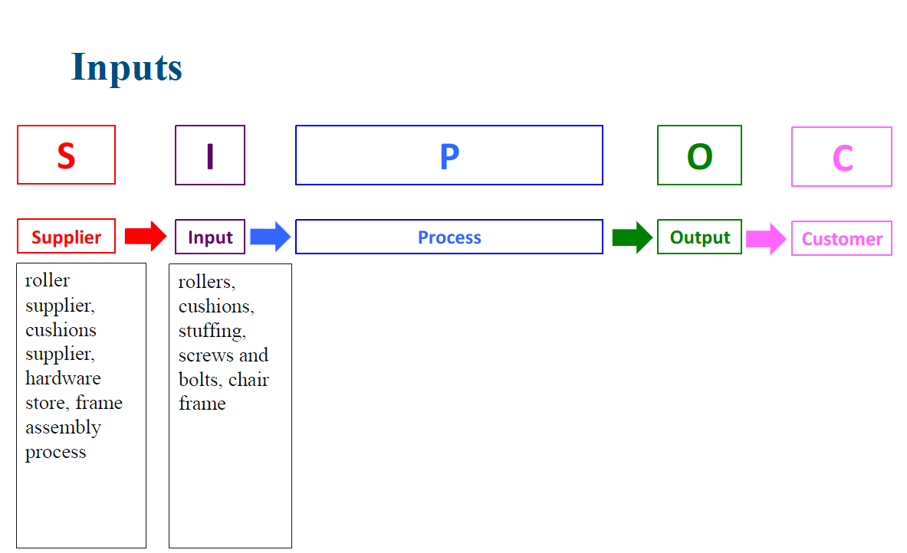

Slide 12
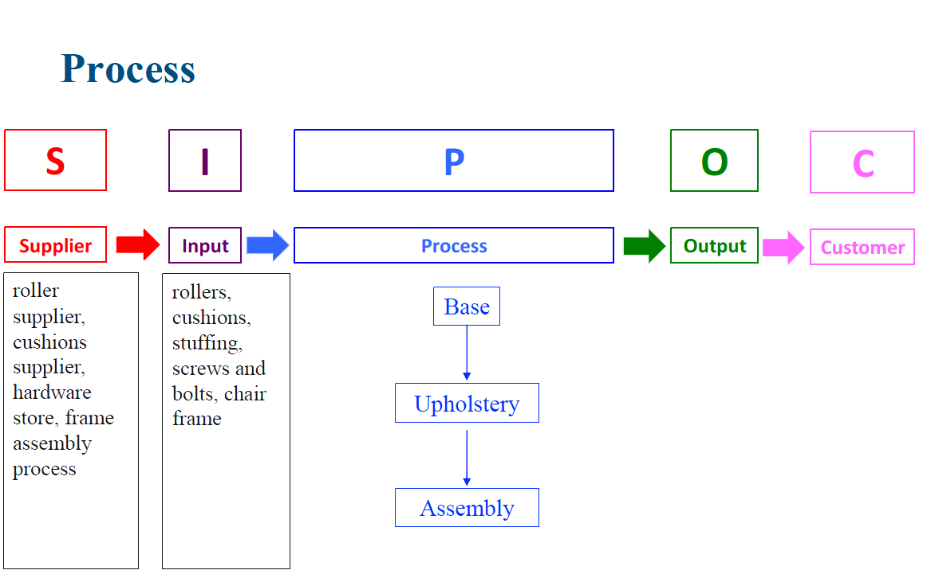

Slide 13
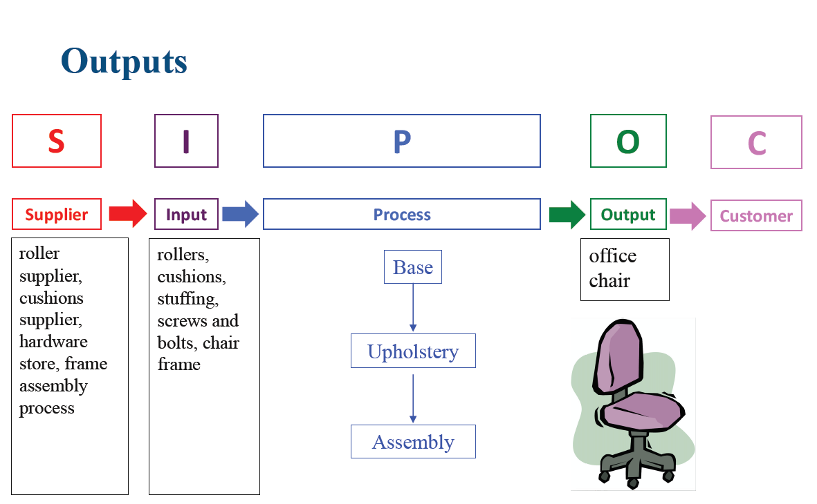

Slide 14
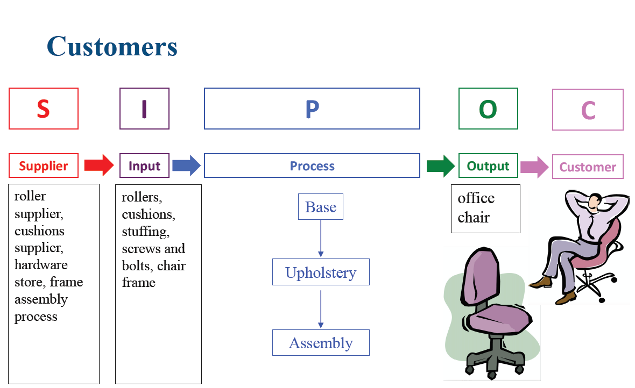

Slide 15

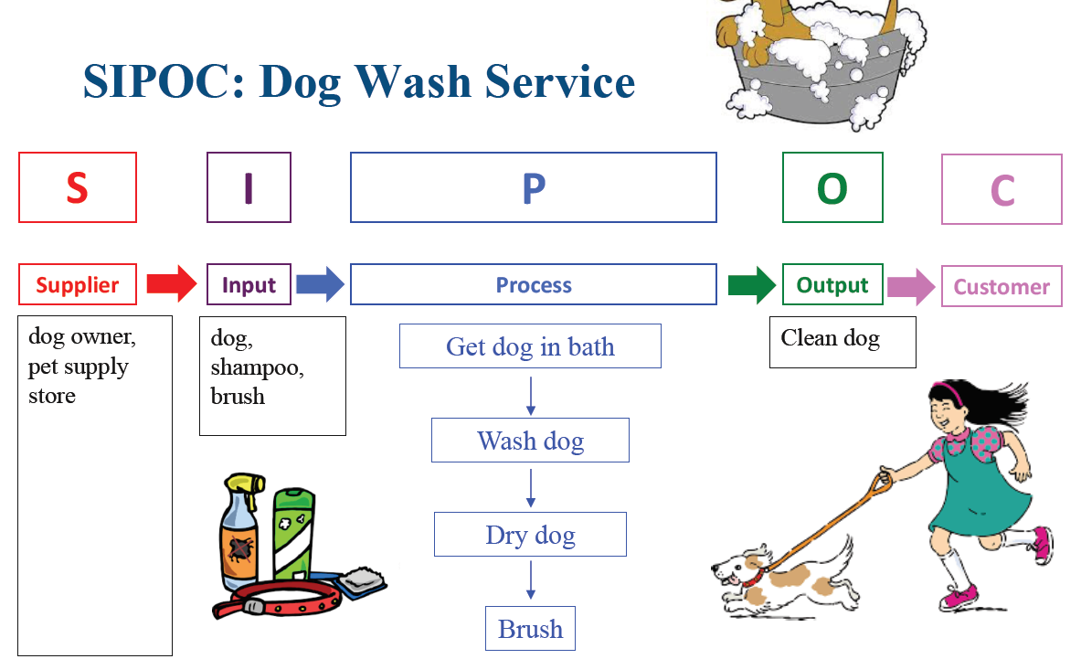

Slide 16
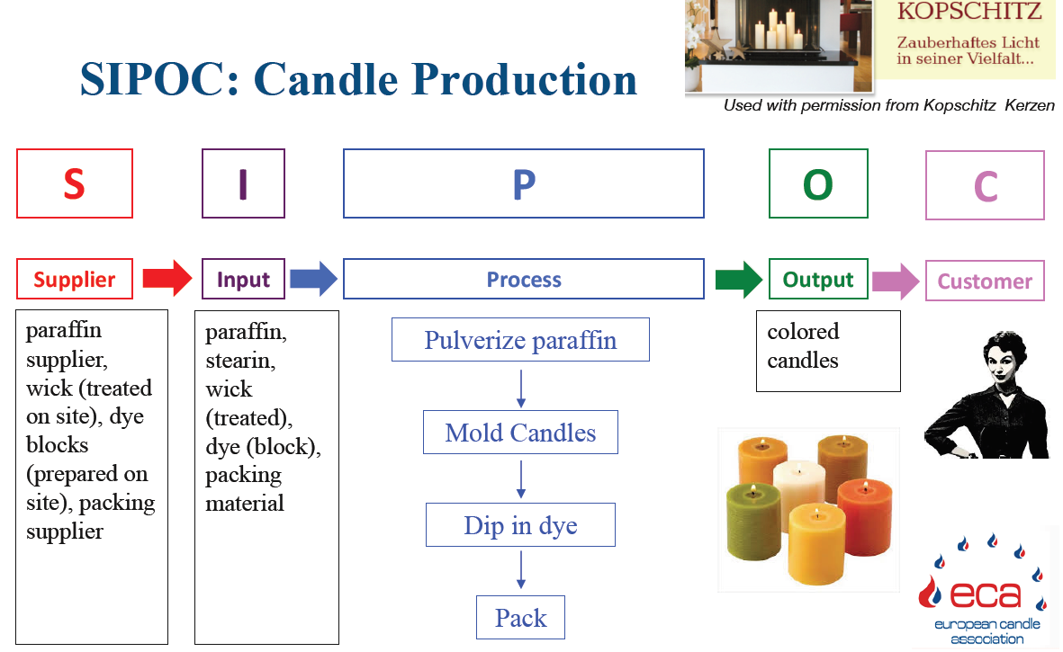

Slide 17
Restrictions and Specifications

Slide 18


Slide 19
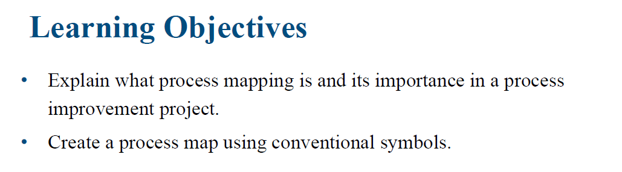

Slide 20
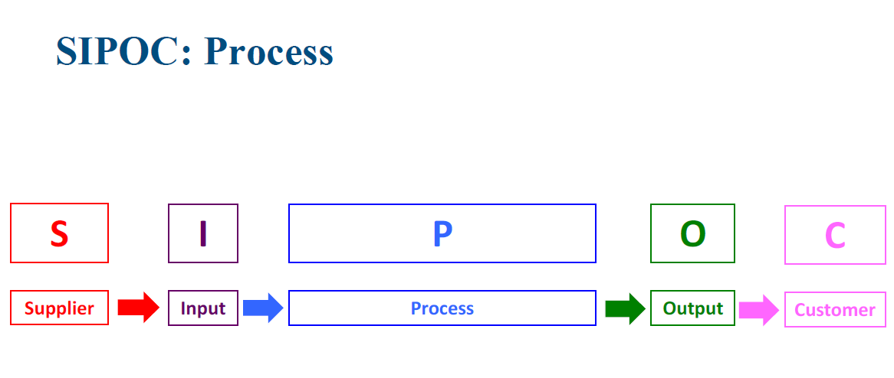

Slide 21
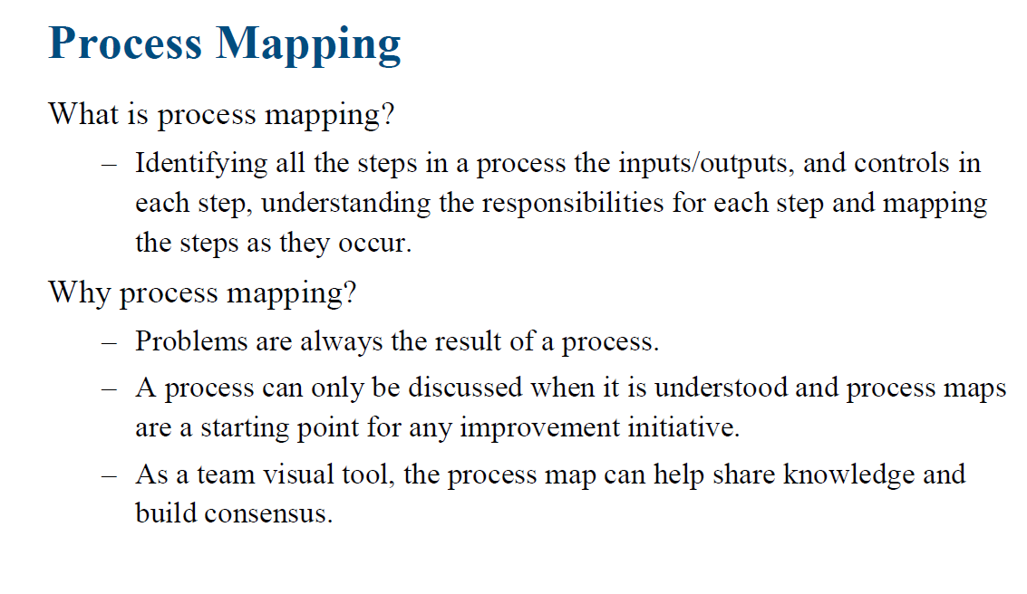

Slide 22
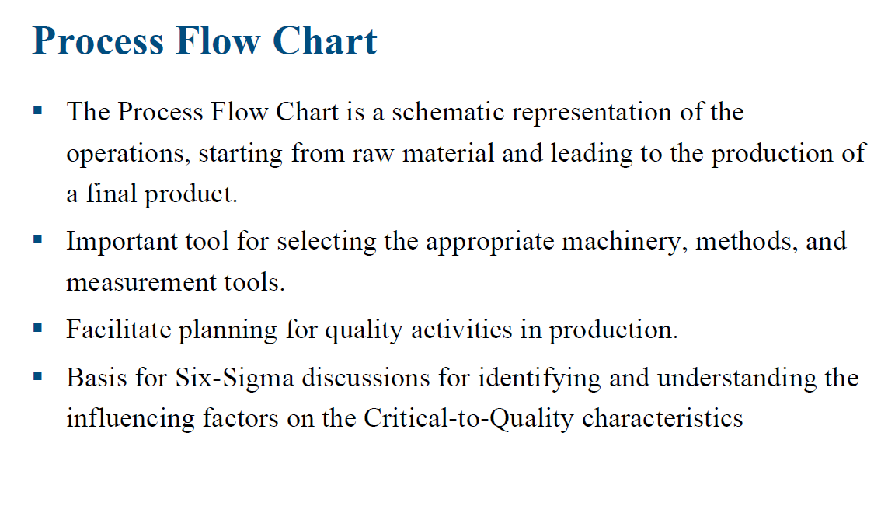

Slide 23
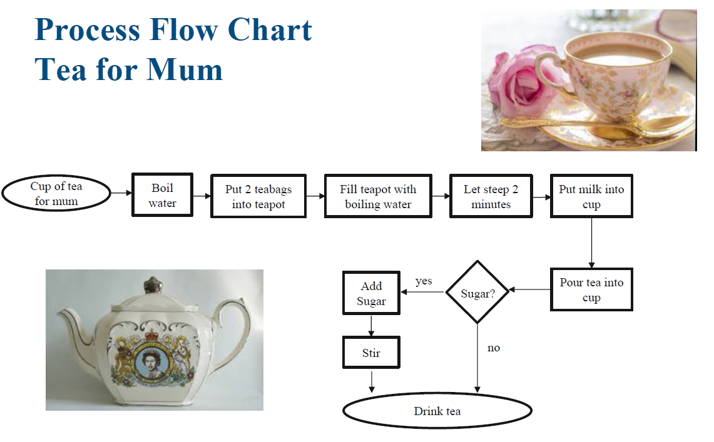

Slide 24
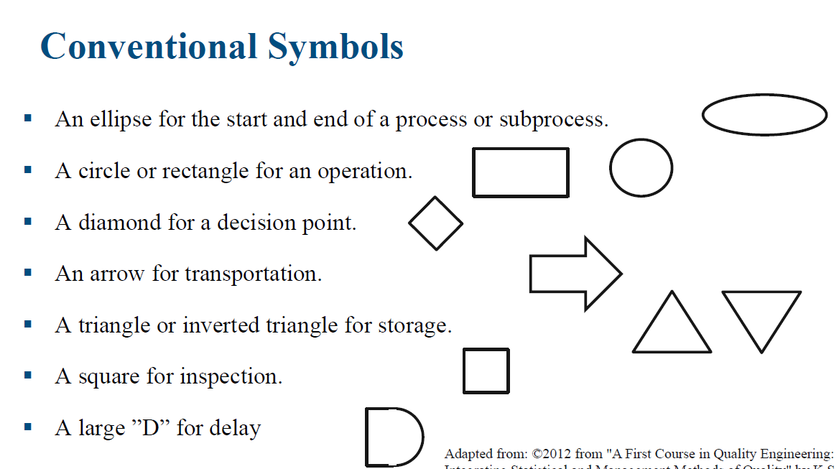

Slide 25
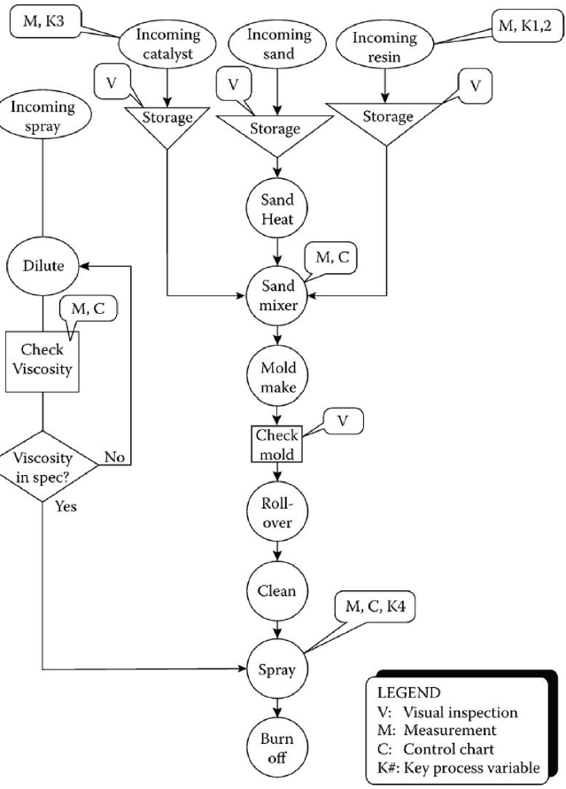
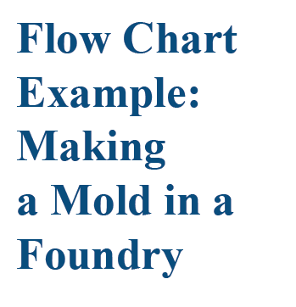

Slide 26
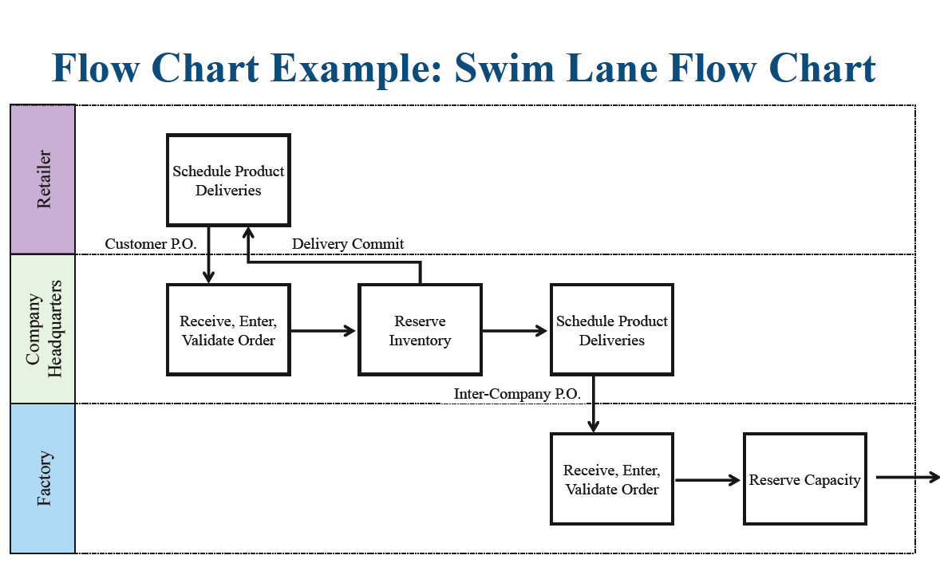

Slide 27
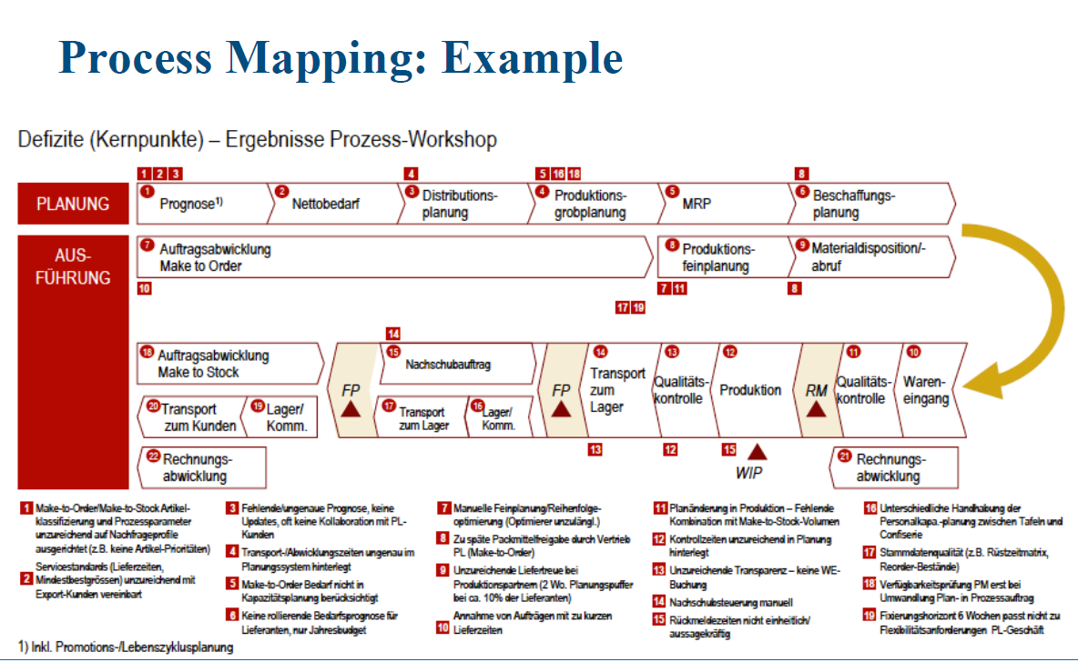

Slide 28
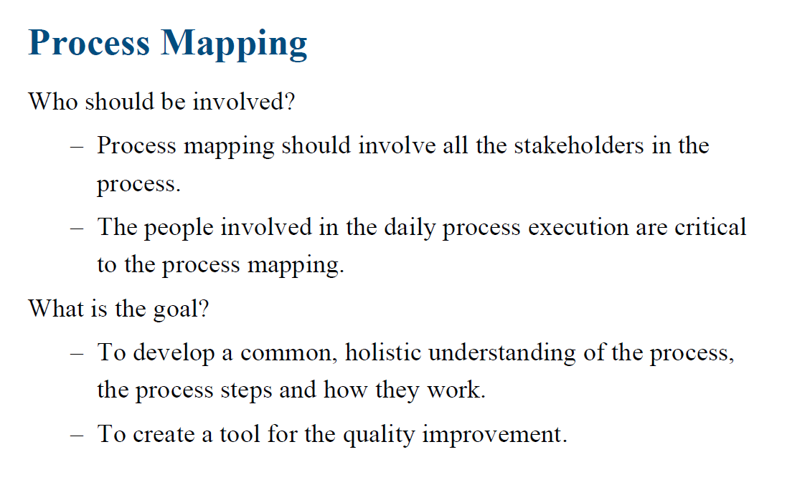

Slide 29
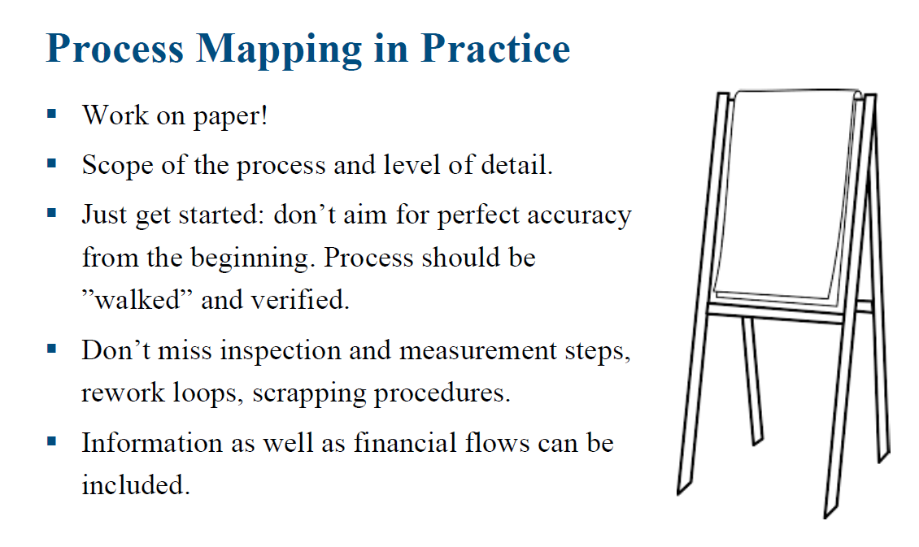

Slide 30

Question 1-Process Mapping
Mapping is best done with a cross-functional group of people who do the work.
Where possible, this group should include the customer and supplier.
TRUE
FALSE

Slide 31
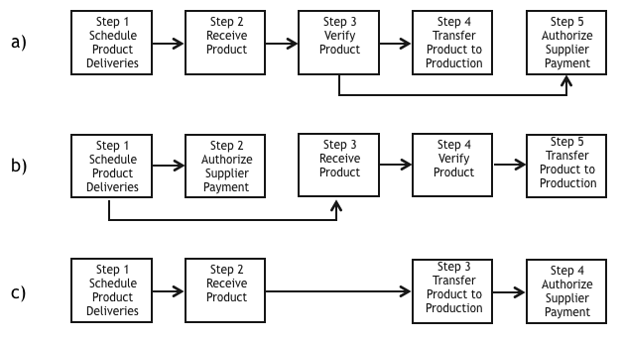
Question 2-Process Mapping 1: Raw Material Ordering
Below are three possible processes for ordering raw material from a supplier, receiving the materials and transferring them into your production and paying the supplier.
Which process(es) is (are) correct?

Slide 32
Question 2-Process Mapping 1: Raw Material Ordering cont.
Process a)
Process b)
Process c)
All are correct
Processes a) and b) only
Explanation
The answer is that all of these processes are correct. For process a) the product is received and checked (verified) before the supplier is paid. This is valid for many receiving processes. Process b) authorizes the supplier payment before the product is received, which can be the case, particularly if there is a shortage of the product. Process c) skips the product verification step. This could be the case if there is a long relationship with the supplier and the quality is assured, for example.
Of course, there can be many other variations of this process. What do you have in your company?

Slide 33
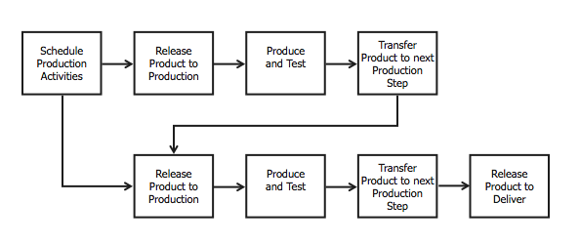
Question 3-Process Mapping 2: Producing and Shipping a Product
Below is a process for producing and shipping a product.
How can we describe this process?

Slide 34
Question 3-Process Mapping 2: Producing and Shipping a Product
This process describes a module: the production for a sub-assembly occurs before the final product is produced.
This process describes two individual products that are sold together.
This process describes two separate factories who produce parts that are sold together.
This process is impossible and cannot be realized.
Explanation
The process could describe a module. First a sub-assembly is produced and tested, then sent on and a larger assembly is produced and tested and delivered.
Since the process map shows that the top flow is combined with the bottom flow, this cannot describe two individual processes.
As the planning is done by one entity, this cannot describe two different factories.

Slide 35
Question 4-Process Mapping 3 cont
Which process is correct ?
Explanation
Process b shows a correct flow from the production (left hand side) and the customer (right hand side).
The customer sends and order and receives an invoice.
Internally the inventory is reserved and the shipment planned.
The production sends the raw material or sub-assembly, which then gets produced and shipped to the customer.
Process a).
Process b)
Process c)
None of the processes are correct.

Slide 36
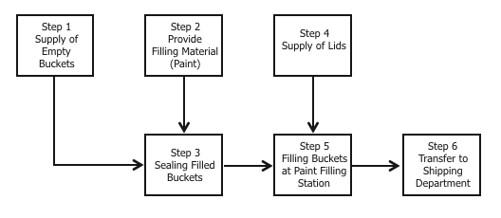
Question 5-Process Mapping 4
Below is a process for the filling of paint buckets.
Which steps NEED to be transposed to describe the process correctly?
Step 4 and Step 5.
Step 1 and Step 2.
Step 1 and Step 4.
Step 3 and Step 5.
Explanation
The buckets need to be filled with paint before they are sealed.

Slide 37
Question 6-Process Mapping
Select all that applies. Process maps are used for which of the following.
Graphically display and define the process
Show where problems are occurring
Evaluate various tasks for the value added, necessity and waste

Slide 38
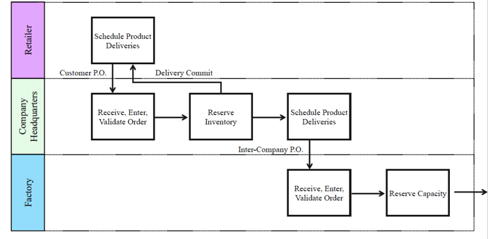
Question 7-Swim Lane Process Map
Answer the following questions using the flowchart
The flowchart in the problem above is an example of a swim lane or cross-functional flowchart describing the roles of different departments/stakeholders involved in the process.
TRUE
FALSE

Slide 39
Question 8-SIPOC
Answer the following questions using the flowchart
The following statements are true about SIPOC EXCEPT
A process snapshot that captures information about a project.
SIPOC diagrams help a team and its sponsor(s) agree on project boundaries and scope.
SIPOC stands for Suppliers, Import, Process, Outputs and Customers.
A SIPOC helps teams verify that process inputs match outputs of the upstream process and inputs / expectations of downstream process(es).

Slide 40
Question 9-Value-added Process Step
Which of the following activities in a process add value to the produced product or service?
Setup
Process
Storage
Inspection

Slide 41
Question 10-Process Mapping
A student utilized a diamond symbol in a Process Map he is creating for the process that was subject to his Lean Six Sigma project. The use of the diamond symbol shows a(n) ___ ___ ___ ____ point in the process.
Ending
Beginning
Decision
Repair station

Slide 42
Question 11-Process Mapping
When developing a Process Map to define a complex process, you'll include activities across various department to capture all the appropriate activity. You will use _____________________ to show which department is responsible for which steps in the process.
Subscripts
Fence Posts
Superscripts
Swim Lanes

Slide 43
Question 12-Process Mapping
In creating a Process Map we use an Ellipse, to designate ____________________ for our process.
A start and stop point
A data collection point
An activity step
Decision Point

Slide 44
Question 14-SIPOC for the Sweetie Shop - PROCESS
Arrange the components in the PROCESS step of the SIPOC diagram for the Sweeite Shop in the correct sequence, from first to last for all four process steps. Please note:In this company, sweeties are never given to the customer before they are paid for.PROCESS - Serving Customer
Select Sweeties
Greet Customer
Give Sweeties to Happy Customer
Collect Payment
Greet Customer
Select Sweeties
Collect Payment
Give Sweeties to Happy Customer

Slide 45
Question 15-SIPOC for the Sweetie Shop - SUPPLIER
Identify and select the component that belongs to the SUPPLIER step in the SIPOC diagram above. (One answer only)
Small child who wants sweeties
Select sweeties
Bag of sweeties
Candy producers

Slide 46
Question 16-SIPOC for the Sweetie Shop - INPUTS
Identify and select the component which belongs to the INPUTS step in the SIPOC diagram above. (One answer only)
Candy suppliers
Small child who wants sweeties
Peppermints, Gummy Bears, Lemon Drops, Licorice Whips
Receive payment

Slide 47
Question 17-SIPOC for the Sweetie Shop - OUTPUTS
Identify and select the component which belongs to the OUTPUT step in the SIPOC diagram above. (One answer only)
Candy producers
Peppermints, Gummy Bears, Lemon Drops, Licorice Whips
Small child who wants sweeties
Bag of Sweeties

Slide 48
Question 1-Process Mapping - 1
The following are the reasons why we employ the use of process mapping EXCEPT
Problems are always the result of a process. A problem arises in the process and causes a deviation in the expected output.
A process can only be discussed when it is understood and process maps are a starting point for any improvement initiative.
Problems are always the input of a process. A problem arises in the output and causes a deviation in the expected input. correct
As a team visual tool, the process map can help share knowledge and build consensus.

Slide 49
Question 2-Process Mapping - 2
Process mapping should involve all the stakeholders in the process and the people involved in the daily process execution are critical to the process mapping.
The goal of process mapping includes the following EXCEPT
To create a tool for the quality improvement.
To create a tool for identifying and understanding the influencing factors of the Kano model quality characteristics. correct
To develop a common, holistic understanding of the process, the process steps and how they work.

Slide 50
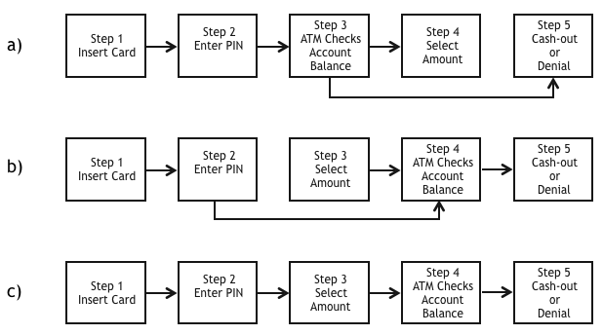
Question 3-Process Mapping - 3
Look at the following processes for making a withdrawal at an ATM.
Which process(es) could describe a withdrawal correctly?
Process a)
Process b)
Process c)
All are correct
Explanation
Only Process c) represents a withdrawal from an ATM correctly. The procedure follows a strict sequence of steps from the beginning to the end of the process. There are no various starting points or outcomes, which are skipped. Therefore a) and b) are wrong.

Slide 51
Question 4-Process Mapping - 4
Process mapping can be defined as Identifying all the steps in a process the inputs/outputs, and controls in each step, understanding the responsibilities for each step and mapping the steps as they occur.
TRUE
FALSE

Slide 52
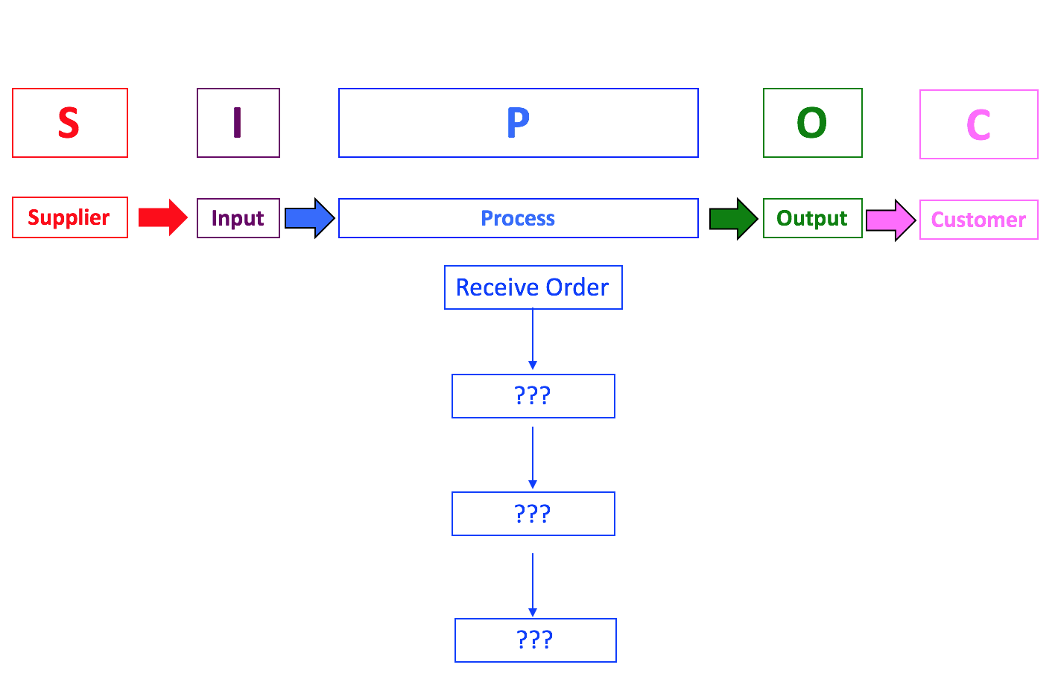
Answer the following questions using the information in this diagram .

Slide 53
Question 5-SIPOC for
Food Ordering Process in a Restaurant - PROCESS
Arrange the components in the PROCESS step of the SIPOC diagram in the correct sequence, from first to last for all four process steps.In this company, food is never packaged and delivered before it is paid for.
[Note: there may more than one way this process can flow, but there is only one correct answer for each of the steps. Look carefully at the choices given to you for each step.]
Collect Payment
Receive Order
Package and Delivery
Prepare Food
Receive Order
Prepare Food
Collect Payment
Package and Delivery

Slide 54
Question 6-SIPOC for a
Food Ordering Process in a Restaurant - SUPPLIERS
Identify and select the component that belongs to the SUPPLIER step in the SIPOC diagram above. (One answer only)
Food wholesalers, grocery stores
Receive order
Packaged order
Hungry person

Slide 55
Question 7-SIPOC for a
Food Ordering Process in a Restaurant - INPUTS
Identify and select the component which belongs to the INPUTS step in the SIPOC diagram above. (One answer only)
Hungry person
Delivery of customer order
Receive order
Cooking facilities, Manpower (chefs, food preparers, etc.) correct
Food wholesalers, grocery stores

Slide 56
Question 8-SIPOC for
a Food Ordering Process in a Restaurant - OUTPUTS
The OUTPUT stage of the SIPOC diagram above consist of the following EXCEPT?
Packaged order
Food wholesalers, grocery stores
Prepared food

Slide 57


