Slide 1





Microsoft Access Training
Prepared By :
Said Fawzy
Manager of Information Center
Tendering Department
Arab Contractors

Slide 2
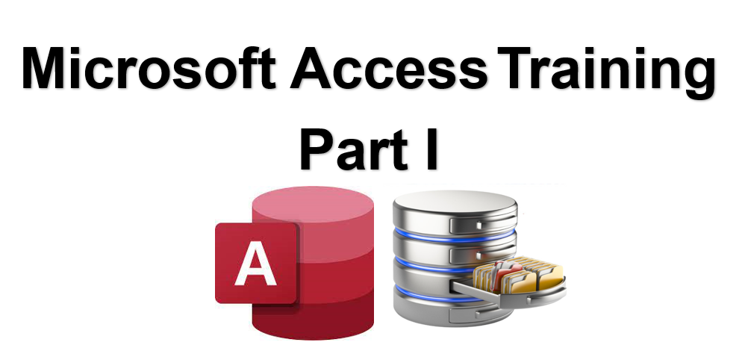
Introduction
Prepared By :
Said Fawzy
Manager of Information Center
Tendering Department
Arab Contractors

Slide 3
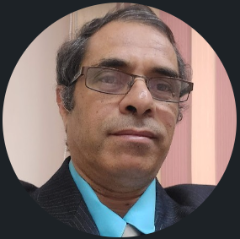

Contact
Cert.
Cert.
Certif.
Quali
JOB
Said Fawzy
Manager of Information Center
Quality Manager
Tendering Department
Arab Contractors

Slide 4
Contact
Cert.
Cert.
Cert.
Quali.
JOB
Said Fawzy
Manager of Information Center
Quality Manager
Tendering Department
Arab Contractors

Slide 5


B.SC In Civil Engineering
1987
Alex University
Contact
Cert.
Cert.
Cert.
Quali.
JOB
Said Fawzy
Manager of Information Center
Tendering Department
Arab Contractors
High Diploma in Construction Project Management
1998
Ein Shams
University

Slide 6



Microsoft Certified Professional (MCP)
1999
B.SC In Civil Engineering
1987
Certified Internet Webmaster(CIW)
2000
Alex University
Contact
Cert.
Cert.
Cert.
Quali.
JOB
Said Fawzy
Manager of Information Center
Tendering Department
Arab Contractors
High Diploma in Construction Project Management
2001
Oracle Certified Master (OCM)
1998
Ein Shams
University
Microsoft Certified Technology Specialist(MCTS)
2006

Slide 7



Microsoft Certified Professional (MCP)
1999
Lead Auditor Quality Management Systems
B.SC In Civil Engineering
2009
1987
Certified Internet Webmaster(CIW)
2000
Alex University
Contact
Cert.
Cert.
Cert.
Quali.
JOB
Said Fawzy
Manager of Information Center
Tendering Department
Arab Contractors
High Diploma in Construction Project Management
2001
Oracle Certified Master (OCM)
1998
Lead Auditor Quality Management Systems
Ein Shams
University
2016
Microsoft Certified Technology Specialist(MCTS)
2006

Slide 8

Advanced Data Analysis Nanodegree
2021
Microsoft Certified Professional (MCP)
1999
Lead Auditor Quality Management Systems
B.SC In Civil Engineering
2009
1987
2022
2000
Nanodegree UX Research Cross-Skilling
Certified Internet Webmaster(CIW)
Alex University
Contact
Cert.
Cert.
Cert.
Quali.
JOB
Said Fawzy
Manager of Information Center
Tendering Department
Arab Contractors
High Diploma in Construction Project Management
2022
2001
Nanodegree Advanced Marketing Analytics
1998
Oracle Certified Master (OCM)
Lead Auditor Quality Management Systems
Ein Shams
University
2016
2023
2006
Microsoft Certified Technology Specialist(MCTS)
IBM Certified Data Analysist Professional

Slide 9
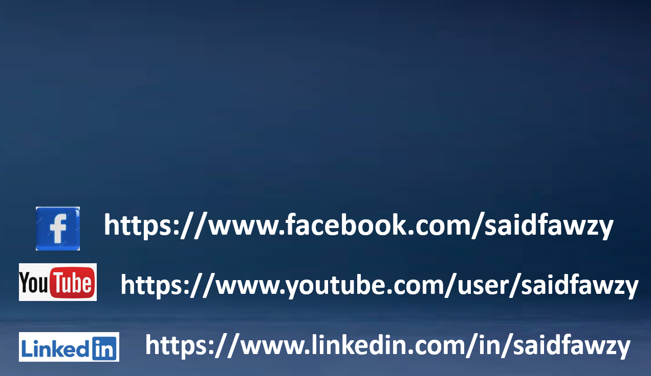

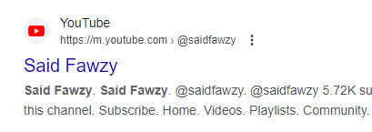
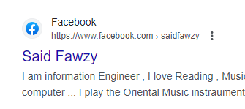
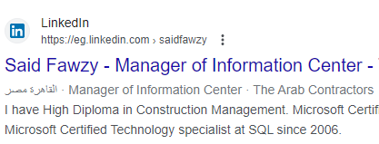


Advanced Data Analysis Nanodegree
2021
Microsoft Certified Professional (MCP)
1999
Lead Auditor Quality Management Systems
B.SC In Civil Engineering
2009
1987
2022
2000
Nanodegree UX Research Cross-Skilling
Certified Internet Webmaster(CIW)
Alex University
Contact
Cert.
Cert.
Cert.
Quali.
JOB
Said Fawzy
Manager of Information Center
Tendering Department
Arab Contractors
High Diploma in Construction Project Management
2022
2001
Nanodegree Advanced Marketing Analytics
1998
Oracle Certified Master (OCM)
Lead Auditor Quality Management Systems
Ein Shams
University
2016
0122 744 99 87
2023
2006
Microsoft Certified Technology Specialist(MCTS)
IBM Certified Data Analysist Professional
Saidfawzy@arabcont.com
Said_fawzy@hotmail.com

Slide 10


Slide 11
PART I
Creating Database and Manipulating Data

Slide 12
Chapter 1
Exploring MS Access Database
Chapter 2
Building Tables
Chapter 3
Tables Relationship
Chapter 4
Query Basics
Chapter 5
Advanced Query Topics

Slide 13
Chapter 6
Creating Automated Requests for Criteria
Chapter 7
Action Queries
Chapter 8
Structured Query Language (SQL)

Slide 14
PART II
Interacting with Users

Slide 15
Chapter 9
Form Basics
Chapter 10
Advanced Form Design Techniques
Chapter 11
Navigation and Switchboard Forms
Chapter 12
Build an Appealing User Interface
Chapter 13
Report Basics

Slide 16
Chapter 14
Advanced Report Design Techniques
Chapter 15
Introduction to Macros

Slide 17



Training
Tell me I will forget.
Show me I might remember something.
Let me do it I will understand.

Slide 18




How would we train?

Slide 19
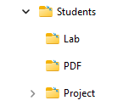
How would we train?

Slide 20
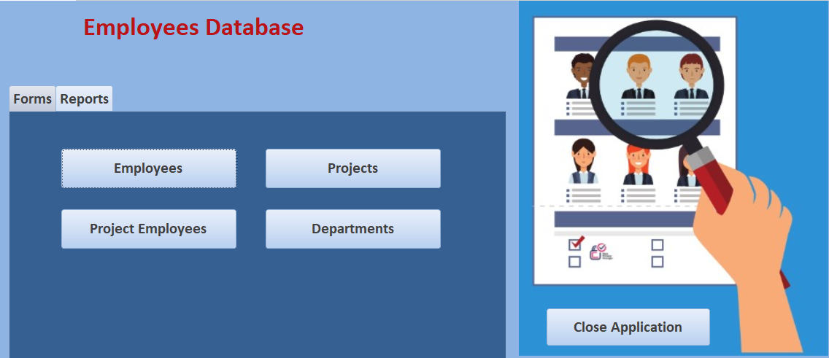

Slide 21
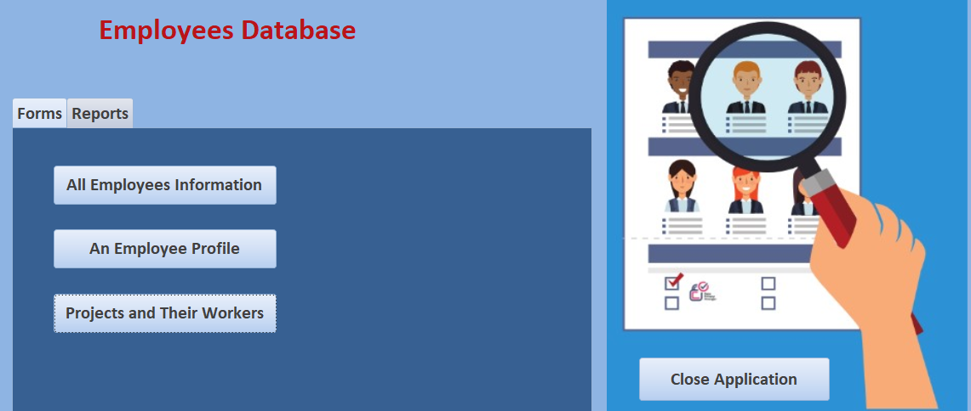

Slide 22
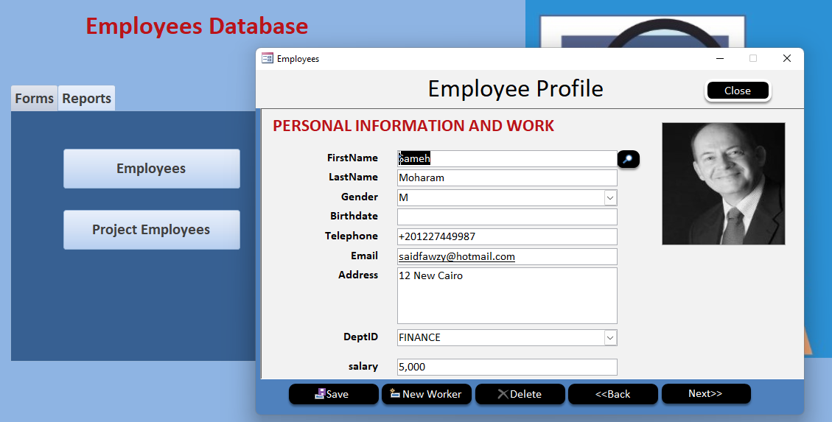

Slide 23
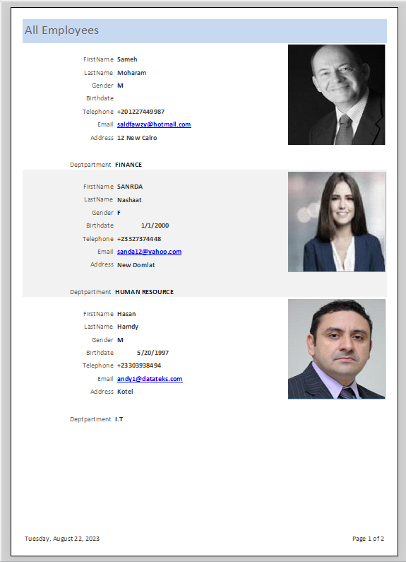
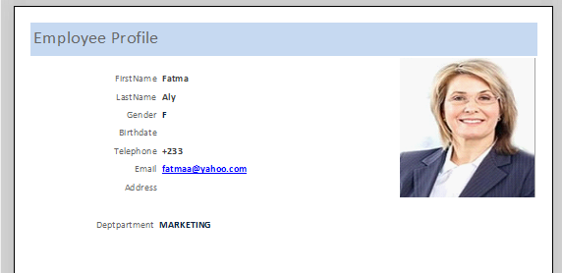

Slide 24


Slide 25
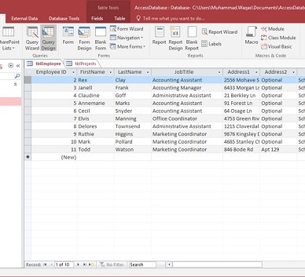

1 Split Access Database
(Two Tier Application)

Slide 26

2 MS Access and SQL Server

Slide 27


3 MS Access and Dataverse

Slide 28
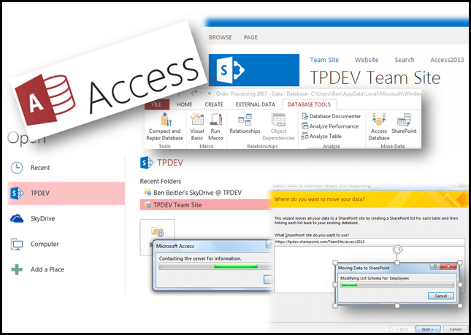
4 MS Access and SharePoint

Slide 29

5 MS Access and PowerApps

Slide 30
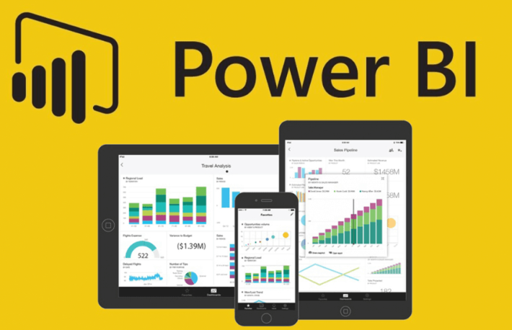
6 MS Access and Power BI

Slide 31





Slide 32



You are Allowed to Talk
about anything except
Religion
Soccer
Policy

Slide 33


