Slide 1




2 Building Tables
Prepared By :
Said Fawzy
Manager of Information Center
Tendering Department
Arab Contractors

Slide 2

1
5
Create Table in Datasheet View
Data types Pros and Cons
2
6
Create a Table in Design View Mode
Creating table using template
3
Defining fields and data types
4
All Data Types available in MS Access

Slide 3


Lab 2A:
Creating Table in Datasheet view

Slide 4

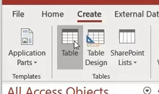
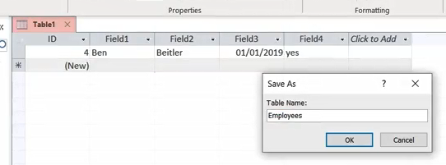
Lab 2A

Slide 5
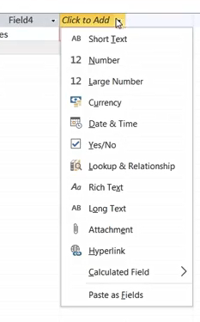
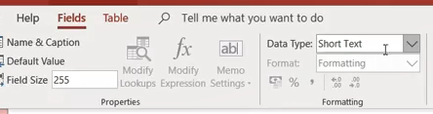
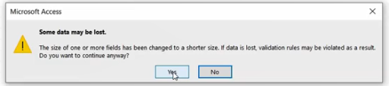
Lab 2A

Slide 6
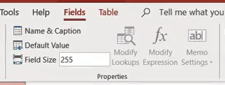
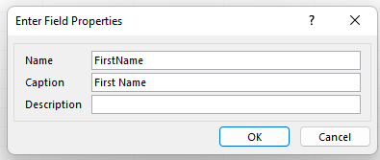
Lab 2A

Slide 7
Lab 2B:
Creating a table
Using Design view

Slide 8

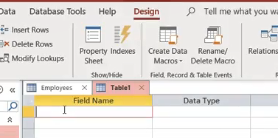
Lab 2B

Slide 9
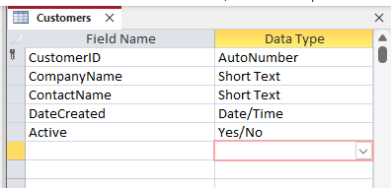

Lab 2B

Slide 10
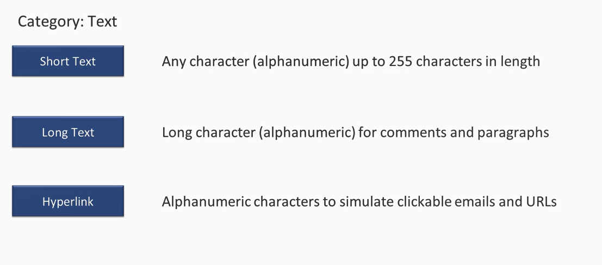
Access Data Types

Slide 11
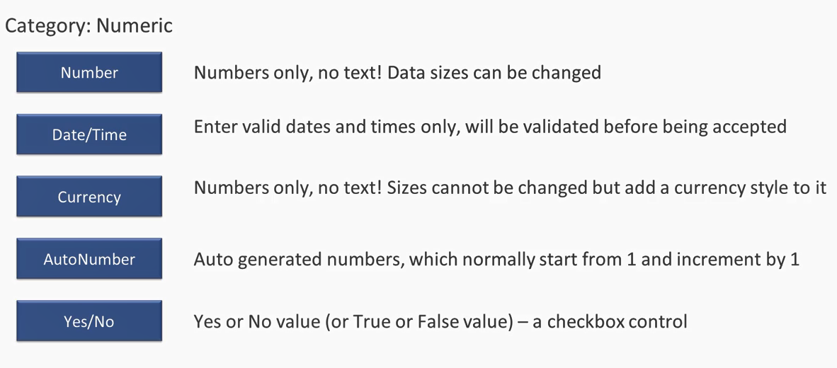
Access Data Types

Slide 12
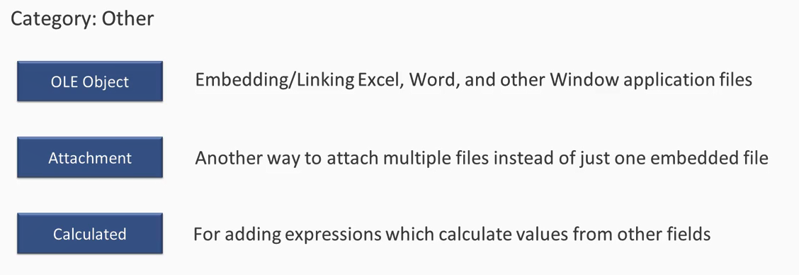
Access Data Types

Slide 13
Lab 2C:
Creating Table from Table Template

Slide 14
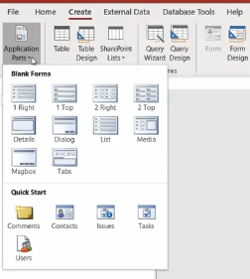
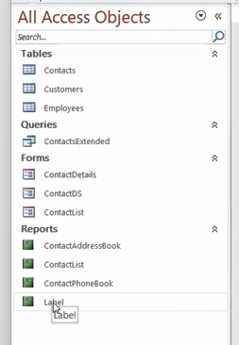
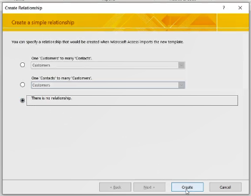
Lab 2C

Slide 15
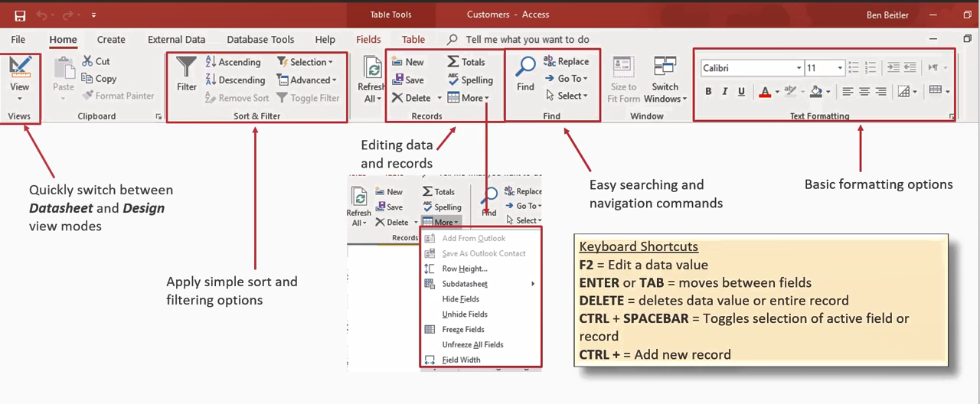
Table Datasheet view

Slide 16
Lab 2D:
Working with table datasheet view

Slide 17
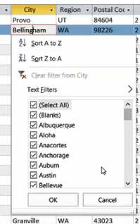
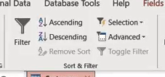
Lab 2D

Slide 18
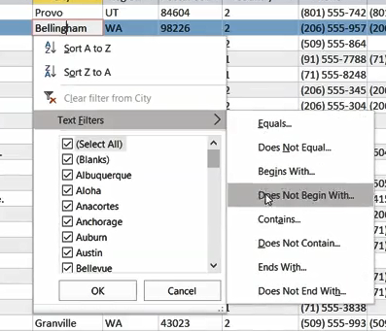
Lab 2D

Slide 19
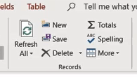
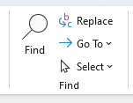
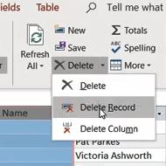
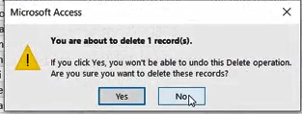
Lab 2D

Slide 20
Lab 2E:
Change Fields Properties

Slide 21
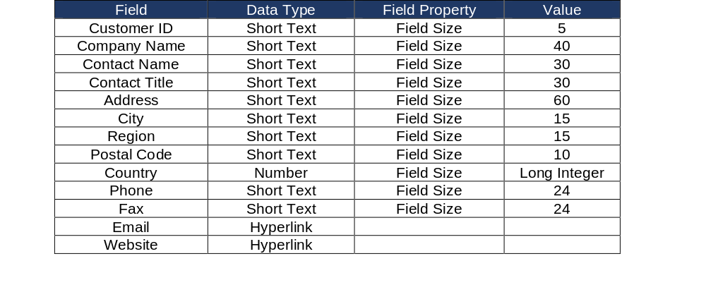
Lab 2E

Slide 22
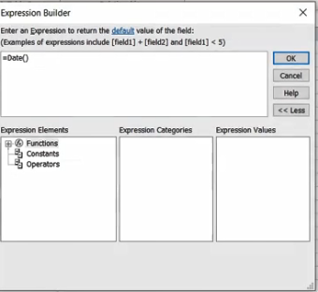
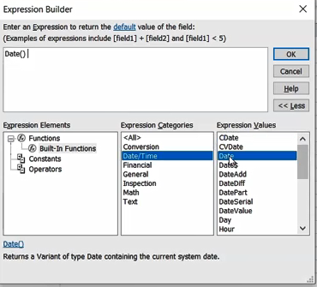

Lab 2E

Slide 23
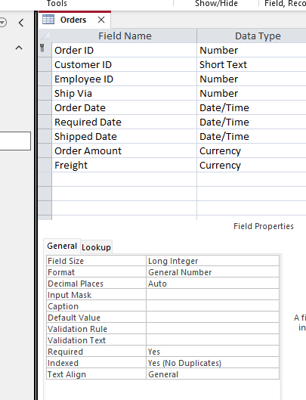
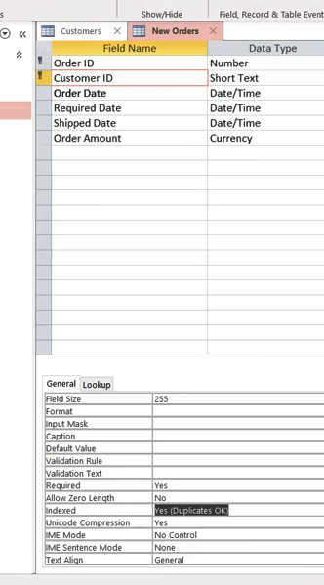
Lab 2E

Slide 24
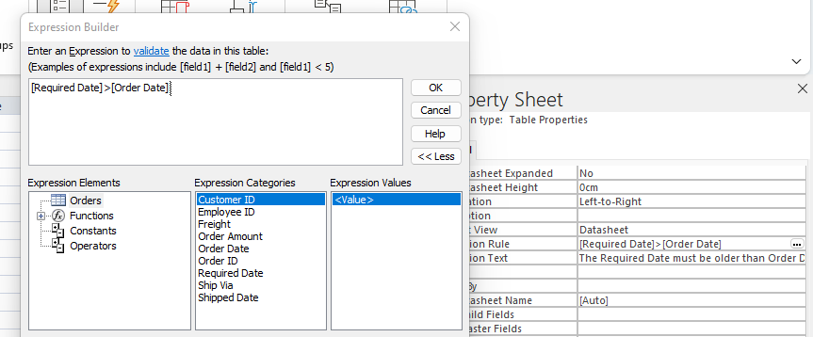
Lab 2E

Slide 25


