Slide 1




3 Tables Relationship
Prepared By :
Said Fawzy
Manager of Information Center
Tendering Department
Arab Contractors

Slide 2

1
5
Primary Key
Cascade Options
2
6
Setting Primary and Secondary Keys
Build Your Project Par 1 (Creating Tables)
3
The relationship Window
4
Define Relationship between Tables

Slide 3
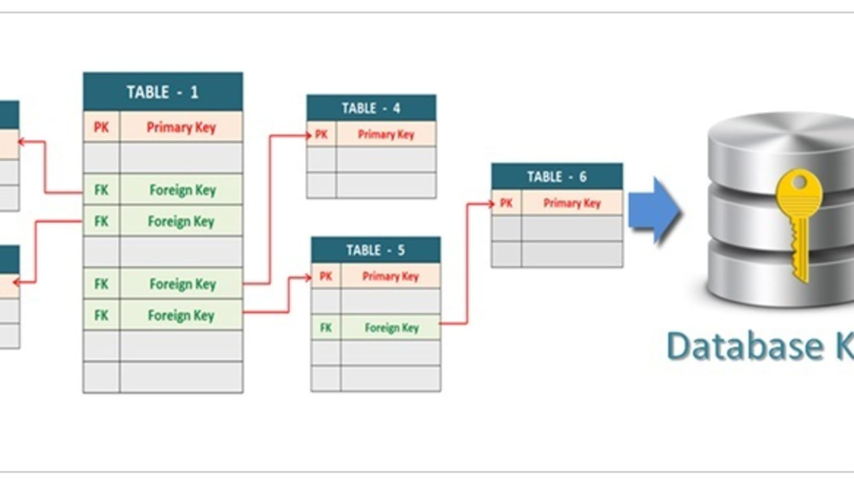
Primary Key
It is a key field that contains a unique value in a table.
Used to join the table with other tables.
A primary Key cannot be left blank (Mandatory) (is NOT NULL).
Secondary key is a field used to connect to other table but allow duplicate values.
Keys are used to speed up the queries.

Slide 4


Lab 3A:
Setting Primary and Secondary Keys

Slide 5

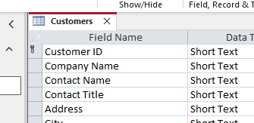

Lab 3A

Slide 6
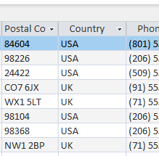
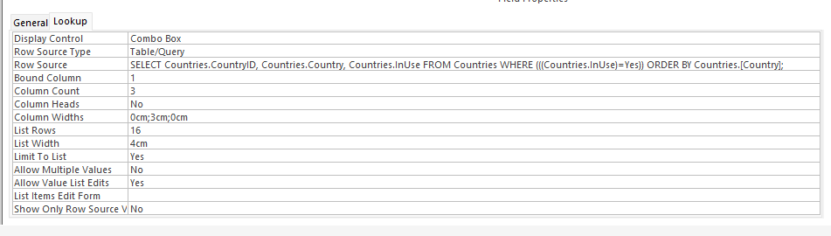
Lab 3A

Slide 7
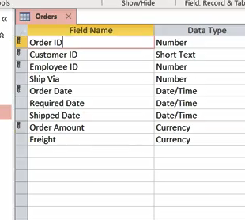
Lab 3A

Slide 8
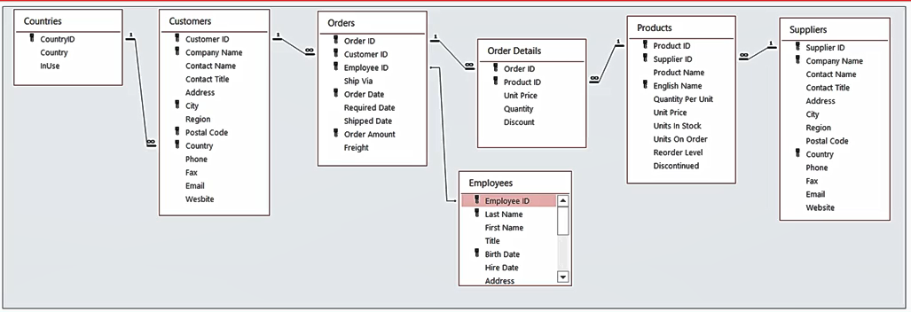
The relationship Window

Slide 9
Lab 3B:
Define Relationship between Tables

Slide 10
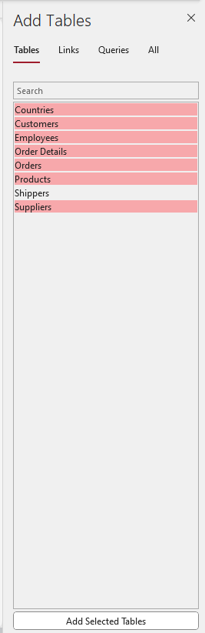
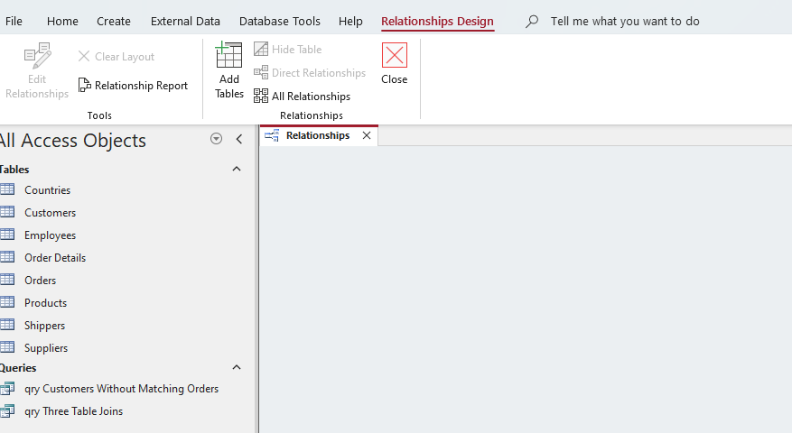
Lab 3B

Slide 11
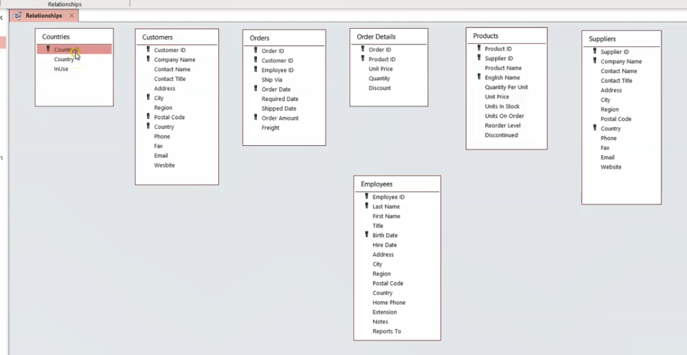
Lab 3B

Slide 12
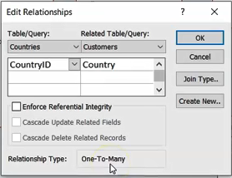
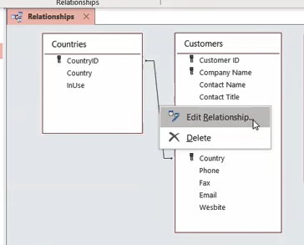
Lab 3B

Slide 13

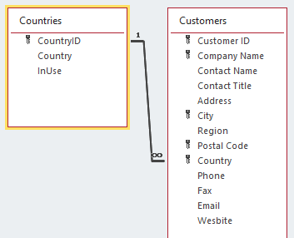
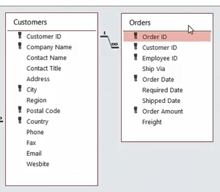
Lab 3B

Slide 14
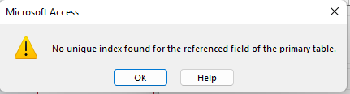

Lab 3B

Slide 15
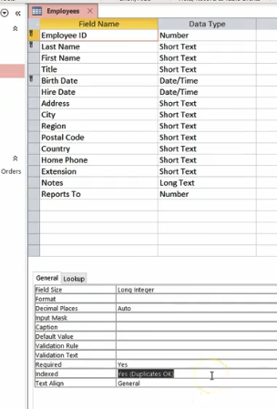
Lab 3B

Slide 16
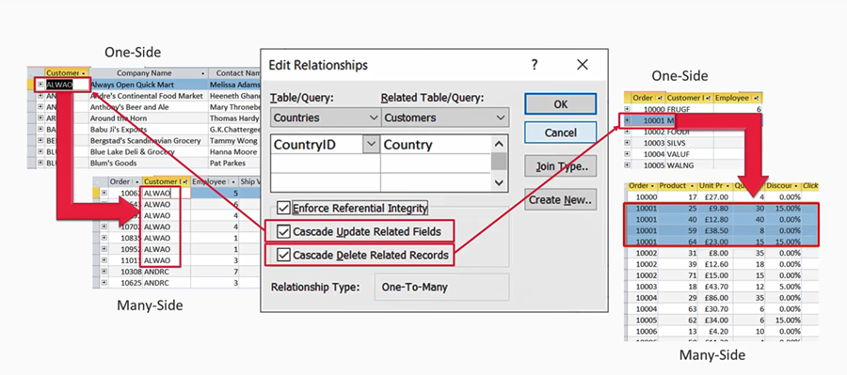
Cascade Options

Slide 17

Build Your Project Part I
Create Tables

Slide 18
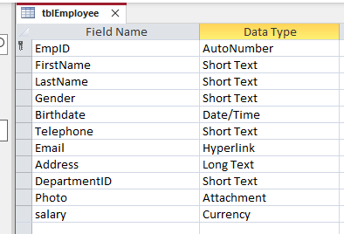
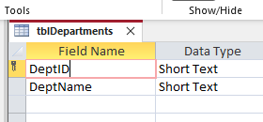
Create Tables

Slide 19
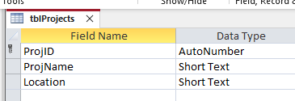
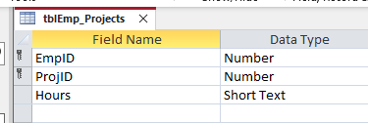
Create Tables

Slide 20
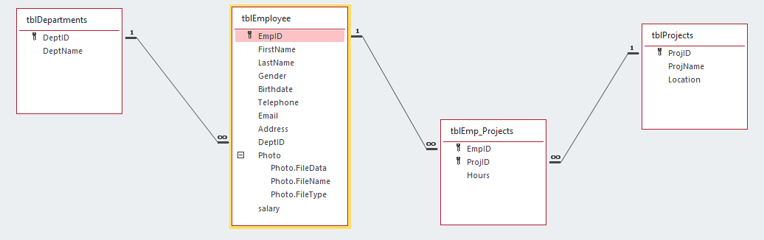
Table Relationship

Slide 21
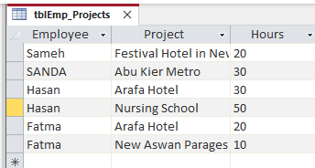
Table Relationship

Slide 22


