Slide 1




4 Queries Basics
Prepared By :
Said Fawzy
Manager of Information Center
Tendering Department
Arab Contractors

Slide 2

1
Create Query Using Query Wizard
2
Query View Modes
3
Create Query Using Design View
4
Customize Query with Criteria

Slide 3
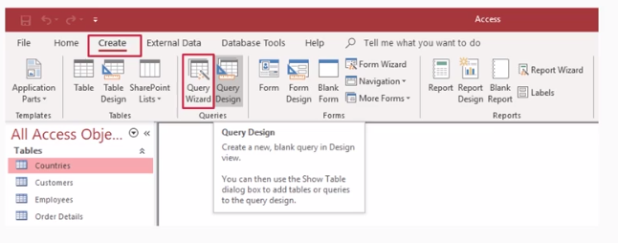
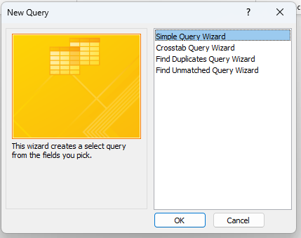
How to Create Query
You can Use:
Query Wizard

Slide 4


Lab 4A:
Creating Query
Using Wizard

Slide 5

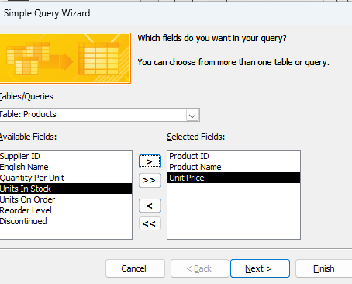
Lab 4A

Slide 6
How to Create Query
You can Use:
Query Design

Slide 7
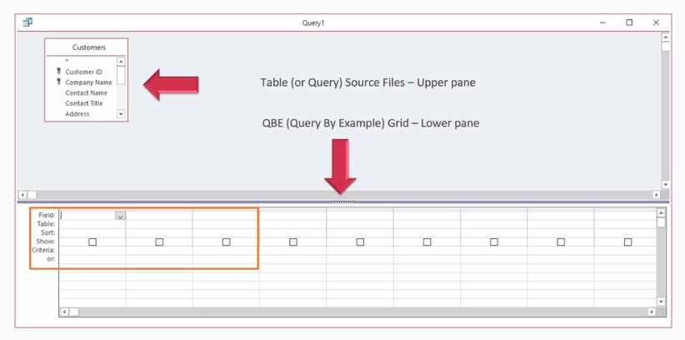
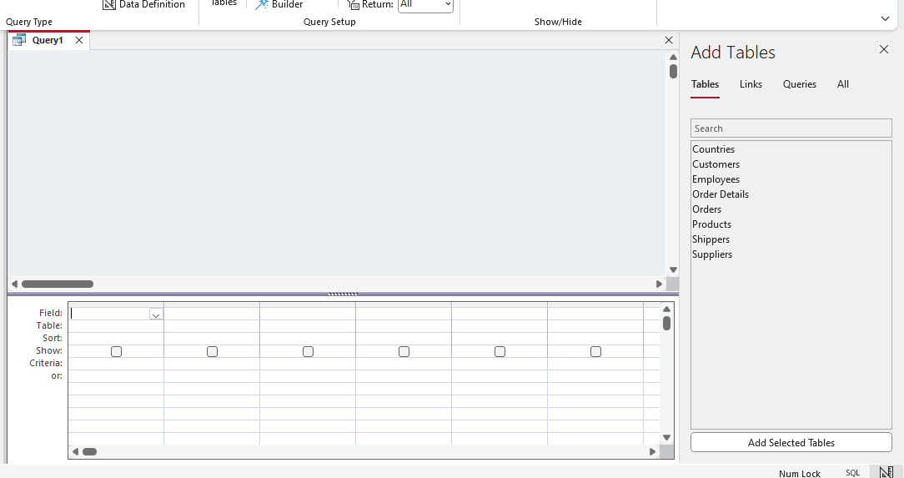
How to Create Query

Slide 8
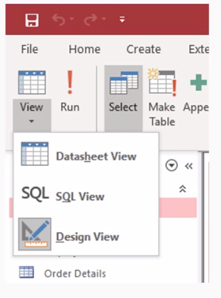
Query View Modes

Slide 9
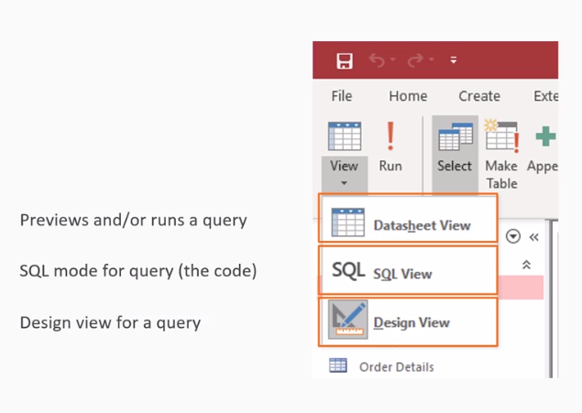
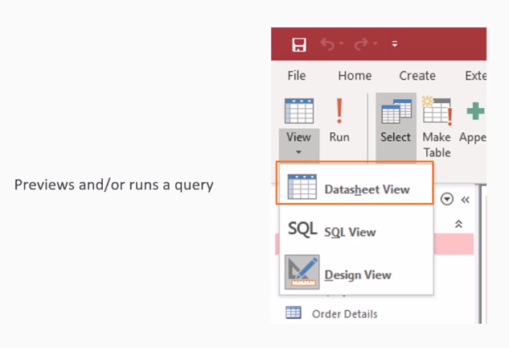
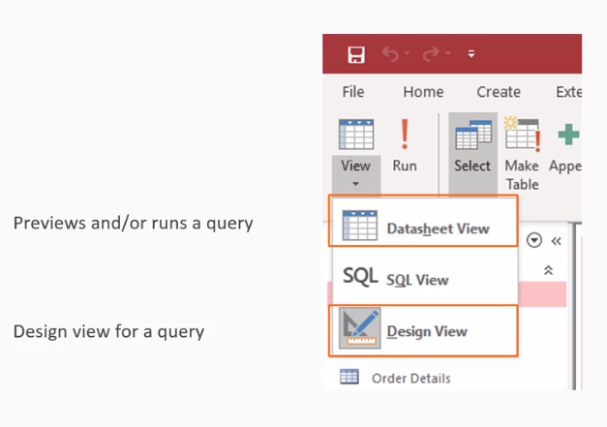
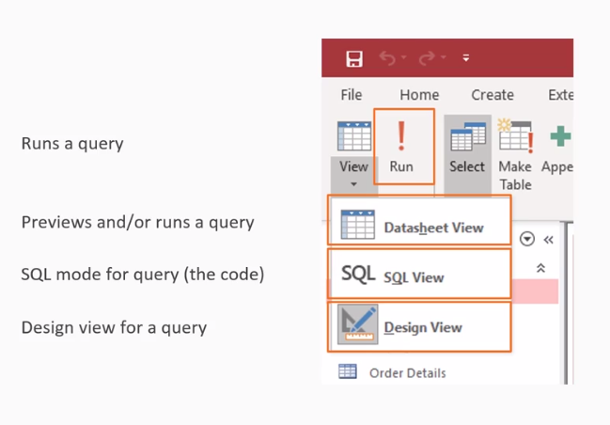

Slide 10
Lab 4B:
Create Query using design view

Slide 11
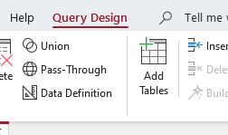
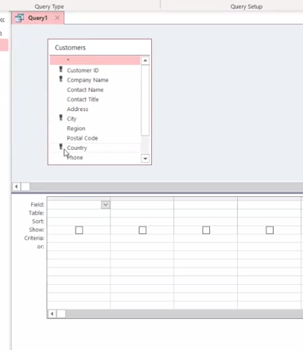
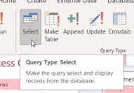
Lab 4B

Slide 12
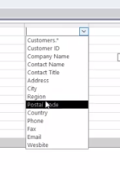
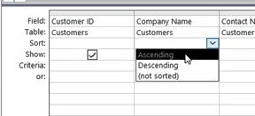
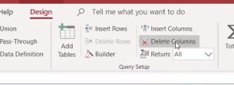
Lab 4B

Slide 13
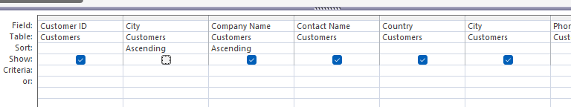
Lab 4B

Slide 14
Lab 4C:
Customize Query with Criteria

Slide 15
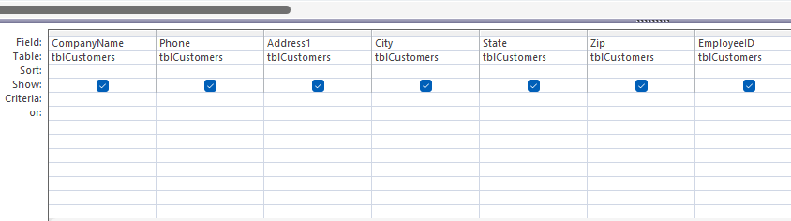
Lab 4C

Slide 16
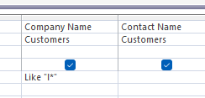
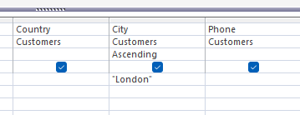
Lab 4C

Slide 17


