Slide 1




7 Action Queries
Prepared By :
Said Fawzy
Manager of Information Center
Tendering Department
Arab Contractors

Slide 2

1
What is Action Queries
2
Type Of Action Queries
3
Creating Action Queries

Slide 3

Action Queries
Action queries are a category of query that changes the table Data

Slide 4
We have
Make table query: they create new table
Append Query: Append data to a table.
Update Query: Update Data in a table.
Delete Query: Delete Data from a table.

Slide 5

Be Careful
You cannot reverse the action of the action queries

Slide 6


Lab 7A: Action Queries

Slide 7

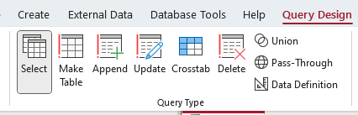
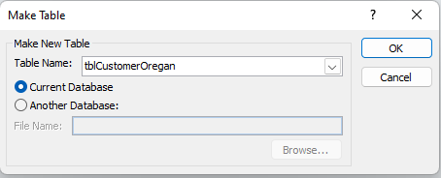
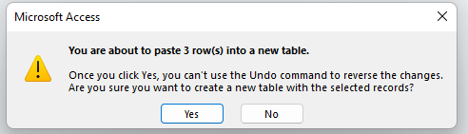
Lab 7A

Slide 8

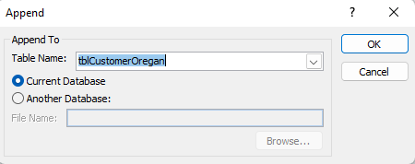
Lab 7A

Slide 9
Lab 7A

Slide 10
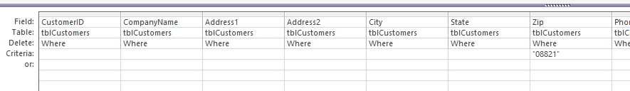
Lab 7A

Slide 11


