Slide 1




I
13 Report Basics
Prepared By :
Said Fawzy
Manager of Information Center
Tendering Department
Arab Contractors

Slide 2

1
Creating Simple Report
2
Exploring Report Design View
3
Creating Form Using Blank Form

Slide 3
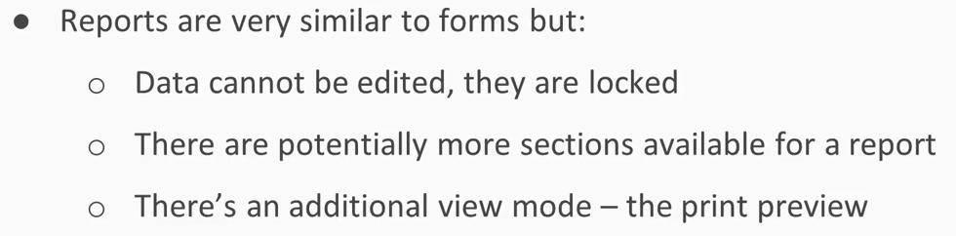
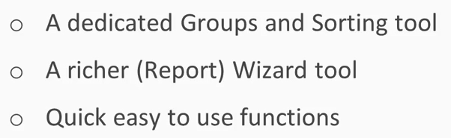
What is Report?

Slide 4


Lab 13A:
Creating Simple Report

Slide 5
Lab 13B:
Exploring Report Design View

Slide 6

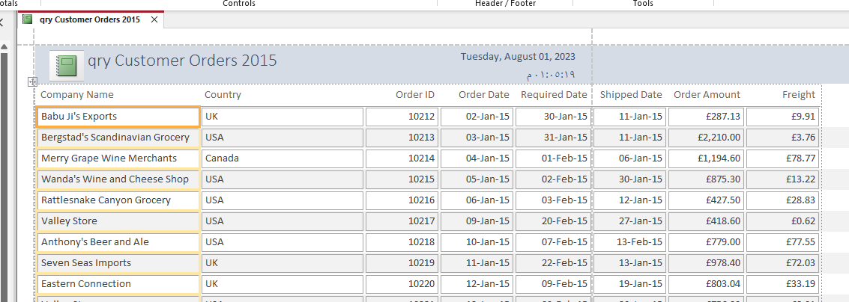
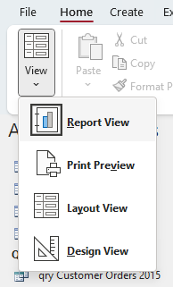
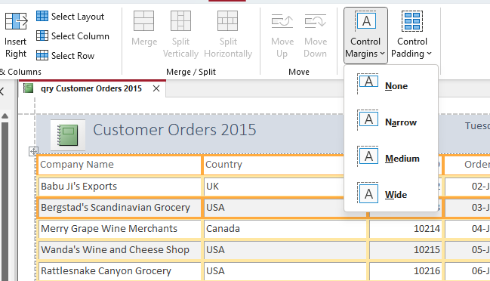
Lab 13B

Slide 7
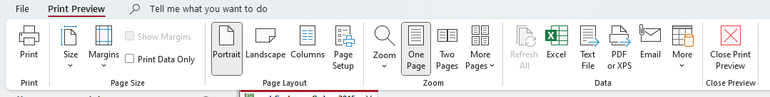
Lab 13B

Slide 8


