Slide 1




I
14 Advanced Report Design Techniques
Prepared By :
Said Fawzy
Manager of Information Center
Tendering Department
Arab Contractors

Slide 2

1
Report Design Canvas
2
Report Sections
3
Creating a Report from Scratch

Slide 3
Report Groups, Sorting and Totals
4
Grouping Report Data
Using Wizard
5
6
Sub Reports

Slide 4
7
Building Reports Using Wizard
8
Build Your Project Part IV
Using Where and Having in Grouping
9

Slide 5
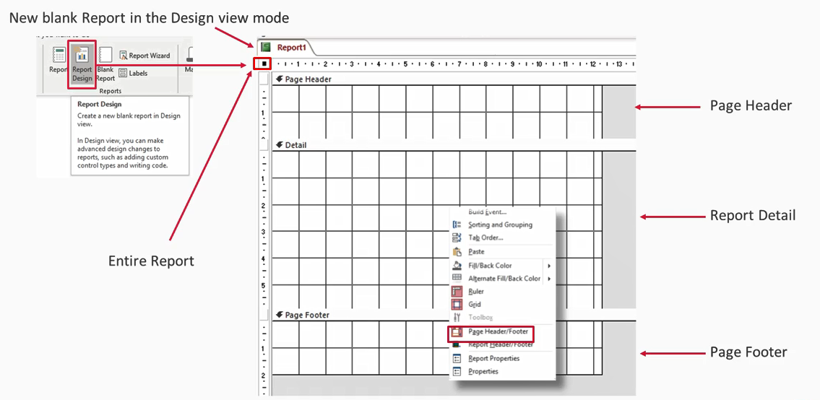
Report Design Canvas

Slide 6
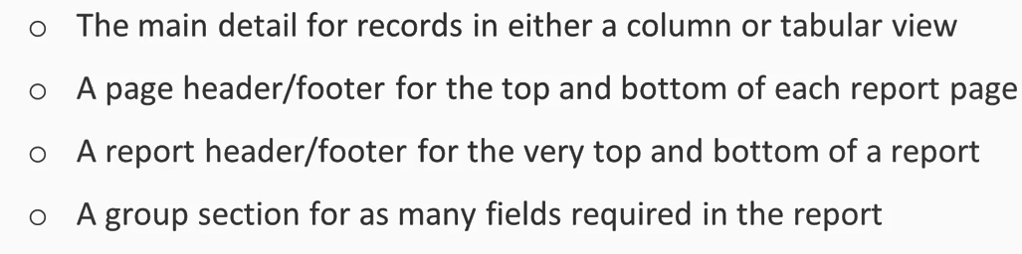
Report Sections

Slide 7


Lab 14A:
Creating a Report from Scratch

Slide 8

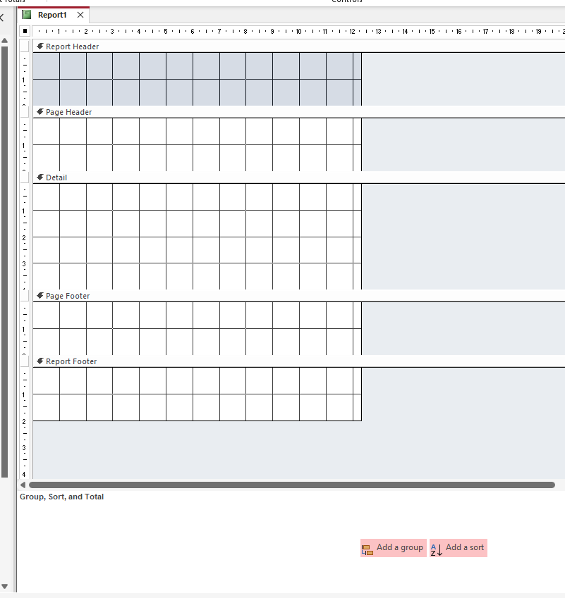
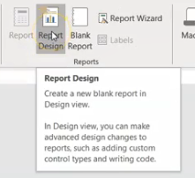
Lab 14A

Slide 9
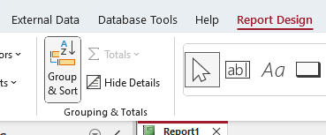
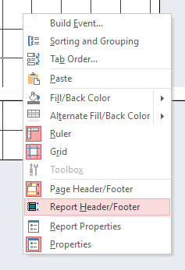
Lab 14A

Slide 10

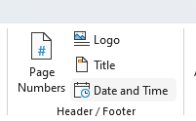
Lab 14A

Slide 11
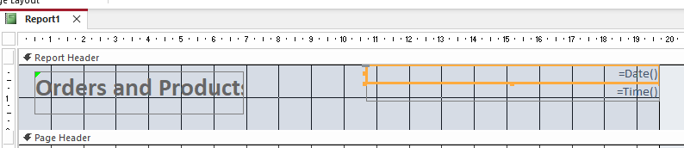
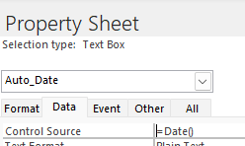
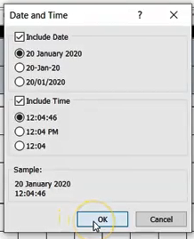
Lab 14A

Slide 12

Lab 14A

Slide 13
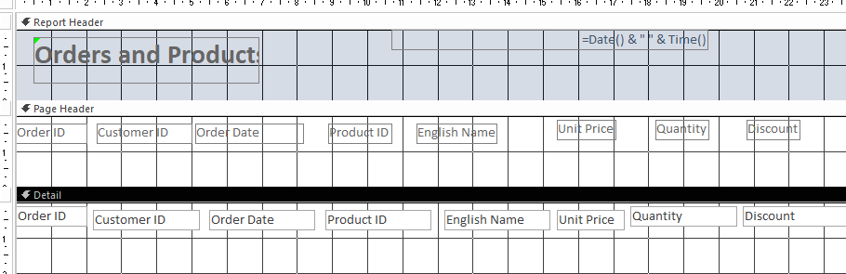
Lab 14A

Slide 14

Lab 14A

Slide 15

Lab 14A

Slide 16
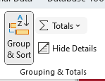
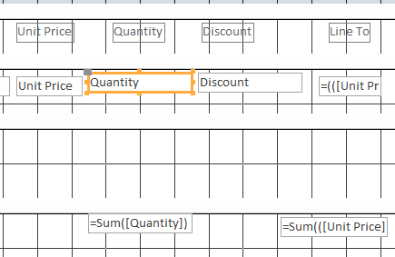
Lab 14A

Slide 17
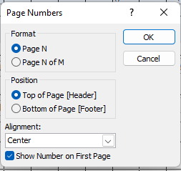
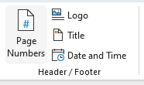

Lab 14A

Slide 18
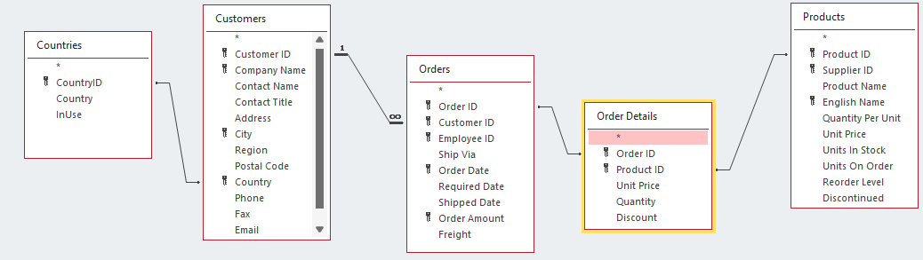
Lab 14A

Slide 19
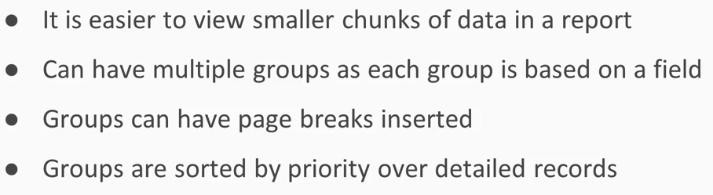
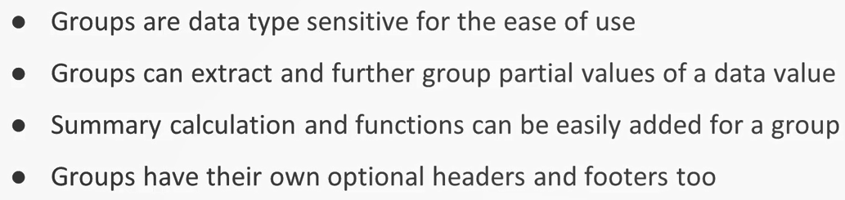
Report Groups, Sorting and Totals

Slide 20
Lab 14B:
Report Grouping,
Sorting and Totals

Slide 21
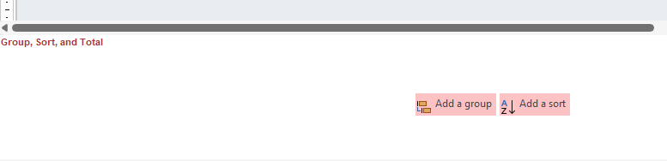
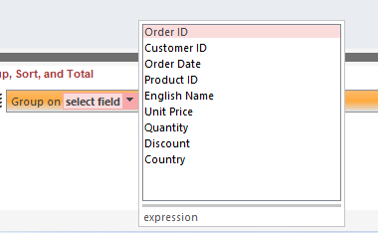
Lab 14B

Slide 22

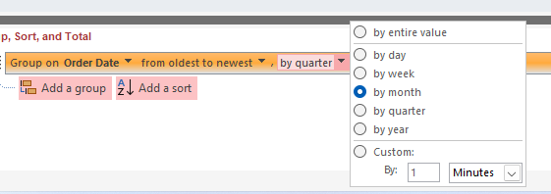
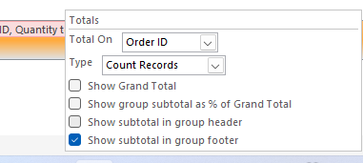
Lab 14B

Slide 23
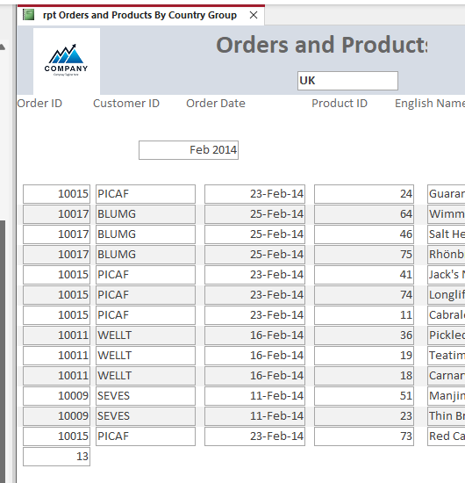
Lab 14B

Slide 24
Lab 14C:
Grouping Report Data
Using Wizard

Slide 25
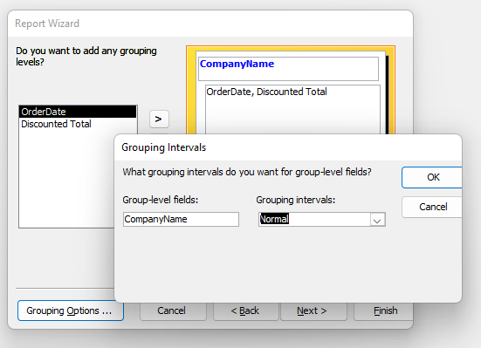
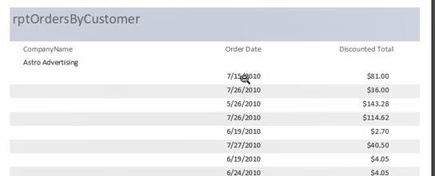
Lab 14C

Slide 26
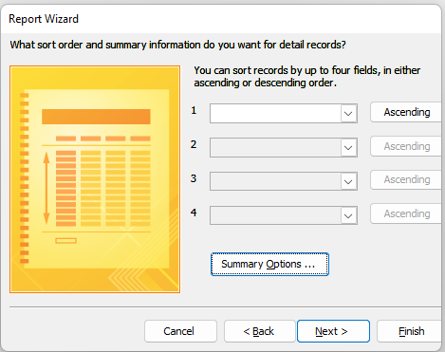
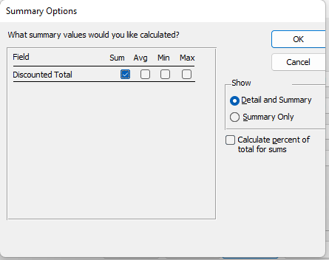
Lab 14C

Slide 27

Lab 14C

Slide 28

Lab 14C

Slide 29
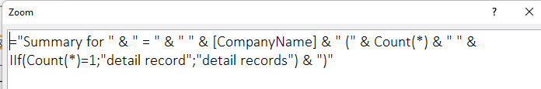
Lab 14C

Slide 30
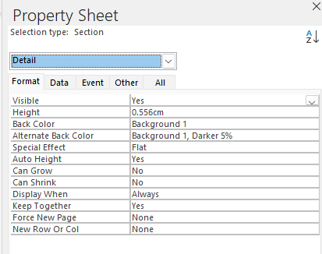
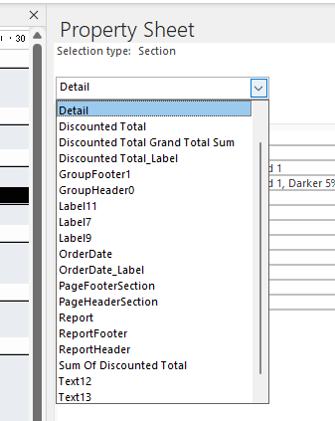
Lab 14C

Slide 31

Lab 14C

Slide 32
Lab 14C

Slide 33
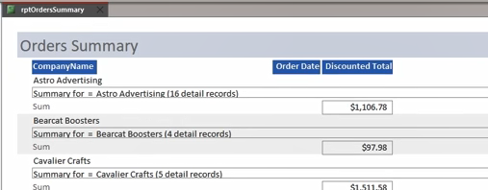
Lab 14C

Slide 34
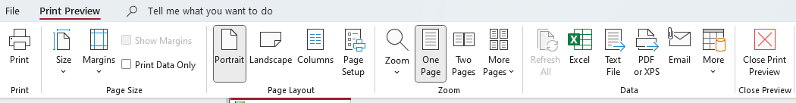
Lab 14C

Slide 35
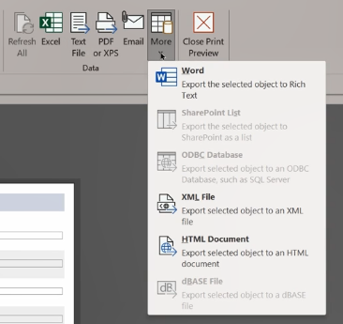
Lab 14C

Slide 36
Sub Reports
Sub report (Child) is a report that is embedded in another report (Parent).
Most of the time there is linked field between the two reports.
The field link is used to filter records between two reports

Slide 37
Lab 14D:
Sub Reports

Slide 38
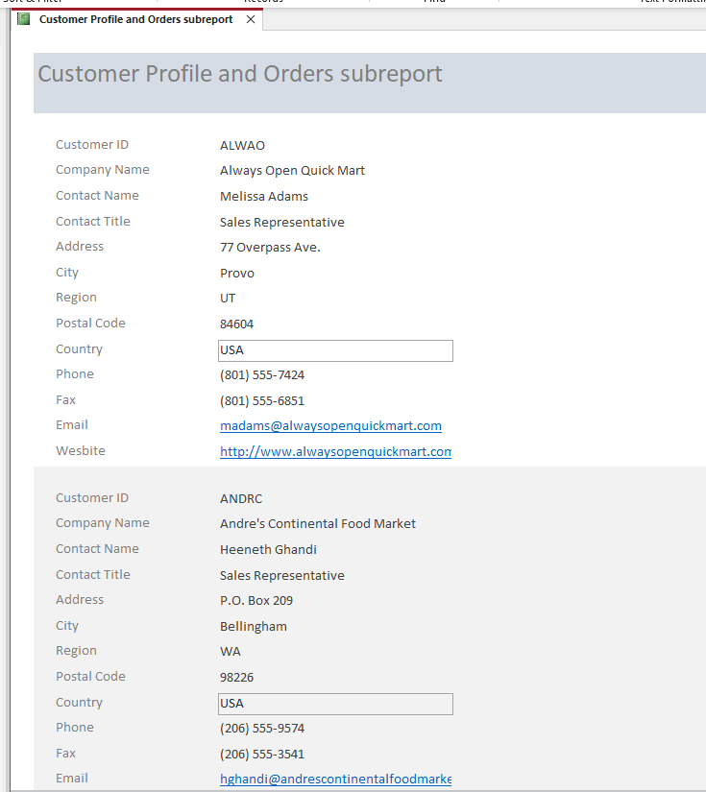
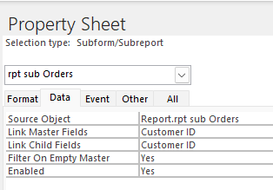
Lab 14D

Slide 39
Report Wizard
Access has a rich report wizard that makes it easier to have a quick report.
You can use it to create reports and then customize the result.

Slide 40
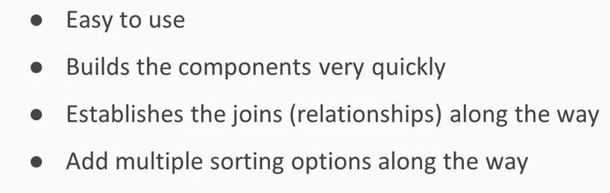
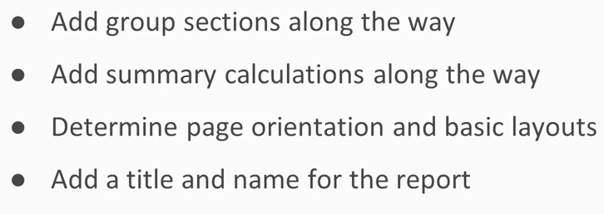
Report Wizard Advantages

Slide 41
Lab 14E:
Building Reports Using Wizard

Slide 42
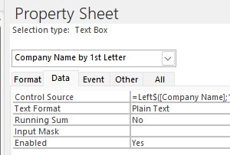
Lab 14E

Slide 43
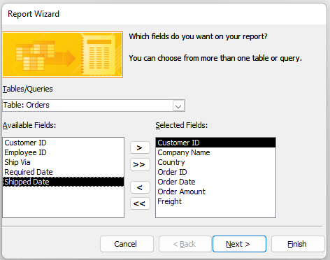
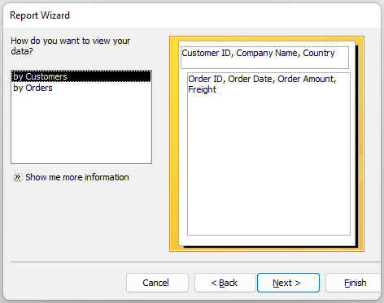
Lab 14E

Slide 44
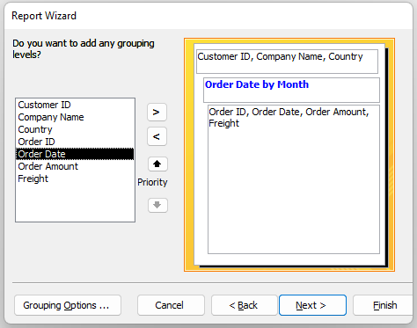
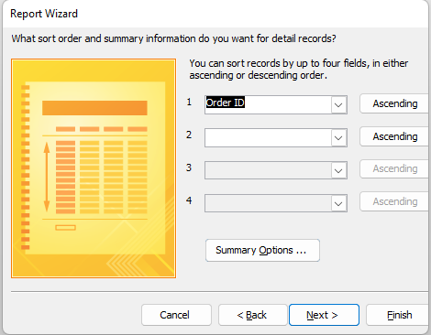
Lab 14E

Slide 45
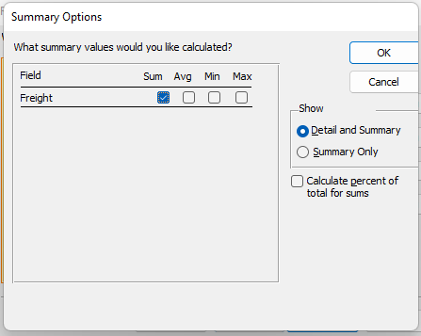
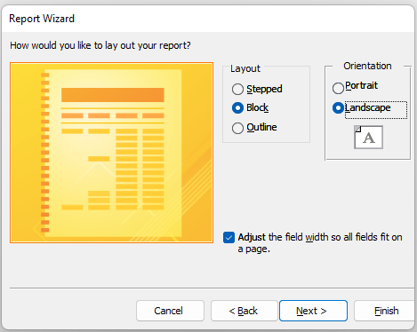
Lab 14E

Slide 46
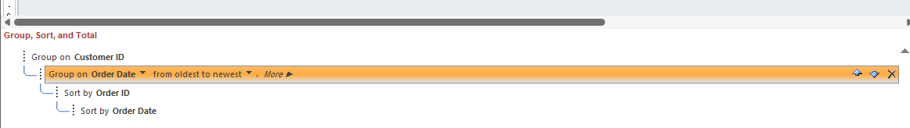
Lab 14E

Slide 47

Build Your Project Part IV
Create Reports

Slide 48
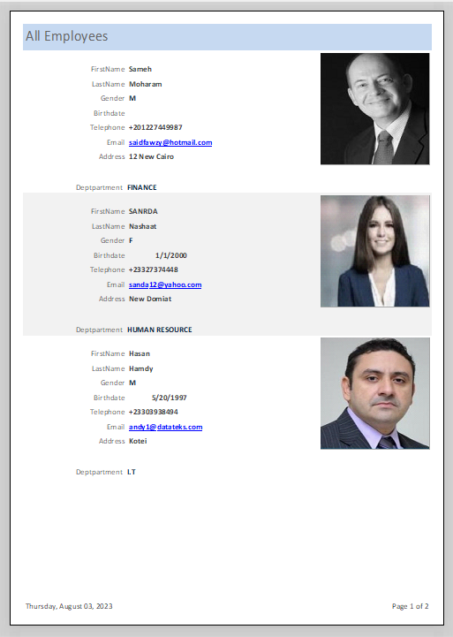
Create All Employees Report

Slide 49
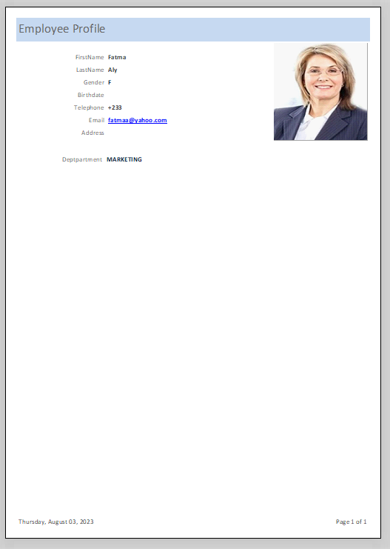
Create An Employee Profile

Slide 50
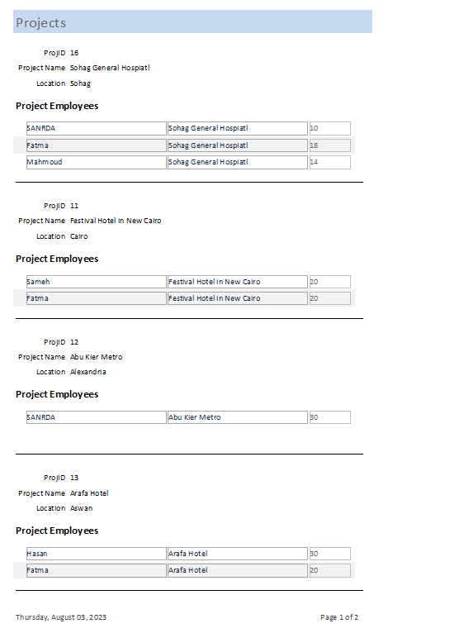
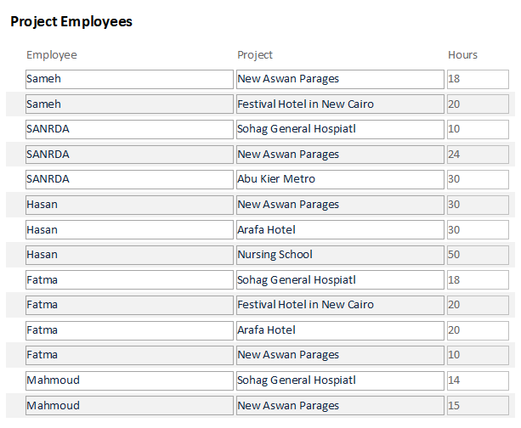
Create Project Employees Report

Slide 51
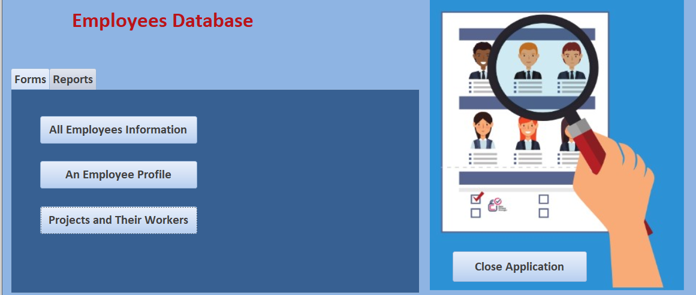
Create Report Buttons In Main Form

Slide 52


