Slide 1
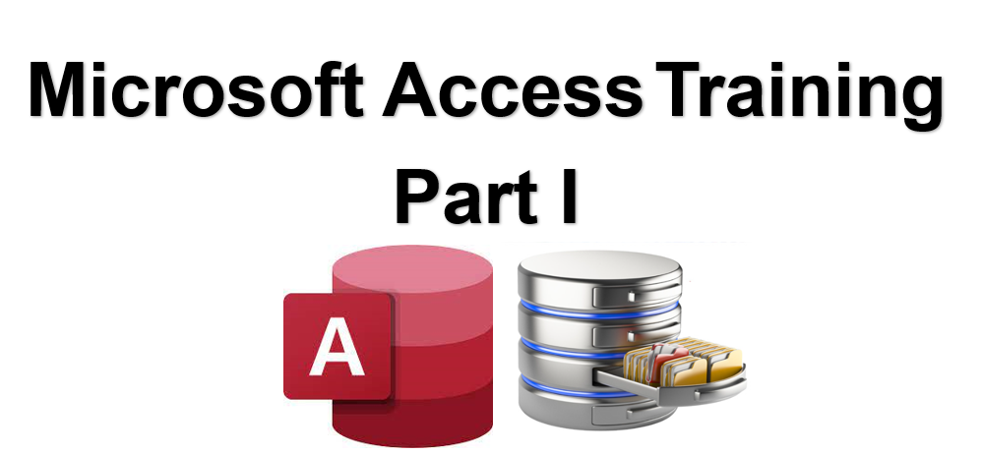



I
15 Introduction to Macros
Prepared By :
Said Fawzy
Manager of Information Center
Tendering Department
Arab Contractors

Slide 2

1
What is Macros?
2
Why Using Macros
Creating a Simple
Macro Hello World
3

Slide 3
4
Events
5
Popular Command Actions
6
Macro Conventions

Slide 4
7
AutoExec Macro
8
Logical IF Control Flow
Using Where and Having in Grouping
9

Slide 5
What is Macros?
Macro is a tool to write code and automate your database actions.
It save you action that use should do manually, like opening a form or report from navigation pane.
You can create a macro that opens a form or report and assign it to a button so user only click the button to open.

Slide 6
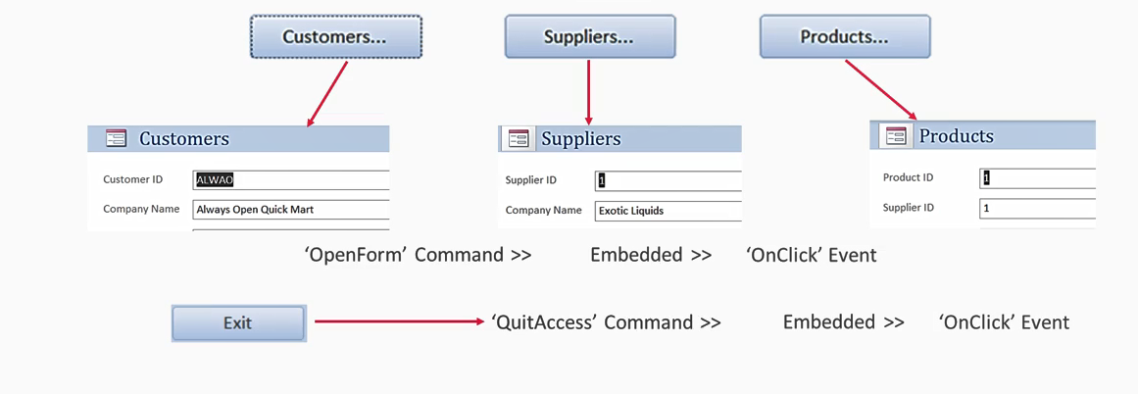
What is Macros

Slide 7
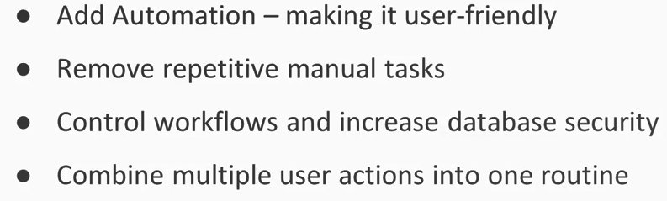
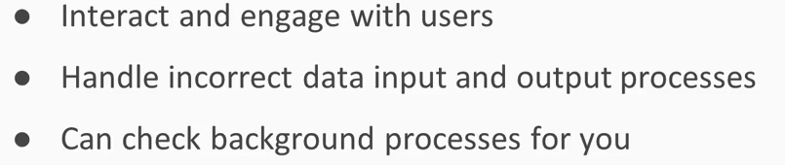
Why Using Macros

Slide 8
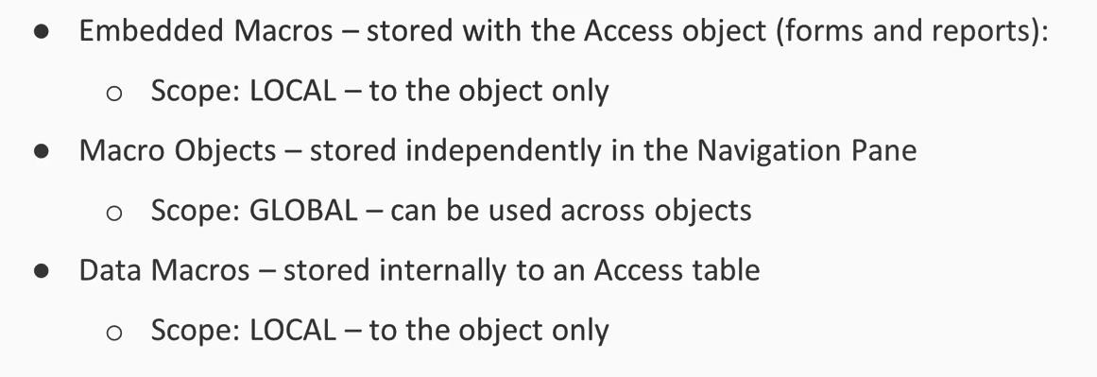
Types of Macros and Their Scopes

Slide 9


15A :
Creating a Simple
Macro Hello World

Slide 10

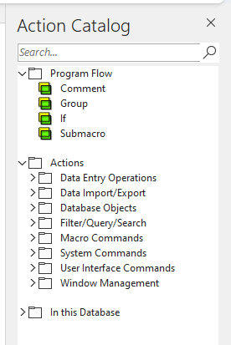
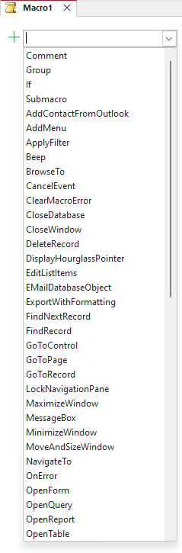
Lab 15A

Slide 11
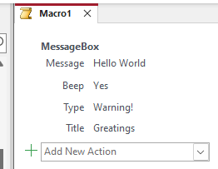
Lab 15A

Slide 12
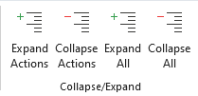
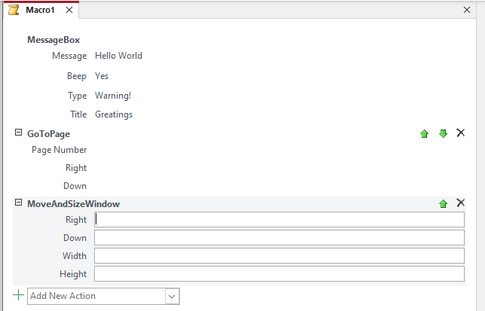
Lab 15A

Slide 13
Events
An event is the result of initiating an action on an object.
The action could be as simple as positioning the mouse on an object even without clicking (Hovering).
The action could consist of (left) clicking, right-clicking, dragging (with the mouse, or dragging with the mouse while holding a key on the keyboard), double-clicking, rolling the wheel (of a mouse), typing (with the keyboard), pressing a key, scrolling (a scroll bar), etc.
When an action is performed on an object, the object must send a message to the operating system (OS), letting the OS know that something (or what) happened.
The OS must then decide what to do, whether to respond to the message or send the message to another object.

Slide 14
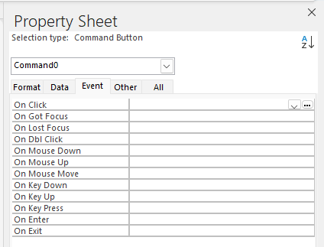
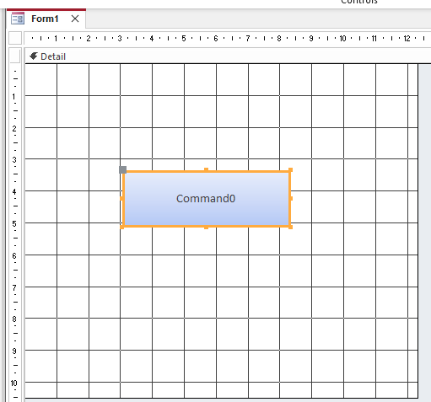

Events
Check
Send A Message

Slide 15
Events
The names of most events start with On, which means, "at the time this is done". Because most, if not all, events have to do with time, an event is said to be fired.
That is, the object fires an event at the time something happens.
When an event is fired, Microsoft Access (or rather the database engine) gathers the necessary information and composes the message to be transmitted where appropriate.
Again, remember that most events have to do with time (they are referred to as occurrences).
In some cases, something must be done before the actual action is applied. For this reason, the names of some events start with Before. When something must be taken care of after the action has applied, the event that must be used to implement the desired behavior starts with After.

Slide 16
Lab 15B:
Assign A Macro to an Event

Slide 17
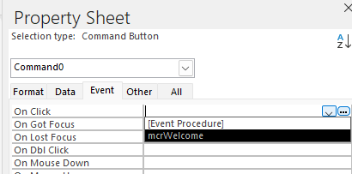
Lab 15B

Slide 18
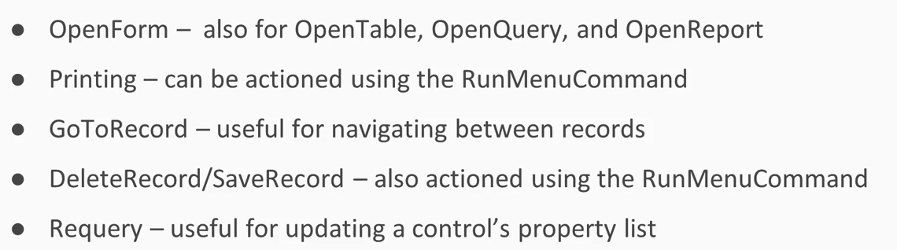
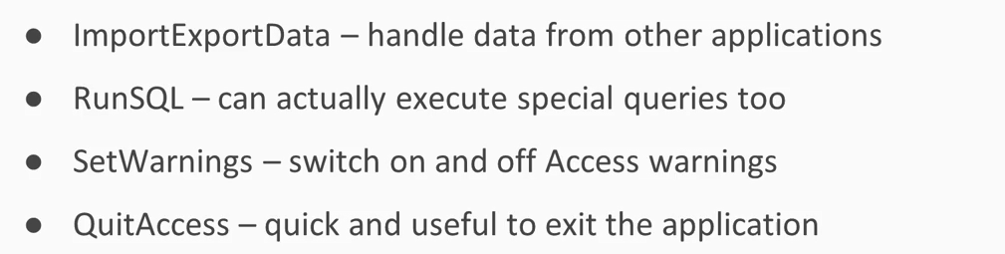
Popular Command Actions

Slide 19
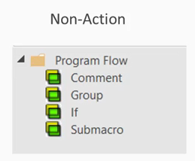
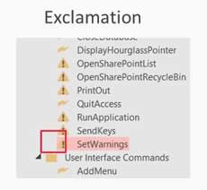
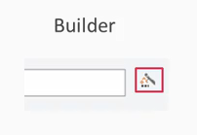
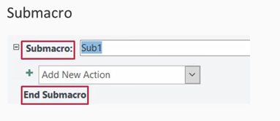

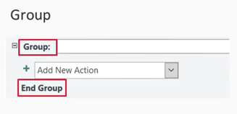
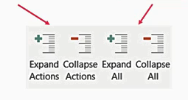
Macro Conventions

Slide 20
AutoExec Macro
AutoExec Macro is a special Macro.
AutoExec Stands for Automatically Execute.
It is a Macro that executes automatically when your database open.
You can have only ONE AutoExec Macro in each database.
And it must be named AutoExec.

Slide 21
Lab 15C:
Create AutoExxec Macro

Slide 22
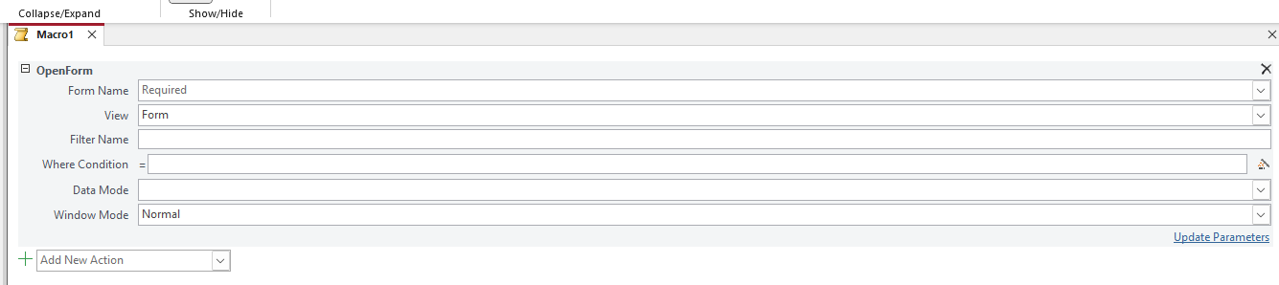
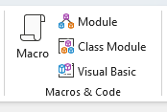
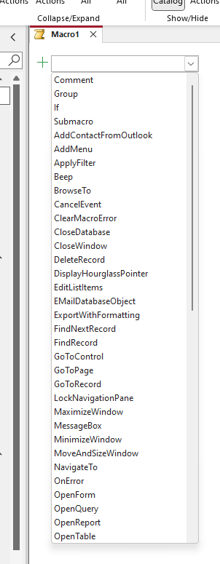
Lab 15C

Slide 23
Lab 15D:
Using Message Boxes to Notify Users

Slide 24
Lab 15E:
Automate Parameter Queries with Macros

Slide 25
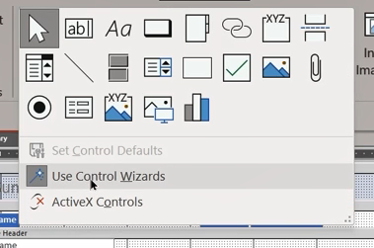
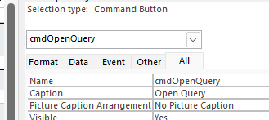
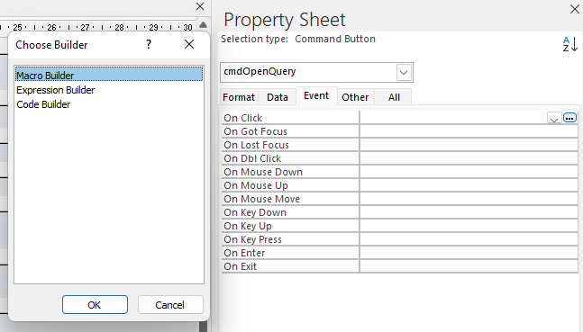
Lab 15E

Slide 26
Lab 15F:
Open a form from another form using Macro

Slide 27
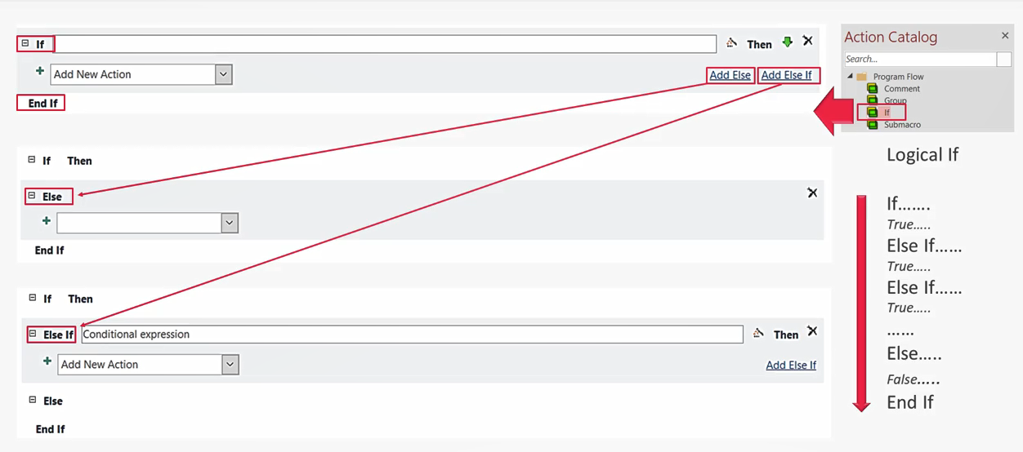
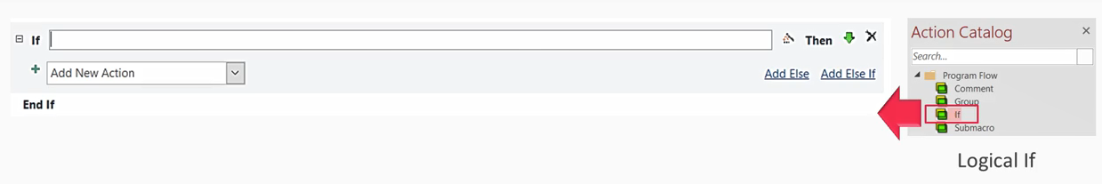
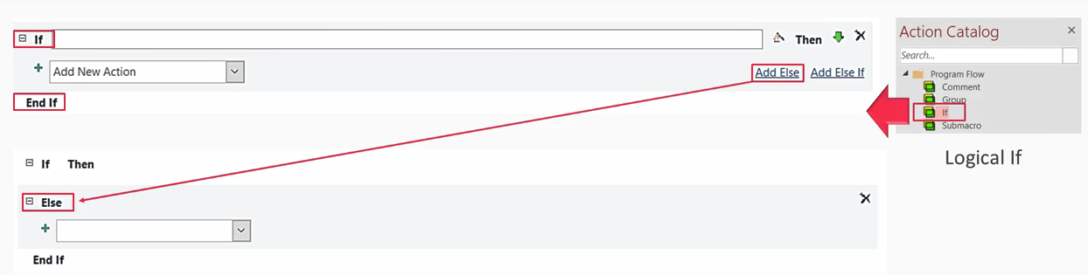
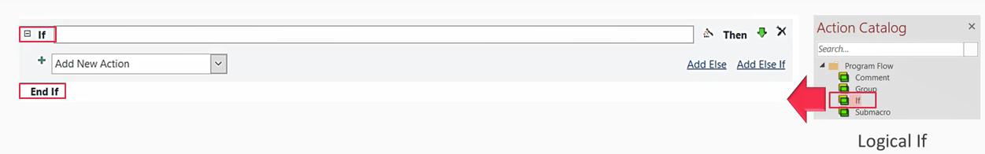
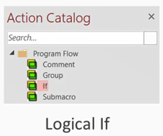
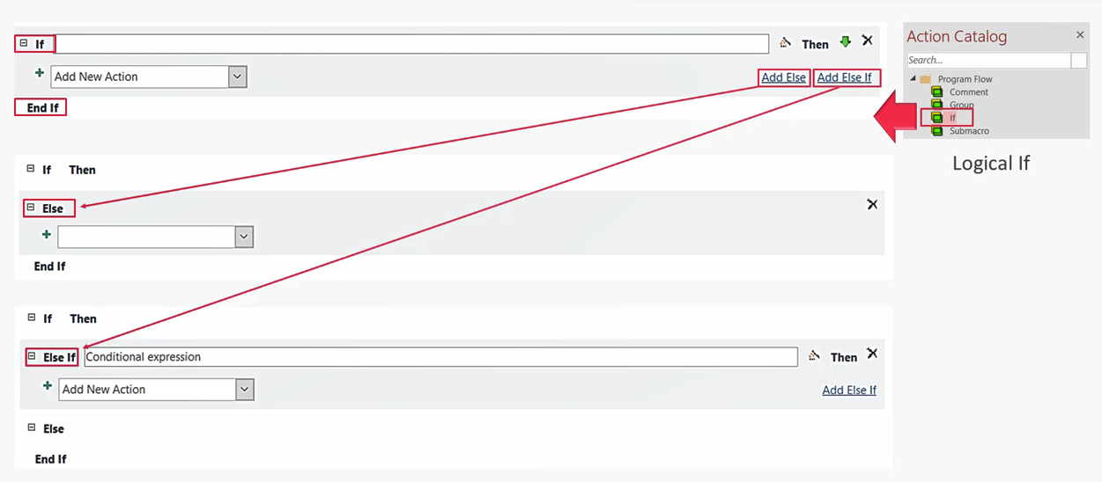
Logical IF Control Flow

Slide 28
Lab 15G:
Hiding /Unhiding
Field Controls with Macros

Slide 29
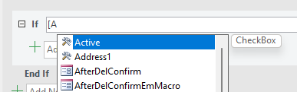
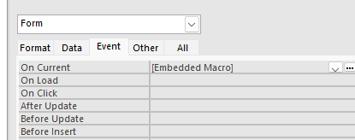
Lab 15G

Slide 30
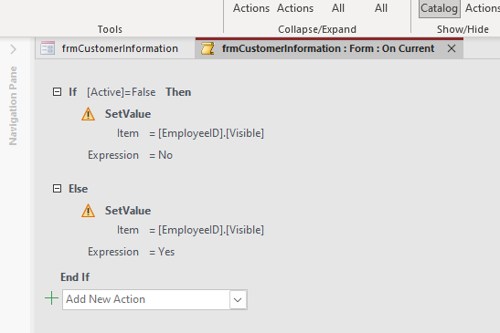
Lab 15G

Slide 31
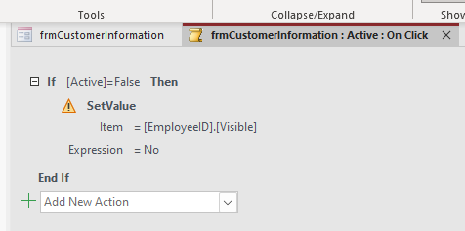
Lab 15G

Slide 32
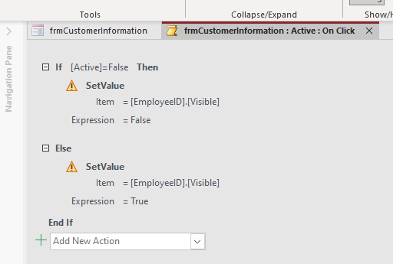
Lab 15G

Slide 33
Lab 15H:
Using Macros to
Validate Data Entry

Slide 34
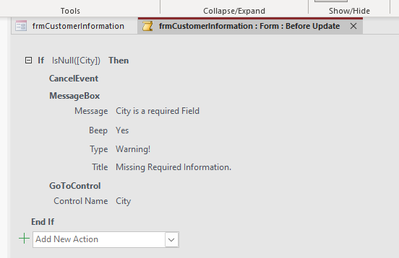
Lab 15H

Slide 35

Build Your Project Part V
Create Macro

Slide 36
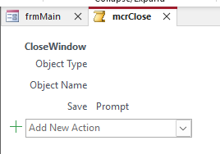
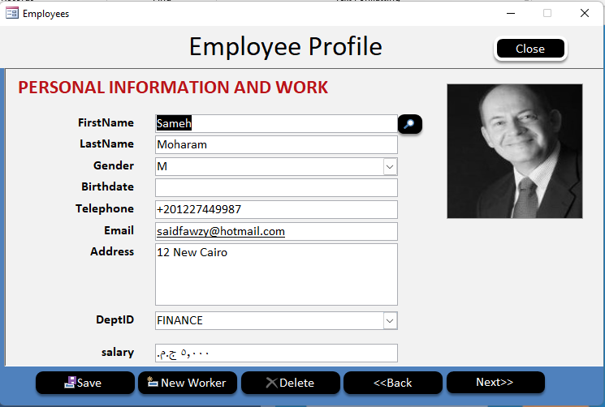
Create Macro

Slide 37


