Slide 1




2
Power BI
QUICK START
Prepared By :
Said Fawzy
Manager of Information Center
Tendering Department
Arab Contractors

Slide 2

Module 2
Extracting and Transforming Data

Slide 3
01
ETL Process
02
Connecting to flat data source
Module Contents
03
Explore Power Query
Cleaning Data
04

Slide 4
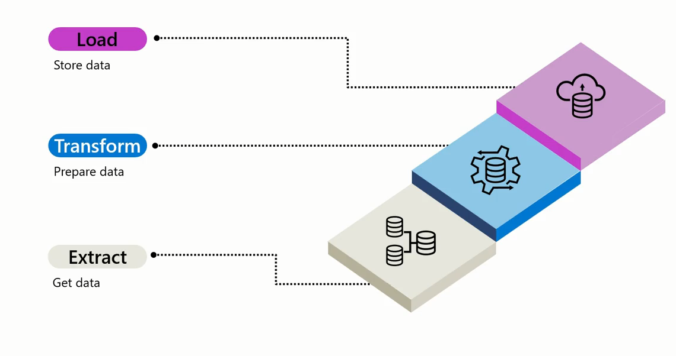

ETL Process

Slide 5




ETL Process
Extract Process

Slide 6
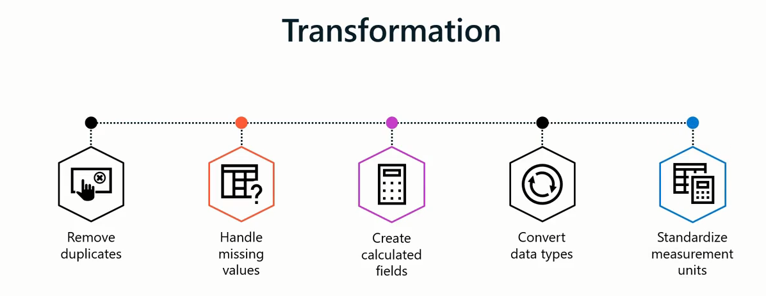
ETL Process

Slide 7
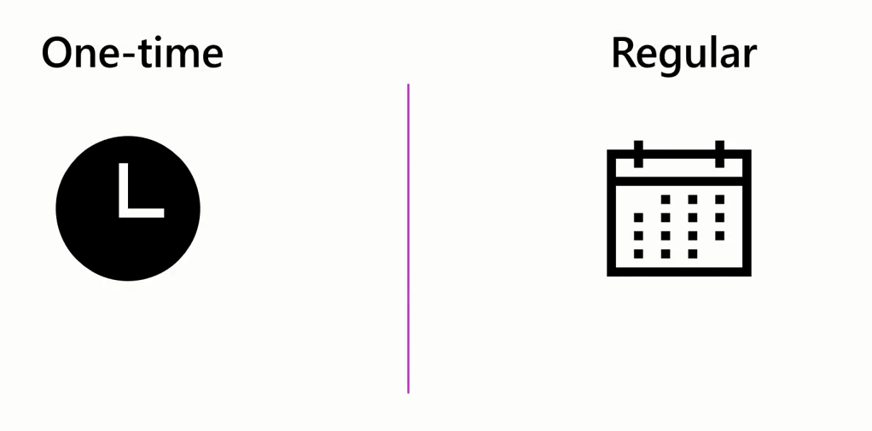
ETL Process
Load Process

Slide 8
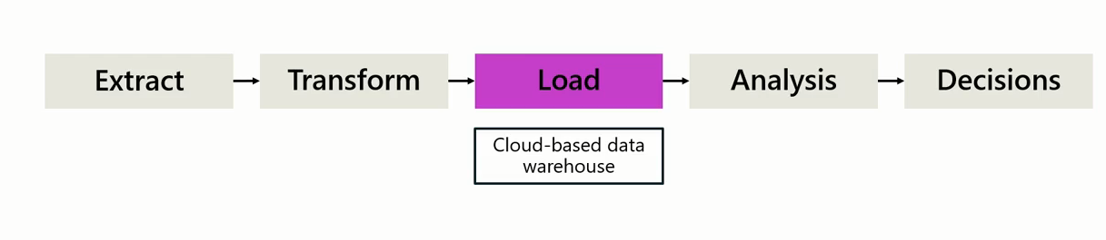
ETL Process

Slide 9

Connecting to flat data source
A flat file is a file type that contains a single data table, with a uniform structure for every row of data, and does not have hierarchies.
What is a Flat File?

Slide 10
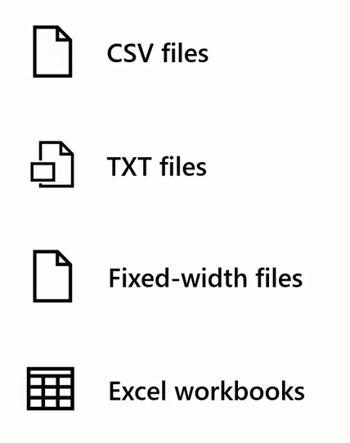
Connecting to flat data source
Examples of Flat Files

Slide 11
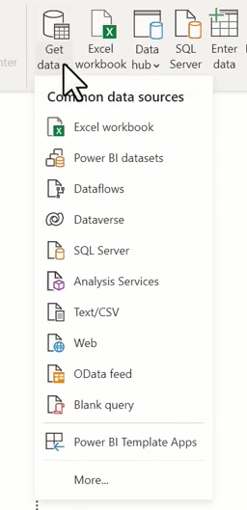
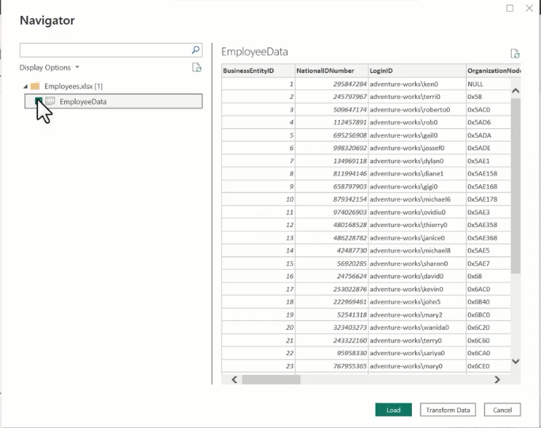
Connecting to flat data source
Set up a Flat Data source

Slide 12


Exercise 2
Connecting to Flat Data Source

Slide 13
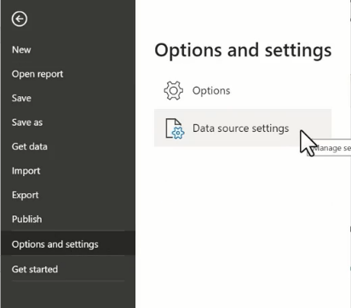
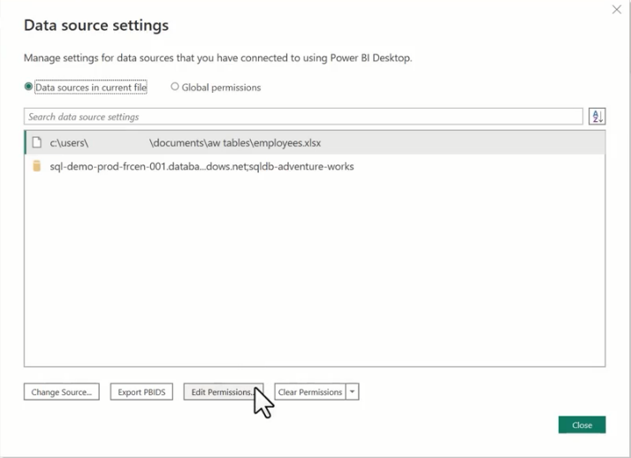
Change the location of your source file

Slide 14
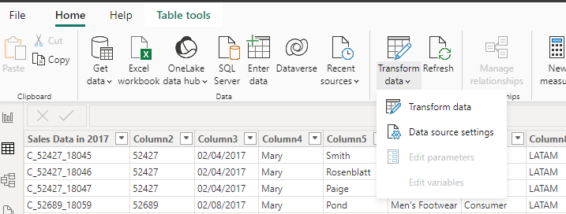
Change the location of your source file

Slide 15
Explore Powe Query
Ribbon

Slide 16
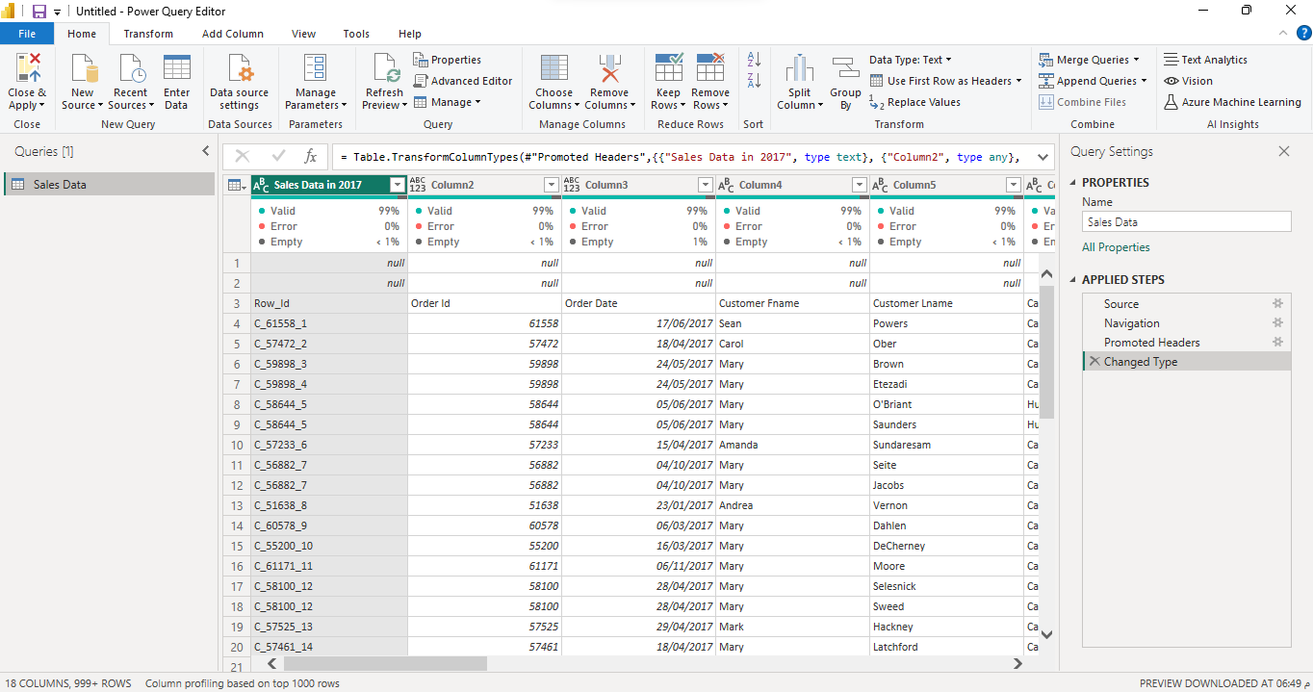
Explore Powe Query

Slide 17
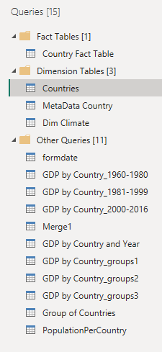
Explore Powe Query
Queries Pane

Slide 18
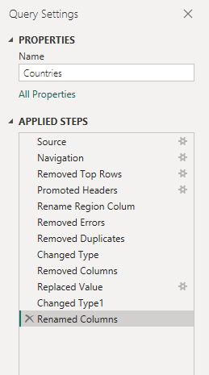
Explore Powe Query
Applied Steps

Slide 19
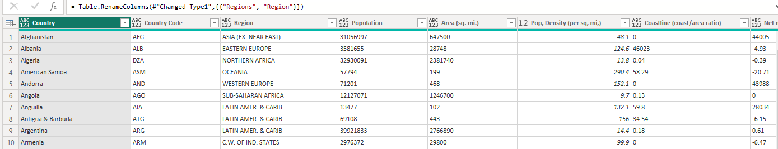
Explore Powe Query
Data Preview

Slide 20
Exercise 3
Exploring Power Query

Slide 21
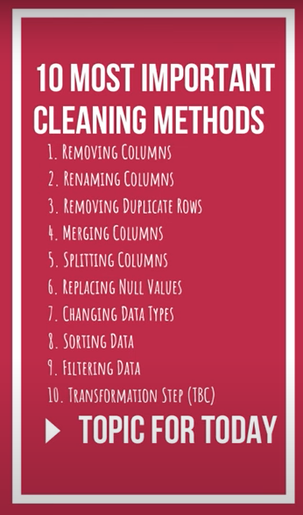
Cleaning Data

Slide 22
Exercise 4
Cleaning Data

Slide 23


