Slide 1




4
Power BI
QUICK START
Prepared By :
Said Fawzy
Manager of Information Center
Tendering Department
Arab Contractors

Slide 2
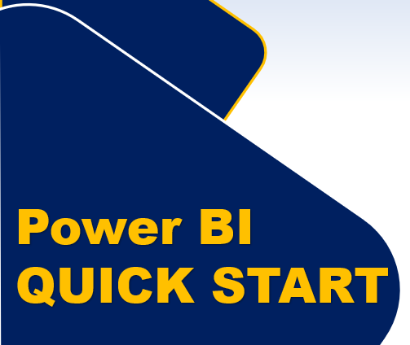
Module 4
Introduction to DAX

Slide 3
01
What is DAX
02
Calculated Columns
Module Contents
03
Measuers
IF & Aggregation Functions
04

Slide 4


What is DAX
DAX
Power BI

Slide 5
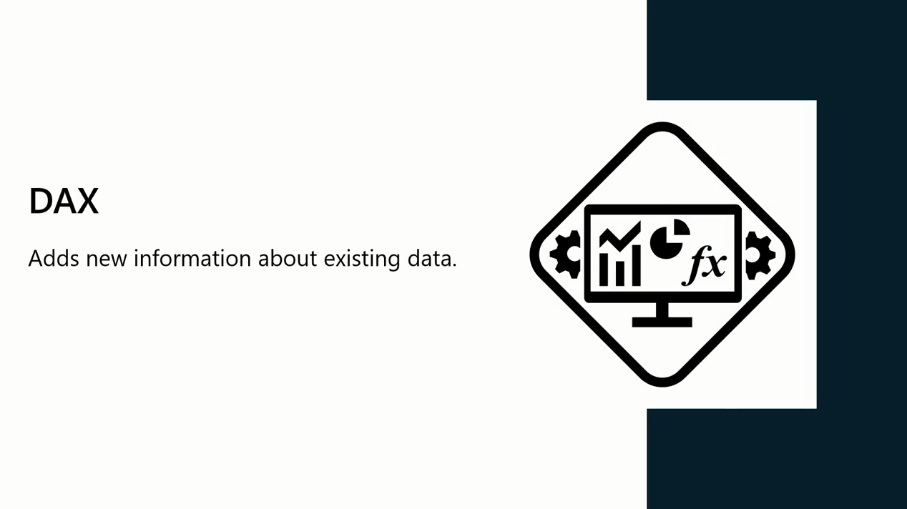
What is DAX
Data Analysis Expression

Slide 6
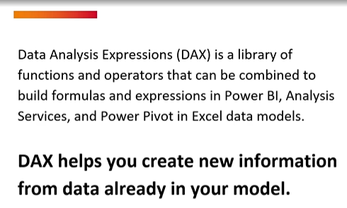
What is DAX

Slide 7
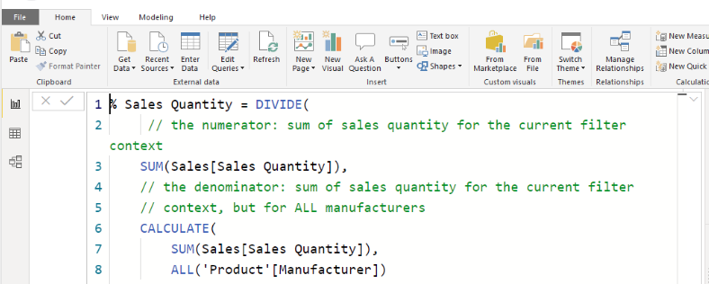
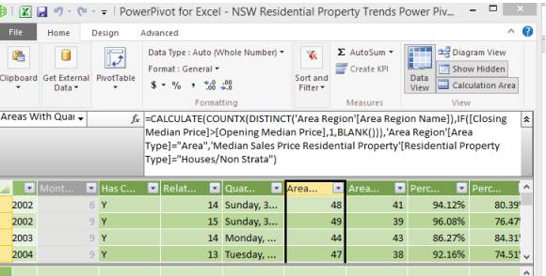
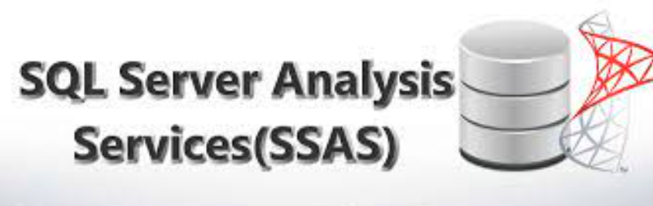
What is DAX
DAX is a programming language used in:
Microsoft SQL Server Analysis Services,
Power Pivot in Excel, and
Power BI.

Slide 8
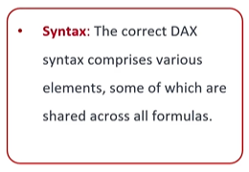
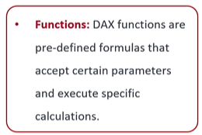
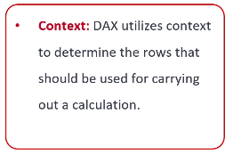
DAX Components

Slide 9
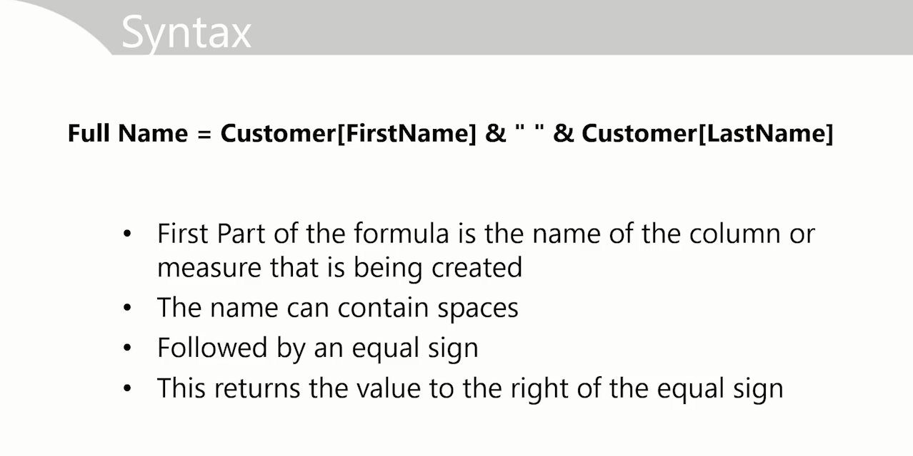
Syntax

Slide 10
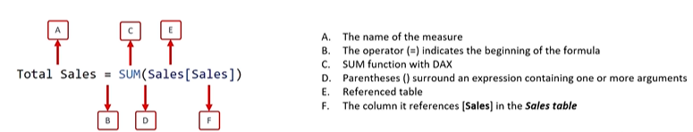
Syntax

Slide 11
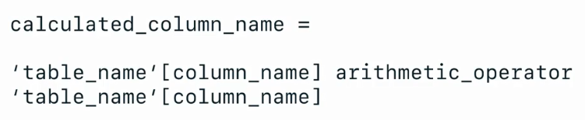
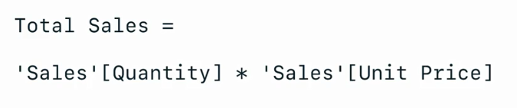
Creating a Calculated Column

Slide 12


Exercise 6
Creating Calculated Columns

Slide 13
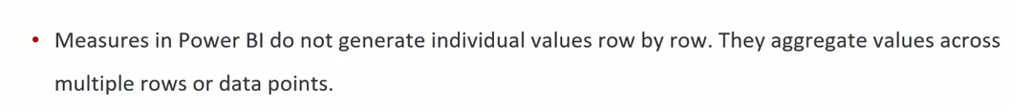
Measures

Slide 14
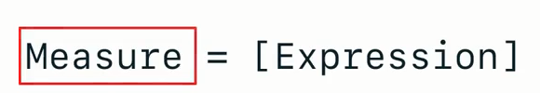
Measure Syntax
Measure Name
Example

Slide 15
Exercise 7
Creating Measures

Slide 16
Exercise 8
IF Function

Slide 17
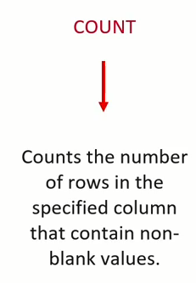
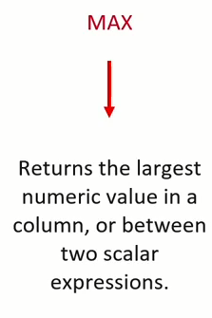
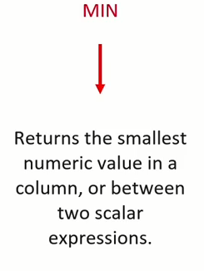
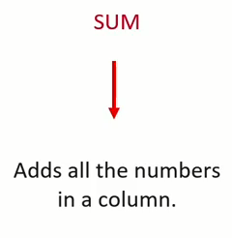
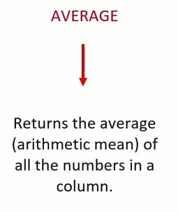
Aggregation Functions

Slide 18
Exercise 9
Creating Aggregation Function

Slide 19
Exercise 10
Organize your Measures in one table

Slide 20
Exercise 11
Create Complete Data Model

Slide 21



