Slide 1




6
Power BI
QUICK START
Prepared By :
Said Fawzy
Manager of Information Center
Tendering Department
Arab Contractors

Slide 2

Module 6
Publishing and Sharing Report

Slide 3
01
The Structure of .pbix file
02
Power BI Account
Module Contents
03
Workspaces
Dashboard
04

Slide 4
The Structure of .pbix file
SalesReport.pbix
Report
Semantic Model
Dataset
Page1
Page2
Visual 1
Visual 1
Visual 2

Slide 5
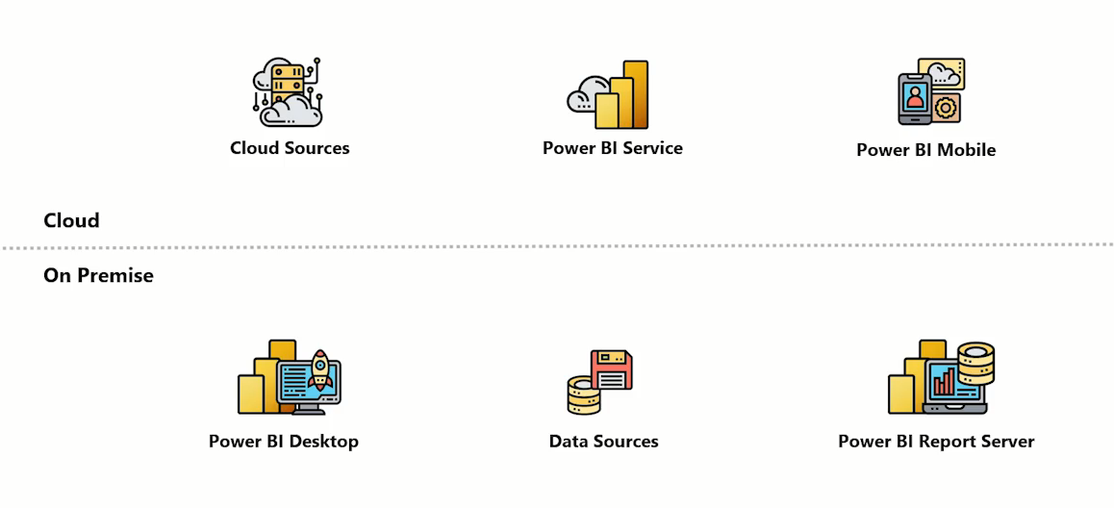
The Structure of .pbix file
Publish
Gateway
Power BI Architecture

Slide 6
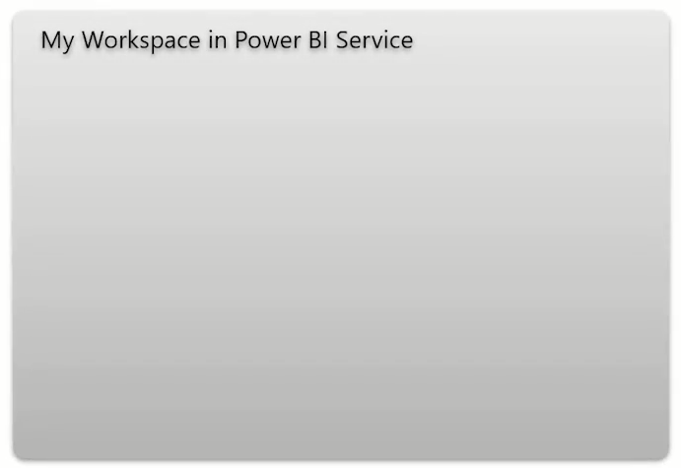

The Structure of .pbix file
SalesReport.pbix
Semantic Model
Report

Slide 7
The Structure of .pbix file
SalesReport.pbix
Semantic Model SalesReport
Report
SalesReport
Dashboard
Report
MarketReport
Semantic Model Finance
Report
MarketReport

Slide 8
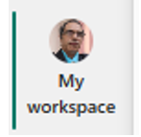

Power BI Account
Free Account
Pro Account

Slide 9
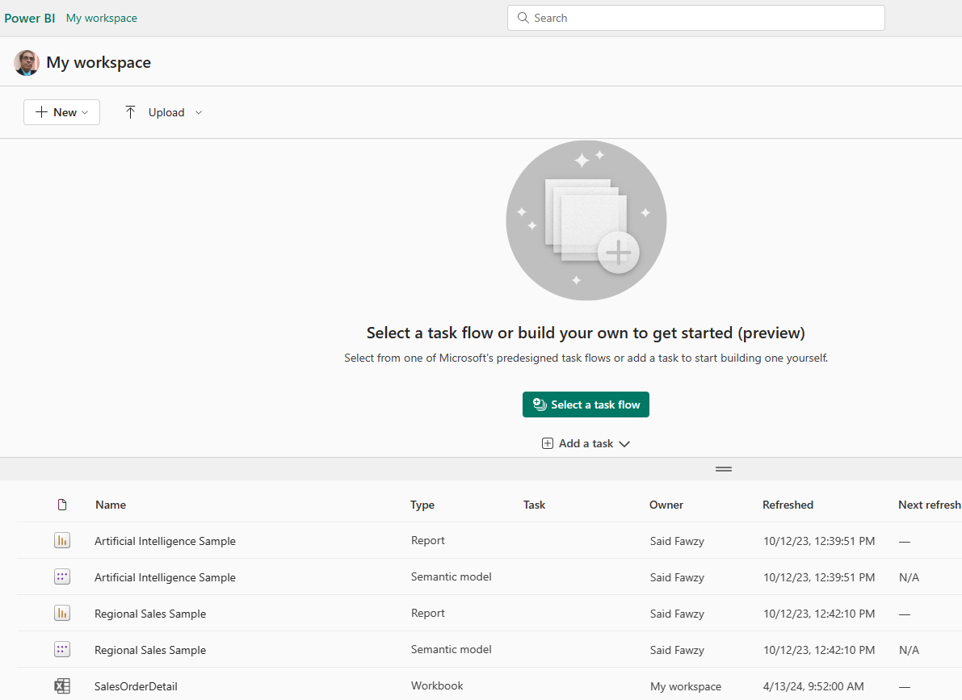
Power BI Account
Personal

Slide 10
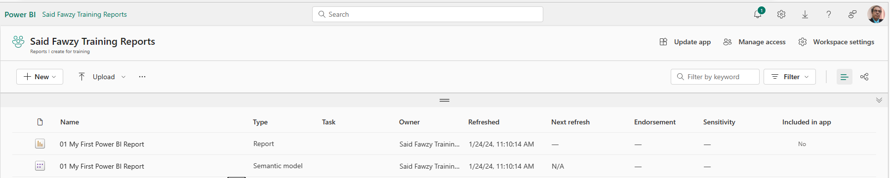
Workspaces

Slide 11
Workspaces

Slide 12


Exercise 23
Publish a Report

Slide 13




Dashboard

Slide 14
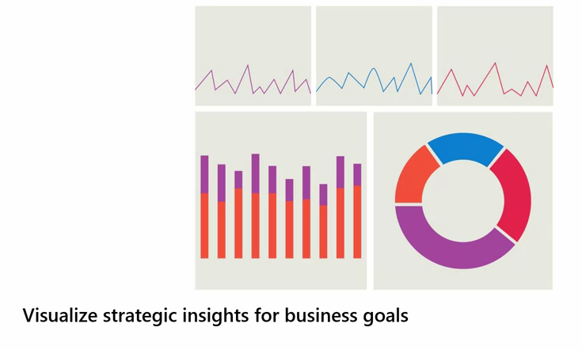
Dashboard

Slide 15
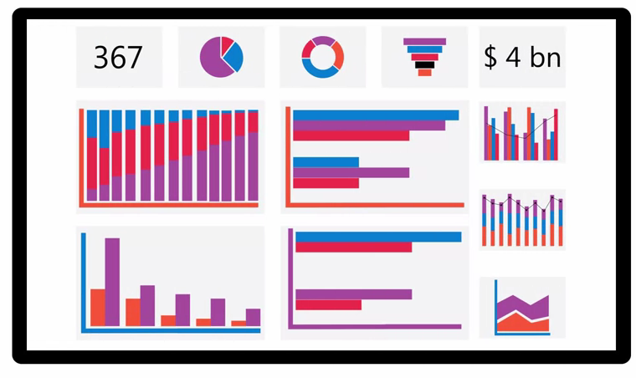
Dashboard

Slide 16
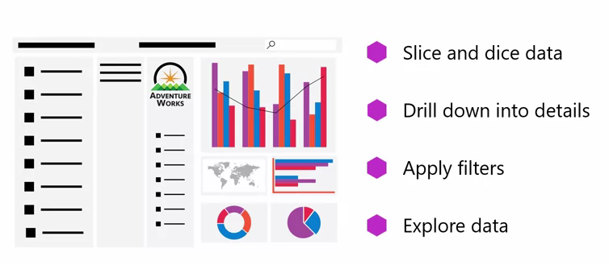
Difference between Report and Dashboard
Report

Slide 17
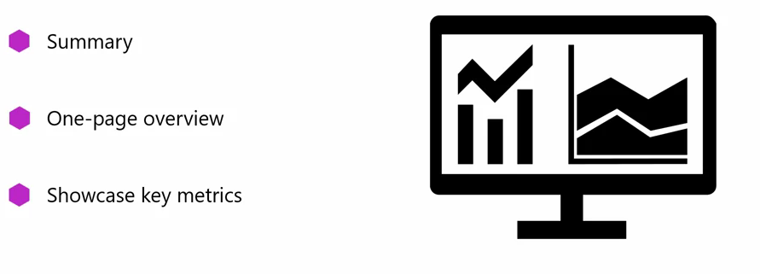
Difference between Report and Dashboard
Report
Dashboard

Slide 18

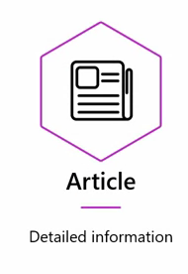
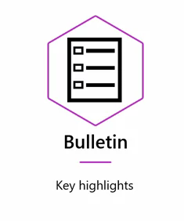
Difference between Report and Dashboard
Report
Dashboard

Slide 19
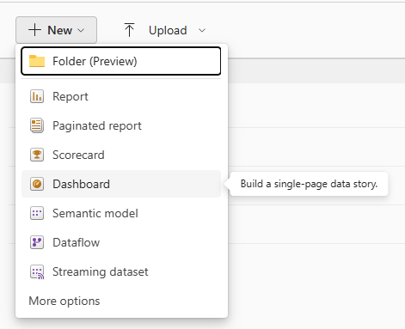
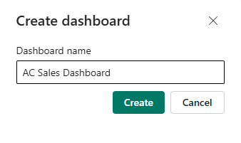
Create Dashboard

Slide 20
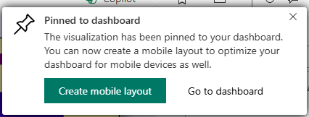
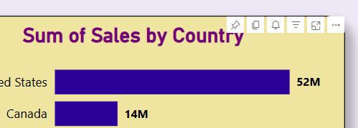
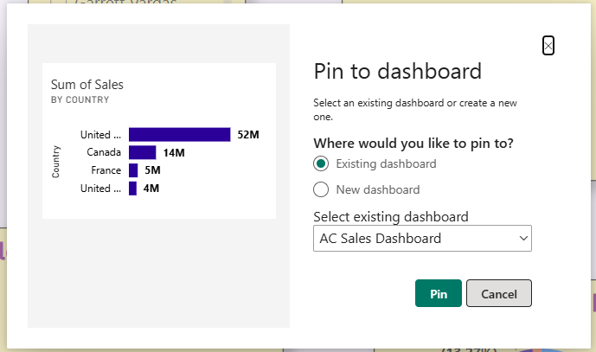
Create Dashboard

Slide 21
Exercise 24
Create a Dashboard

Slide 22



