Slide 1




7
Power BI
QUICK START
Prepared By :
Said Fawzy
Manager of Information Center
Tendering Department
Arab Contractors

Slide 2

Module 7
Final Project

Slide 3
01
Create Report
02
Publish Your Report
Module Contents
03
Create Dashboard

Slide 4
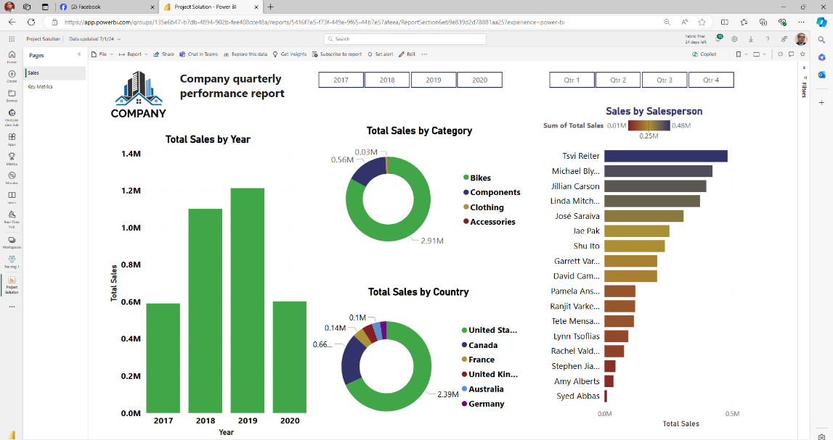
Create And Publish Sales Report

Slide 5


Final Project
Create And Publish Sales Report

Slide 6



