Slide 1




Preparing Data for
Analysis with
Microsoft Excel
Prepared By :
Said Fawzy
Manager of Information Center
Tendering Department
Arab Contractors

Slide 2
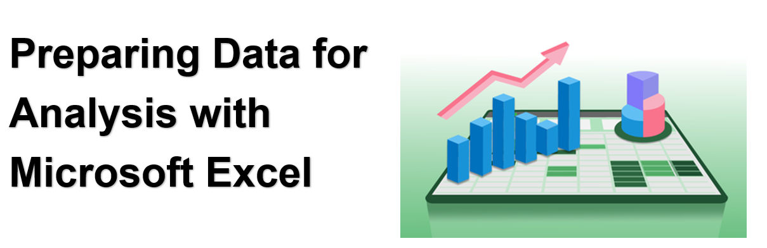
Introduction
Prepared By :
Said Fawzy
Manager of Information Center
Tendering Department
Arab Contractors

Slide 3
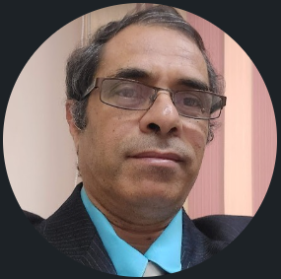

Contact
Cert.
Cert.
Certif.
Quali
JOB
Said Fawzy
Manager of Information Center
Quality Manager
Tendering Department
Arab Contractors

Slide 4
Contact
Cert.
Cert.
Cert.
Quali.
JOB
Said Fawzy
Manager of Information Center
Quality Manager
Tendering Department
Arab Contractors

Slide 5


B.SC In Civil Engineering
1987
Alex University
Contact
Cert.
Cert.
Cert.
Quali.
JOB
Said Fawzy
Manager of Information Center
Tendering Department
Arab Contractors
High Diploma in Construction Project Management
1998
Ein Shams
University

Slide 6



Microsoft Certified Professional (MCP)
1999
B.SC In Civil Engineering
1987
Certified Internet Webmaster(CIW)
2000
Alex University
Contact
Cert.
Cert.
Cert.
Quali.
JOB
Said Fawzy
Manager of Information Center
Tendering Department
Arab Contractors
High Diploma in Construction Project Management
2001
Oracle Certified Master (OCM)
1998
Ein Shams
University
Microsoft Certified Technology Specialist(MCTS)
2006

Slide 7



Microsoft Certified Professional (MCP)
1999
Lead Auditor Quality Management Systems
B.SC In Civil Engineering
2009
1987
Certified Internet Webmaster(CIW)
2000
Alex University
Contact
Cert.
Cert.
Cert.
Quali.
JOB
Said Fawzy
Manager of Information Center
Tendering Department
Arab Contractors
High Diploma in Construction Project Management
2001
Oracle Certified Master (OCM)
1998
Lead Auditor Quality Management Systems
Ein Shams
University
2016
Microsoft Certified Technology Specialist(MCTS)
2006

Slide 8

Advanced Data Analysis Nanodegree
2021
Microsoft Certified Professional (MCP)
1999
Lead Auditor Quality Management Systems
B.SC In Civil Engineering
2009
1987
2022
2000
Nanodegree UX Research Cross-Skilling
Certified Internet Webmaster(CIW)
Alex University
Contact
Cert.
Cert.
Cert.
Quali.
JOB
Said Fawzy
Manager of Information Center
Tendering Department
Arab Contractors
High Diploma in Construction Project Management
2022
2001
Nanodegree Advanced Marketing Analytics
1998
Oracle Certified Master (OCM)
Lead Auditor Quality Management Systems
Ein Shams
University
2016
2023
2006
Microsoft Certified Technology Specialist(MCTS)
IBM Certified Data Analysist Professional

Slide 9


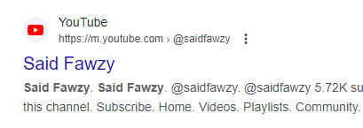
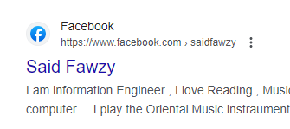
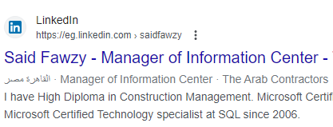


Advanced Data Analysis Nanodegree
2021
Microsoft Certified Professional (MCP)
1999
Lead Auditor Quality Management Systems
B.SC In Civil Engineering
2009
1987
2022
2000
Nanodegree UX Research Cross-Skilling
Certified Internet Webmaster(CIW)
Alex University
Contact
Cert.
Cert.
Cert.
Quali.
JOB
Said Fawzy
Manager of Information Center
Tendering Department
Arab Contractors
High Diploma in Construction Project Management
2022
2001
Nanodegree Advanced Marketing Analytics
1998
Oracle Certified Master (OCM)
Lead Auditor Quality Management Systems
Ein Shams
University
2016
0122 744 99 87
2023
2006
Microsoft Certified Technology Specialist(MCTS)
IBM Certified Data Analysist Professional
Saidfawzy@arabcont.com
Said_fawzy@hotmail.com

Slide 10


Slide 11
Chapter 1
Introduction to Microsoft Excel
Chapter 2
Working With Blocks of Data
Chapter 3
Formula in Excel
Chapter 4
Functions in Excel
Chapter 5
Using Functions to Clean Text

Slide 12
Chapter 6
Date and Time Functions
Chapter 7
Logical Functions
Chapter 8
Final Project

Slide 13

Training
Tell me I will forget.
Show me I might remember something.
Let me do it I will understand.

Slide 14



How would we train?
Exercise

Slide 15
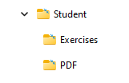
How would we train?

Slide 16





Slide 17



You are Allowed to Talk
about anything except
Religion
Soccer
Policy

Slide 18


