Slide 1




6
Date and Time Functions
Prepared By :
Said Fawzy
Manager of Information Center
Tendering Department
Arab Contractors

Slide 2

1
Understand date and time calculations
2
Dynamic date and time entries

Slide 3
Understand date and time calculations
1

Slide 4


Slide 5


Slide 6


Slide 7


Slide 8
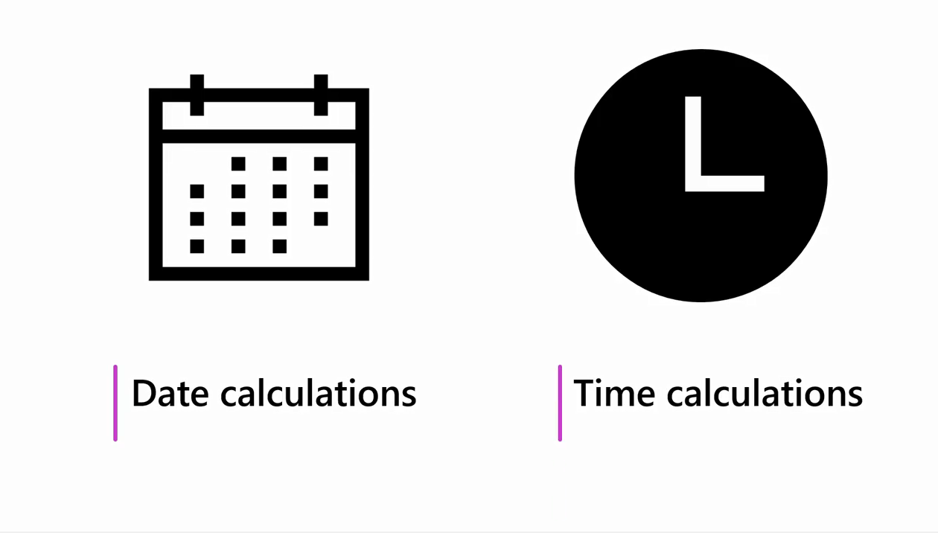

Slide 9

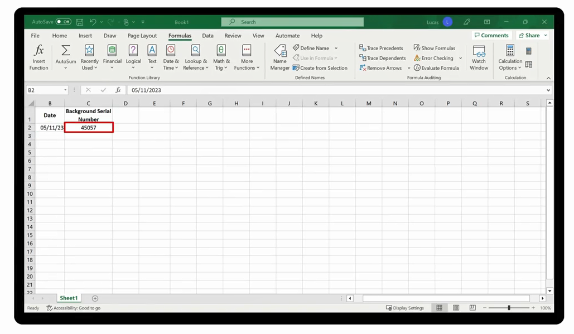
1 Jan 1900

Slide 10
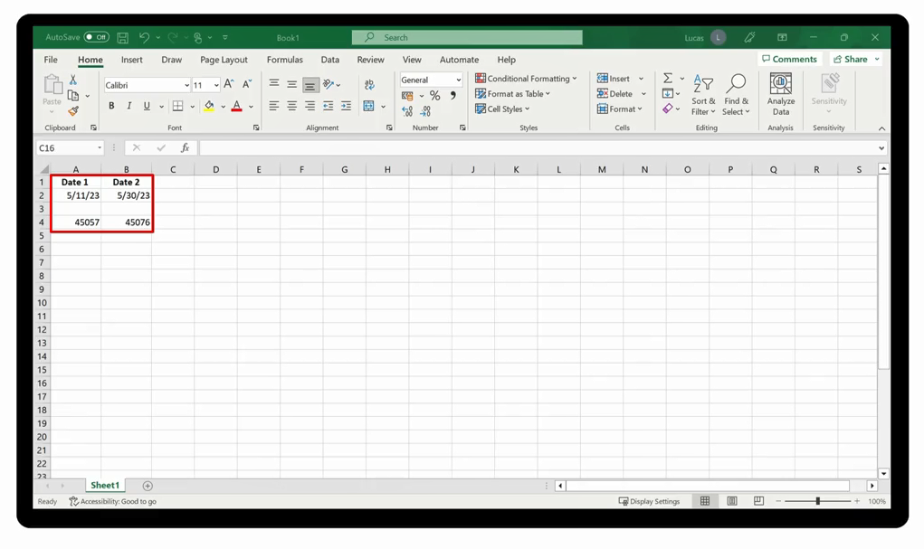

Slide 11


Slide 12

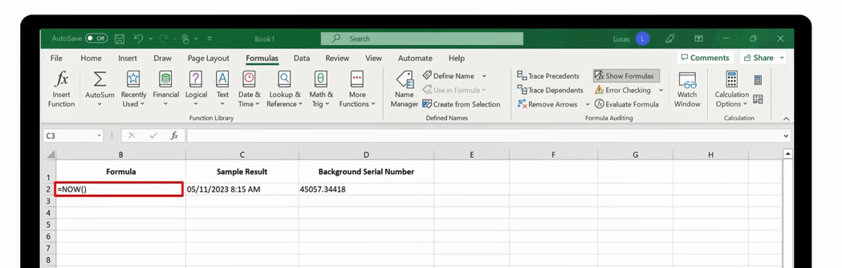

Slide 13
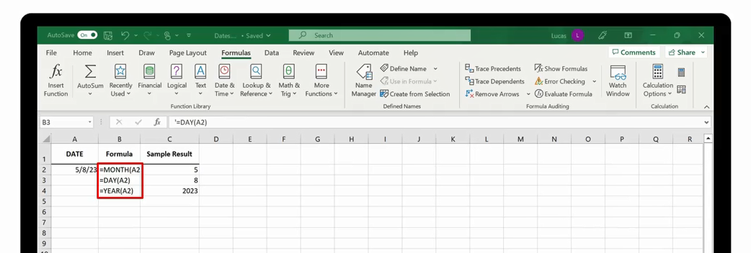

Slide 14

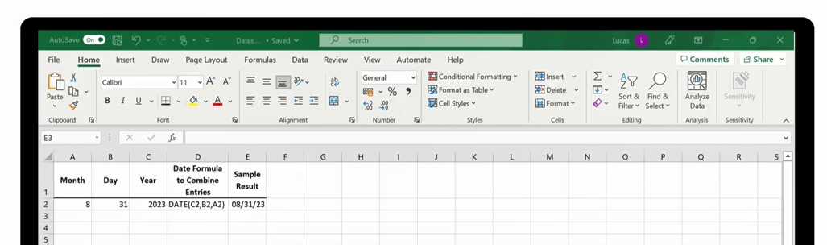

Slide 15

Question 6-1
The date 05/30/23 has a serial number of 45076. What serial number will the date 05/31/23 have?
    45077
    45078
    45079

Slide 16

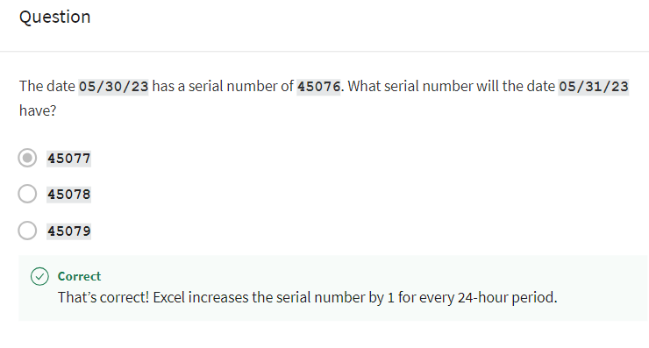
Question 6-1
Explanation

Slide 17
2
Dynamic date and time entries

Slide 18

Demo 6

Slide 19
Question 6-2
How many arguments does the TODAY function require?
    None
    One
    Two

Slide 20
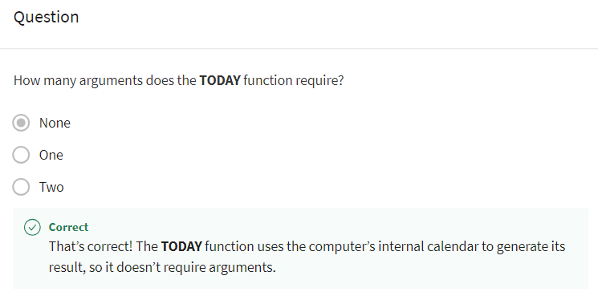
Question 6-2
Explanation

Slide 21
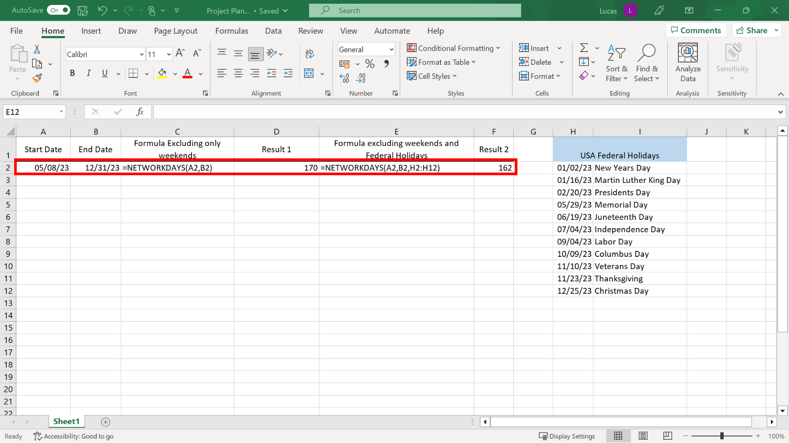
NETWORKDAYS

Slide 22
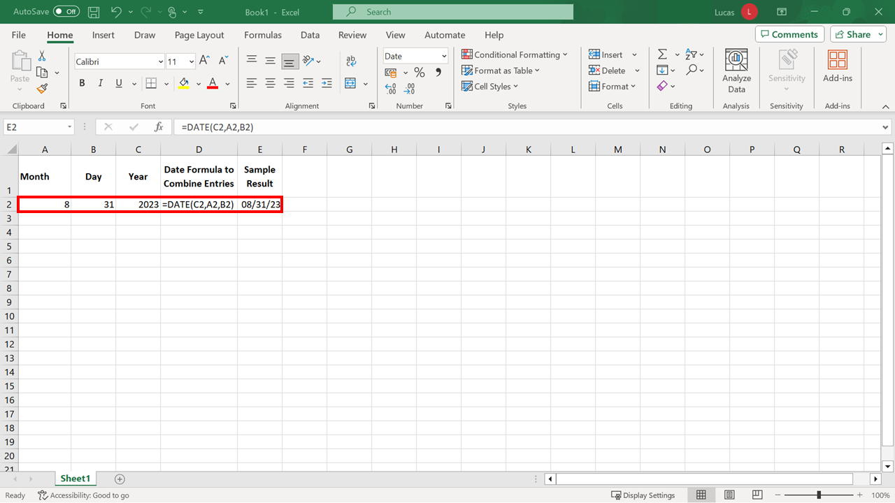
DATE

Slide 23
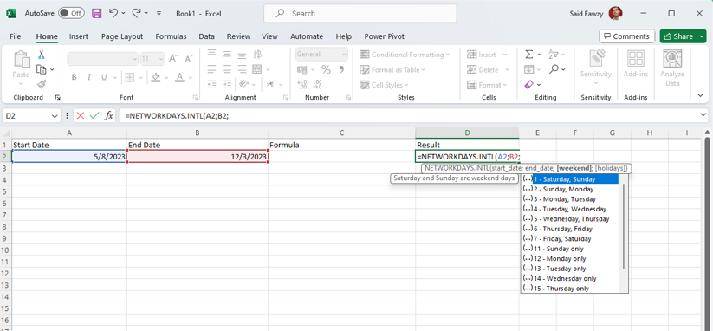
NETWORKDAYS.INTL

Slide 24


Exercise 6:
Calculating the number of working days remaining in the year.

Slide 25

Exercise Questions
Question 1
In the spreadsheet, you were asked to create a formula using the MONTH function. The formula was:
=MONTH(D5)
Cell D5 contained the entry 07/02/23. This date is in American format. What was the result of this calculation?
    2
    7
    2023

Slide 26
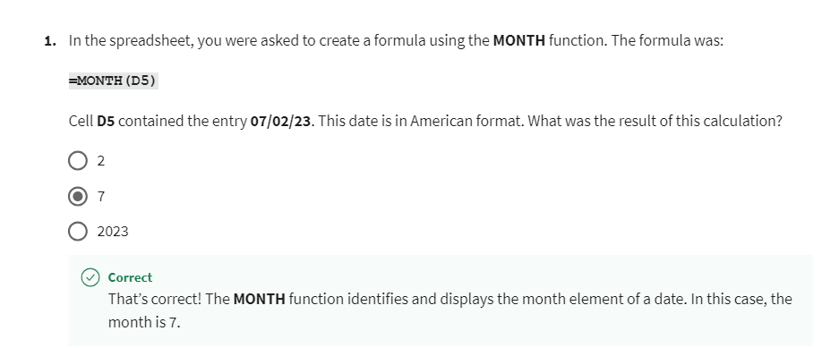
Exercise Questions
Explanation

Slide 27
Exercise Questions
Question 2
True or False: The result of your TODAY function in cell B1 changes each time the formulas in the worksheet recalculate.
    True
    False

Slide 28
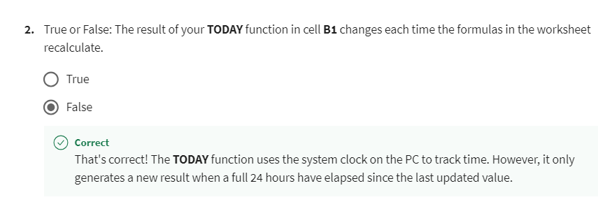
Exercise Questions
Explanation

Slide 29
Exercise Questions
Question 3
You created a formula using the NETWORKDAYS function. You added two arguments for the function, which were the start date, and the end date. What data did the formula automatically exclude from the result?
    Any holiday date
    Any weekend date
    Any weekend and holiday date

Slide 30
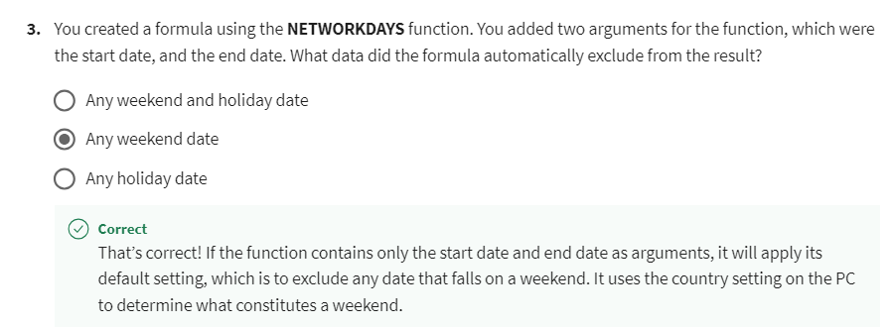
Exercise Questions
Explanation

Slide 31


Slide 32

6
Question 1
You have created a formula in your spreadsheet using the TODAY function. What must you include after the word TODAY in your formula?
    An opening and closing parenthesis and one space.
    An opening and closing parenthesis and two spaces.
    An opening and closing parenthesis only.

Slide 33
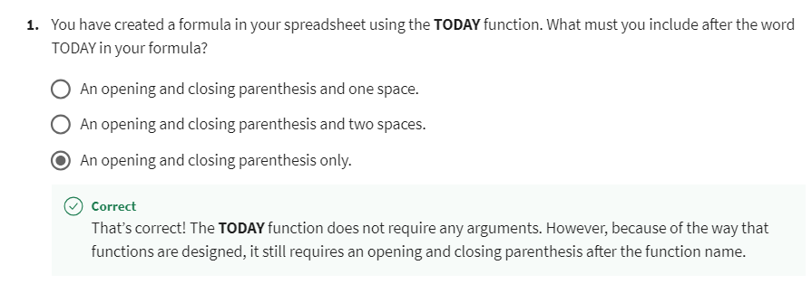
6
Explanation

Slide 34
6
Question 2
You have created a formula in your spreadsheet using the NOW function. By default, what will the formula display in its result?
    The date only.
    The time only.
    The date and time.

Slide 35
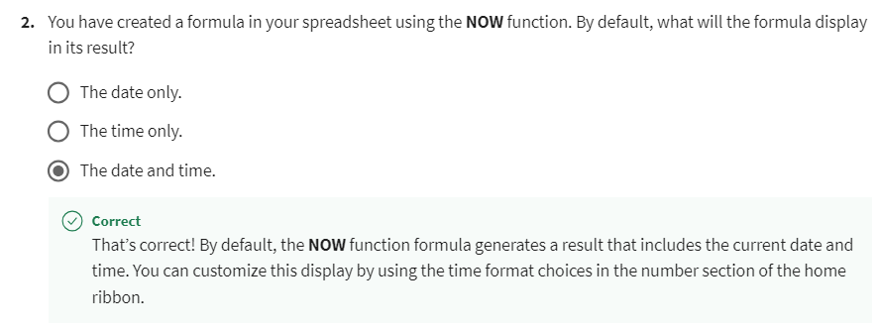
6
Explanation

Slide 36
6
Question 3
You are working on a spreadsheet that contains three columns called Day, Month and Year. In another column, you would like to combine these entries so that it shows a complete date. Which function should you use to achieve this?
    DATE
    DATEDIF
    CONCAT

Slide 37
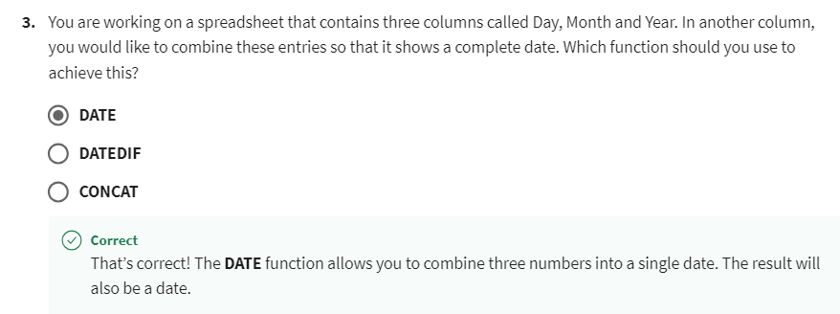
6
Explanation

Slide 38
6
Question 4
True or False: You can use the NETWORKDAYS.INTL function to calculate the number of working days between two dates while excluding national holidays and weekends because it has built-in knowledge of public holidays.
    True
    False

Slide 39
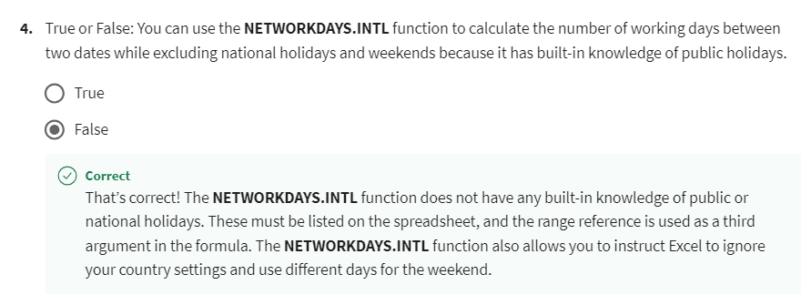
6
Explanation

Slide 40
6
Question 5
You have entered the following three dates in your spreadsheet in the month, day and year format. Which of these dates has the largest serial number?
    04/15/2020
    09/10/2025
    01/30/2023

Slide 41
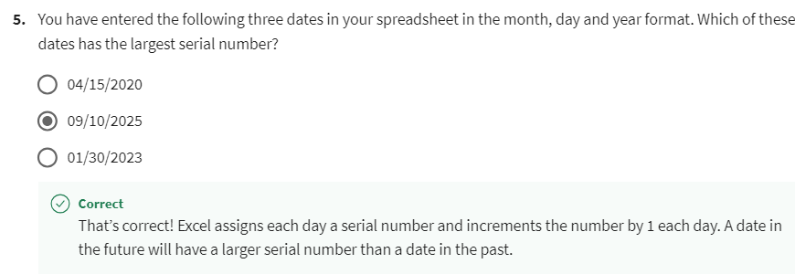
6
Explanation

Slide 42


