Slide 1




8
Final Project
Prepared By :
Said Fawzy
Manager of Information Center
Tendering Department
Arab Contractors

Slide 2

1
Creating an executive data summary
2
Final Exam
3
Working with rows and columns
4
Working with worksheets

Slide 3

Creating an executive data summary

Slide 4
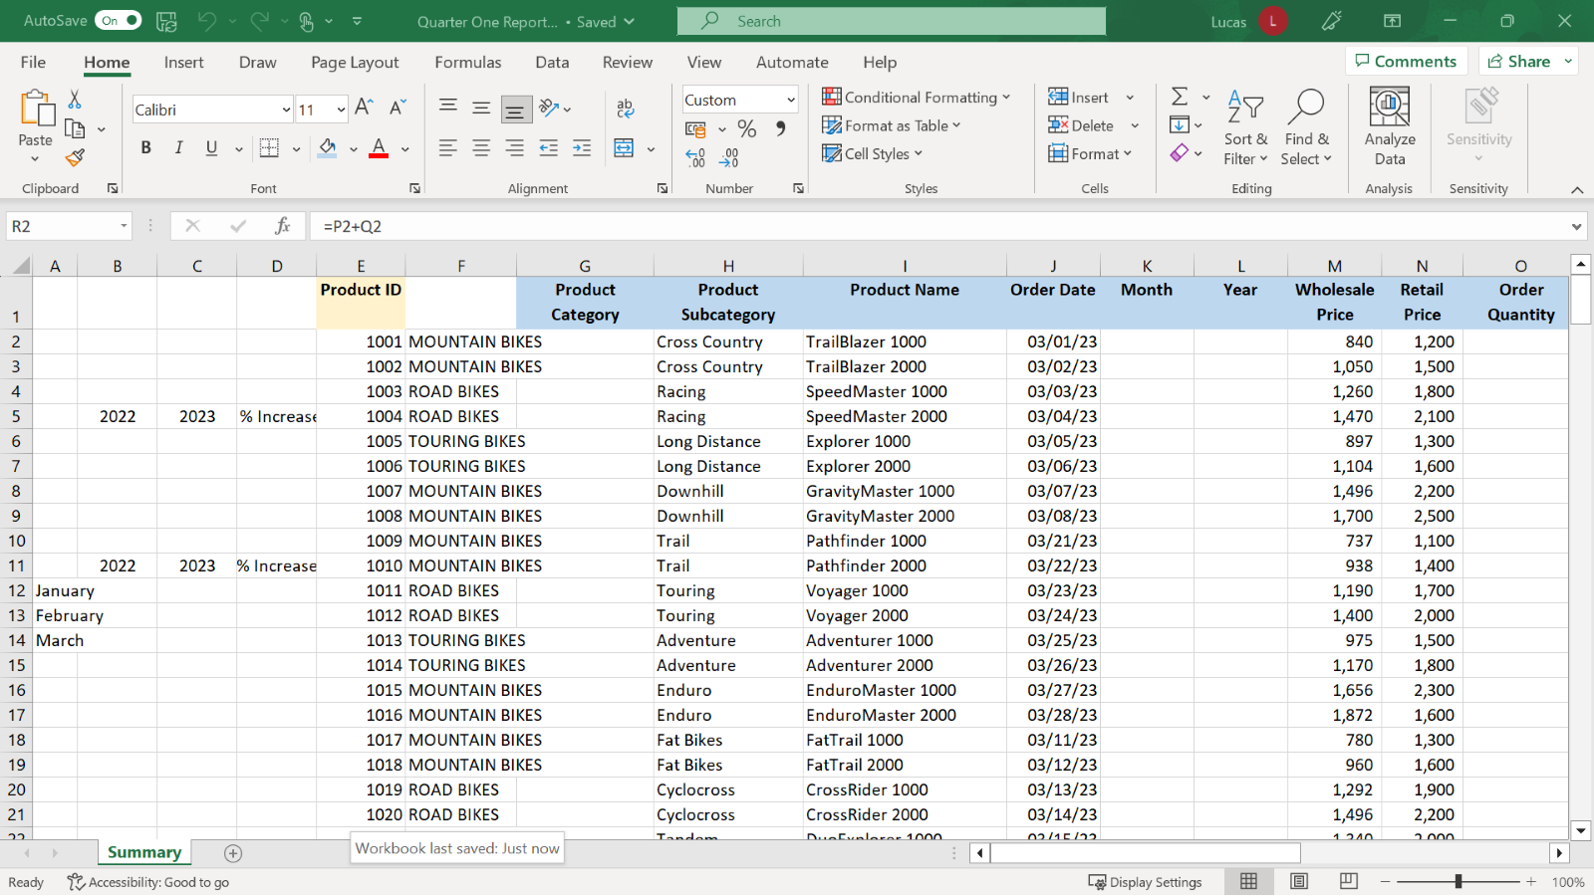

Slide 5
Case study
Jamie is attending a management meeting. She has been asked to prepare an Excel worksheet that presents sales figures for the first quarter of the year and compares these figures to the results for the same period in the previous year.
This worksheet is called Summary and is in the workbook Quarter One Report.xlsx. In this worksheet, you’ll need to complete the following actions:
  Create formulas that show the total quarter-one sales for both 2022 and 2023.
  Create formulas that show the percentage increase in sales in 2023.
  And break down these totals by month with the use of further calculations.
help Jamie to complete this worksheet.

Slide 6
Step1: Project file
Use file Final Project.xlsx.

Slide 7
Step 2: Add and format headings.

Slide 8
Step 3: Customize and reorganize how the data is displayed

Slide 9
Step 4: Use formulas to create new row information

Slide 10
Step 5: Create formulas to calculate and compare the profit margin across two years.

Slide 11
Final Project Questions

Slide 12
Question 1
You had to freeze the screen so that the summary data in columns A to F and the headings in row 1 were always visible. On the Freeze drop-down options in the View ribbon, which choice did you make?
    Freeze First Column
    Freeze Top Row
    Freeze Panes

Slide 13
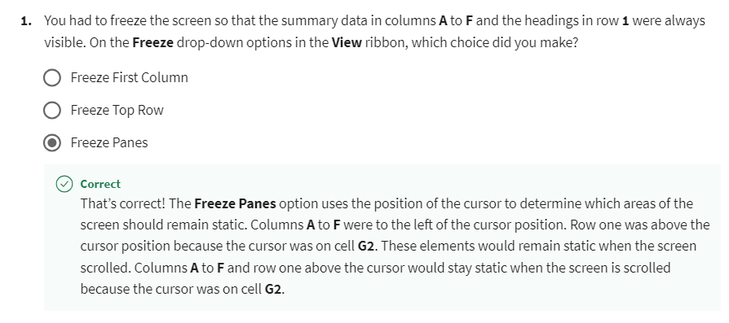
Explanation

Slide 14
Question 2
You created the following formula in cell B12 to calculate the total sales for January 2022.
=SUMIF(K2:K103,1,R2:R103)
Before copying this formula down to cells B13 and B14, which references did you need to add dollar signs to?
    R2:R103 only
    K2:K103 only
    K2:K103 and R2:R103

Slide 15
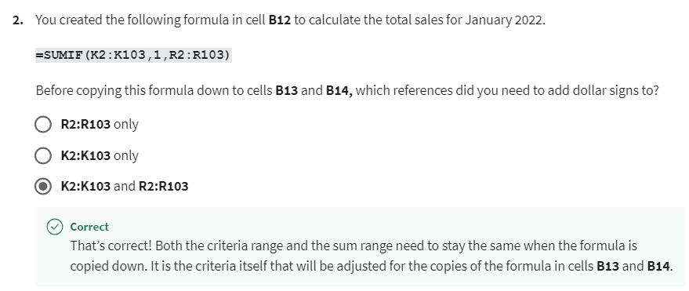
Explanation

Slide 16
Question 3
In cell D6, you created a formula to work out the percentage difference between the 2022 quarter-one sales and the 2023 quarter-one sales. Which of the following describes the logic of how this calculation should be designed?
    (2023 total – 2022 total)/2023
    (2022 total – 2023 total)/2022 total
    (2023 total-2022 total)/2022 total

Slide 17
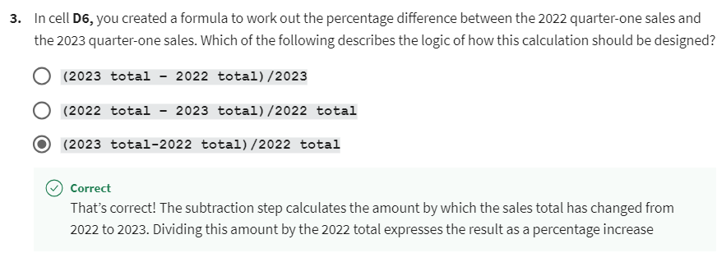
Explanation

Slide 18
Question 4
In cell C12 you used SUMIF to calculate the total sales for January 2023 and then copied that formula down to cells C13 and C14. When you completed the exercise, what result was generated in C14?
    $164,740
    $143,555
    $145,535

Slide 19
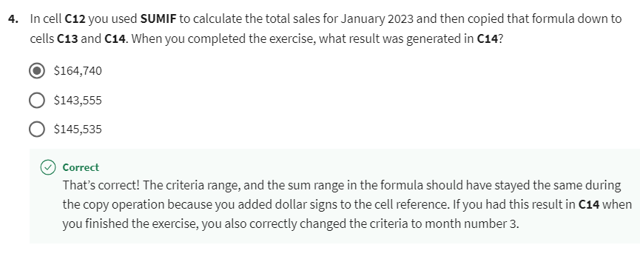
Explanation

Slide 20
Question 5
The headings you added in rows 4 and 10 had to be centered across the tables of information that they related to by using the Merge & Center choice on the Home ribbon. Before selecting the Merge & Center button you typed the heading and then highlighted the cell range that the heading had to be centered in. Where should you type the heading before selecting Merge & center?
    In the middle of the cell range the heading is to be centered in.
    On the left edge of the cell range the heading is to be centered in.
    On the right edge of the cell range the heading is to be centered in.

Slide 21
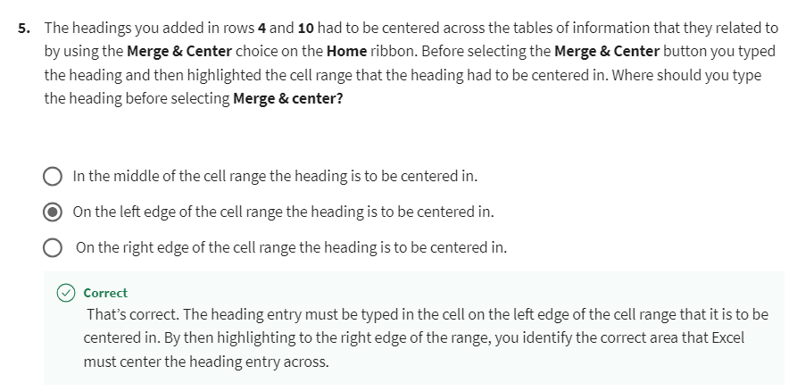
Explanation

Slide 22


Slide 23


