Slide 1





4 Transforming Data in Power BI
Prepared By :
Said Fawzy
Manager of Information Center
Tendering Department
Arab Contractors

Slide 2

4 Transforming Data
in Power BI
Prepared By :
Said Fawzy
Manager of Information Center
Tendering Department
Arab Contractors

Slide 3

1
Why Data Need to Be Transformed.
2
Introduction to Power Quey
3
The Applied Steps List
4
Data Types

Slide 4
1
Why Data Need to Be Transformed

Slide 5

Why data needs to be transformed

Slide 6
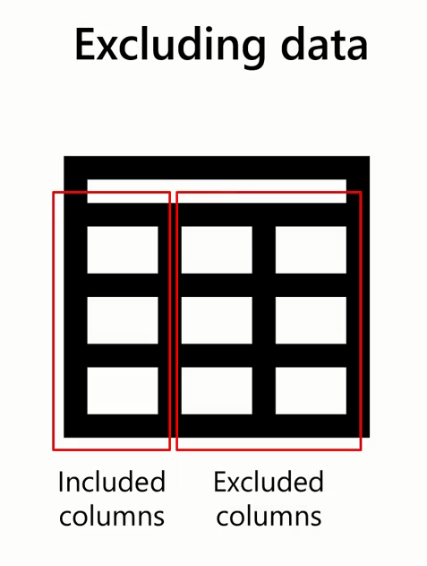
Some Iconicity You Might Find in Data

Slide 7
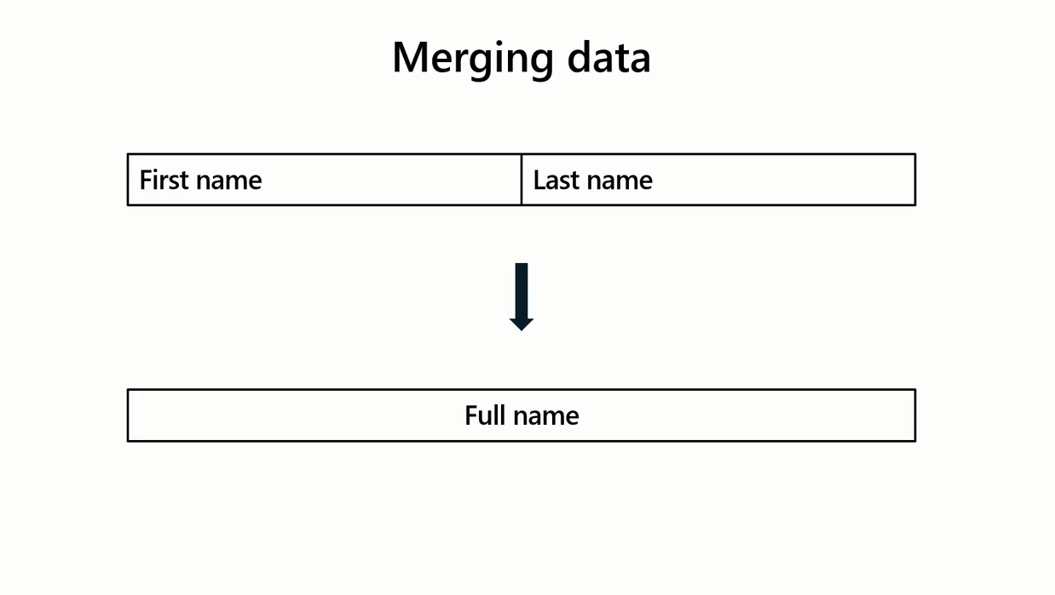

Slide 8


Slide 9
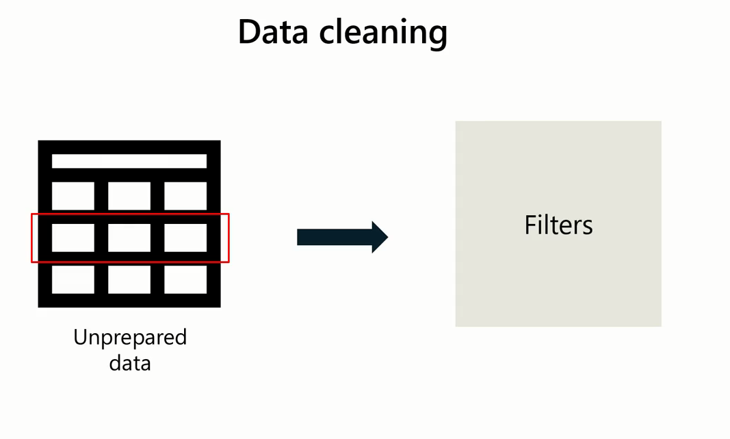

Slide 10

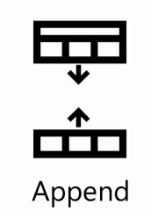






Slide 11
Question
Data transformation is the process of preparing data for analysis.
A. True
B. False

Slide 12
ANSWER
Data transformation is the process of preparing data for analysis.
A. True
B. False

Slide 13
2
Introduction to Power Query

Slide 14


Slide 15
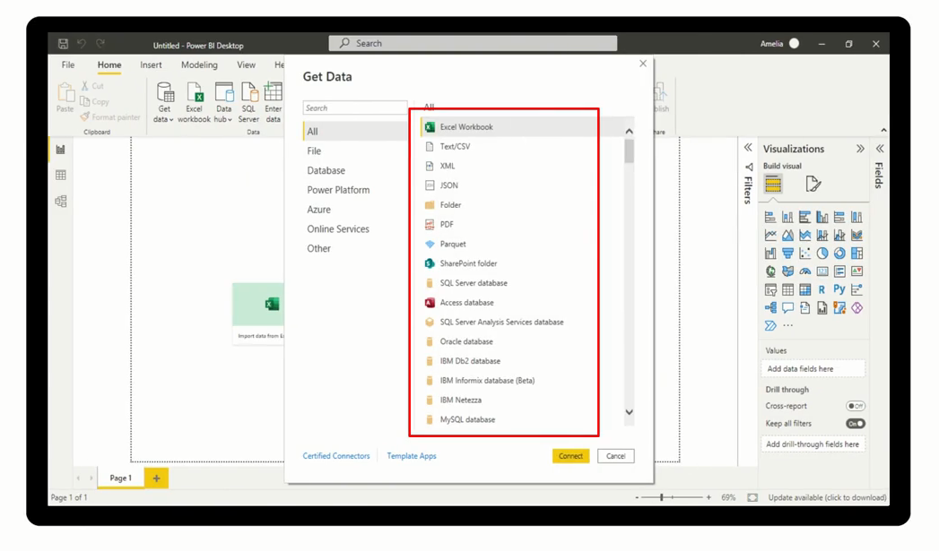

Features that Power Query can help with

Slide 16
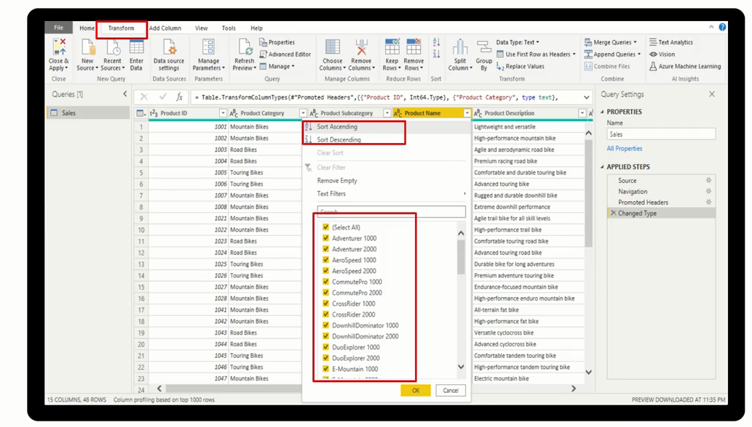

Features that Power Query can help with

Slide 17
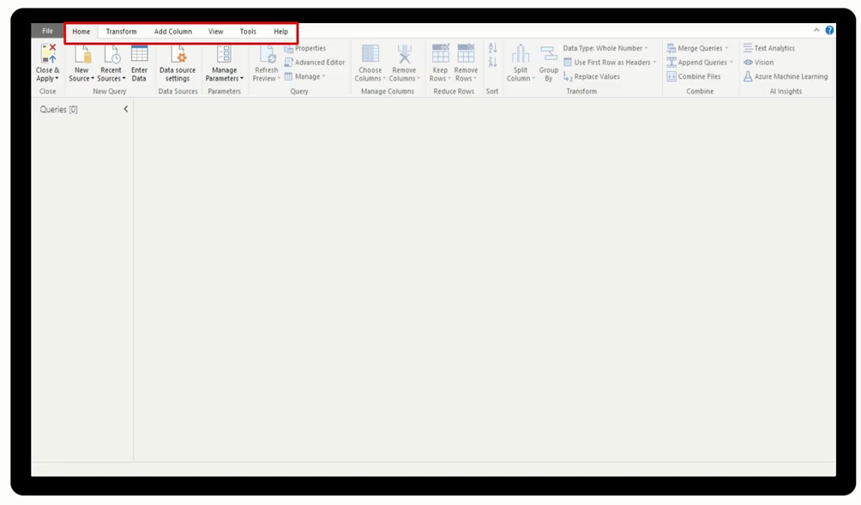

Features that Power Query can help with

Slide 18
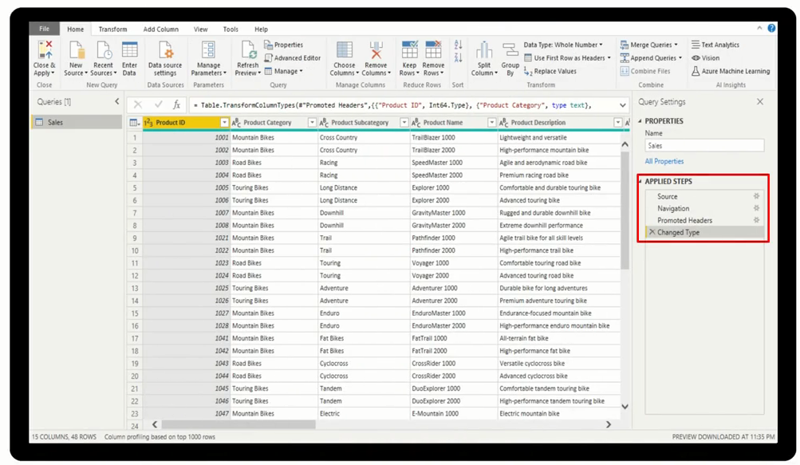

Features that Power Query can help with

Slide 19
Explore Power Query
Ribbon

Slide 20
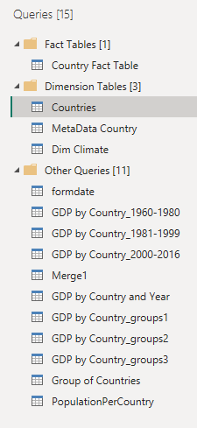
Explore Power Query
Queries Pane

Slide 21
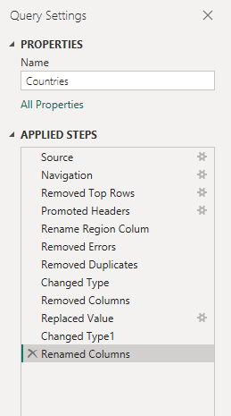
Explore Power Query
Applied Steps

Slide 22
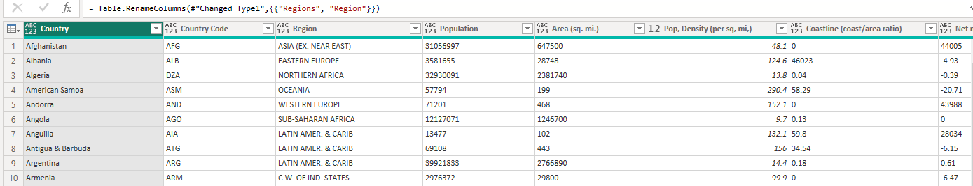
Explore Power Query
Data Preview

Slide 23
Question
What is the primary purpose of Power Query in Power BI?
A. To automate the process of sharing reports and dashboards.
B. To create insightful visualizations and reports.
C. To facilitate seamless data preparation for analysis and visualization.
D. To predict future trends and patterns in the data.

Slide 24
ANSWER
What is the primary purpose of Power Query in Power BI?
A. To automate the process of sharing reports and dashboards.
B. To create insightful visualizations and reports.
C. To facilitate seamless data preparation for analysis and visualization.
D. To predict future trends and patterns in the data.

Slide 25

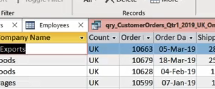
Exercise 4: Exploring Power Query

Slide 26
1
The Applied Steps List

Slide 27
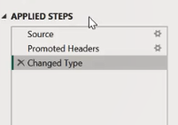
Applied Steps List

Slide 28
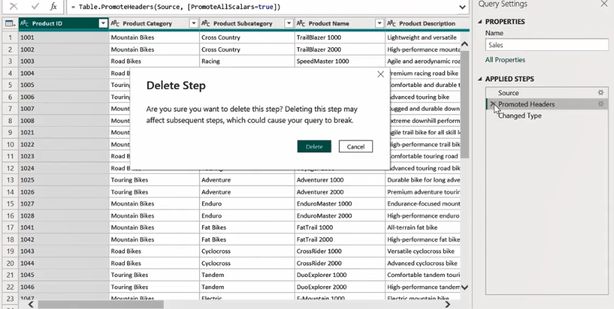
Removing a Step

Slide 29
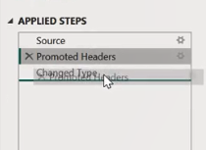
Reordering a Step

Slide 30
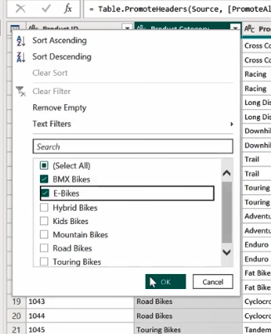
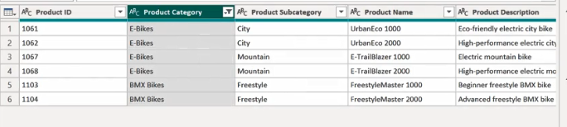
Apply Filter

Slide 31

Sorting Dataset

Slide 32
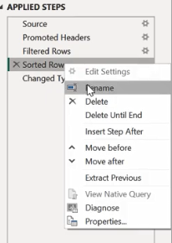
Renaming a Step

Slide 33
Question
What is the purpose of the Applied Steps section in the Power Query Editor?
A. To provide a graphical user interface for designing and managing queries.
B. To preview the data after the applied transformations.
C. To show the sequence of transformations applied to the selected query.
D. To display a list of all the queries in your Power BI project.

Slide 34
ANSWERS
What is the purpose of the Applied Steps section in the Power Query Editor?
A. To provide a graphical user interface for designing and managing queries.
B. To preview the data after the applied transformations.
C. To show the sequence of transformations applied to the selected query.
D. To display a list of all the queries in your Power BI project.

Slide 35
Exercise 5: Editing Rows

Slide 36
4
Data Types

Slide 37
Number types
Decimal number
Fixed decimal number
Whole number:

Slide 38
Date and Time types
Date/time:
Date:
Time:
Date/time/timezone:.
Duration:

Slide 39
Other data types
Text
True/false: This is also known as Boolean data type,
Binary:.

Slide 40
Exercise 5: Changing Data Types

Slide 41


Slide 42
Question 1
Which of the following operations are steps in the data transformation process? Select all that apply.
A. Cleaning data
B. Creating insights from data
C. Shaping data
D. Removing data

Slide 43
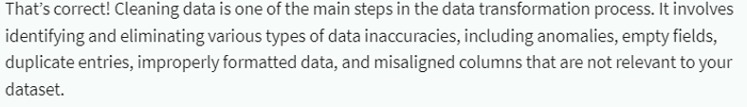


ANSWERS 1
Which of the following operations are steps in the data transformation process? Select all that apply.
A. Cleaning data
B. Creating insights from data
C. Shaping data
D. Removing data
A
C
D

Slide 44
Question 2
Which of the following data types are part of the number type group? Select all that apply.
A. Binary
B. Whole number
C. Fixed decimal number
D. Text

Slide 45
ANSWER 2
Which of the following data types are part of the number type group? Select all that apply.
A. Binary
B. Whole number
C. Fixed decimal number
D. Text

Slide 46
Question 3
Which one of the following features are used to track, re-order or delete the steps completed in Power Query?
A. Properties
B. New Source
C. Applied Steps
D. Queries

Slide 47
ANSWER 3
Which one of the following features are used to track, re-order or delete the steps completed in Power Query?
A. Properties
B. New Source
C. Applied Steps
D. Queries

Slide 48
Question 4
Which of the following options can be used for Power Query Optimization? Select all that apply.
A. Choose the right data types for columns.
B. Filter rows in the queries.
C. Choose only the columns that you will use in the data model.

Slide 49
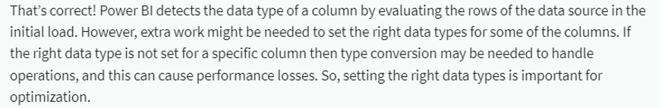
ANSER 4
Which of the following options can be used for Power Query Optimization? Select all that apply.
A. Choose the right data types for columns.
B. Filter rows in the queries.
C. Choose only the columns that you will use in the data model.
A
B
C

Slide 50


