Slide 1





Microsoft Access
Advanced Training
Joins
Prepared By :
Said Fawzy
Manager of Information Center
Tendering Department
Arab Contractors

Slide 2
Joints

Slide 3



Slide 4

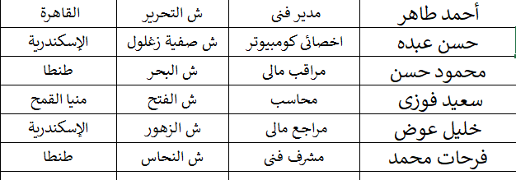
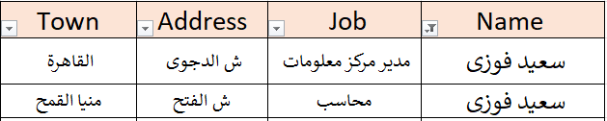
Emp
بيانات سعيد فوزى

Slide 5
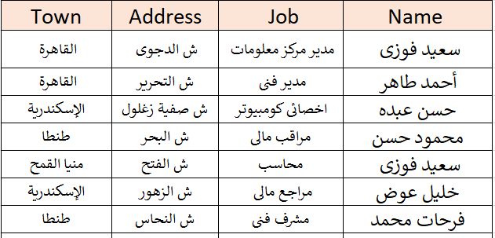
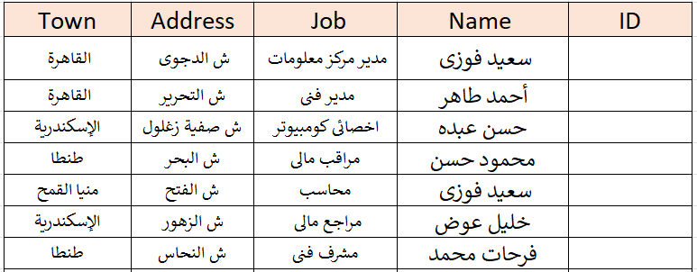
Constraints
Emp
PK
INSERT
Required
UPDATE
Unique

Slide 6

Constraints
Emp
PK
INSERT
Required
UPDATE
Unique

Slide 7
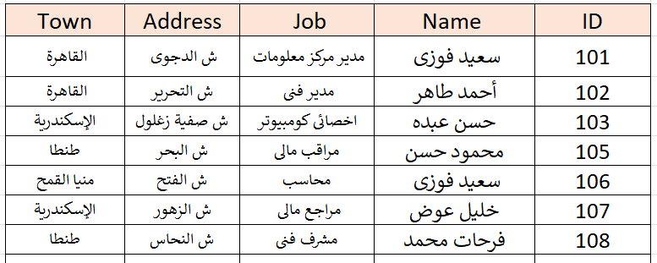
Emp
INSERT

Slide 8

Emp
INSERT

Slide 9
Emp
INSERT

Slide 10
Emp
INSERT

Slide 11
Emp
INSERT

Slide 12
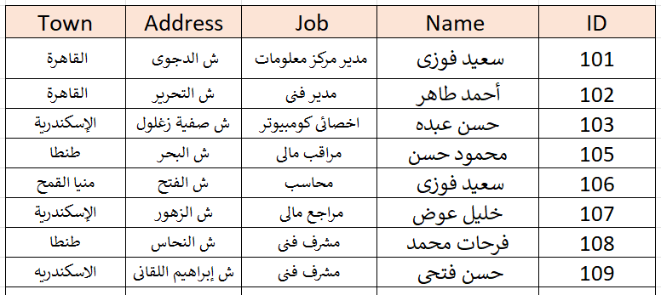


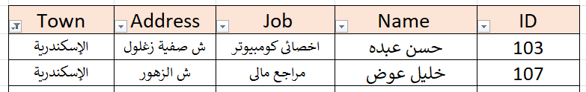
Emp
الإسكندرية

Slide 13
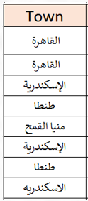
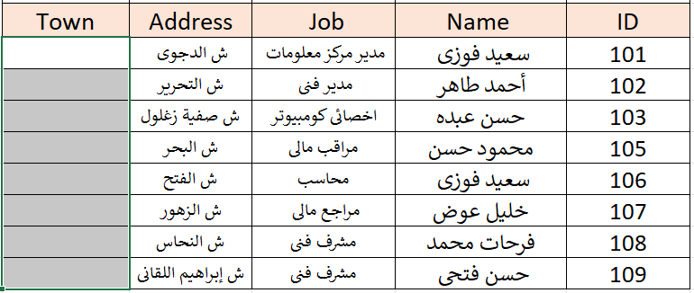
Emp

Slide 14
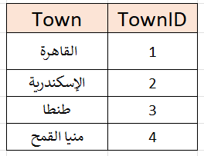
Emp
Towns

Slide 15
Constraints
Emp
Towns
PK
Required
Unique

Slide 16

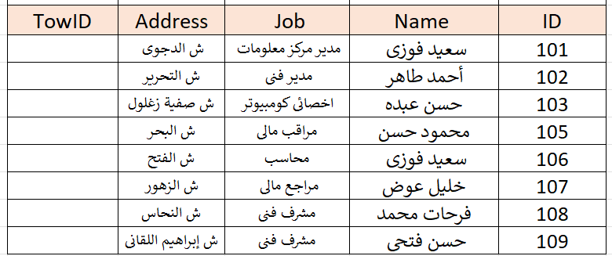
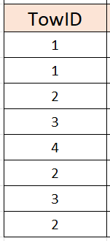
Emp
Towns
FK
PK
INSERT
Constraints
UPDATE
DELETE

Slide 17
Emp
Towns
FK
PK
INSERT
Constraints
UPDATE
DELETE

Slide 18
Emp
Towns

Slide 19
Emp
Towns

Slide 20
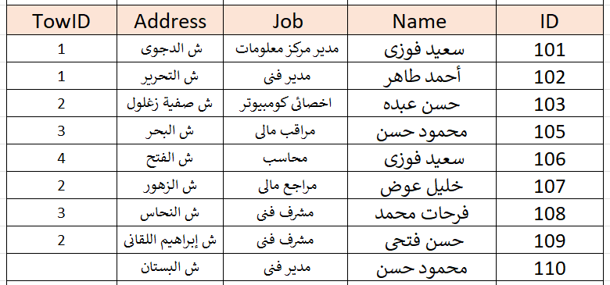

Emp
Towns

Slide 21
Emp
Towns
DELETE
We have no Orphans

Slide 22
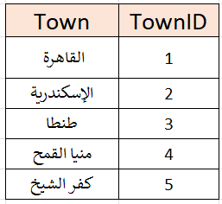
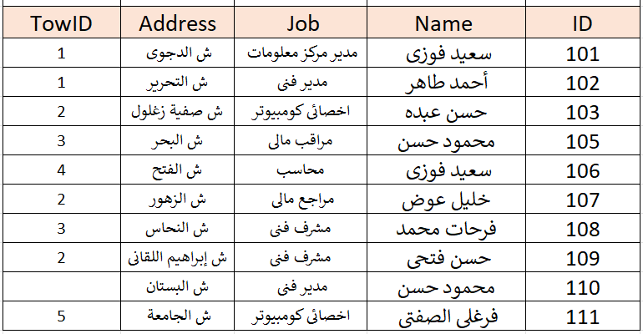

Towns
1
Emp

Slide 23
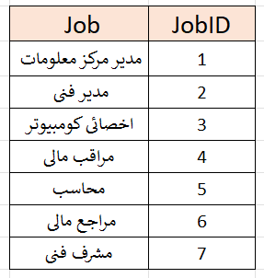
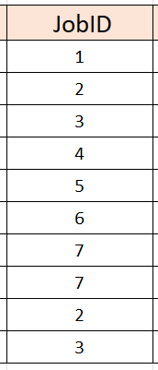
Towns
Jobs
1
1
Emp

Slide 24
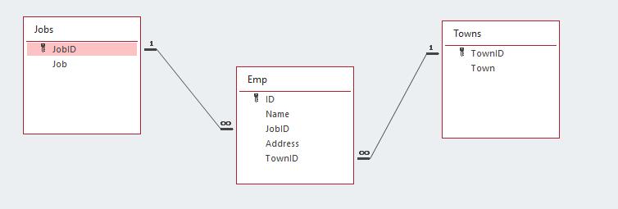

Slide 25
Towns
Jobs
1
1
Emp
How to retrieve data ?

Slide 26
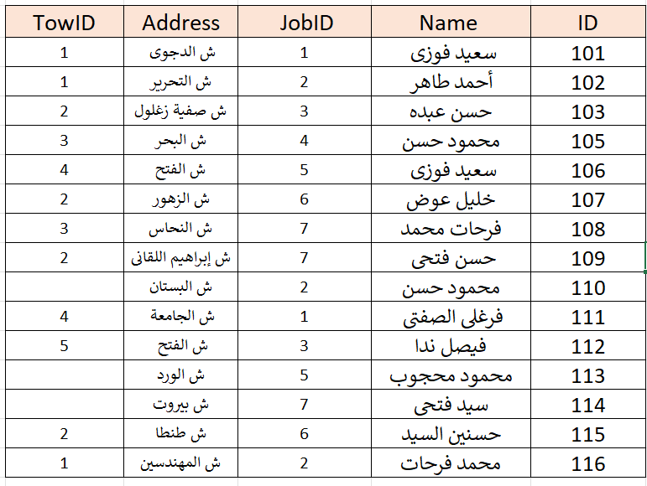
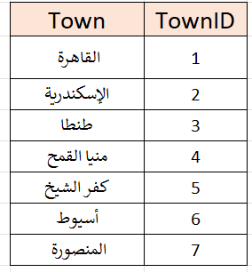
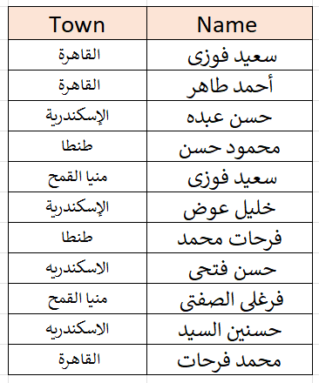
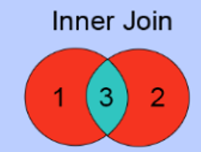
الاسم والبلد
المشترك فقط

Slide 27
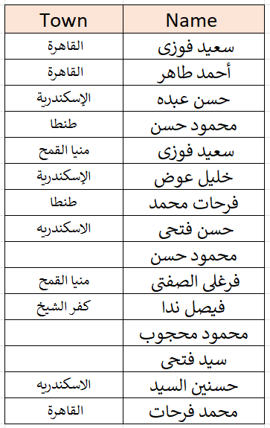
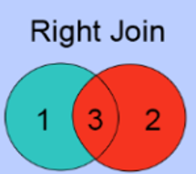
الاسم والبلد
كل الأسماء

Slide 28
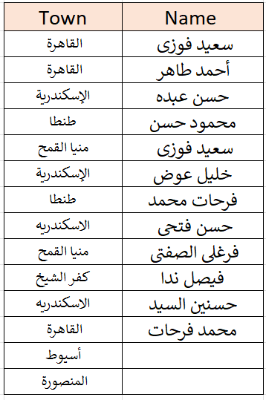
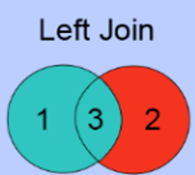
الاسم والبلد
كل البلاد

Slide 29
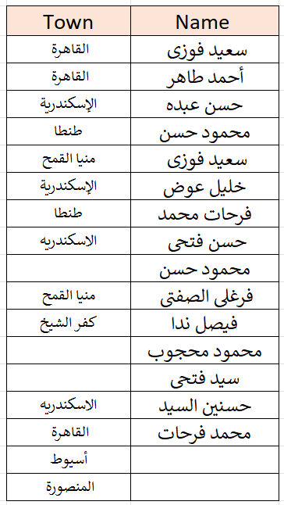
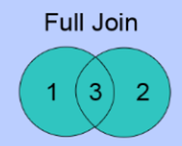
الاسم والبلد
كله كله

Slide 30
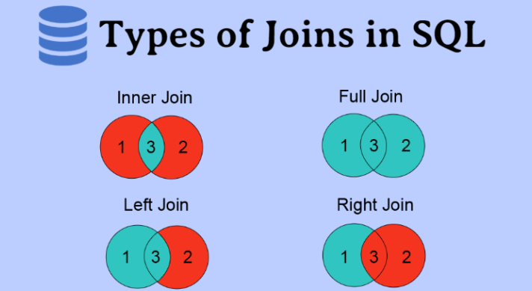


Slide 31
1. Inner Join
In an inner join, we only select the data which is common in both the tables. (ie, part 3 here)
In order to make it more precise, all the records from both the tables matching up the condition mentioned with the join are picked in this join.

Slide 32
2. Left Join
n left join, we select all the data from the left table and from the right table only select the data set which matches up with the condition mentioned with the join (here area 1+3)

Slide 33
3. Right Join
In right join, we select all the data from the right table and from the left table only select the data set which matches up with the condition mentioned with the join (here 3+2)

Slide 34
4. Full Join
In full join, all the records form both the tables are merged and selected irrespective of the condition mentioned with the join having met or not. (here 1+2+3)

Slide 35


