Slide 1

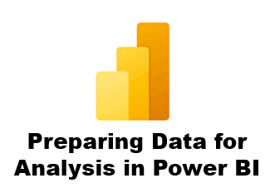



3 Connecting to Data Sources
Prepared By :
Said Fawzy
Manager of Information Center
Tendering Department
Arab Contractors

Slide 2

3 Connecting to Data Sources
in Power BI
Prepared By :
Said Fawzy
Manager of Information Center
Tendering Department
Arab Contractors

Slide 3

1
The ETL process
2
Data Sources in Power BI
3
Combining Data Sources
4
Connecting to a flat file

Slide 4
1
The ETL process

Slide 5
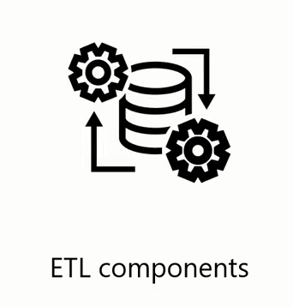
ETL Process

Slide 6
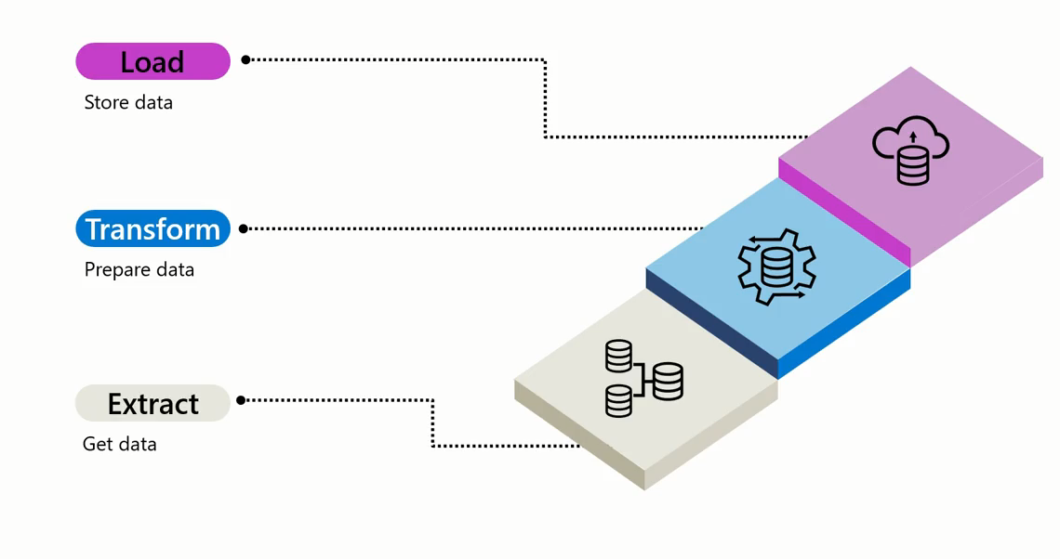
ETL Process

Slide 7

ETL Process

Slide 8




Extract Process

Slide 9
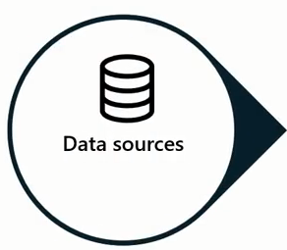
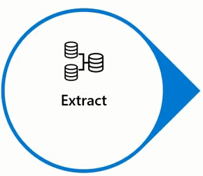

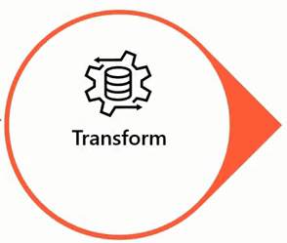
Extract Process

Slide 10
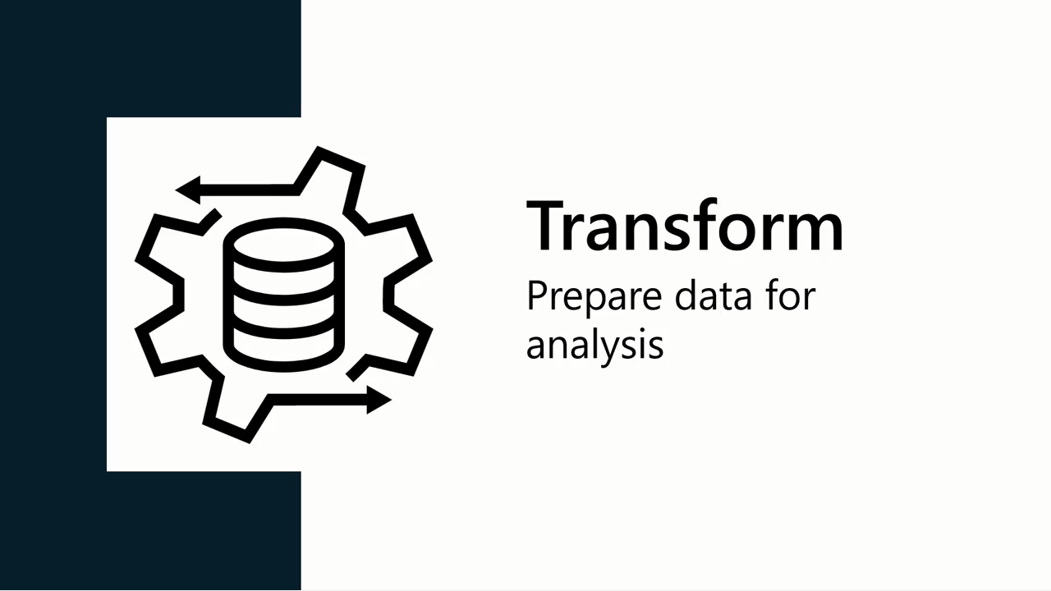

Slide 11
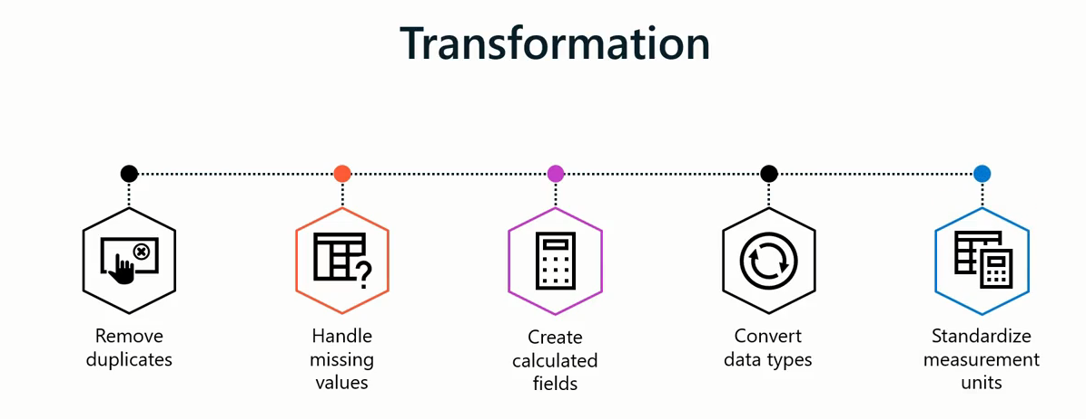

Transform Process

Slide 12


Slide 13

Load Process

Slide 14
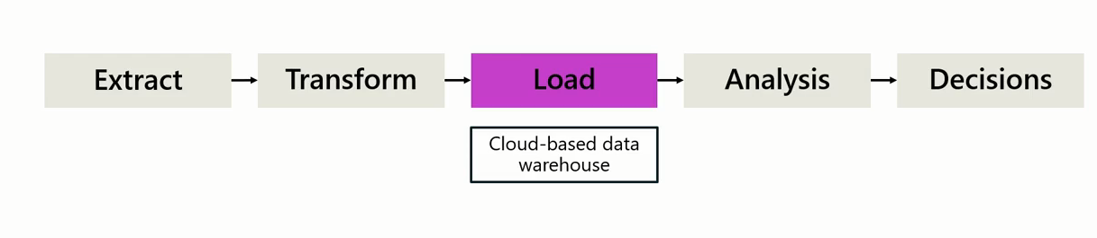
ETL Process

Slide 15

ETL Process

Slide 16
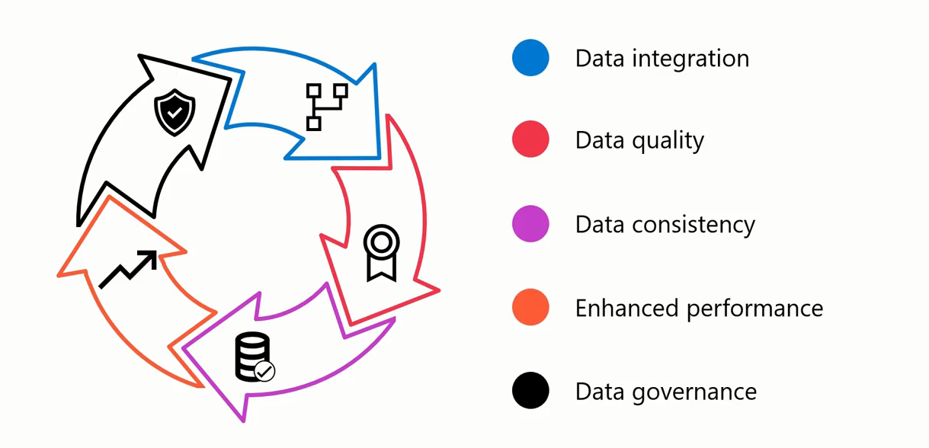
ETL Process

Slide 17
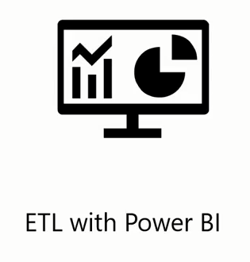
ETL Process

Slide 18
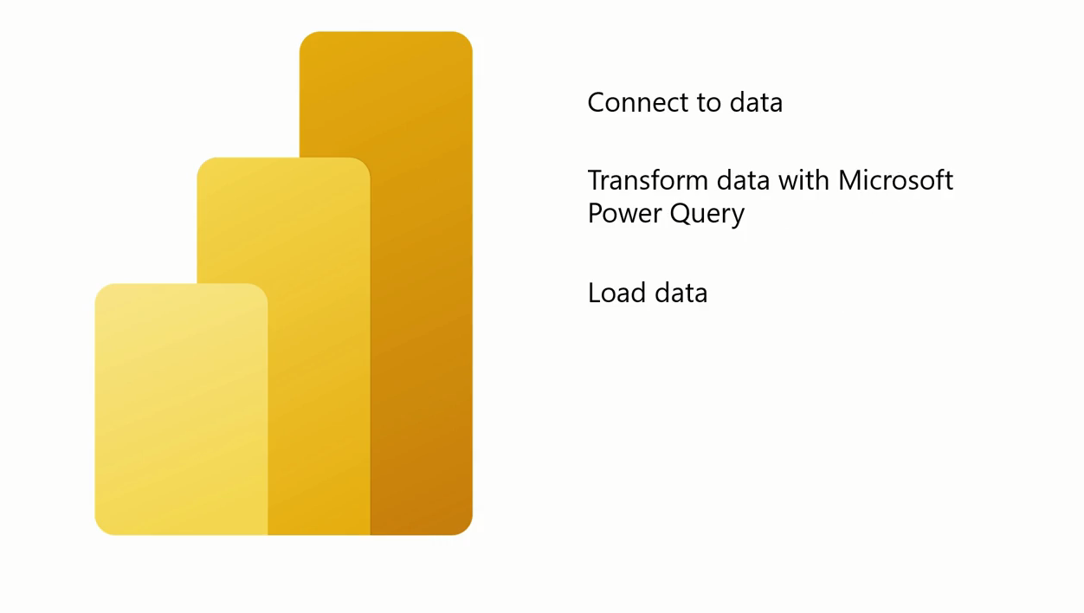
ETL With Power BI

Slide 19
Question
In the ETL process, which step involves retrieving raw data from different sources, such as databases and files?
A. Transform
B. Visualize
C. Load
D. Extract

Slide 20
ANSWERS
In the ETL process, which step involves retrieving raw data from different sources, such as databases and files?
A. Transform
B. Visualize
C. Load
D. Extract

Slide 21
2
Data Sources in Power BI

Slide 22
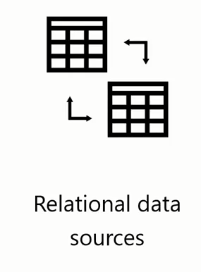
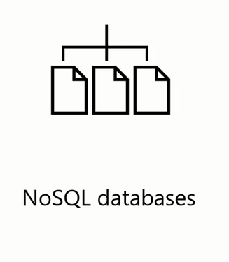

Data Sources You can Connect in Power BI

Slide 23
3
Combining Data Sources

Slide 24
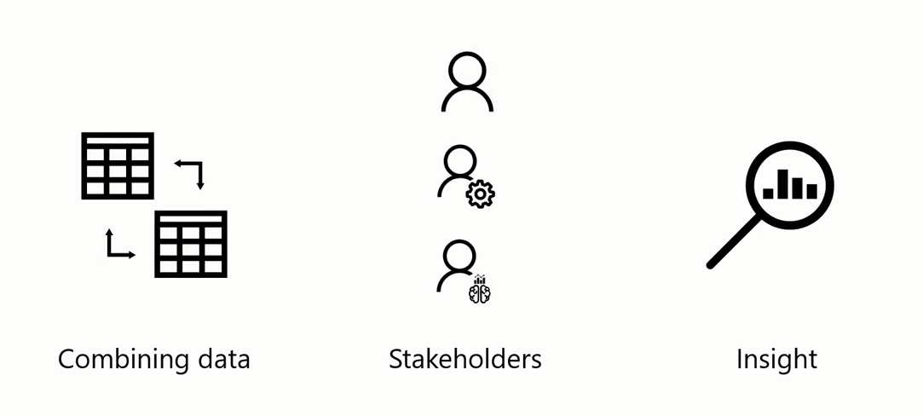
Combining Data Sources benefits

Slide 25
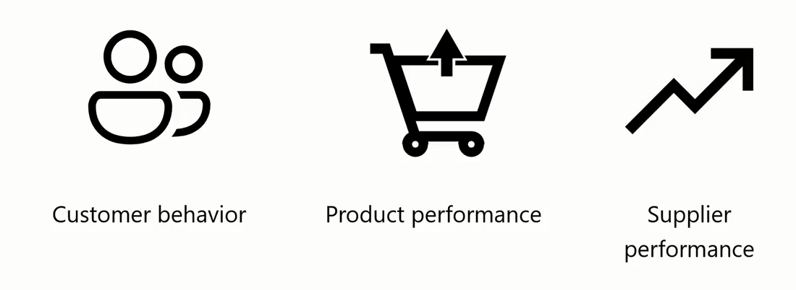
Combining Data Sources benefits

Slide 26
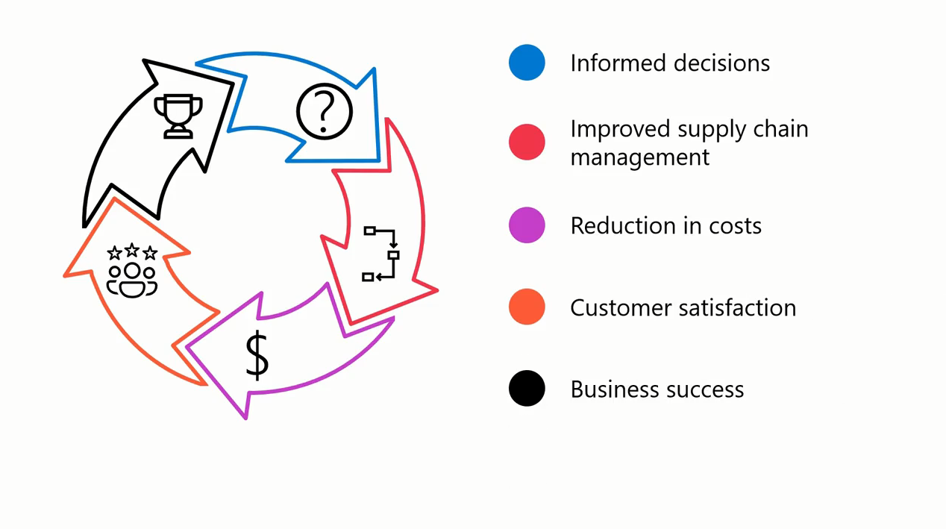
Combining Data Sources benefits

Slide 27
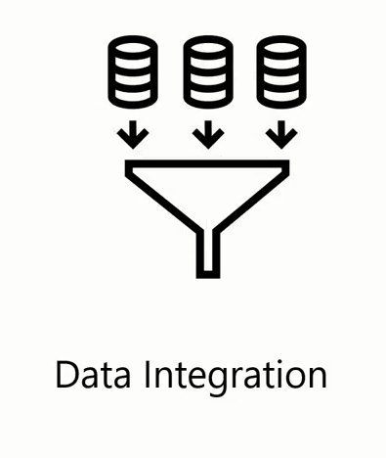
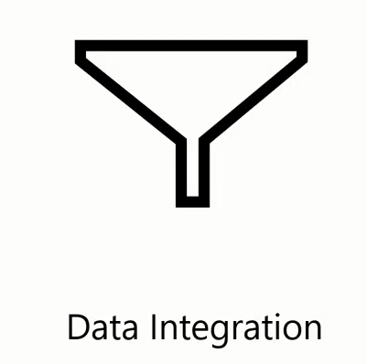
Combining Data Sources benefits

Slide 28
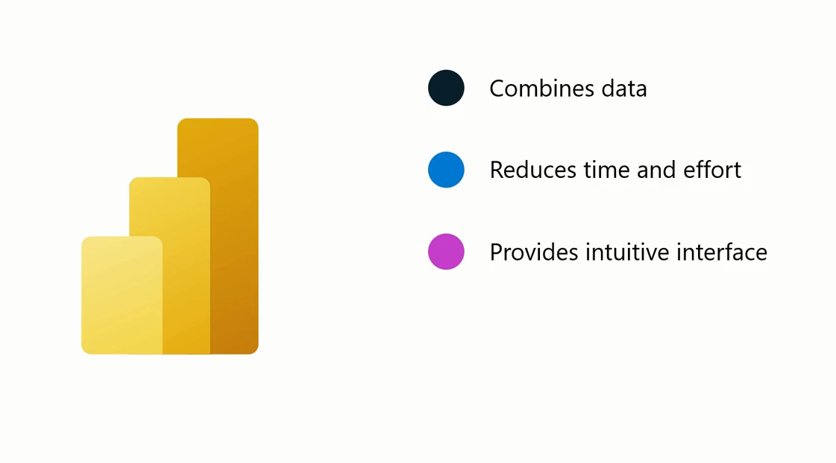
Combining Data Sources benefits

Slide 29

Combining Data Sources benefits

Slide 30
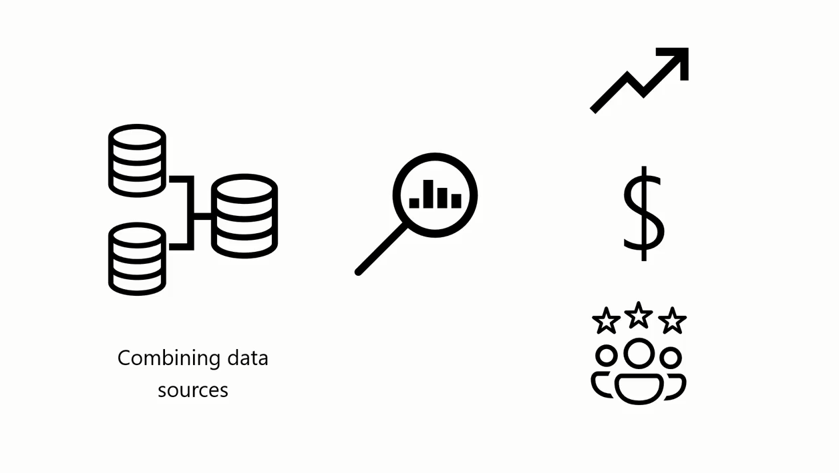
Combining Data Sources benefits

Slide 31
Question
You are setting up Power BI connectors for Adventure Works. What kind of services can the company use Power BI to connect to?
Power BI connectors only link to Microsoft services
Power BI connectors are limited to local computers or personal accounts.
Power BI connects to many external apps and cloud services.

Slide 32
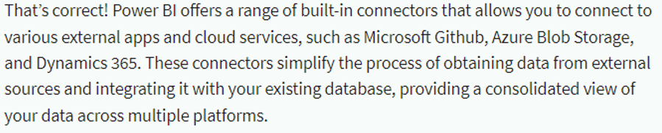
ANSWER
You are setting up Power BI connectors for Adventure Works. What kind of services can the company use Power BI to connect to?
Power BI connectors only link to Microsoft services
Power BI connectors are limited to local computers or personal accounts.
Power BI connects to many external apps and cloud services.

Slide 33
4
Connecting to a flat file

Slide 34

What is a Flat File?
A flat file is a file type that contains a single data table, with a uniform structure for every row of data, and does not have hierarchies.

Slide 35
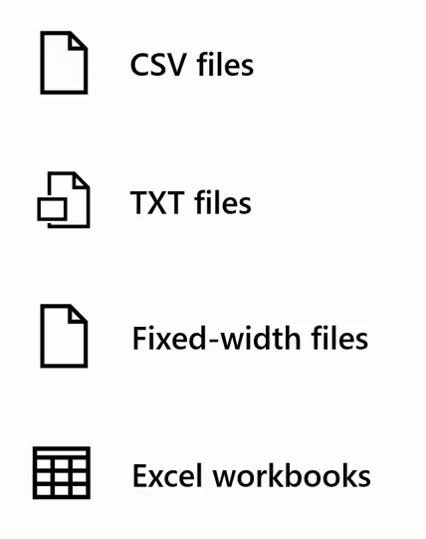
Examples of Flat Files

Slide 36
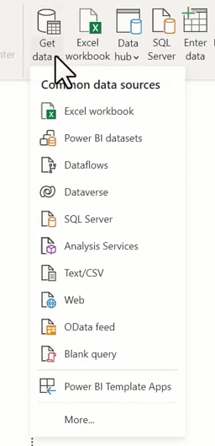
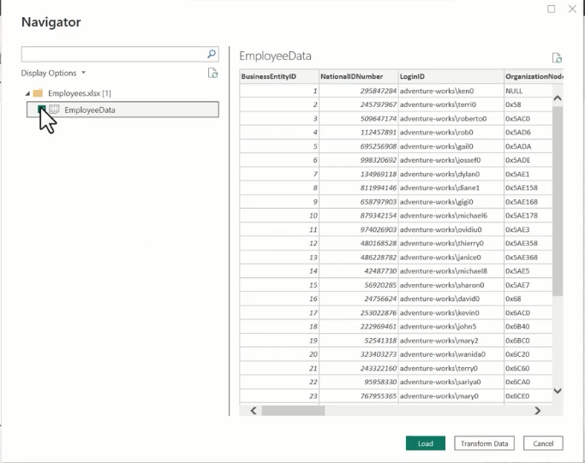
Set up a Flat Data source

Slide 37
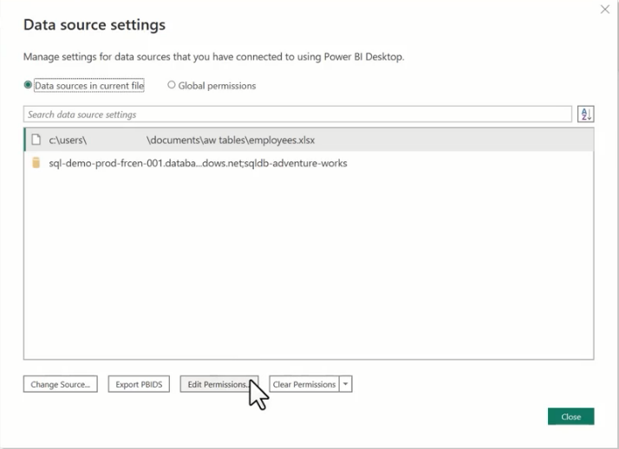
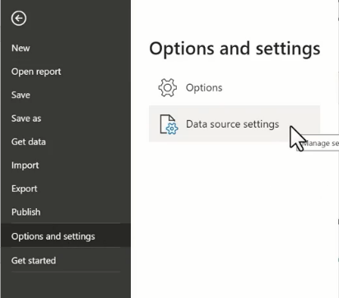
change the location of your source file

Slide 38
Question
What should you do if you need to change the location of your source file in Power BI?
A. Select the correct option.
B. Clear permissions.
C. Update the connection string.
D. Create a new connection string and leave the old one unchanged.

Slide 39
ANSWER
What should you do if you need to change the location of your source file in Power BI?
A. Select the correct option.
B. Clear permissions.
C. Update the connection string.
D. Create a new connection string and leave the old one unchanged.

Slide 40

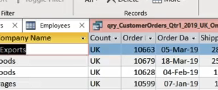
Exercise 2: Preparing Settings of Project File

Slide 41
Exercise 3: Connecting to Data Source

Slide 42


Slide 43
Question 1
What is the difference between a dataset and a data source in Power BI?
A dataset is the same as a data source, but with fewer features.
A dataset is a container that holds some of the data from a data source, whereas a data source is where the data actually comes from.
A dataset and data source are the same thing.

Slide 44

ANSWER 1
What is the difference between a dataset and a data source in Power BI?
A dataset is the same as a data source, but with fewer features.
A dataset is a container that holds some of the data from a data source, whereas a data source is where the data actually comes from.
A dataset and data source are the same thing.

Slide 45
Question 2
What is the maximum size of an Excel workbook that can be uploaded to Power BI?
1 GB
10 GB
100 GB

Slide 46
ANSWER 2
What is the maximum size of an Excel workbook that can be uploaded to Power BI?
1 GB
10 GB
100 GB

Slide 47
Question 3
What are the types of workbooks that Power BI supports? Select all that apply:
A. Workbooks with ranges or tables of data.
B. Workbooks with connections to external data sources.
C. Workbooks with shapes and images
D. Workbooks with data models

Slide 48


ANSWER 3
What are the types of workbooks that Power BI supports? Select all that apply:
A. Workbooks with ranges or tables of data.
B. Workbooks with connections to external data sources.
C. Workbooks with shapes and images
D. Workbooks with data models
A
B
D

Slide 49
Question 4
What is the primary purpose of the Transform step in the ETL process?
A. To clean, structure, and enrich the data to make it more suitable for analysis.
B. To load the transformed data into the final storage system.
C. To extract data from multiple sources.
D. To analyze and visualize the data.

Slide 50
Question 4
What is the primary purpose of the Transform step in the ETL process?
A. To clean, structure, and enrich the data to make it more suitable for analysis.
B. To load the transformed data into the final storage system.
C. To extract data from multiple sources.
D. To analyze and visualize the data.

Slide 51
Question 5
What does source data refer to? Select all that apply.
A. Data that has been analyzed and refined for specific purposes.
B. Pre-processed data used for analysis and decision-making.
C. Raw, unprocessed information collected, stored, and managed by an organization.
D. The initial input used as the basis for further processing, transformation, and analysis.
B
C

Slide 52


