Slide 1
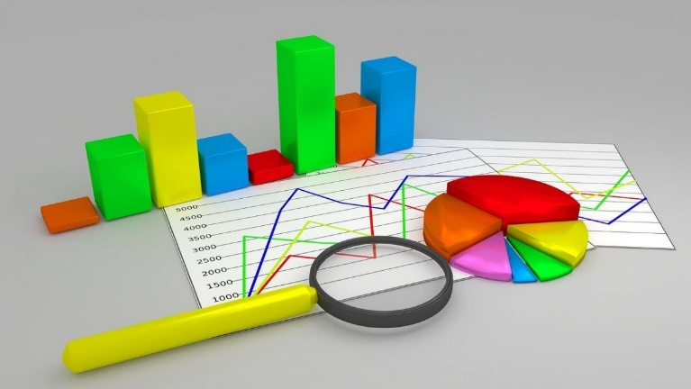
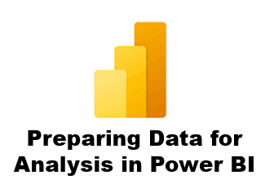



7 Data Profiling
Prepared By :
Said Fawzy
Manager of Information Center
Tendering Department
Arab Contractors

Slide 2

7 Data Profiling
Prepared By :
Said Fawzy
Manager of Information Center
Tendering Department
Arab Contractors

Slide 3

1
Introduction to Data Profiling
2
Profiling Data in Column
3
Apply Data Profiling in Power BI

Slide 4
1
Introduction to Data Profiling

Slide 5


Slide 6
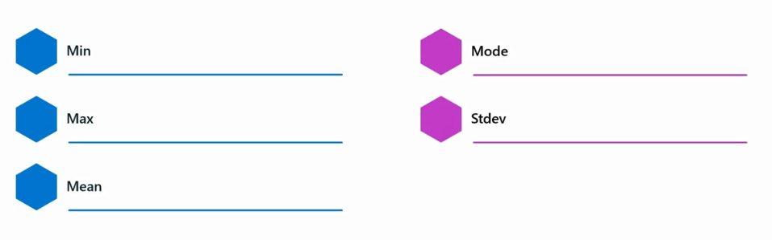
You should check these characteristics for each numerical field

Slide 7

Example

Slide 8

Example

Slide 9
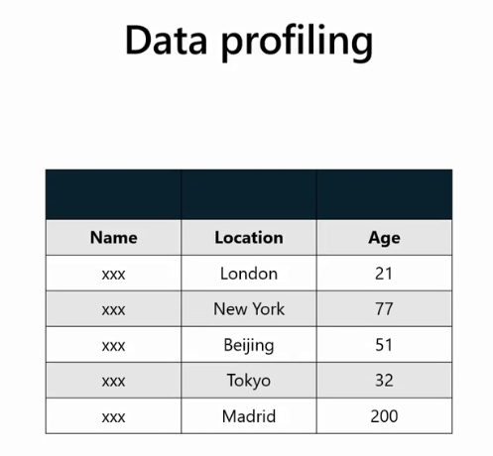
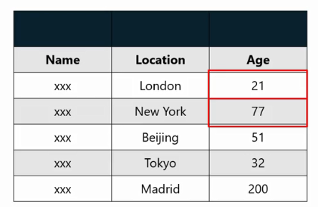
Min , Max
Example

Slide 10
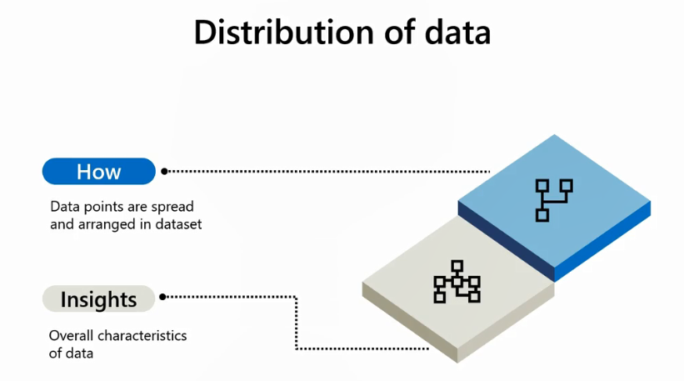

Slide 11
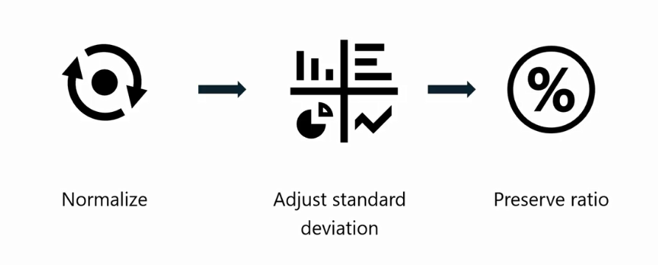
Outlier
A data point that significantly deviates from other observations.
Min-Max Scaling

Slide 12
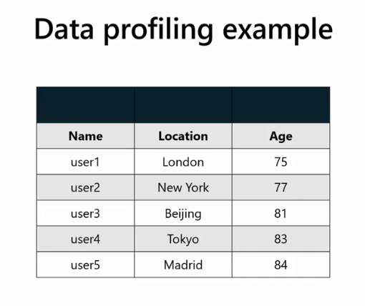
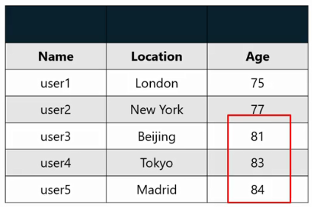

Slide 13

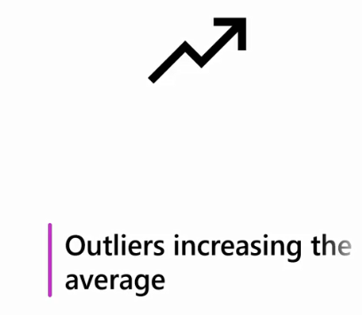

Slide 14
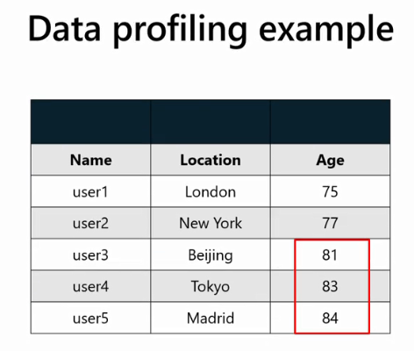
Outliers

Slide 15


Slide 16


Slide 17
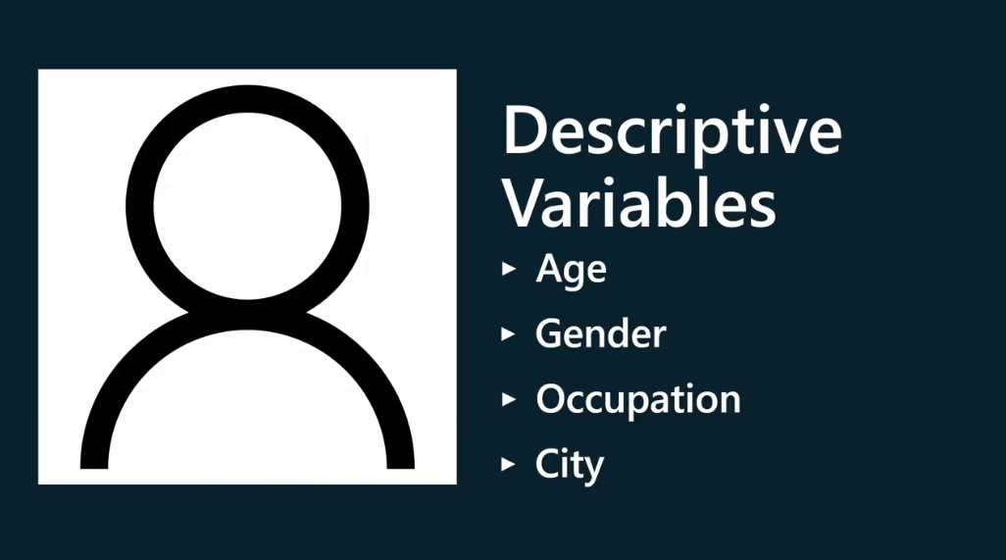

Slide 18


Slide 19
Question
Which column characteristic gives the most frequently repeated value in selected records? Select the correct option.
A. Mode
B. Average
C. Min

Slide 20
ANSWER
Which column characteristic gives the most frequently repeated value in selected records? Select the correct option.
A. Mode
B. Average
C. Min

Slide 21
2
Profiling Data in Columns

Slide 22




You must always Check data

Slide 23
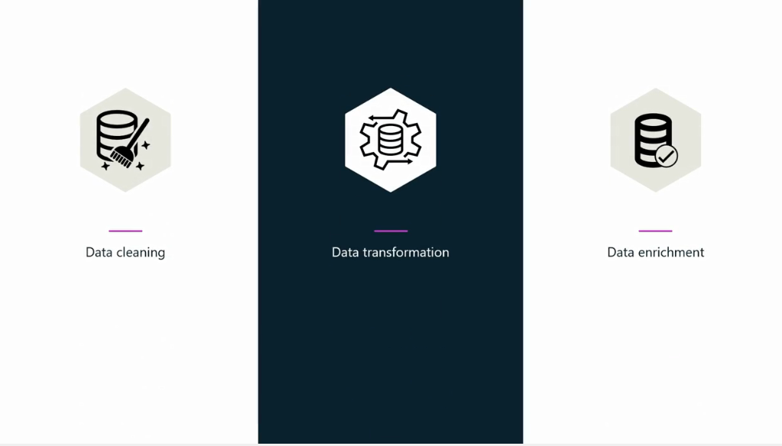

Slide 24


Slide 25


Slide 26
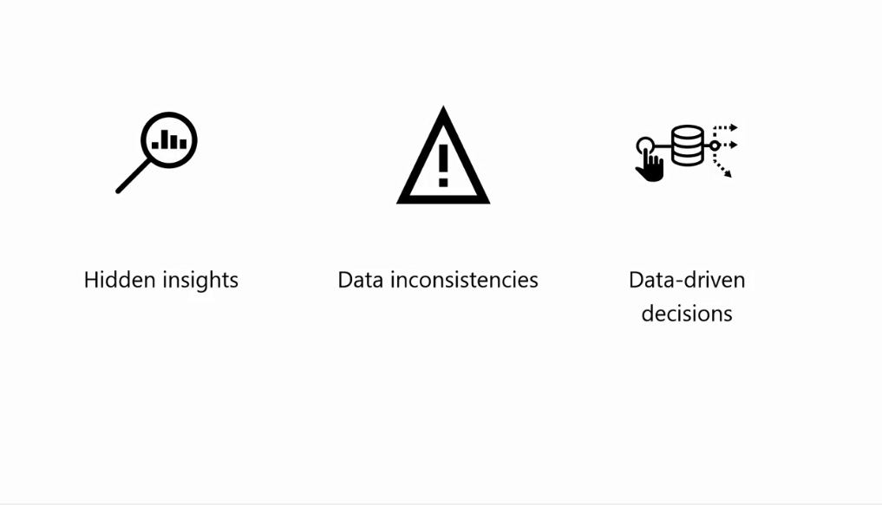

Slide 27
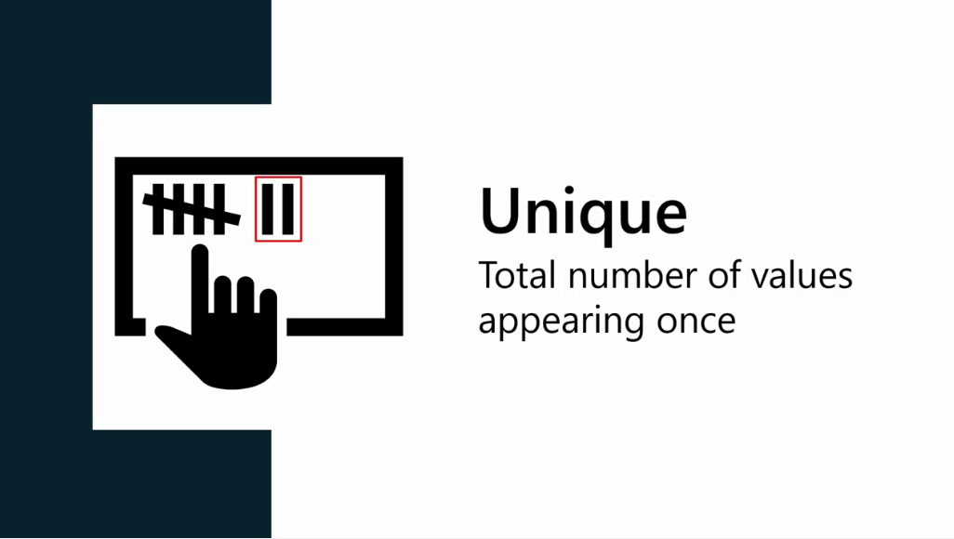

Slide 28
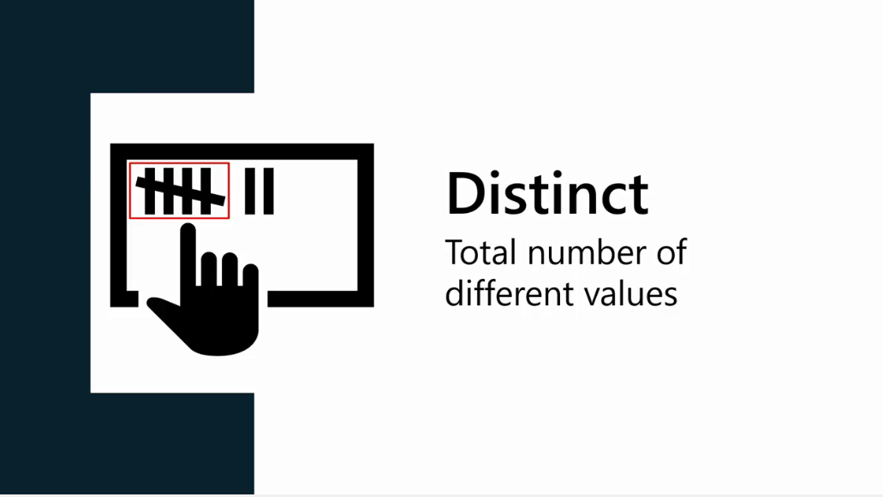

Slide 29
Profiling Tools in Power Query
Microsoft power BI offers the following two profiling tools in the Power Query editor:
column quality, and
column distribution.

Slide 30



Slide 31
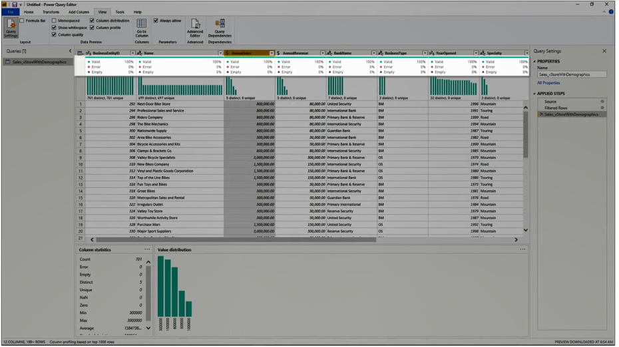

Slide 32
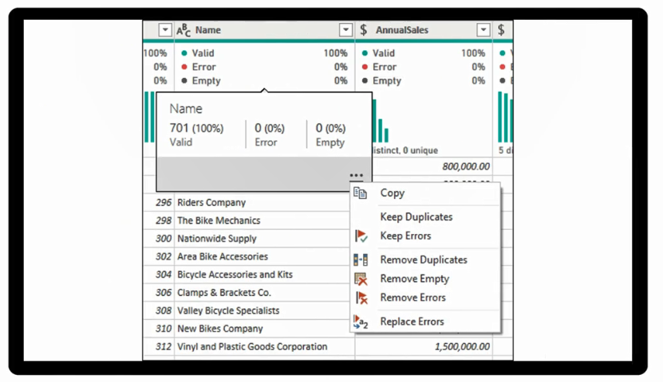

Slide 33


Slide 34
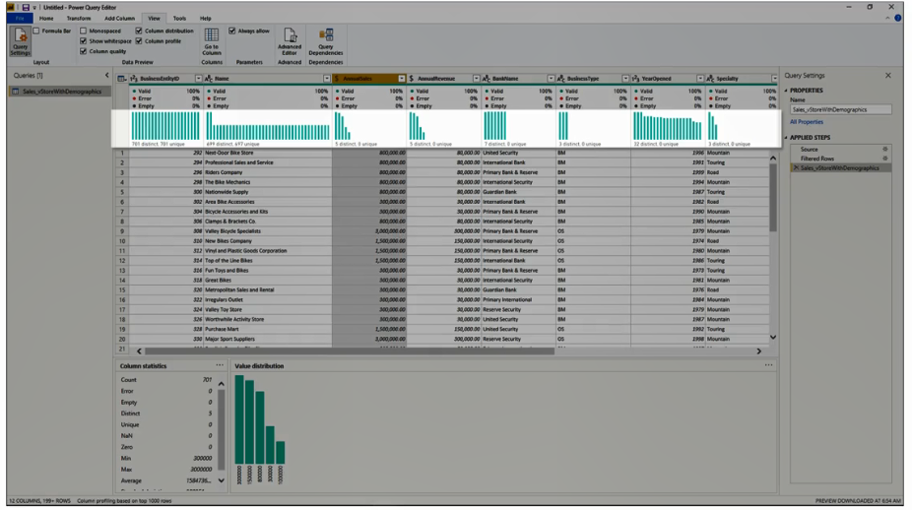

Slide 35
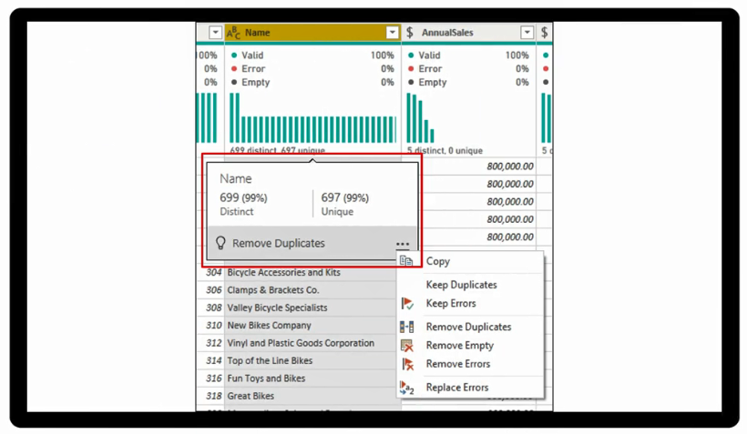

Slide 36
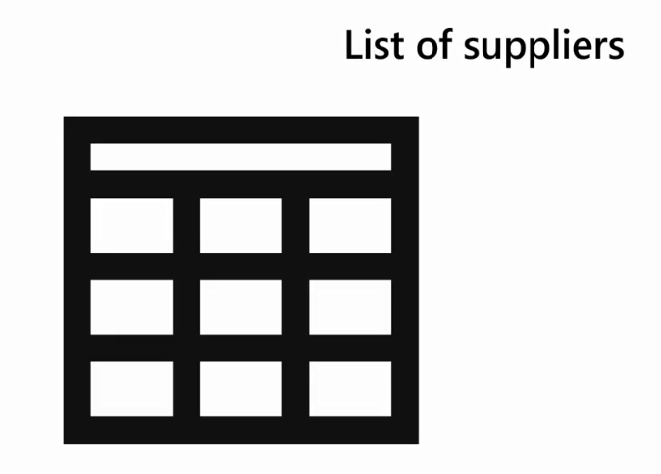
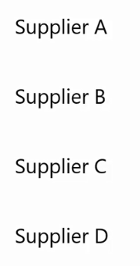
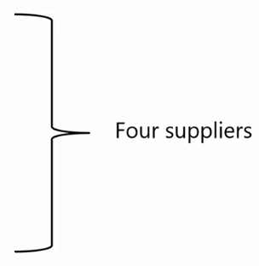
Example

Slide 37
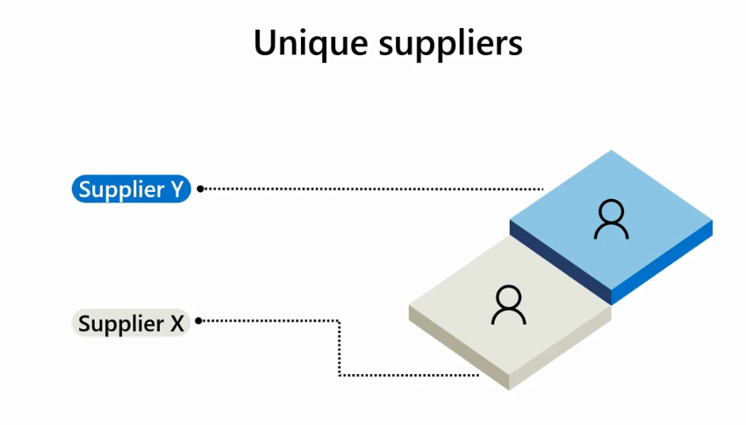

Slide 38
Question
Which menu item gives the distinct and unique row values amounts for a selected column?
A. Column Distribution
B. Column Profile
C. Column Quality

Slide 39
ANSWER
Which menu item gives the distinct and unique row values amounts for a selected column?
A. Column Distribution
B. Column Profile
C. Column Quality

Slide 40
3
Apply Data Profiling in Power BI

Slide 41
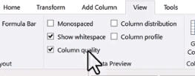
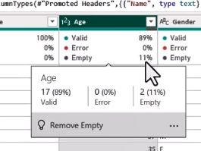

Slide 42
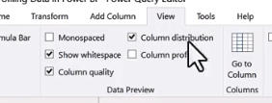
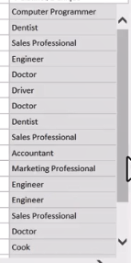
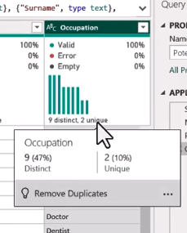

Slide 43
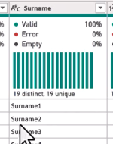
If all the row values are distinct, then unique and distinct amounts will be equal

Slide 44
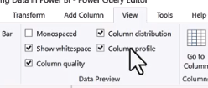
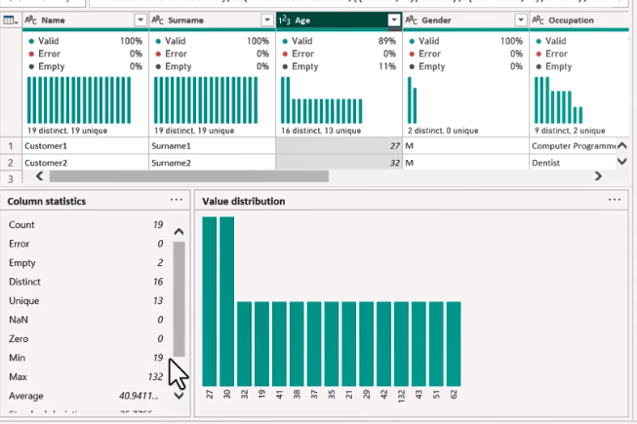

Slide 45
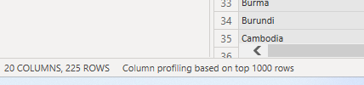

Power Query performs data profiling on the initial 1,000 rows of your data.

Slide 46

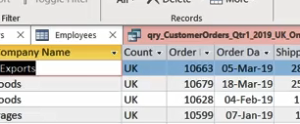
Exercise 18: Profiling a dataset

Slide 47


Slide 48
Question 1
Which of the following Power Query menu items provides the user with column information like the number of empty and distinct rows and rows with errors?
A. Column Quality
B. Column Profile
C. Column Distribution

Slide 49

ANSWER 1
Which of the following Power Query menu items provides the user with column information like the number of empty and distinct rows and rows with errors?
A. Column Quality
B. Column Profile
C. Column Distribution

Slide 50
Question 2
Which of the following is defined as a data point that significantly deviates from other observations?
A. Standard Deviation
B. Outlier
C. Anomaly

Slide 51
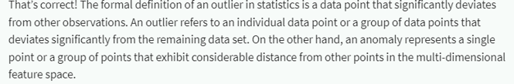
ANSWER 2
Which of the following is defined as a data point that significantly deviates from other observations?
A. Standard Deviation
B. Outlier
C. Anomaly

Slide 52
Question 3
True or False: Distinct is known as “total number of different values”, regardless of how many of each we have. Unique is known as “total number of values that only appear once”. In this case, for fields with Primary Key or Unique Constraint defined, the values of Unique and Distinct will be equal.
A. True
B. False

Slide 53
ANSWER 3
True or False: Distinct is known as “total number of different values”, regardless of how many of each we have. Unique is known as “total number of values that only appear once”. In this case, for fields with Primary Key or Unique Constraint defined, the values of Unique and Distinct will be equal.
A. True
B. False

Slide 54
Question 4
You import an Excel table named EmployeeData2023 into Power Query. You removed all other columns except Country.
The Country column has the following 10 row values:
• USA
• France
• France
• Ireland
• England
• England
• USA
• USA
• Spain
• France
What are the unique and distinct values of this column?
A. 1 unique and 5 distinct
B. 3 unique and 7 distinct
C. 2 unique and 8 distinct
D. 2 unique and 5 distinct

Slide 55
ANSWER 4
You import an Excel table named EmployeeData2023 into Power Query. You removed all other columns except Country.
The Country column has the following 10 row values:
• USA
• France
• France
• Ireland
• England
• England
• USA
• USA
• Spain
• France
What are the unique and distinct values of this column?
A. 1 unique and 5 distinct
B. 3 unique and 7 distinct
C. 2 unique and 8 distinct
D. 2 unique and 5 distinct

Slide 56
Question 5
You need to identify if data in a column contains Empty values. Which of the following can be used to quickly identify this? Select all that apply.
A. Column Distribution
B. Column Profile
C. Column Quality

Slide 57
ANSWER 5
You need to identify if data in a column contains Empty values. Which of the following can be used to quickly identify this? Select all that apply.
A. Column Distribution
B. Column Profile
C. Column Quality
B
C

Slide 58


