Slide 1
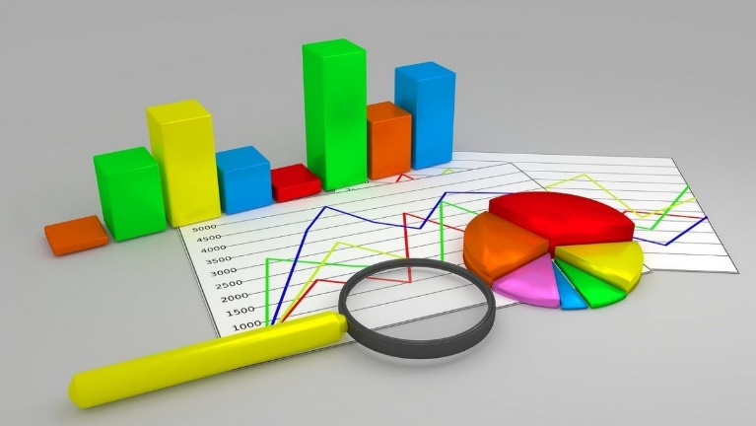



Introduction to Data Analysis Using Excel
Prepared By :
Said Fawzy
Manager of Information Center
Tendering Department
Arab Contractors

Slide 2

Introduction
Prepared By :
Said Fawzy
Manager of Information Center
Tendering Department
Arab Contractors

Slide 3


Contact
Cert.
Cert.
Certif.
Quali
JOB
Said Fawzy
Manager of Information Center
Tendering Department
Arab Contractors

Slide 4
Contact
Cert.
Cert.
Cert.
Quali.
JOB
Said Fawzy
Manager of Information Center
Tendering Department
Arab Contractors

Slide 5


B.SC In Civil Engineering
1987
Alex University
Contact
Cert.
Cert.
Cert.
Quali.
JOB
Said Fawzy
Manager of Information Center
Tendering Department
Arab Contractors
High Diploma in Construction Project Management
1998
Ein Shams
University

Slide 6



Microsoft Certified Professional (MCP)
1999
B.SC In Civil Engineering
1987
Certified Internet Webmaster(CIW)
2000
Alex University
Contact
Cert.
Cert.
Cert.
Quali.
JOB
Said Fawzy
Manager of Information Center
Tendering Department
Arab Contractors
High Diploma in Construction Project Management
2001
Oracle Certified Master (OCM)
1998
Ein Shams
University
Microsoft Certified Technology Specialist(MCTS)
2006

Slide 7



Microsoft Certified Professional (MCP)
1999
Lead Auditor Quality Management Systems
B.SC In Civil Engineering
2009
1987
Certified Internet Webmaster(CIW)
2000
Alex University
Contact
Cert.
Cert.
Cert.
Quali.
JOB
Said Fawzy
Manager of Information Center
Tendering Department
Arab Contractors
High Diploma in Construction Project Management
2001
Oracle Certified Master (OCM)
1998
Lead Auditor Quality Management Systems
Ein Shams
University
2016
Microsoft Certified Technology Specialist(MCTS)
2006

Slide 8

Advanced Data Analysis Nanodegree
2021
Microsoft Certified Professional (MCP)
1999
Lead Auditor Quality Management Systems
B.SC In Civil Engineering
2009
1987
2022
2000
Nanodegree UX Research Cross-Skilling
Certified Internet Webmaster(CIW)
Alex University
Contact
Cert.
Cert.
Cert.
Quali.
JOB
Said Fawzy
Manager of Information Center
Tendering Department
Arab Contractors
High Diploma in Construction Project Management
2022
2001
Nanodegree Advanced Marketing Analytics
1998
Oracle Certified Master (OCM)
Lead Auditor Quality Management Systems
Ein Shams
University
2016
2023
2006
Microsoft Certified Technology Specialist(MCTS)
IBM Certified Data Analysist Professional

Slide 9


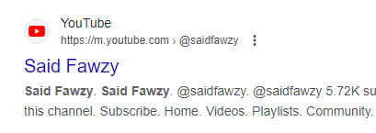
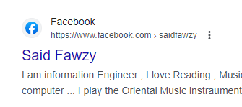
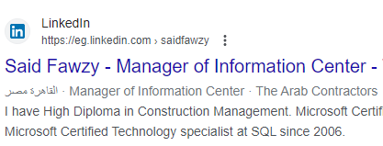


Advanced Data Analysis Nanodegree
2021
Microsoft Certified Professional (MCP)
1999
Lead Auditor Quality Management Systems
B.SC In Civil Engineering
2009
1987
2022
2000
Nanodegree UX Research Cross-Skilling
Certified Internet Webmaster(CIW)
Alex University
Contact
Cert.
Cert.
Cert.
Quali.
JOB
Said Fawzy
Manager of Information Center
Tendering Department
Arab Contractors
High Diploma in Construction Project Management
2022
2001
Nanodegree Advanced Marketing Analytics
1998
Oracle Certified Master (OCM)
Lead Auditor Quality Management Systems
Ein Shams
University
2016
0122 744 99 87
2023
2006
Microsoft Certified Technology Specialist(MCTS)
IBM Certified Data Analysist Professional
Saidfawzy@arabcont.com
Said_fawzy@hotmail.com

Slide 10
Prerequisites

Slide 11
Excel Basics.
Advance Excel.
Charts Using Excel.
Introduction to Data Analysis.

Slide 12
Course Outline

Slide 13
Module 00: Excel Charts Basics
Module 01: Introduction to Reporting in Excel
Module 02: Excel Tables
Module 03: Basic Pivot Tables
Module 04: Dashboards

Slide 14
Module 05: Profitability Analysis and Finding Anomalies
Module 06: Comparing Year over Year in Pivot Tables
Module 07: Reporting Hierarchical Data
Module 08: Introduction to multi-table pivot tables and the data mode

Slide 15

Training
Tell me I will forget.
Show me I might remember something.
Let me do it I will understand.

Slide 16




How would we train?

Slide 17







Slide 18
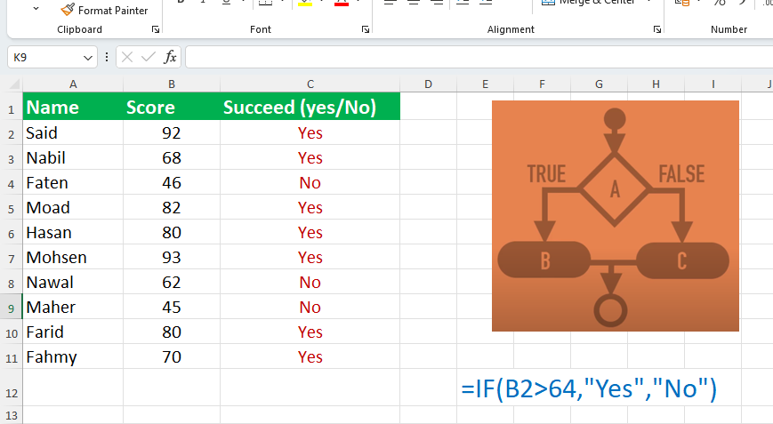

Slide 19
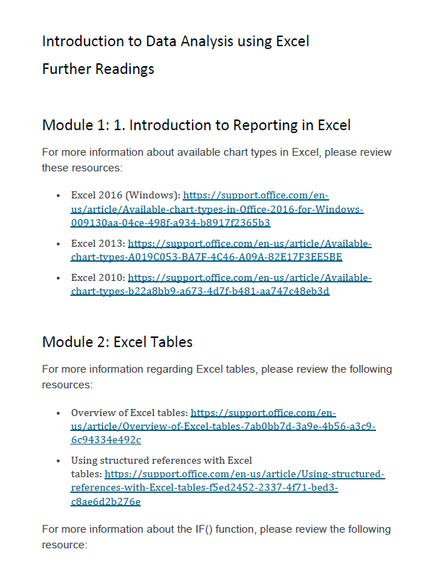

Slide 20
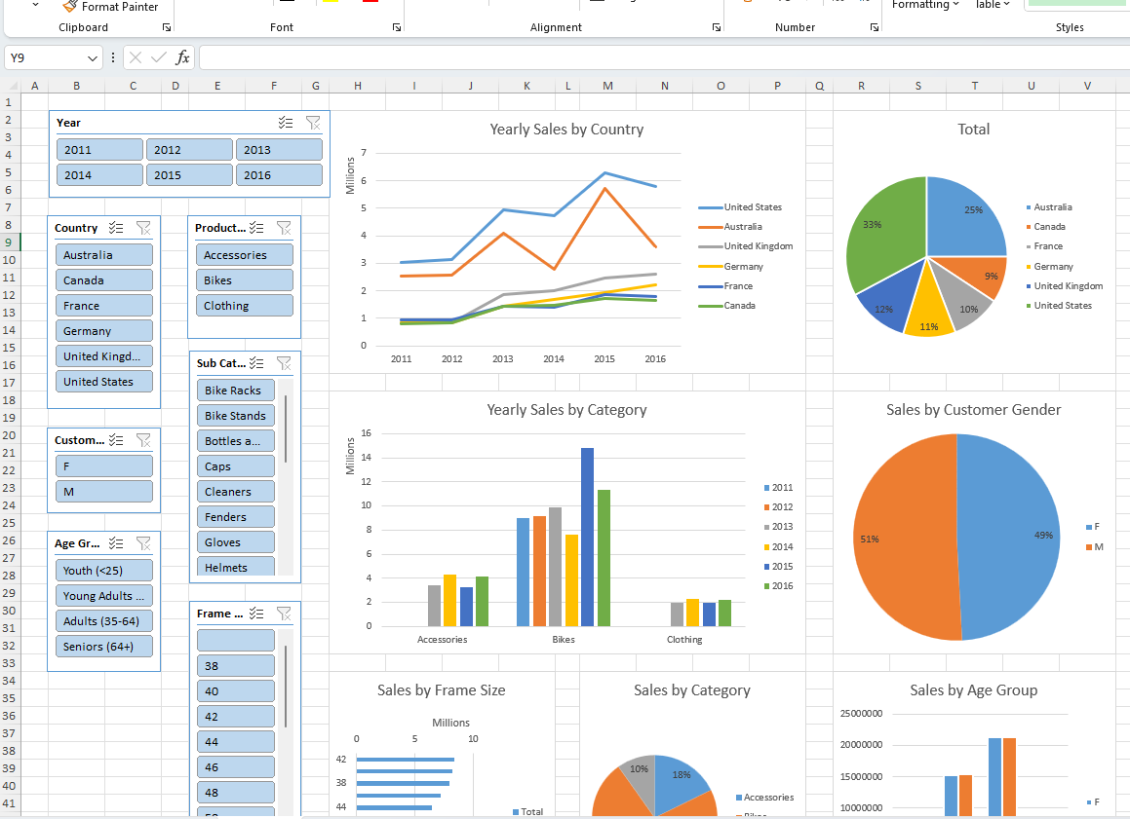

Slide 21
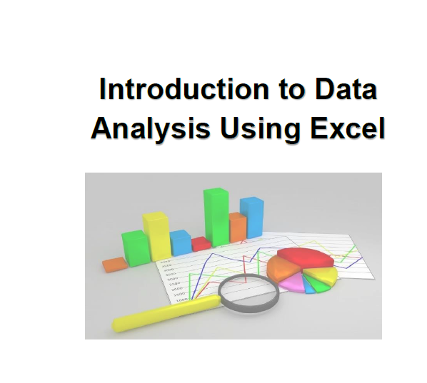
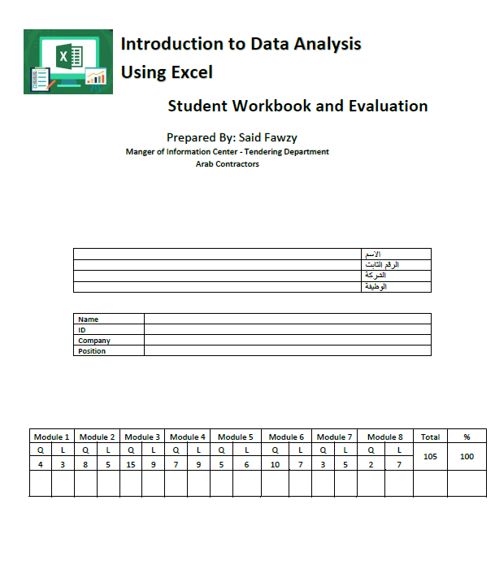
Said Fawzy

Slide 22
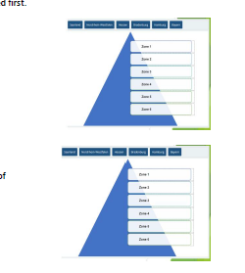

Slide 23
What Next?

Slide 24

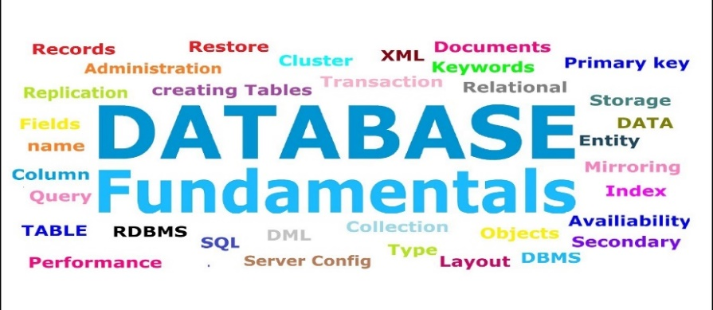




Microsoft Excel Track
Database Track
Basics
Advanced
Part I
Charts
Part II

Slide 25
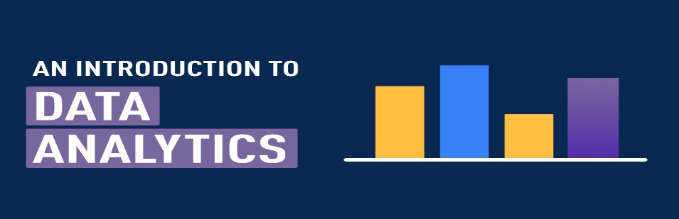
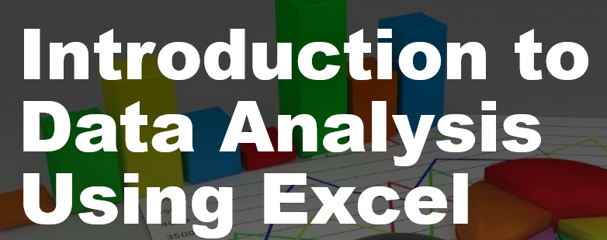

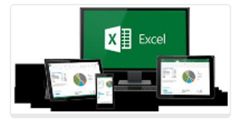
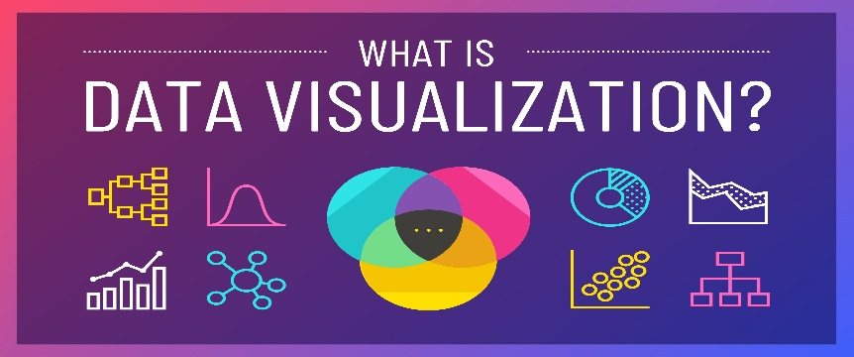
Data Analysis Track
Data Transformation
And Data Modeling in
Part I
Analyzing and Visualizing
Data With Excel
Data Visualization in
Part II
Principles of

Slide 26





Slide 27


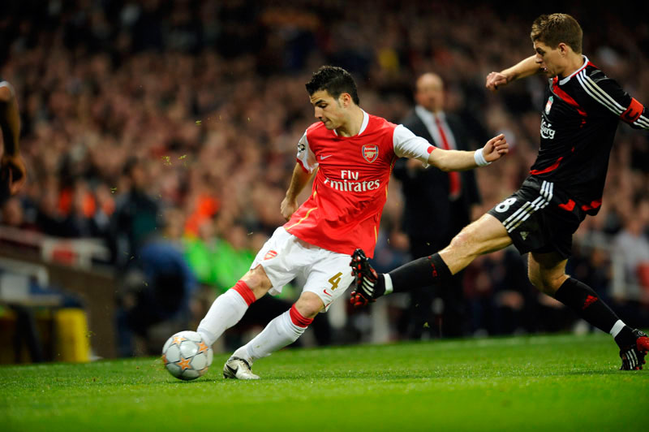
You are Allowed to Talk
about anything except
Religion
Soccer
Policy

Slide 28
Lab 0 : Excel Chart Basics

Slide 29
Feed back

