Slide 1


Said Fawzy
Module 01:
Introduction to Reporting In Excel

Slide 2
Demo 1
Creating Charts

Slide 3




Jack
IT Manager
YOU
presenter
Lucy
New Sales Manage

Slide 4
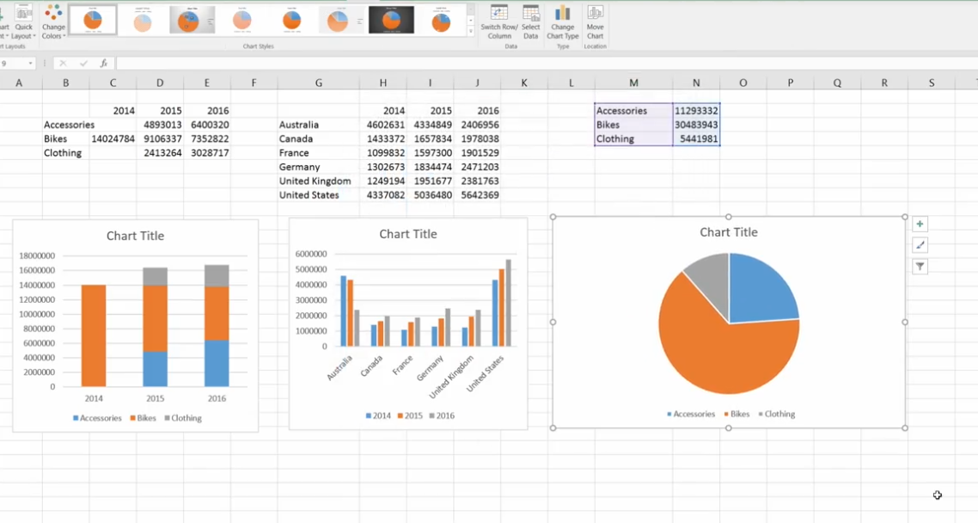

Slide 5
Knowledge Checks
Quiz

Slide 6
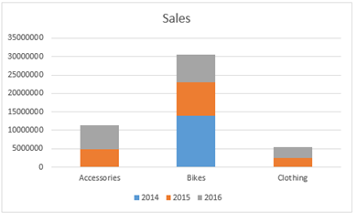

Question 1
You are asked to display a trend for each product by year. What should you do?
Change the chart type to pie chart.
Modify the chart to have the product categories as Legend and years as horizontal axis.
Transpose the table, and create the chart from scratch.
Add summary for each year, and insert a new column chart.
Explanation
We need to have the product categories as Legend and years as Horizontal axis. You can do this by switching rows and columns using the Switch Rows/Columns button in the ribbon.

Slide 7
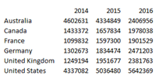
Question 2
You have collected the following data and are considering using a pie chart to display it.
What is a problem that you are likely to encounter by using a pie chart?
You will have to put the legend below or above the pie because the county names are too long to appear next to the appropriate slice
The differences in the data are too small between Canada, Germany, and the United Kingdom for the pie chart to have value.
The pie chart will only show one of the year’s data.
The numbers collected in the data exceed those that can be used effectively in a pie chart.
Explanation
Pie charts only include data that is the first column of data and will ignore any other columns in the data..

Slide 8
Question 3
You have collected the following data and want to use a chart to display it.
Which chart should you use to display it?
Histogram
Line chart.
Pie chart
Scatter plot
Explanation
You can create a line chart showing each country as a separate line for the 3 years of data that you have.

Slide 9

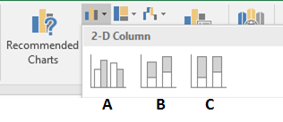
Question 4
You are asked to display the percentage of sales by category for each year in a column chart.
A
A and B
B and C
C
Explanation
C is a 100% Stacked Column chart that shows the ratio between the series for each category.

Slide 10
Lab 1

Slide 11

Scenario
Use Data in file Lab1Start v5.xlsx.
You are the new marketing manager of an established Bicycle company.
The company sells bicycles and accessories, such as clothing and other accessories to bikers in six countries.

Slide 12

Scenario
The company has just hired Lucy as its new Sales manager.
You are tasked to introduce Lucy to the company, its product portfolio and its sales performance since 2011.
To do this, you have asked Jack, the IT manager to prepare some data for you.
Now, it's your job to present this data in a compelling manner.

Slide 13
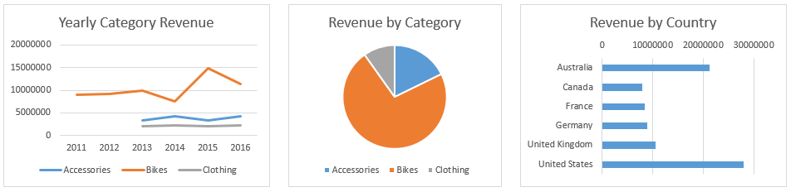
Lab 1 –Step 1
The first thing you'd like to do is to present the data graphically.
You do this by creating charts for the three groups of data you received from Jack, your IT manager.
If you haven't done so, give the chart a descriptive title.

Slide 14
Lab 1- Step 2
Once you have created the three charts above, let's customize them a little bit more.
For the "Yearly Category Revenue", display the total for each year as a separate line.
  Create a total line in the range B7 to H7
  Select the Yearly Category Revenue chart.
  The data source for the chart is highlighted.
  Drag the highlighted selection to include the total row (B7 to H7)

Slide 15
Question 1
Lab 1
What does the Yearly total sales look like?
Increasing year over year.
Similar to the yearly bikes revenue
Decreasing year over year.
Similar to the yearly accessories revenue
Explanation
While the company introduces new product category, the yearly sales relatively mirrored the yearly bike sales. This might require further investigation!

Slide 16
Lab 1 – Step 3
For the "Revenue by Category", display the percentage for each component.
  Select the Revenue by Category chart.
  Select the pie in the chart, right-click and add data labels.
  Select Percentage in the Label Options.

Slide 17
Question 2
Lab 1
What percentage of the total revenue comes from the Bikes category?
10%.
18%
36%.
72%.
Explanation
While the company introduces new product category, the yearly sales relatively mirrored the yearly bike sales. This might require further investigation!

Slide 18
Lab 1 –Step 4
For the Revenue by Country, sort the countries from the one with highest revenue to lowest revenue.
  Select the data source for the Revenue by Country chart.
  Sort the data by Revenue from Largest to Smallest.
  Select the Revenue by Country chart.
  Select the Y axis, the axis that shows the country name.
  Select Categories in reverse order in the Axis options.

Slide 19
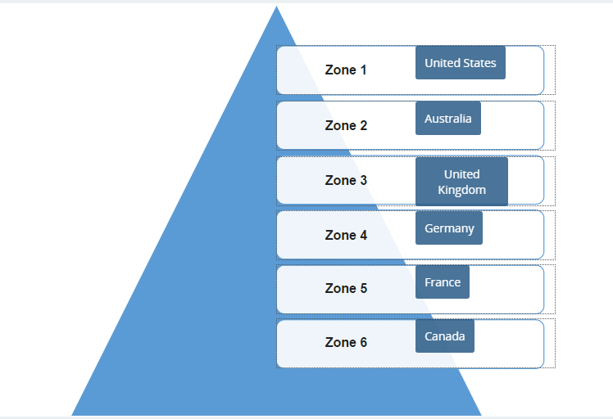
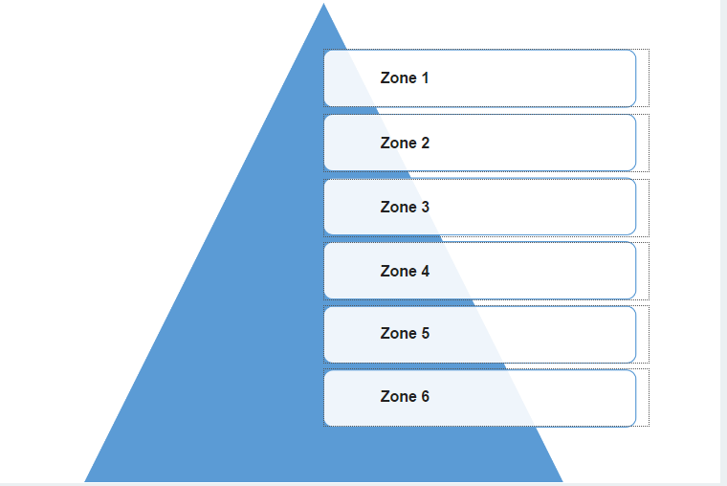
Question 3
Lab 1
Rank the Countries from the highest to lowest revenue. (Highest in Zone 1, Lowest in Zone 6)

Slide 20
Feed back

