Slide 1


Said Fawzy
Module 02:Excel Tables

Slide 2
Before we start:
Functions you should know:
IF
Nested IF
IFS
RIGHT
TEXT
See Extra Demos

Slide 3
Demo

Slide 4

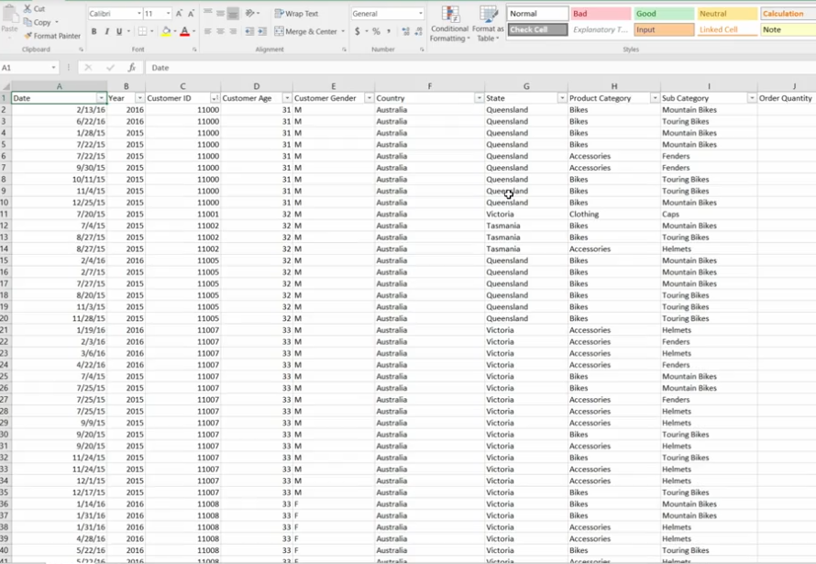
Jack gave us range of data

Slide 5

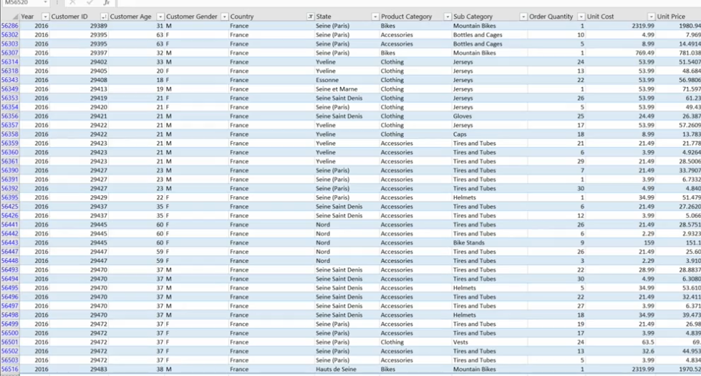
But we need Excel Table

Slide 6
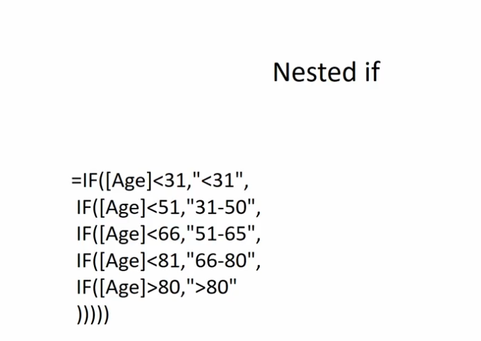
We can use nested IF

Slide 7
We can use IFS
=IFS([@[Customer Age]]<21,"<21",
[@[Customer Age]]>21,"21-30",
[@[Customer Age]]<41,"31-40")

Slide 8
Knowledge Checks
Quiz
Please use the following file to answer the questions :
SalesForCourse_quizz_table.xlsx.

Slide 9

Question 1
What is the difference between a table and a range in Excel? Select four that apply.
In tables, you can add many types of totals for each column without writing any formulas..
A range can be converted to a table, but a table cannot be converted to a range.
Tables are formatted with alternate colors by default.
Formulas in tables refer to other columns by name and not by regular Excel reference.
Formulas in table columns are automatically applied to new rows.
Explanation
Table can be converted to a range from by clicking ‘Convert to Range’ button in the Table Tools contextual ribbon

Slide 10
Question 2
If you filter the table to show only sales in United Kingdom, what will be calculated in the Total row?
The total of all rows.
The totals will recalculate according to the filtered rows.
The totals will recalculate according to the unfiltered rows.
The totals will recalculate only when you reopen the file.
Explanation
The formulas in total rows are using SUBTOTAL function that ignores filtered rows

Slide 11
Question 3
You are only interested in the data for male customers in France. After setting the appropriate filters, answer the following questions.
How many rows are displayed?
2573
What is the total revenue for the displayed rows? Only provide whole number. Do not provide symbols or any decimals places.
1770366

Slide 12
Question 3 (cont.)
What is the average revenue? Only provide numbers, no currency symbols, and report to two decimal points.
688.06

Slide 13
Lab 2

Slide 14
Scenario
Use Data in file Lab2Start.xlsx.
While your first attempt to show the company's performance to Lucy was not bad, clearly, she has a lot more requirements than what you provided.
She wants to know more about the year over year sales, sliced into different categories, sub-categories, and countries.
She also wants to see additional information such as customer demographics.
Jack has provided you with a different data source. This time the data has more than one hundred thousand rows.
Before you can create additional reports to Lucy, first you need to prepare the data.

Slide 15

Lab 2 –Step 1
The first thing you need to do is to convert the data into an Excel table.
Once you do that, you can add total row, filter the data, and the total will reflect the total only for the filtered data.
Let's try this.
Add a total row for the table, and use the Sum aggregation to show the total of the Revenue column and then filter the data only for United States.

Slide 16
Question 1
Lab 2
What is the total revenue for all the sales in the United States?
101990988
27975547
24606895
12494351

Slide 17
Lab 2-Step 2
Now, you need to add several columns, derived from existing columns in the data.
First, let's add a "Month" column. Insert a new column to the left of the Customer ID column, and use formula to derive the month of sales from the Date column.
HINT: Use the Text() function (=TEXT([@Date],"MM")

Slide 18
Question 2
Lab 2
What is the total revenue for all the sales in the month of December??
9086931
8801313
6809175
6494188

Slide 19
Lab 2-Step 3
Next, let's add an "Age Group" column.
Insert a new column to the left of the Customer Gender, and use formula to derive the age group from the Customer Age column.
Let's group the customers based on the following criteria:
      Youth (<25)
      Young Adults (25-34)
      Adults (35-64)
      Seniors (>64)
HINT: Use the nested IF() functions. Alternatively, you can use the IFS() function if it is available in your version (2016 + updates from O365)

Slide 20
Question 3
Lab 2
What is the total revenue for all the sales for Young Adults Age Group?
56053751
29918498
30655614
5556163

Slide 21
Lab 2-Step 4
Now, let's add a "Frame Size" column.
Insert a new column to the left of the Order Quantity, and use formula to derive the frame size of a bicycle from the last two characters of the Product column, when the Product Category is Bikes.
Otherwise, leave it blank.
HINT: Use the IF() and RIGHT() function.

Slide 22
Question 4
Lab 2
What is the total revenue for all the bikes with frame size 62 for the customer age group Seniors?
22914
125893
159102
12452

Slide 23
Lab 2 –Step 5
Last but not least, let's add a "Profit" column.
Insert a new column to the right of the Revenue, and use formula to derive the Profit from both the Revenue and Cost columns.
Show the total for the Profit column.
Use the Sum aggregation in the total row of the table, for the Profit column.
HINT: Profit is Revenue less Cost.

Slide 24
Question 5
Lab 2
What is the total profit for United States sales in the month of October 2015, for customer age group Adults?
111823
142036
148903
138419

Slide 25
Feed back

