Slide 1


Said Fawzy
Module 03: Basic Pivot Tables

Slide 2
Demo 3 A
Basic Pivot Tables

Slide 3

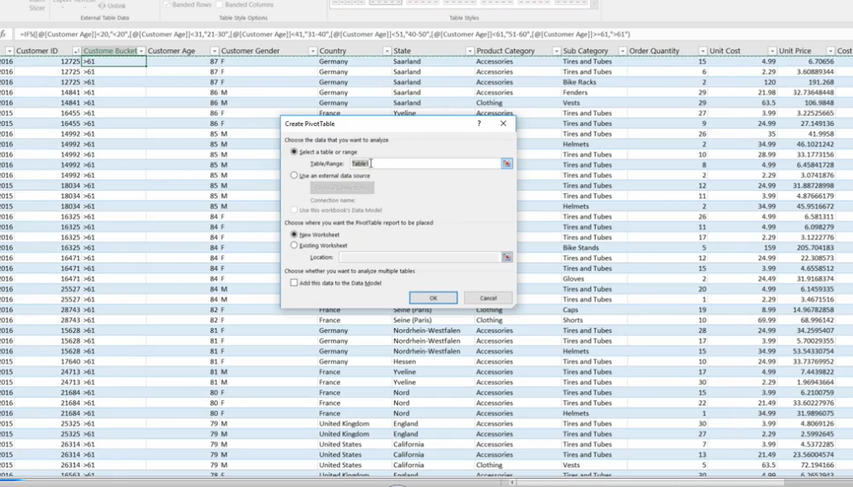
Design >Summaries with pivot table

Slide 4
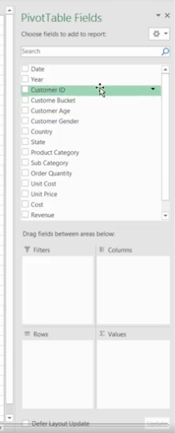
Chose from Field List

Slide 5
Demo 3 B
Creating Dashboard
using Pivot table

Slide 6
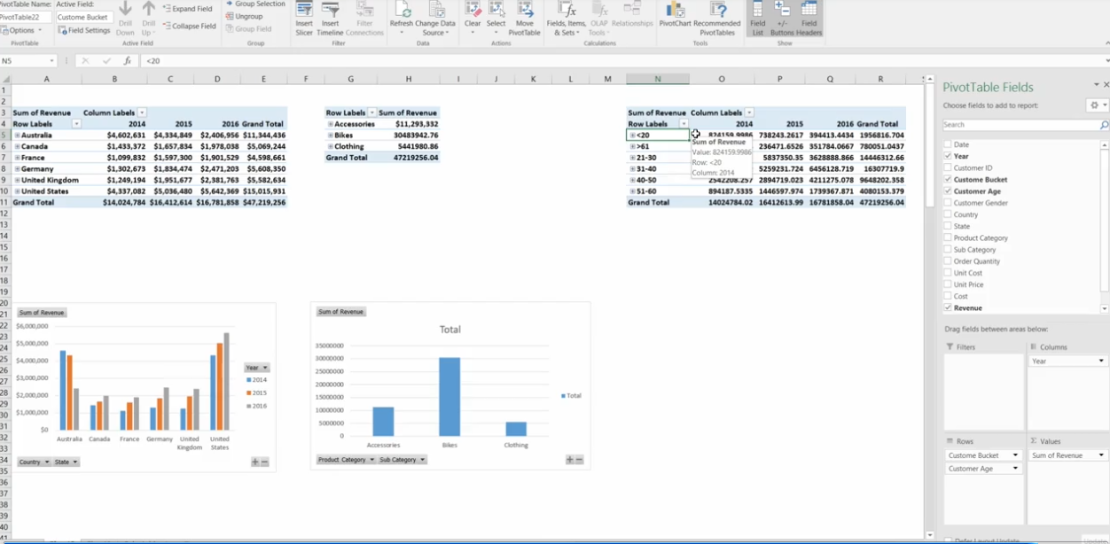
Create Dashboard

Slide 7
Knowledge Checks
Quiz

Slide 8
Question 1
PROBLEM
You have the following Pivot Table fields.
You need to calculate the number of sales by age.
Drag the appropriate field names and aggregated field names to the appropriate Pivot Table Areas (Filters, Rows, Columns, or Values) to perform the task

Slide 9
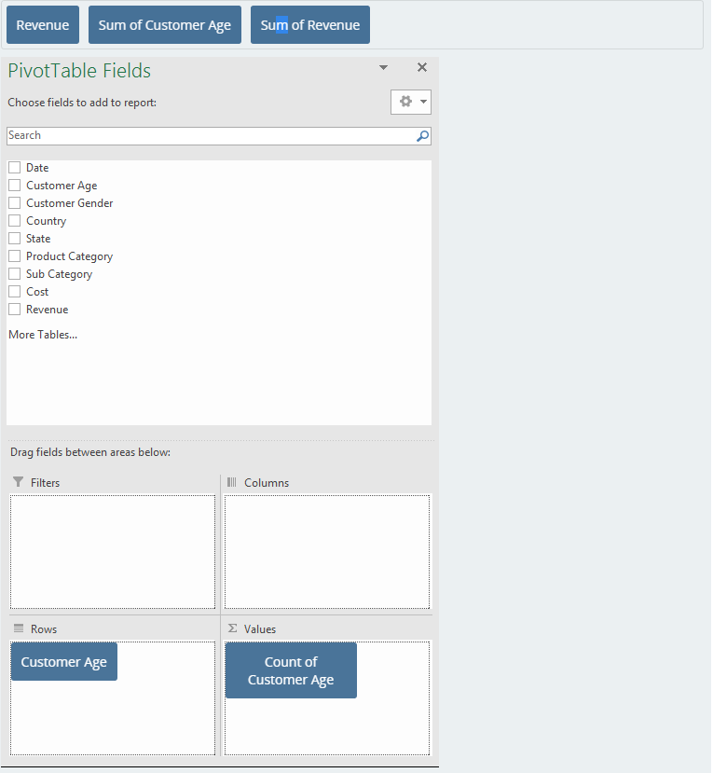
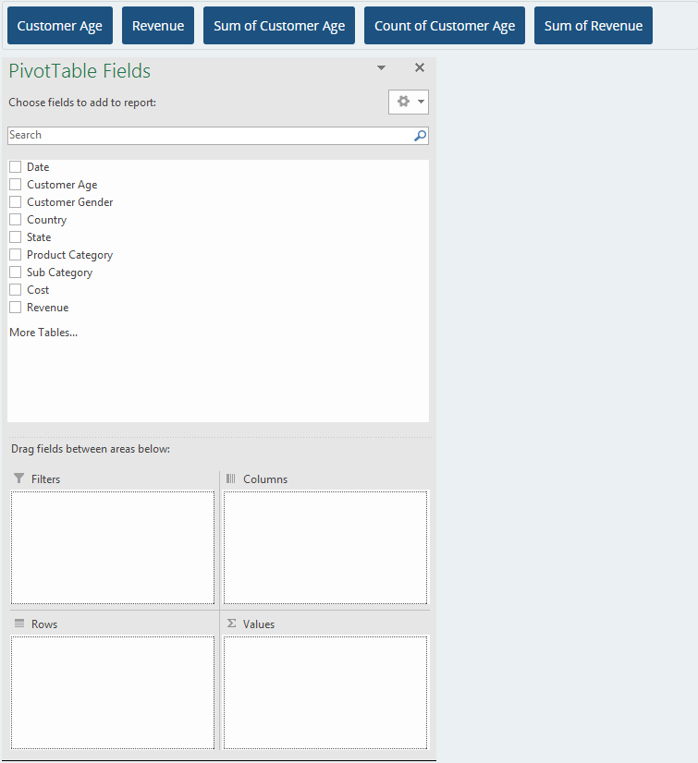
Question 1 (cont.)

Slide 10
Question 2
PROBLEM
You have the following Pivot Table fields.
Your manager asks you to build a pivot table that shows revenue by state and country.
How would you arrange the field names and aggregated field names to the appropriate Pivot Table Areas (Filters, Rows, Columns, or Values)?

Slide 11
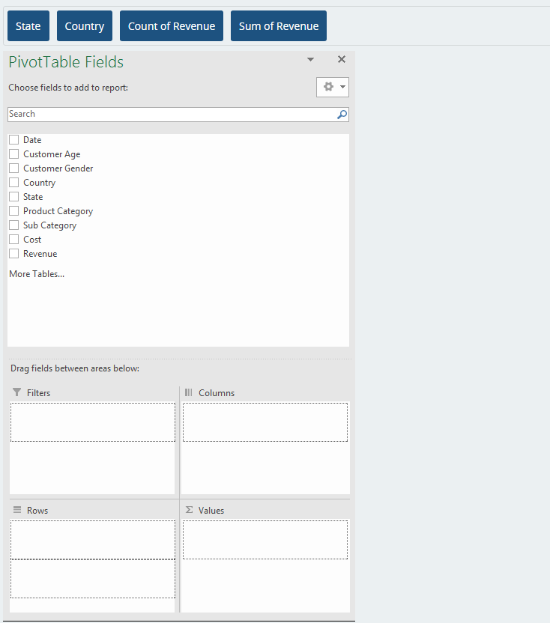
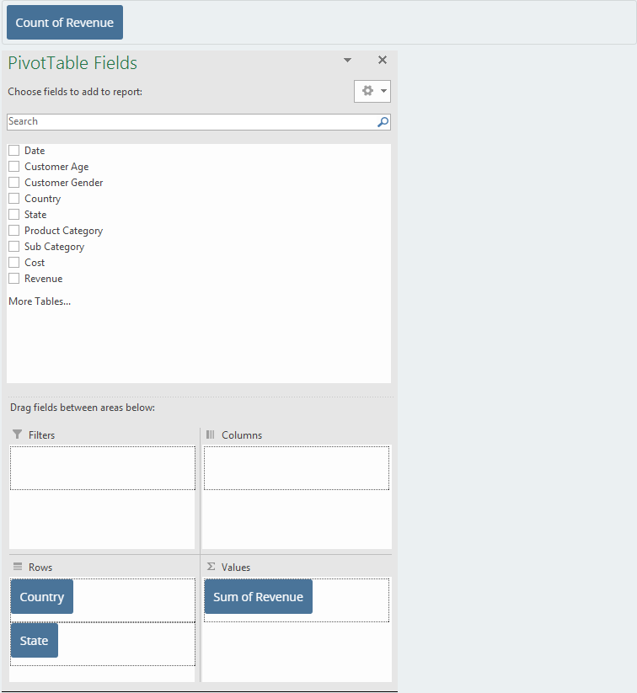
Question 2 (cont.)

Slide 12

Question 3
You have a pivot that is based on an Excel table. You need to add new rows to the Excel table and want to be able to see the values for these new rows in the PivotTable. What should you do?
Create a new pivot table.
Add rows anywhere in the table, and it will automatically update the pivot to include the new values.
Add rows anywhere in the table, and refresh the pivot table.
You must add the new rows only after the last row and refresh the pivot table..
Explanation
Rows can be added to the table at any position. Refresh is required to include new/changed/deleted rows in the calculation of the pivot.

Slide 13
Question 4
Use Data in file SalesForCourse_quizz_table.xlsx
Using the data provided, create a pivot with “Country “as rows, “Month” as columns, and “Revenue” as values. Drag “Years” to the filter area. What does the value 286,779 in the first summarized field of the pivot table (uppermost left value) represent?
The total for January in France for the first year (2015).
he total for January in France for the last year (2016).
The total for January in all countries.
The aggregated value for January in France in 2015 and 2016.
Explanation
Year is not included in the pivot so the value for January is an aggregation of all years.

Slide 14
Question 5…Numeric input
Create a new PivotTable with “Customer Gender” as rows, “Product Category” as columns, and “Revenue” as values.
a. How much revenue was raised through the purchase of bikes by women? Provide a whole number without currency symbols or decimal places.
5728781
b. How much revenue was raised through clothing purchased by men? Provide a whole number without currency symbols or decimal places.
1817262

Slide 15
Question 6
When you summarize data using an Excel Pivot Table, each number found in a Pivot Table cell represents one or more records in the pivot table’s source data and is directly related to the Column and Row fields you used in the Pivot Table.
A quick way to review this underlying set of records is to use the Show Details feature - right click within the desired cell and select Show Details from the menu options.
This is commonly called Drilling down into the data and can also be achieved by double-clicking in the cell in question

Slide 16
Question 6 (Cont.)
Create a new PivotTable with “Country” as rows, “Product Category” as columns, “Year” as a filter, and “Revenue” as values. Filter by year 2015.

Slide 17
Question 6 (Cont.)
Drill down into the data for the cell that represents the revenue for bike sales in Germany, 2015. A new worksheet is created with a table in it. What is the content of this table?
The table shows columns for Year, Country, Revenue, and Products
The table contains all rows in SalesTable corresponding to 2015, Bikes and Germany
The table includes data from SalesTable for the first month of 2015 and the first subcategory of Bikes.
The table includes data from SalesTable for 2015 and the first subcategory of Bikes.
Explanation
Double clicking a value in a PivotTable creates a new table that contains all rows used to calculate the selected value.

Slide 18
Question 7…Numeric input
Calculate the answers to the following questions using the data provided and PivotTables. All answers should be provided in whole numbers, without currency symbols or decimals
a. Total revenue for sales of bikes in the country that sold the most in 2016:
2257187
b. Number of sales transactions for bikes in the US in 2016:
1415

Slide 19
Question 7…Numeric input (cont.)
c. Average number of clothing items purchased in the US during 2016 rounded to the nearest whole number:
2
d. The largest revenue registered in a single transaction in the Germany during 2015:
3089

Slide 20
Question 7…Numeric input (cont.)
e. The largest revenue registered in a single transaction during 2015:
3224

Slide 21
Lab 3

Slide 22

Scenario
Use Data in file Lab3AStart.xlsx.
Now that you have prepared the data in an Excel table, you can start to create pivot tables to aggregate the data and create some reports.
From your conversation with Lucy, you know that she is interested in looking into the yearly sales data broken down by countries, product categories, and age groups.

Slide 23

Lab 3A
First, let's start by naming the Excel table. Name the Excel table prepared in the previous lab to SalesTable. From now on, every time you add a pivot table, it should be based on this SalesTable, unless mentioned otherwise.

Slide 24
Lab 3A – Step 1
Now, proceed to add your first pivot table. Insert a new pivot table based on the SalesTable to a new sheet. Arrange the layout so that the pivot table displays the Product Category and Sub Category in the Rows, Year in the Columns, and Revenue (Sum of) as the Values.

Slide 25
Question 1
Lab 3A
Which year did the company start selling Touring Bikes?
A. 2011.
B. 2012
C. 2013.
D. 2014

Slide 26
Lab 3A –Step 2
Insert another pivot table to the same sheet, next to the existing pivot table. Arrange the layout so that the pivot table displays the Country and State in the Rows, Year in the Columns, and Revenue (Sum of) as the Values. Sort the pivot table by Sum of Revenue so that the Country and State with the highest revenue is displayed first.

Slide 27
Question 2
PROBLEM
Rank the States for Germany, from the highest to lowest revenue.
Hint: Sort the States field in descending order by Sum of Revenue

Slide 28
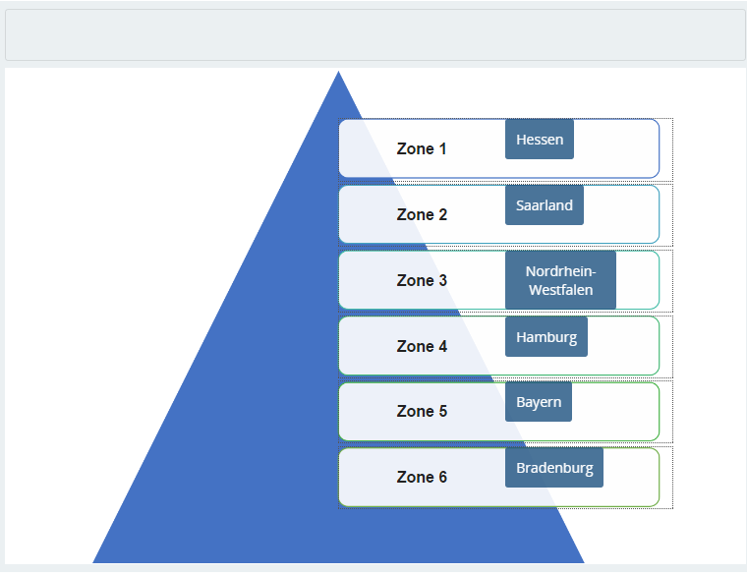
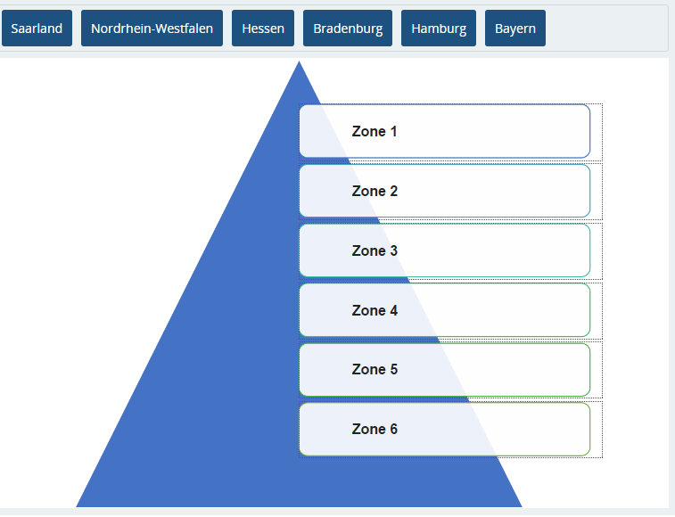
Question 2 (cont.)

Slide 29
Question 3
PROBLEM
What about for the year 2013?
Hint: Expand Germany and sort the State field in descending order by Sum of Revenue using values from the 2013 column.

Slide 30
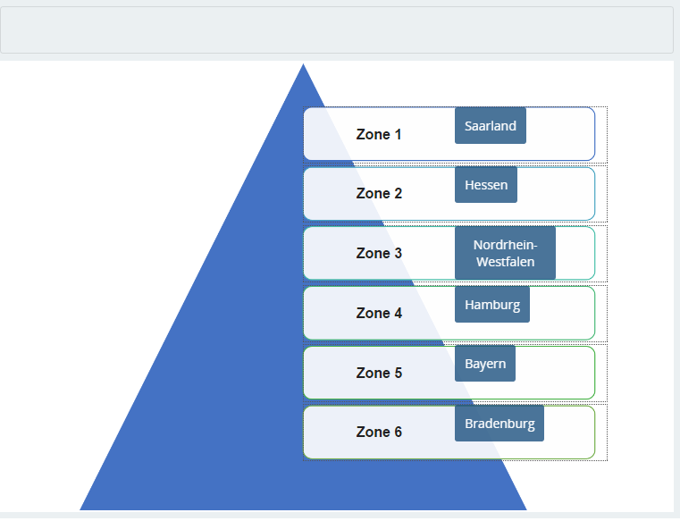
Question 3 (cont.)

Slide 31
Lab 3A – Step 3
Let's add another pivot table.
This time arrange the layout so that the pivot table displays the Frame Size in the Rows and Revenue (Sum of) as the Values.
Hide the rows that do not have a Frame size (blank Frame size), then sort the pivot table by Sum of Revenue so that the Frame size with the highest revenue is displayed first.

Slide 32
Question 4
Lab 3A
Which frame size sold the most?
A. 40.
B. 42
C. 44
D. 48

Slide 33
Lab 3A – Step 4
Last but not least, add another pivot table with Age Group as the Rows and Revenue (Sum of) as the Values.
You will learn how to custom sort the Age Group in the next module.
But for now, sort the pivot table by Sum of Revenue so that the Age Group with the highest revenue is displayed first.

Slide 34
Question 5
Lab 3A
Which Age Group has the lowest revenue?
A. Youth.
B. Young Adults
C. Adults
D. Seniors

Slide 35
Lab 3B – Step 1
Now you can start adding some charts to the sheet.
First, add a pivot chart for the pivot table that shows yearly sales by Country.
Select a Line chart to display the yearly trend.
Make sure that the Years are located in the X axis, the Revenue in the Y axis, and the Countries as categories.
Hint: You might find the Switch Row/Column in Select Data Source window useful. In addition, try Collapsing the Country fields in order to hide the States fields.

Slide 36
Question 1
Lab 3B
In this chart, you can clearly see the sales trend for each Country.
Which country’s trend is the most different when compared to the other countries?
A. United States.
B. Australia
C. Germany.
D. United Kingdom.

Slide 37
Lab 3B –Step 2
Add another pivot chart for the pivot table that shows yearly sales by Product Category.
Select a Column chart to display the yearly sales by category so that the years are together.

Slide 38
Question 2
Lab 3A
Which year does the Bikes category have the least sales?
A. 2011.
B. 2012
C. 2013.
D. 2014

Slide 39
Lab 3B – Step 3
Add another pivot chart, this time for the pivot table that shows Revenue by Age Group.
Select a Pie chart to display the proportion of each Age Group.
Add the Data labels to show percentage, formatted to two decimal points.

Slide 40
Question 3
Lab 3A
In this chart, you can clearly see the proportion of sales for each Age Group.
What is the proportion of sales for Young Adults?
A. 54.96%.
B. 29.33%
C. 35.95%
D. 49.74%

Slide 41
Lab 3B – Step 4
Add another pivot chart, this time for the pivot table that shows Revenue by Frame size.
Select a Bar chart to display the order of sales by Frame size.
Sort the Y axis to show the Frame size that has the most sales on the top.
Hint: Select the Categories in reverse order option in the Axis Options.

Slide 42
Question 4
Lab 3A
In this chart, you can clearly see the order of sales by Frame size.
Which frame size sold the least?
A. 52.
B. 54
C. 46
D. 48

Slide 43
Feed back

