Slide 1

Exploratory Analysis of Residential Property Data

Slide 2
About me
    I am Kadiyala Sai Dheeraj, a B.Tech graduate in Artificial Intelligence and Machine Learning from R.M.D Engineering College(2025).
I want to learn data analysis to transform raw data into meaningful insights that support better decision-making. With my background in AI and Machine Learning, data analysis helps me understand patterns, trends, and business problems, and build data-driven, real-world solutions.
linkedin :https://www.linkedin.com/in/kadiyala-sai-dheeraj-511a26260/
Github: https://github.com/saidheeraj97019

Slide 3
Objectives of the session
Phase 1: Data Exploration & Initial Assessment
what is Python ??
Python is a high-level, open-source programming language that is easy to read and write, and is widely used for data analysis, automation, web development, and artificial intelligence.
Why it is important ??
Python is important because it is simple, versatile, and powerful. It has a rich set of libraries (like NumPy, Pandas, and Matplotlib) that make data analysis, machine learning, and automation faster and more efficient.

Slide 4
Step 1: Data Understanding
Data Set:
https://www.kaggle.com/code/ruchi798/housing-prices-eda-and-prediction/input?select=Hyderabad.csv
Columns available in the data:
                'Price', 'Area', 'Location', 'No. of Bedrooms', 'Resale’,
                'MaintenanceStaff', 'Gymnasium’, 'Swimming Pool’, 'LandscapedGardens', 'JoggingTrack’,
                'RainWaterHarvesting', 'IndoorGames', 'ShoppingMall','Intercom', 'SportsFacility’,
                'ATM', 'ClubHouse', 'School', '24X7Security', 'PowerBackup', 'CarParking', 'StaffQuarter',
                'Cafeteria', 'MultipurposeRoom', 'Hospital', 'WashingMachine',
                'Gasconnection', 'AC', 'Wifi', 'Children’s playarea', 'LiftAvailable',
                'BED', 'VaastuCompliant', 'Microwave', 'GolfCourse', 'TV',
                'DiningTable', 'Sofa', 'Wardrobe', 'Refrigerator'

Slide 5
libraries used :
DataType in each Column:
All columns are integers except Location, which is object (categorical) data type.
Dimension of the data:
Dataset consists of 32963 Rows and 40 Columns.
Missing Values:
Dataset doesn’t have any missing(NULL) Values.
Numpy
Matplotlib
Seaborn
Pandas

Slide 6
Distribution of key fields:
Duplicates:
Dataset consists of 3,828 rows and multiple unwanted columns like
“Microwave”, “AC” etc .
These columns which doesn’t have any relation to the Price Parameter.
Price -- Numerical
Location -- Categorical
Area -- Numerical
No of Bedrooms -- Numerical

Slide 7
Phase 2: Data Cleaning & Manipulation
Problem Summary:
.
The dataset consists of 3,828 records with both numerical and categorical features.
It contains unnecessary and irrelevant columns that do not contribute to the analysis.
The data requires cleaning and preprocessing before analysis.
The goal is to analyze patterns and relationships (such as price vs. location) to extract meaningful insights for data-driven decision making.

Slide 8
Missing Values:
The dataset does not contain any missing values.
All columns have complete and consistent data, requiring no imputation.
Duplicates & Inconsistencies:
3,828 duplicate records were identified and removed to ensure data uniqueness.
The Location column contained inconsistent values with numbers and extra text.
Regular expressions (Regex) were used to clean the Location column by:
Removing numeric characters (0–9)
Removing unnecessary text such as “Phase”

Slide 9
Data Type Corrections:
Bivariate Insights:
A relationship is observed between Price and Location, indicating that property prices vary across different locations.
Certain locations show higher average prices, while others are more affordable.
2 & 3 BHK dominate the market
No data type corrections were required.
All columns were already in their appropriate and expected data types for analysis.

Slide 10
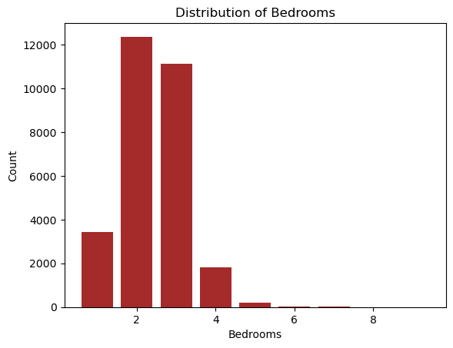
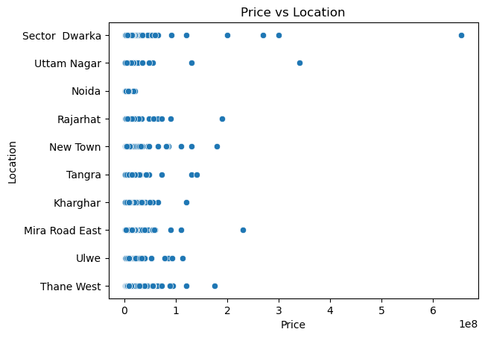

Slide 11
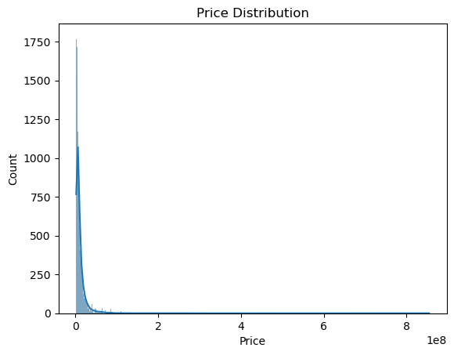
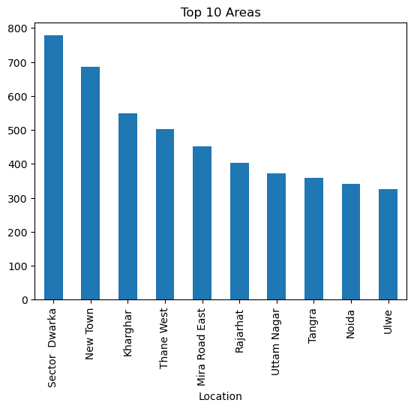
← Right Skewed
Univariate Analysis

Slide 12
Summary of Bivariate Relationships Discovered:
Price vs Area:
  Weak positive relationship (correlation ≈ 0.27)
  Larger properties tend to have higher prices, but area alone does not strongly explain price variation.
  Interpretation (without graphs):
  Area is the most influential variable, but its impact on price is limited, indicating other factors also play a role.

Slide 13
Price vs Number of Bedrooms:
Very weak positive relationship (correlation ≈ 0.15)
Increase in bedrooms slightly increases price, but not significantly.
Insight:
Bedrooms likely influence price indirectly through area rather than independently.

Slide 14
Conclusion:
The dataset was successfully cleaned by removing duplicates and correcting inconsistencies in the Location column.
No missing values or data type issues were found, ensuring data reliability.
Bivariate analysis revealed that location significantly influences price variation.
overall, the analysis provided clean, consistent data and meaningful insights to support data-driven decision making.
Bivariate analysis revealed weak positive relationships between price and factors such as area and number of bedrooms, while individual amenities showed negligible impact.

Slide 15

THANK YOU

