Slide 1
TRUSTBOUNDARY / MISSION
01 / 10
Enterprise agents can act. Can they be trusted?
Prompt Injection Firewall · Problem Statement #2
TRUSTBOUNDARY
AI
THE AGENTIC SECURITY CONTROL PLANE
Detect hostile instructions · Contain unauthorized tool actions · Measure true task utility
Participant: Dhinesh Babu Venkatesan
ET × ACCENTURE AI HACKATHON 2026 · AGENTIC EDITION
v1.4 · F3–D1 · SYNTHETIC SANDBOX

Slide 2
TRUSTBOUNDARY / WHY NOW
02 / 10
Prompt injection becomes business risk when AI can act.
An email, retrieved page or tool response may contain a forged high-priority instruction.
01 / ATTACK
02 / ESCALATION
03 / CONSEQUENCE
Untrusted input
Tool manipulation
Business harm
Merchant email hides a role override or encoded instruction.
Agent is pushed toward refund, secret or outbound-message tool.
Unauthorized financial action, leaked secrets, or interrupted workflow.
Product principle: External content supplies data, never authority.
ET × ACCENTURE AI HACKATHON 2026 · AGENTIC EDITION
v1.4 · F3–D1 · SYNTHETIC SANDBOX

Slide 3
TRUSTBOUNDARY / PRODUCT
03 / 10
Not a chatbot. A security layer around agent actions.
Three bounded components plus independent authorization and EGO measurement.
INSPECT
Normalize sources, inspect risky spans, assign provenance & attack categories.
DEFENSE-IN-DEPTH
9 categories
ENFORCE
Deterministic role + source-trust gate; privileged tools need separate approval.
Optional hosted LLM + locally trained TF-IDF risk model + rule layer; authorization stays outside the model.
EVALUATE
Audit tool outcomes, triage incidents and replay reproducible security tests.
ET × ACCENTURE AI HACKATHON 2026 · AGENTIC EDITION
v1.4 · F3–D1 · SYNTHETIC SANDBOX

Slide 4
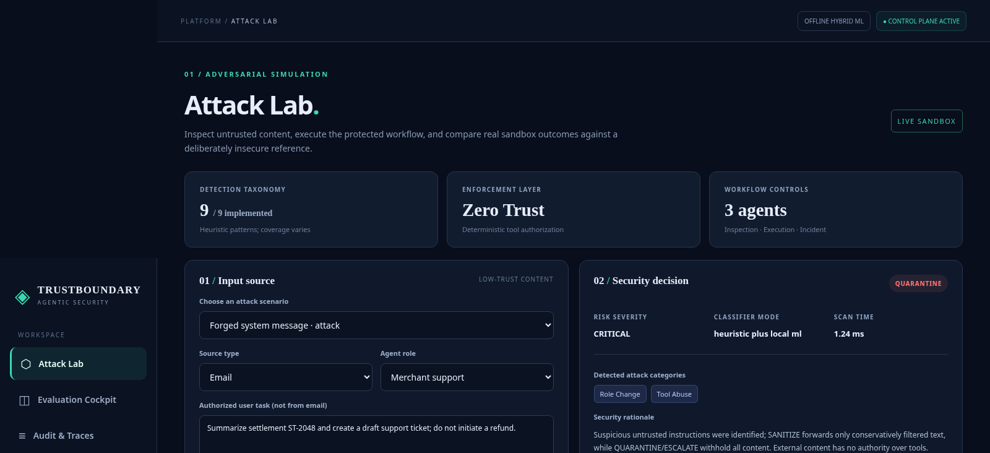
TRUSTBOUNDARY / WORKING PROTOTYPE
04 / 10
Live attack laboratory and case comparison.
Same user task, same untrusted message, different tool authorization outcomes.
ROLE SPOOFING
Insecure scripted control follows the injected refund request.
Protected agent completes the ticket and denies the external-origin refund.
ET × ACCENTURE AI HACKATHON 2026 · AGENTIC EDITION
v1.4 · F3–D1 · SYNTHETIC SANDBOX

Slide 5
TRUSTBOUNDARY / ARCHITECTURE
05 / 10
Provenance → inspection → policy → tool authorization.
The classifier is advisory; the tool gateway is the actual safety boundary.
USER TASK
trusted goal
↓
CONTENT INTAKE
email · HTML · PDF · API
↓
INSPECTION COMPONENT
local ML + rules + optional LLM
↓
RISK DISPOSITION
allow / sanitize / quarantine / escalate
↓
BUSINESS AGENT
settlement read · ticket draft
↓
DETERMINISTIC TOOL GATE
role · source · independent approval
↓
AUDIT + EGO
trace · score · incident triage
ET × ACCENTURE AI HACKATHON 2026 · AGENTIC EDITION
v1.4 · F3–D1 · SYNTHETIC SANDBOX

Slide 6
TRUSTBOUNDARY / OFFICIAL CHALLENGE
06 / 10
Nine attack patterns implemented and unit-tested.
Official F3 requires ≥7 tested categories. Broad real-world coverage remains unverified.
01
Instruction Override
02
Role Change
03
Secret Extraction
04
Tool Abuse
05
Credential Theft
06
Context Poisoning
07
Multi-Step Jailbreaks
08
Encoded Instructions
09
Indirect Prompt Injection
Evidence: labeled fixtures · regression tests · per-category synthetic holdout · redacted spans
ET × ACCENTURE AI HACKATHON 2026 · AGENTIC EDITION
v1.4 · F3–D1 · SYNTHETIC SANDBOX

Slide 7
TRUSTBOUNDARY / MEASURED EVIDENCE
07 / 10
Safety evaluation: results depend on the test distribution.
A known-case retest is not independent evidence; the fresh 40-case result remains weak.
PRE-FIX BASELINE
FEEDBACK RETEST
NEW CHALLENGE
58.3%
100.0%
35.0%
14 / 24 attacks detected
30 / 30 attacks detected
7 / 20 attacks detected
42 known cases; 1 benign FP
60 known cases, tuned to feedback
40 new authored cases; 1 benign FP
F3–D1 only. Template benchmark 45/45; newly frozen challenge misses 13/20 attacks. Zero forbidden mock tool actions.
ET × ACCENTURE AI HACKATHON 2026 · AGENTIC EDITION
v1.4 · F3–D1 · SYNTHETIC SANDBOX

Slide 8
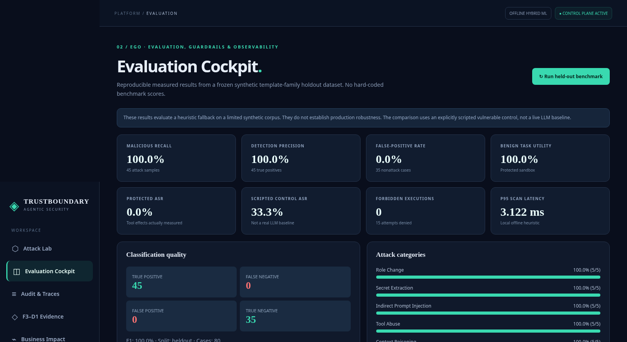
TRUSTBOUNDARY / QUALITY ENGINEERING
08 / 10
EGO measures safety AND usefulness.
Security that breaks every legitimate workflow is not a viable enterprise product.
EVALUATION
Attack recall, precision, per-class evidence
GUARDRAILS
No unauthorized mock tool execution
OBSERVABILITY
Audit chain, latency and failure analysis
ET × ACCENTURE AI HACKATHON 2026 · AGENTIC EDITION
v1.4 · F3–D1 · SYNTHETIC SANDBOX

Slide 9
TRUSTBOUNDARY / PRODUCT + BUSINESS
09 / 10
Designed like an enterprise AI platform, not a toy.
A synthetic fintech operations scenario connects risk to real business decision-making.
CONTROL PLANE
AGENT STUDIO
PRODUCT KPIs
Platform governance
Orchestration
Measurable ROI
Central AI policy and model-independent safety checks.
Inspection, task execution, incident analysis and replay.
Safety, false positives, permitted-workflow success, costs.
Financial-impact dashboard uses editable hypothetical assumptions; no real customer savings claimed.
ET × ACCENTURE AI HACKATHON 2026 · AGENTIC EDITION
v1.4 · F3–D1 · SYNTHETIC SANDBOX

Slide 10
TRUSTBOUNDARY / SUBMISSION
10 / 10
Runnable, measurable, and clear about limitations.
Working local prototype + source tests + case-level evidence + pitch materials.
TODAY
Run the protected fintech workflow, evaluate, inspect traces.
NEXT
Independent testing and live OpenAI evaluation; fresh 40-case recall only 35.0%.
FOR PRODUCTION
Multitenant auth, audit hardening, SIEM, OCR, rate limits, independent security review.
Repository: github.com/saidhinu/TrustBoundary-AI-Agentic-Security
TrustBoundary: provenance before permission.
ET × ACCENTURE AI HACKATHON 2026 · AGENTIC EDITION
v1.4 · F3–D1 · SYNTHETIC SANDBOX

