Slide 1
BIOMOLECULEs
by : Zaigham Hasan

Slide 2
CARBOHYDRADATES
Carbohydrates are chemical compounds that contain carbon and the elements of water: hydrogen and oxygen. A few also contain nitrogen or sulfur.
There are two main groups of
carbohydrates: sugars and starches.
Sugars are small, water soluble
molecules that taste sweet. Starches
are very large, insoluble molecules.

Slide 3
CARBOHYDRADATES
Carbohydrates may be monosaccharides, disaccharides, or polysaccharides.
Monosaccharides
Simple sugars all have the same general formula Cn(H2O)n. The simplest common sugar found in animals is glucose (C6H12O6)
Glucose has two molecular forms:
a straight chain and a ring.
About 98 percent of the sugar molecules in a solution are in ring form.

Slide 4
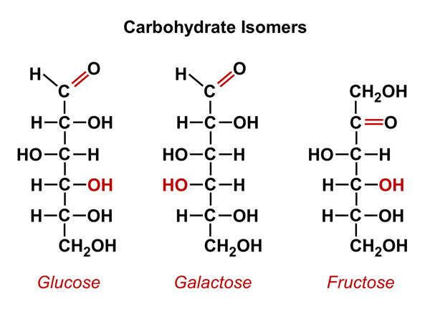
CARBOHYDRATE

Slide 5
CARBOHYDRADATES
Disaccharides
Disaccharides are sugars made by linking together two monosaccharide rings by a condensation reaction.
An OH group from each monosaccharide unit reacts together to make water (H2O) and form an oxygen bridge between the sugar rings.

Slide 6
CARBOHYDRADATES
Maltose (C12H22O11) is a disaccharide
that is a product of starch digestion
and is also found in some germinating
seeds. It is formed by two glucose
molecules joined together by a
glycosidic (C-O-C) bond.

Slide 7
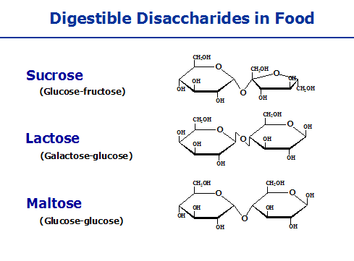
CARBOHYDRATE

Slide 8
CARBOHYDRADATES
Polysaccharides
Carbohydrates with large numbers of
rings in their molecules are called polysaccharides.
Polysaccharides are used in living things for energy storage and to build structures
For example
Starch, glucose, cellulose, chitin

Slide 9
CARBOHYDRADATES
Polysaccharides in animals
In animals polysaccharides are mainly used for energy storage. In humans up to 10 percent of the weight of the liver can be glycogen—an instant store of energy that is easier to mobilize than fat, which is used for long-term energy storage.
A typical glycogen molecule may contain 300 to 400 glucose units in a branching molecule.
Glycogen also occurs in yeasts and
bacteria

Slide 10
CARBOHYDRADATES
Chitin is made of acetylglucosamine, glucose units with an amino group attached.
It is common in shellfish (the edible crab can be 70 percent chitin) where it is an important part of the shell.
Chitin is also found in the exoskeleton of insects.
Chitin is a structural polysaccharide and is not used as an energy store.

Slide 11
CARBOHYDRADATES
Polysaccharides in plants
Plants store starch as granules inside their cells. Roots such as potatoes and carrots are often rich in starch, which provides the energy needed for the next generation to develop before it can produce its own food by photosynthesis.
Cellulose is a structural polysaccharide and gives the cell wall its strength. Animals cannot digest cellulose, and so it passes through the gut largely untouched as roughage.

Slide 12
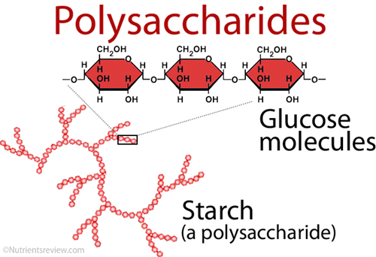
CARBOHYDRATE

Slide 13
PROTEIN
All proteins are made of small amino
acid molecules linked by peptide
bonds in long chains resembling a
string of beads.
l The number and order of amino acids
in the chain decides how the protein
will behave.

Slide 14
PROTEIN
Some proteins have more than one
chain of amino acids and some have
extra groups of atoms added. For
example, hemoglobin, which
transports oxygen from the lungs to
cells throughout the body, is a protein
with four amino acid chains wrapped
around a central group containing
iron.

Slide 15
PROTEIN
AMINO ACID
Amino acid molecules are made of four groups bonded with a single carbon atom. Three of these groups are non-variable.
The amino group NH2 is a basic group, which means it behaves as an alkali in solution.
At the other end of the molecule is a carboxyl group (COOH), which acts as an organic acid.
The third group is a hydrogen atom.
The fourth group is variable. It is often shown in diagrams by the letter R..

Slide 16
PROTEIN
Different amino acids have different R groups.
There are about 20 naturally occuring amino acids
The simplest amino acid is glycine. The R group here is a single hydrogen atom
More complicated amino acids such as proline have R groups containing many atoms, complex rings and sometimes elements such as sulfer or phosphorous

Slide 17
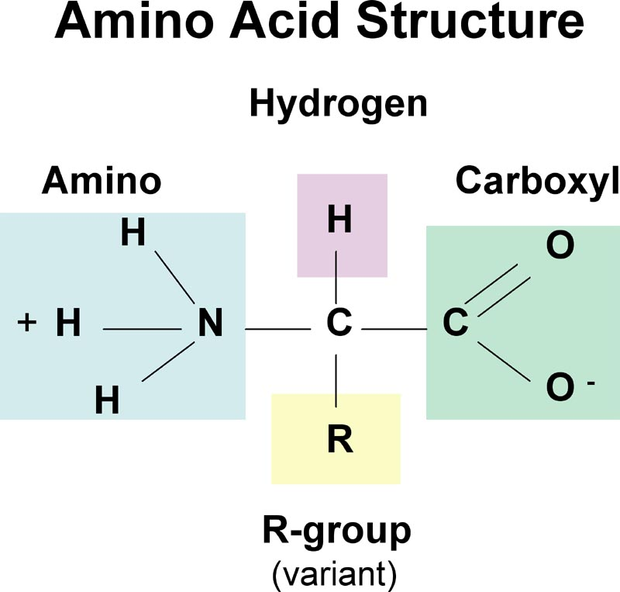
PROTEIN

Slide 18
PROTEIN
Types of protein
There are two main groups of proteins: fibrous and globular.
Fibrous proteins
Fibrous proteins have chains twisted into spiral shapes held together by strong bonds to make the molecule look like a spring.
For example
They are found in skin and hair

Slide 19
PROTEIN
Globular proteins
Globular proteins have chains that wind in and out of each other, twisting into complex shapes that look like a ball of wood. Their chains are held together with a mixture of strong and weak bonds.
Globular proteins often have more than one chain and can contain extra non-protein groups. For example
hemoglobin contain iron ions.

Slide 20
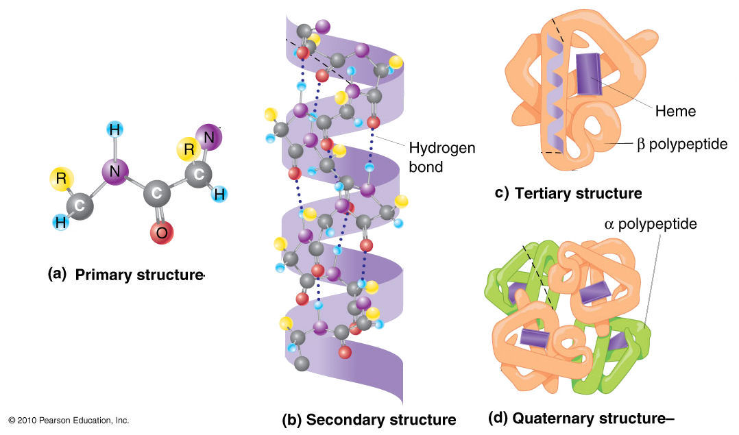
PROTEIN

Slide 21
LIPIDS
In biology and biochemistry, a lipid is a biomolecule that is soluble in non polar solvents.
Non-polar solvents are typically hydrocarbons used to dissolve other naturally occurring hydrocarbon lipid molecules that do not (or do not easily) dissolve in water, including fatty acids, waxes, sterols, fat-soluble vitamins (such as vitamins A, D, E, and K), monoglycerides, diglycerides, triglycerides, and phospholipids.

Slide 22
LIPID
Scientists sometimes broadly define lipids as hydrophobic or amphiphilic small molecules; the amphiphilic nature of some lipids allows them to form structures such as vesicles, multilamellar/unilamellar liposomes, or membranes in an aqueous environment.
Biological lipids originate entirely or in part from two distinct types of biochemical subunits or "building-blocks": ketoacyl and isoprene groups. Using this approach, lipids may be divided into eight categories: fattyacids, glycerolipids, glycerophospholipids, sphingolipids, saccharolipids, and polyketides

Slide 23
LIPID
Lipids also encompass molecules such as fatty acids and their derivatives (including tri-, di-, monoglycerides, and phospholipids), as well as other sterol-containing metabolites such as cholesterol. Although humans and other mammals use various biosynthetic pathways both to break down and to synthesize lipids, some essential lipids can't be made this way and must be obtained from the diet.

Slide 24
LIPIDS
FATTY ACIDS
Fatty acid residues when they are part of a lipid, are a diverse group of molecules synthesized by chain-elongation of an acetyl-CoA primer with malonyl-CoA group in the process called fatty acid syntheiss
They are made of a hydrocarbon chain that terminates with carboxylic acid group
This arrangement confers the molecule with polar, hydrophillic end and non polar hydrophobic end that is insoluble in water

Slide 25
ENZYMES
Enzymes are proteins that control the rate of reactions in living things.
Sugar reacts easily with oxygen to give carbon dioxide and water—but outside organisms it needs to be heated to well above 300°F (150°C)
to start the reaction.
Inside living organisms, enzymes make the same reaction work at temperatures as low as the freezing point.

Slide 26
ENZYMES
Each reaction has its own enzyme—if the enzyme is missing the reaction does not take place.
An enzyme for one reaction will not work on another reaction.
Most reactions in living things are broken down into many steps—and each step needs its own enzyme.
There are two hypotheses of enzyme action: lock and key and induced fit.

Slide 27
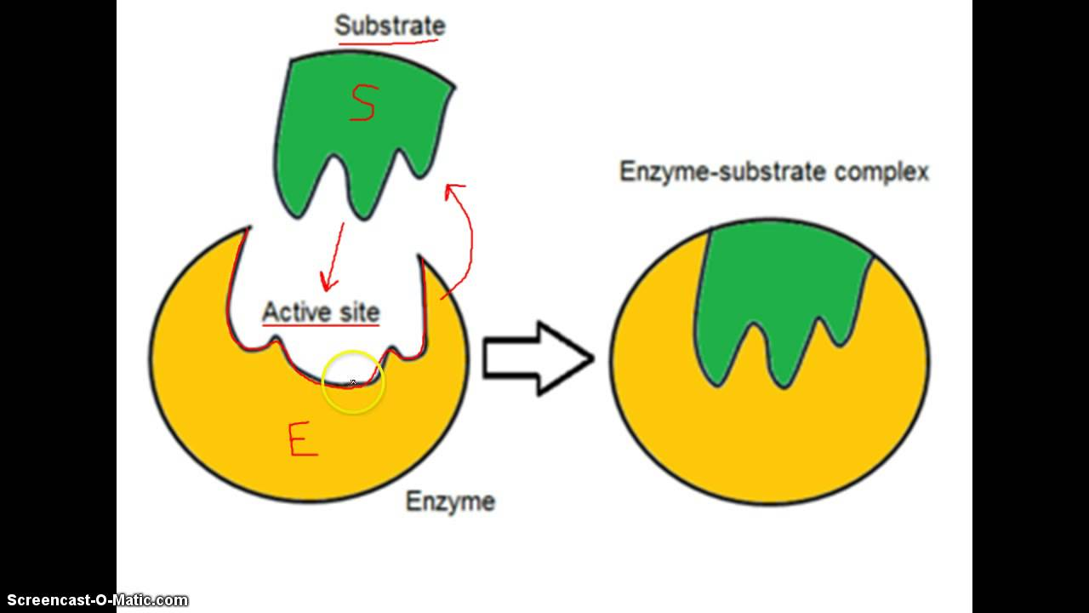
ENZYME

Slide 28
ENZYMES
Lock-and-key hypothesis
In this hypothesis, when the chemicals involved in a reaction (the substrates) get near an enzyme molecule, they “fit” into a part of the molecule called the active site, like a key in a lock.
The enzyme is shaped so that the important parts of each chemical are close enough to each other to react
together.
When the reaction has occurred, the new chemicals (the products) do not fit in the lock and are released.
This leaves the enzyme free to catalyze another reaction.

Slide 29
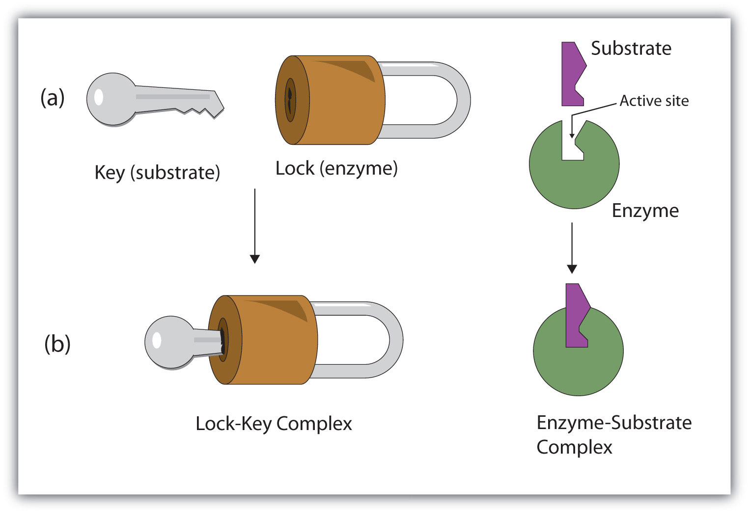
ENZYME

Slide 30
ENZYMES
Induced-fit hypothesis
This hypothesis suggests that the substrate helps the enzyme to form the correct shape to receive it.

Slide 31
ENZYMES
Coenzymes
Coenzymes are usually small molecules that are needed in some enzyme reactions to help the reaction work properly.
As with enzymes, many coenzymes only work with particular enzyme reactions. If the coenzyme is missing, the reaction will not work properly.
The coenzyme from another reaction will not do the job.
Vitamins and minerals are often involved in reactions as coenzymes.

Slide 32
ENZYMES
Inhibitors
Inhibitors reduce or destroy the activity of an enzyme—sometimes to dangerous levels.
There are two types of inhibitors:
competitive inhibitors and noncompetitive
inhibitors.

Slide 33
ENZYMES
Competitive inhibitors
Competitive inhibitors bind with the active site of an enzyme.
In effect, they “compete” with the normal substrate for this site and block it.
Many competitive inhibitors are released from the active site so the enzyme can be regenerated.
The higher the concentration of the“normal” substrate compared with the inhibitor, the less effect the inhibitor has.

Slide 34
ENZYMES
A non-competitive inhibitor does not bind to the active site.
It binds with a different part of the enzyme molecule.
This distorts the shape of the enzyme so it cannot function properly.
Non-competitive inhibitors are not released from the enzyme molecule so the enzyme cannot be regenerated.
Even a low concentration of a noncompetitive inhibitor can be very dangerous.

