Slide 1
Temperature Resistant Hubs
5 ~ 7 USB Ports

Slide 2

1. ORICO USB 3.0 허브, 7 포트 스플리터, 고속 전송 USB-A 타입 PC 확장
https://www.11st.co.kr/products/6441606868?utm_term=&utm_campaign=%B4%D9%B3%AA%BF%CDpc_%B0%A1%B0%DD%BA%F1%B1%B3%B1%E2%BA%BB&utm_source=%B4%D9%B3%AA%BF%CD_PC_PCS&utm_medium=%B0%A1%B0%DD%BA%F1%B1%B3
https://front.wemakeprice.com/product/2696541264?utm_source=danawa&utm_medium=PRICE_af&utm_campaign=null

Slide 3
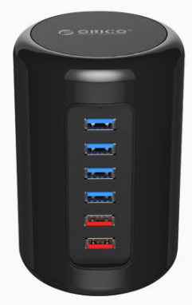
2. 오리코 RH4CS USB허브 (6포트USB3.0유전원)
https://www.lotteon.com/p/product/LO1843215285?sitmNo=LO1843215285_1843215286&mall_no=1&dp_infw_cd=SCH%EC%98%A4%EB%A6%AC%EC%BD%94%20%ED%97%88%EB%B8%8C&areaCode=SCH

Slide 4
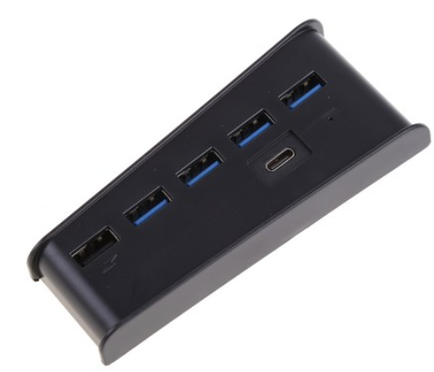
2. USB 허브 어댑터 6 포트 USB 3.0 USB A
https://www.coupang.com/vp/products/7463243502?itemId=19457903792&vendorItemId=86568422823&src=1032034&spec=10305199&addtag=400&ctag=7463243502&lptag=P7463243502&itime=20240104105045&pageType=PRODUCT&pageValue=7463243502&wPcid=16879384198458490507261&wRef=prod.danawa.com&wTime=20240104105045&redirect=landing&mcid=7d0457f51a5942c6a5347ac77e4b069d&isAddedCart=

Slide 5
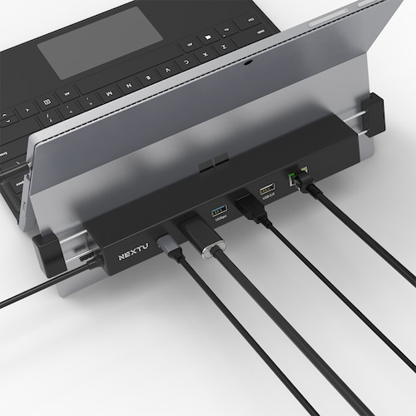
4.이지넷유비쿼터스 NEXTU NEXT-2291TCH-SUR (6포트/USB 3.1 Type C)
https://prod.danawa.com/info/?pcode=15158285&keyword=NEXT+usb+%ED%97%88%EB%B8%8C&cate=11239702

Slide 6
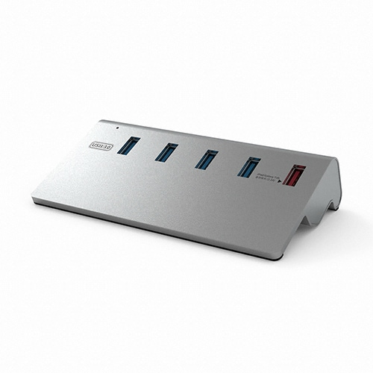
5.이지넷유비쿼터스 넥스트 NEXT-316U3 (5포트/USB 3.0)
https://prod.danawa.com/info/?pcode=9213162&keyword=NEXT+usb+%ED%97%88%EB%B8%8C&cate=11239702

Slide 7
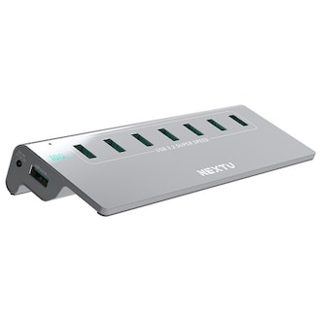
6. 이지넷유비쿼터스 NEXTU NEXT-337G2-10G (7포트/USB3.1)
https://prod.danawa.com/info/?pcode=17430791&keyword=NEXT+usb+%ED%97%88%EB%B8%8C&cate=11239702

Slide 8
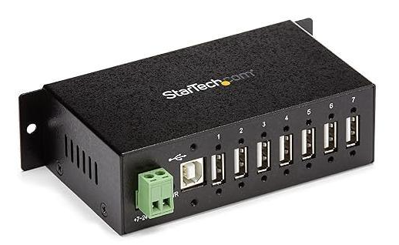
7.StarTech.com 7-Port USB 2.0 Hub with Power Adapter - Metal Industrial USB-A Hub with ESD 350W Protection
https://item.gmarket.co.kr/Item?goodscode=2989678455&GoodsSale=Y&jaehuid=200002657

