Slide 1
USB HUB OPTIONS
GEN2

Slide 2
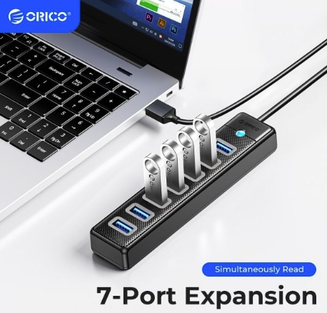
ORICO USB 3.0 허브, 7 포트 스플리터, 고속 전송 USB-A 타입 PC 확장
29,570 원 / USB-A / 7 PORTS
https://www.11st.co.kr/products/6441606868?utm_term=&utm_campaign=%B4%D9%B3%AA%BF%CDpc_%B0%A1%B0%DD%BA%F1%B1%B3%B1%E2%BA%BB&utm_source=%B4%D9%B3%AA%BF%CD_PC_PCS&utm_medium=%B0%A1%B0%DD%BA%F1%B1%B3
https://front.wemakeprice.com/product/2696541264?utm_source=danawa&utm_medium=PRICE_af&utm_campaign=null

Slide 3
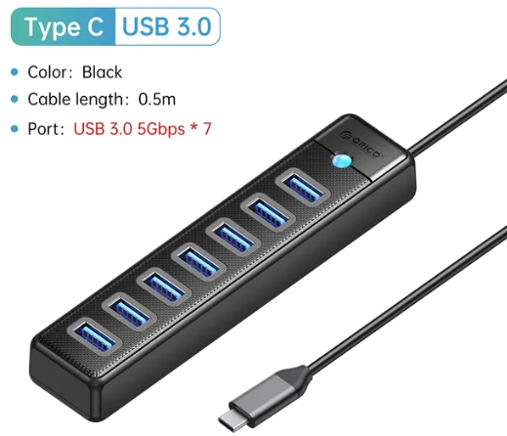
ORICO USB 3.0 허브 7 포트 스플리터, 고속 전송 C /10,028원
https://ko.aliexpress.com/item/1005005421278007.html?spm=a2g0o.detail.0.0.74f390he90hecR&gps-id=pcDetailTopMoreOtherSeller&scm=1007.40050.362094.0&scm_id=1007.40050.362094.0&scm-url=1007.40050.362094.0&pvid=b3263ebd-e3ed-4757-b02d-42e0d510a542&_t=gps-id:pcDetailTopMoreOtherSeller,scm-url:1007.40050.362094.0,pvid:b3263ebd-e3ed-4757-b02d-42e0d510a542,tpp_buckets:668%232846%238110%231995&pdp_npi=4%40dis%21KRW%2132719%219296.0%21%21%2123.68%21%21%402141113616989789735091607e132b%2112000032997523188%21rec%21KR%21%21AB

Slide 4
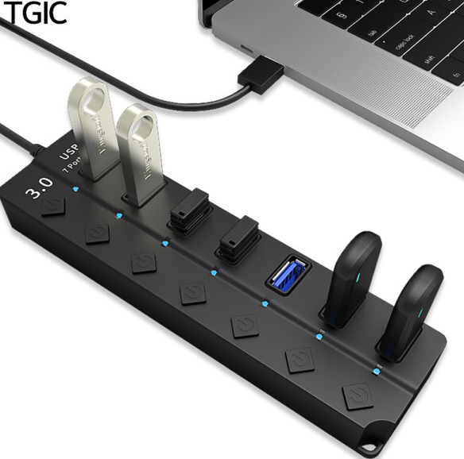
TGIC USB 허브 TGHUB-7310A
15,120 원 / USB-A / 7 PORTS
http://itempage3.auction.co.kr/DetailView.aspx?ItemNo=D414868585&frm3=V2
https://www.coupang.com/vp/products/6557536504?itemId=14665265789&vendorItemId=81906382217&src=1032034&spec=10305199&addtag=400&ctag=6557536504&lptag=P6557536504&itime=20231103124330&pageType=PRODUCT&pageValue=6557536504&wPcid=16879384198458490507261&wRef=prod.danawa.com&wTime=20231103124330&redirect=landing&mcid=380d5d58d3d943a6ab696a0fdd520437&isAddedCart=

Slide 5
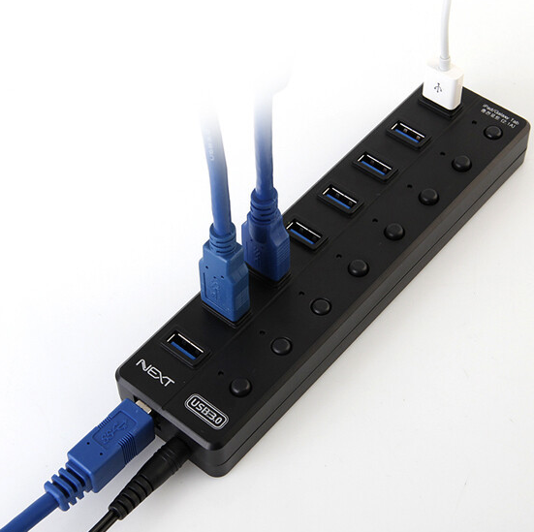
이지넷유비쿼터스 넥스트 NEXT-UH308
23,100 원 / USB-A / 8 PORTS
https://item.gmarket.co.kr/Item?goodscode=2475029462&GoodsSale=Y&jaehuid=200002657&service_id=pcdn
https://www.coupang.com/vp/products/285667629?itemId=906109022&vendorItemId=70636901926&src=1032034&spec=10305199&addtag=400&ctag=285667629&lptag=P285667629&itime=20231103120807&pageType=PRODUCT&pageValue=285667629&wPcid=16879384198458490507261&wRef=prod.danawa.com&wTime=20231103120807&redirect=landing&mcid=6aea0581ab6d476bbefa5d09356e954f&isAddedCart=

Slide 6
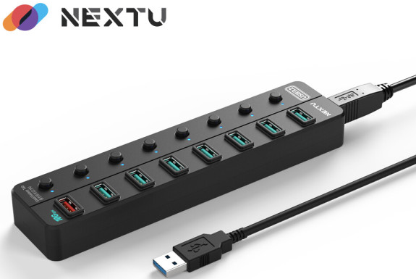
USB 3.0 8포트 USB-A 5Gbps GEN2 고석 케이블
51,900 원 / USB-A /8 PORTS/0.8m/유전원/10G
http://itempage3.auction.co.kr/DetailView.aspx?itemno=C617366700
https://item.gmarket.co.kr/Item?goodscode=3150980819&buyboxtype=ad

Slide 7
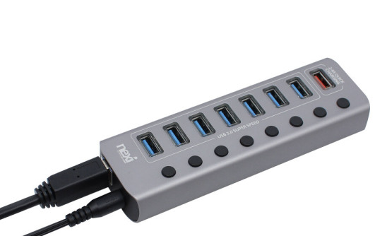
이지넷유비쿼터스 넥스트 NEXT
32,000 원 / USB / 8 PORTS
http://itempage3.auction.co.kr/DetailView.aspx?itemno=D284270383

Slide 8
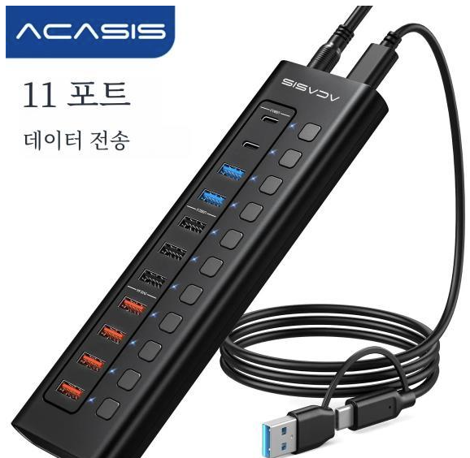
이지넷유비쿼터스 넥스트 NEXT
57,400 원 / USB / 11 PORTS
https://item.gmarket.co.kr/Item?goodscode=3268894426&GoodsSale=Y&jaehuid=200002657
https://www.coupang.com/vp/products/7673859673?itemId=20478741969&vendorItemId=87557789007&src=1032034&spec=10305199&addtag=400&ctag=7673859673&lptag=P7673859673&itime=20231103123715&pageType=PRODUCT&pageValue=7673859673&wPcid=16879384198458490507261&wRef=prod.danawa.com&wTime=20231103123715&redirect=landing&mcid=a9fc4162f02841b4aa0385a9fcbd669b&isAddedCart=

Slide 9
버튼 없는 12V/3A USB 허브 옵션들
https://www.coupang.com/vp/products/5567229067?itemId=8853250977&vendorItemId=76140398530&src=1032034&spec=10305199&addtag=400&ctag=5567229067&lptag=I8853250977&itime=20231107132337&pageType=PRODUCT&pageValue=5567229067&wPcid=16879384198458490507261&wRef=prod.danawa.com&wTime=20231107132337&redirect=landing&mcid=97a4fc2e97d04c7e82fa9ee1780274a6&isAddedCart=
https://www.coupang.com/vp/products/93559008?itemId=289971310&vendorItemId=5416200991&q=usb+%ED%97%88%EB%B8%8C+%EC%A0%84%EC%9B%90&itemsCount=27&searchId=530cf64bfa1a4b6c922be39d9e9506bd&rank=5&isAddedCart=
https://www.coupang.com/vp/products/93559008?itemId=289971311&vendorItemId=5314390491&q=usb+%ED%97%88%EB%B8%8C+%EC%A0%84%EC%9B%90&itemsCount=27&searchId=530cf64bfa1a4b6c922be39d9e9506bd&rank=11&isAddedCart=
https://www.coupang.com/vp/products/315897461?vendorItemId=5434082895&sourceType=SDP_ALSO_VIEWED&searchId=51e324fc21014606ac58156db271d706&rmdId=51e324fc21014606ac58156db271d706&eventLabel=recommendation_widget_pc_sdp_001&platform=web&rmdABTestInfo=43385:C&rmdValue=p93559008:vt-1.0.0:p315897461&isAddedCart=
https://www.coupang.com/vp/products/7274437346?vendorItemId=86002195430&sourceType=sdp_bottom_promotion&searchId=feed-b2d8da3d002f45aabf92fac422211eeb-gw_promotion&isAddedCart=

