Slide 1
[모터114] wheel in motor 및 드라이브 견적
제품과 가격

Slide 2
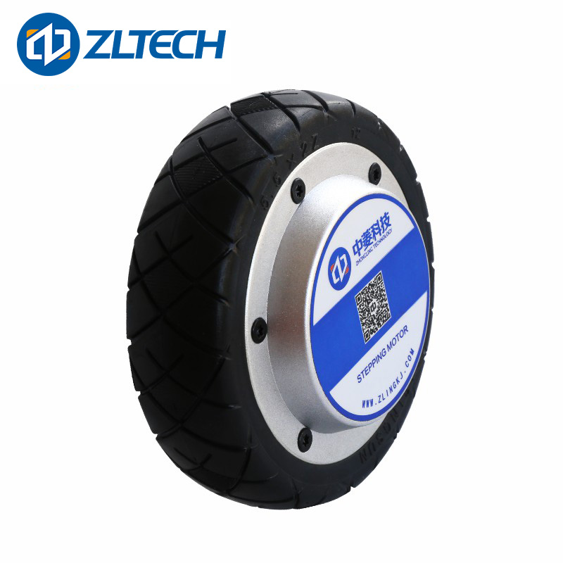
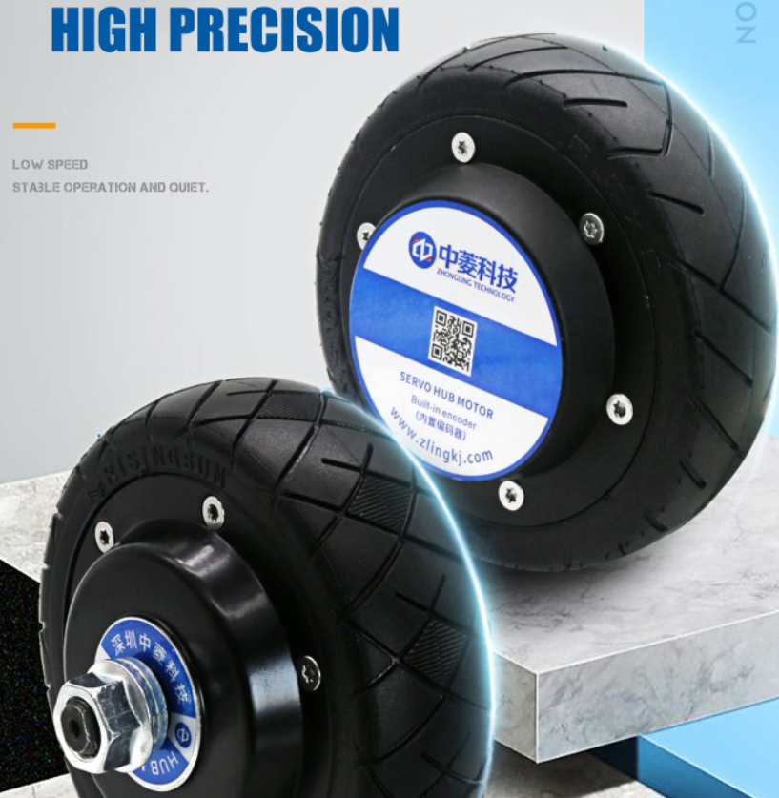
Wheeled Motor
ZLLG55ASM150-B V2.0(Single
Shaft)
ZLLG55ASM150 V2.0
(Single Shaft)
5.5inch/24V/150W/Single Shaft/Rubber/500 max rpm/Encoder 60kg /Torque 3.2Nm /With Brake
Driver - ZLAC8015 & ZLAC8015D
750,000
http://zlrobotmotor.com/info/380.html
5.5inch/24V/150W/Single Shaft/Rubber /Torque 3.2Nm /Encoder/60kg/No Brake
200,000원

Slide 3
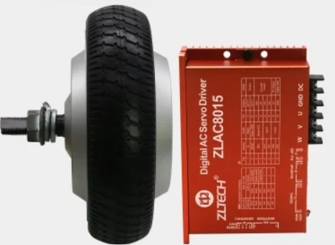
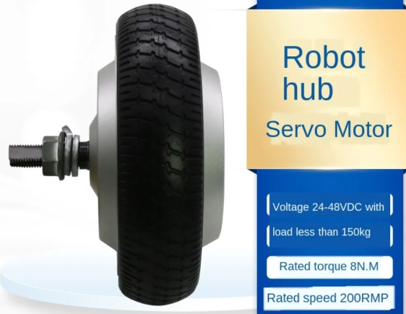
Wheeled Motor
ZLLG65ASM250-4096 (Single
shaft)
ZLLG65ASM250-4096-B (Single
shaft)
6.5inch/48V/250W/Single Shaft/Rubber/Torque 8Nm/Encoder/No Brake
280,000원
https://ko.aliexpress.com/item/4001158741021.html?gatewayAdapt=glo2kor
6.5inch/48V/250W/Single Shaft/Rubber /Torque 8Nm /Encoder /With Brake
860,000

Slide 4
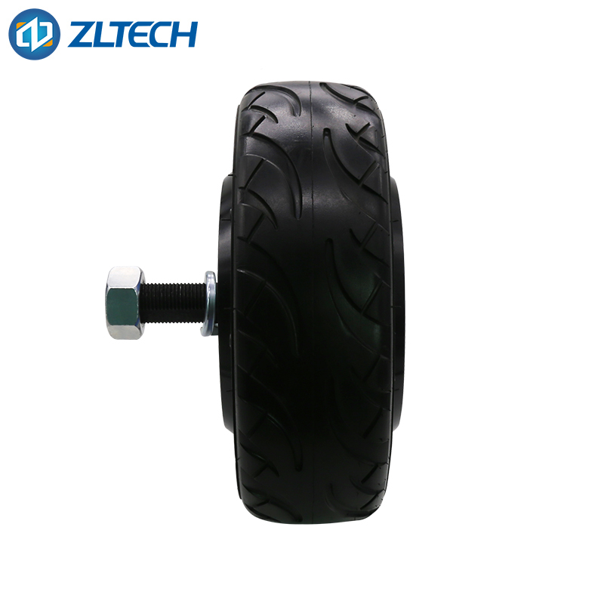
Wheeled Motor
ZLLG10ASM800-R V2.0
10inch/ 48V/800W/Single Shaft/Rubber /Torque 80Nm /Encoder/IP65/60kg/With Brake
추천 드라이버 - ZLAC8030
520,000원
http://www.zlrobotmotor.com/info/393.html

Slide 5
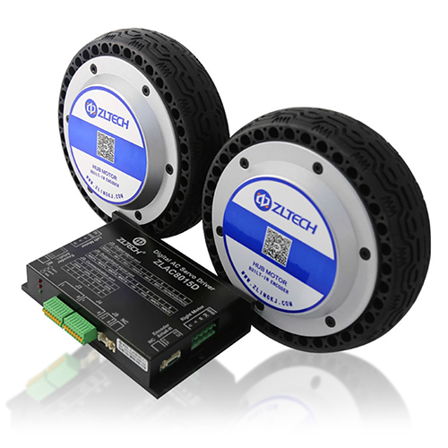
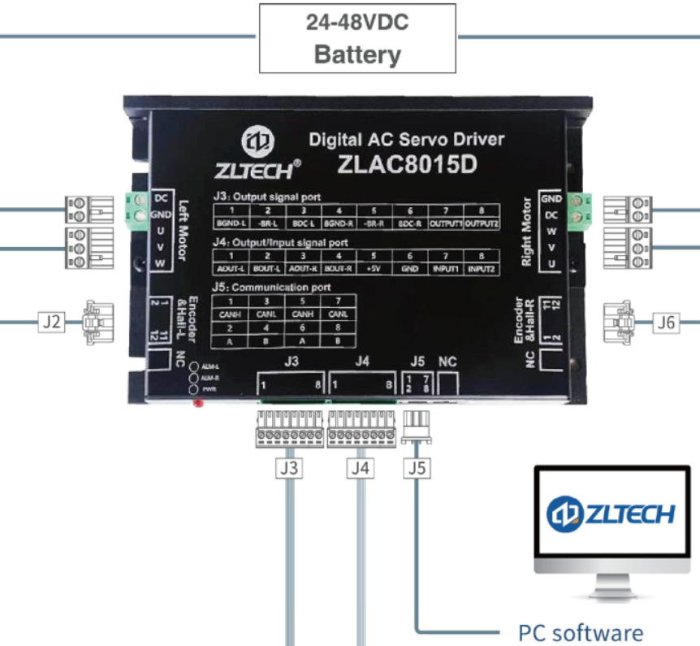
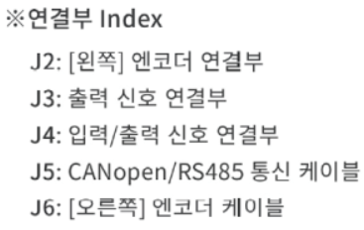
Motor Driver
ZLAC8015D V2.0
2Axial Driver/15A/RS-485/CANopen
380,000
https://smotion.co.kr/product/zltech-zlac8015d-canopenrs-485-%EC%A0%9C%EC%96%B4%EC%9A%A9-2%EC%B6%95-wheel-in-motor%EC%9D%B8%ED%9C%A0%EB%AA%A8%ED%84%B0%EC%9A%A9-%EB%93%9C%EB%9D%BC%EC%9D%B4%EB%B2%84/206/

Slide 6
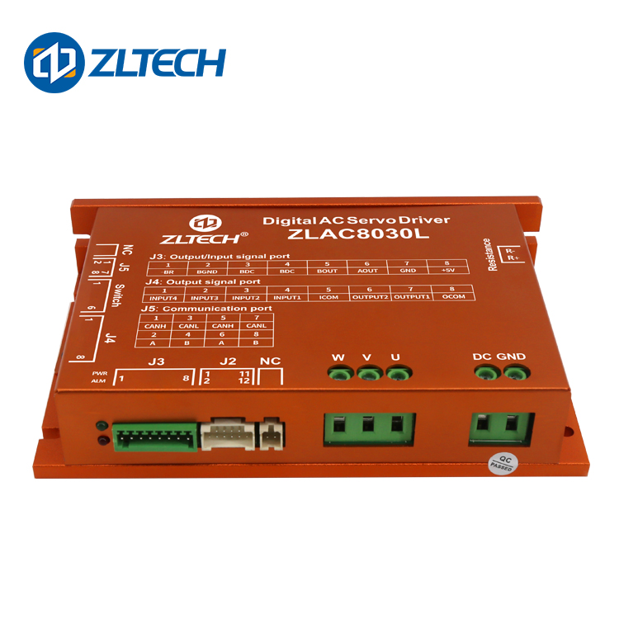
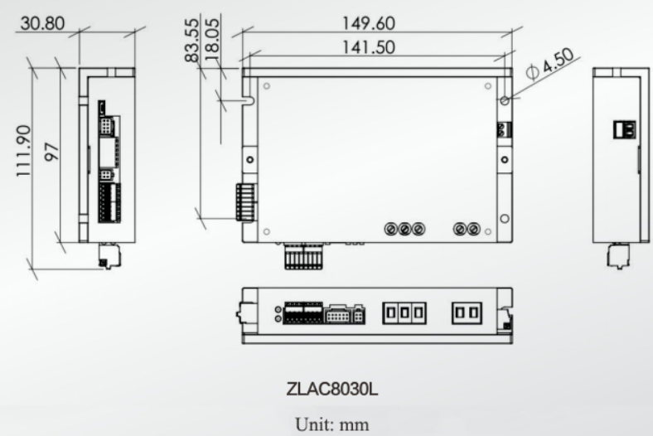
Motor Driver
ZLAC8030L
Single Channel Driver/15A/RS-485 가능/CANpen/ 30A
500 -1000W 모터용
380,000

Slide 7
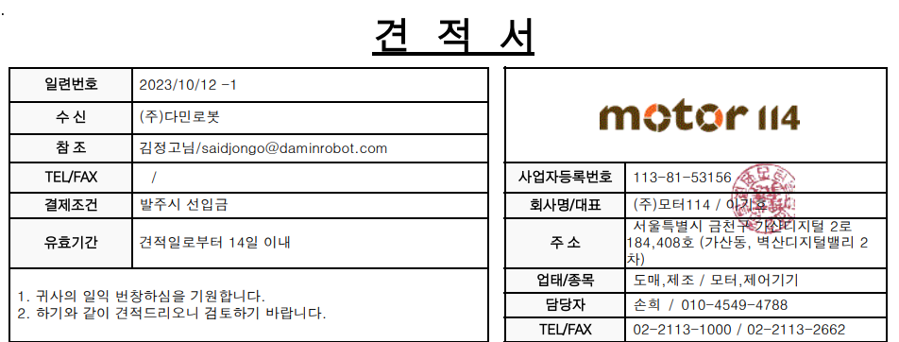
결론
RC-485 통신 가능하고 스펙이 좋은 114모터 드라이버는 ZLAC8015D V2.0 추천 합니다. 써도 되는 ZLAC8015D V1도 있는데 지금 단종되었다고 합니다.
ZLAC8015D V2.0 드라이버는 웬만한 엔코더 모터들 제어 가능하고 전류와 파워 범위가 적당합니다.
견적서와 카다로그 - https://github.com/DaminRobot/-114

