Slide 1
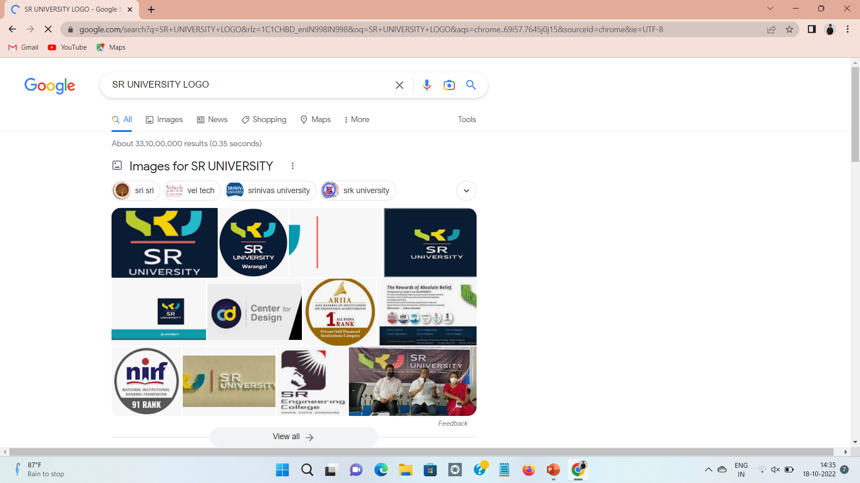
SNAKE GAME
Group-27
TEAM MEMBERS:
2103A51L14 (JAKKOJU AKSHAY KUMAR)
2103A51L25 (NAGABELLI SAI DIKSHITH)
MENTOR:
RAVI CHYTHANYA SIR

Slide 2
SNAKE GAME
CONTENTS:
Abstract
Features
Objective
Model Template
Elements
Screens
Conclusion

Slide 3
ABSTRACT:
Snake game is a computer action game , whose goal is to control a snake to move directions on the board and to collect the food.
This project is a game written in java based on the game called “snake” which has been around since the earliest days of home computing and has re-emerged in recent years on mobile phones. This project aims to bring more fun and simplicity of snake game. In this it will calculate the score.

Slide 4
FEATURES:
The player controls a long, thin creature , resembling a snake, which roams around on a bordered plane , picking up the food and trying to avoid hitting its own tail or the edges of the playing area.
Each time the snake eats a piece of food , its tail grows longer , making the game increasingly difficult

Slide 5
Playing snake game helps to build the habit of practice. That means it is a perfect way to teach the “practice makes perfect”.
Brain functionality is increased.
It helps to increase focus and learning productivity.
This game is a good way to learn how to recognize patters.
It helps to develop problem solving abilities.

Slide 6
It teaches the importance of having goal.
It helps to understand the idea of growth.
This is an excellent opportunity to learn about spatial awareness and plan ahead to your next move

Slide 7
OBJECTIVE:
Use arrow keys to control the snake.
The snake moves to the right , timer is set to some amount of time , and if you manage to press up or down arrow and then very fast left(when the timer hasn’t gone off), the snake will move backwards and finally eat itself.
Most of the games doesn’t allow you to change from right to left( or up to down ) in one step , but this is allowed.

Slide 8
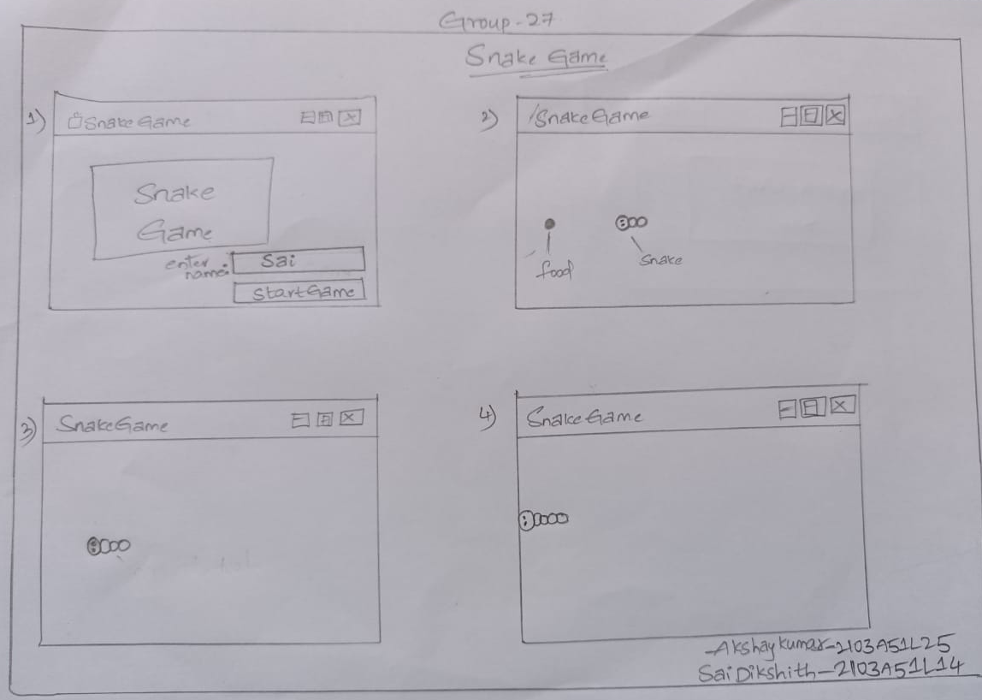
MODEL TEMPLATE:

Slide 9
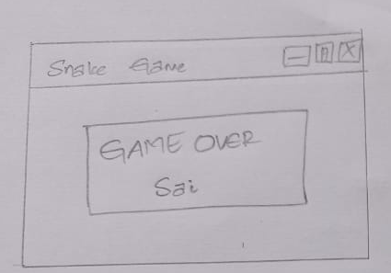

Slide 10
ELEMENTS:
Event Queue
Action Listener
Action Event
JFrame
JLabel
JOptionPane
JButton
JTextField
keyListener

Slide 11
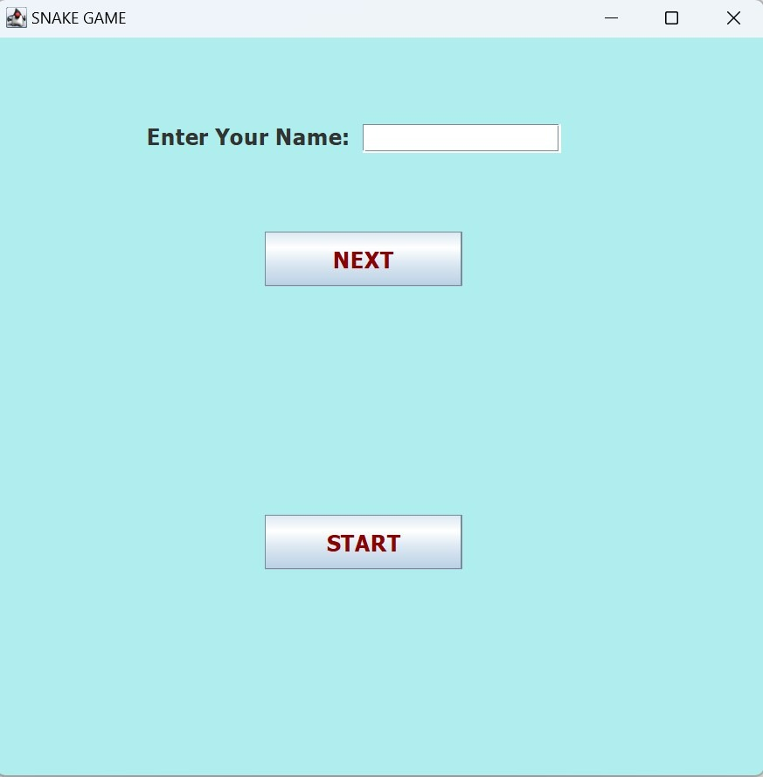
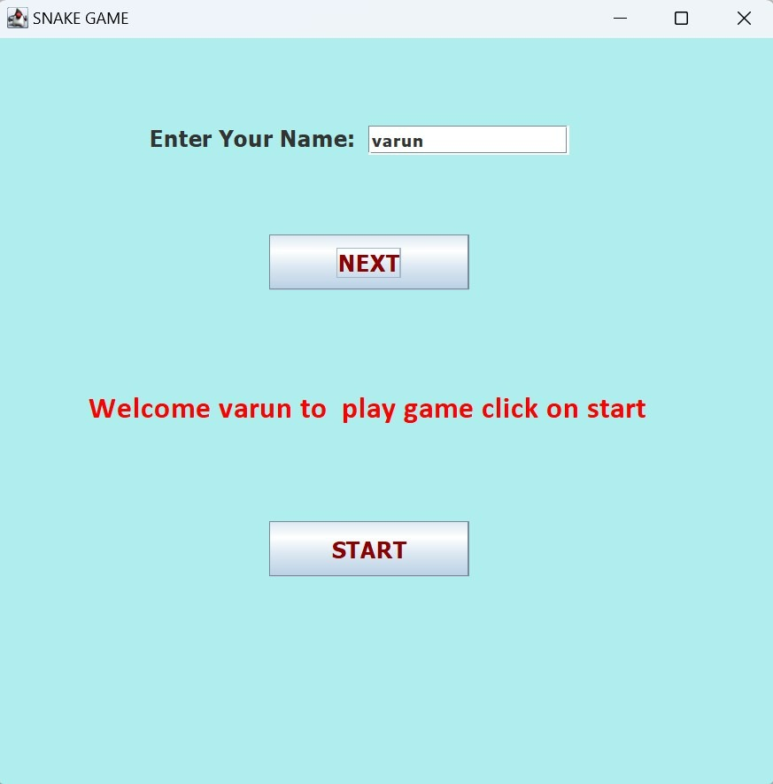
SCREENS:
1.
2.

Slide 12
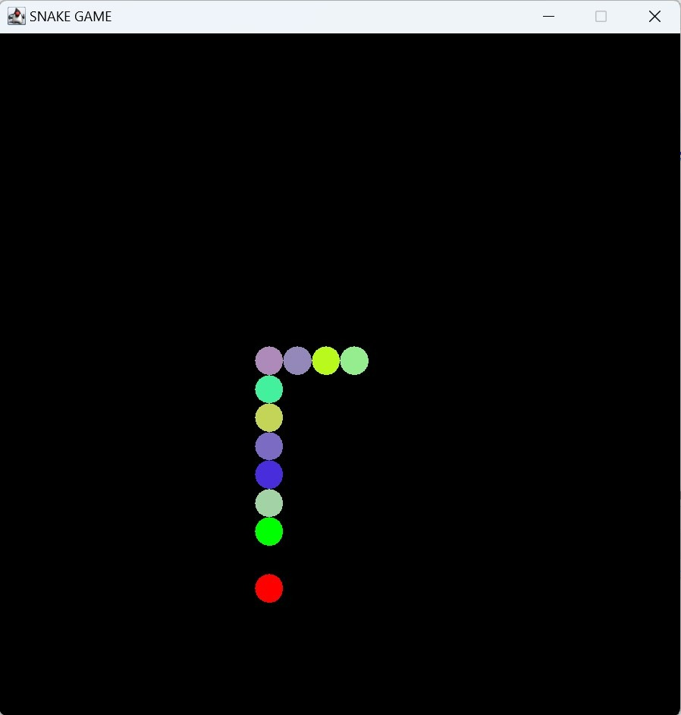
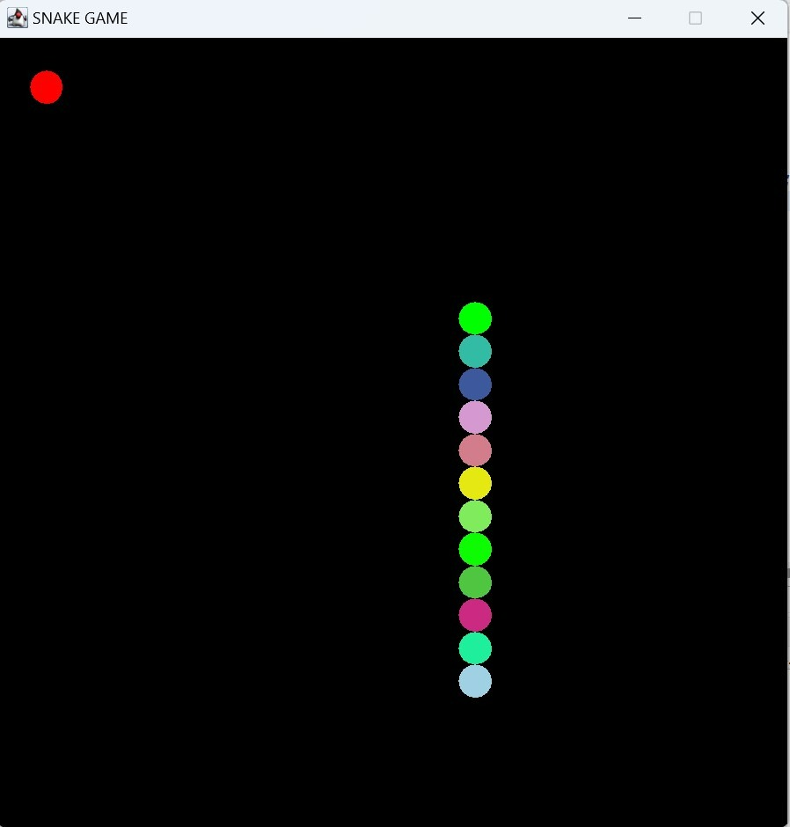
3.
4.

Slide 13
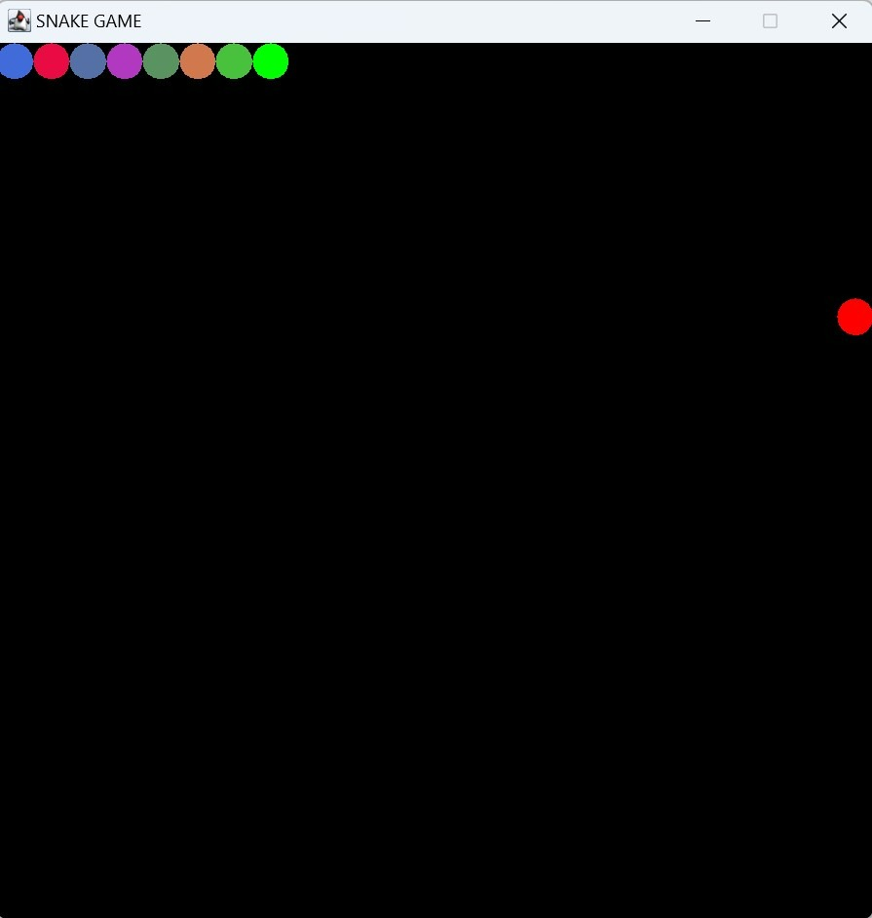
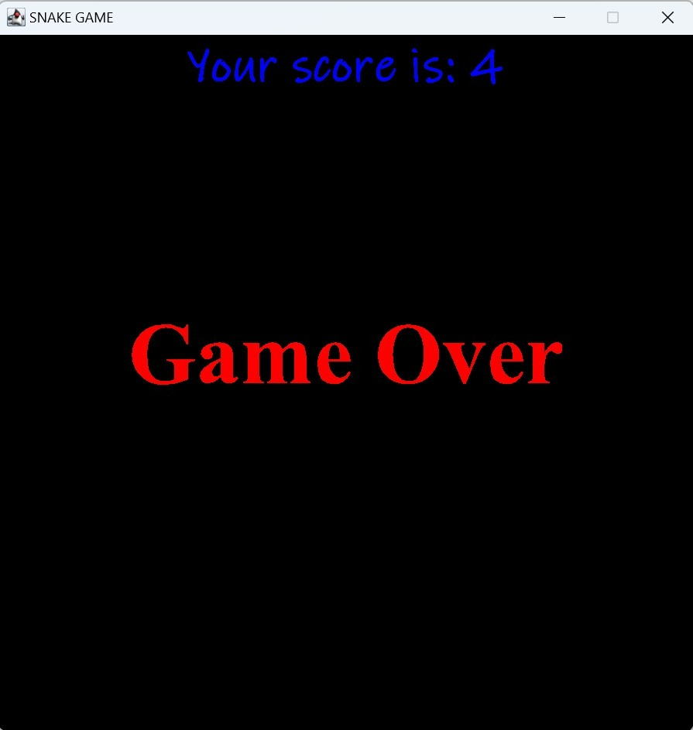
RESULT:
5.
6.

Slide 14
CONCLUSION:
The game is played by one player , who has the objective of obtaining the highest score possible.
The player is in a control of the snake which is constantly moving around the board.
The snake is go on increasing its height according to eating the food.
If it touches the border or its tail the game is over

Slide 15
THANK YOU.!

