Slide 1



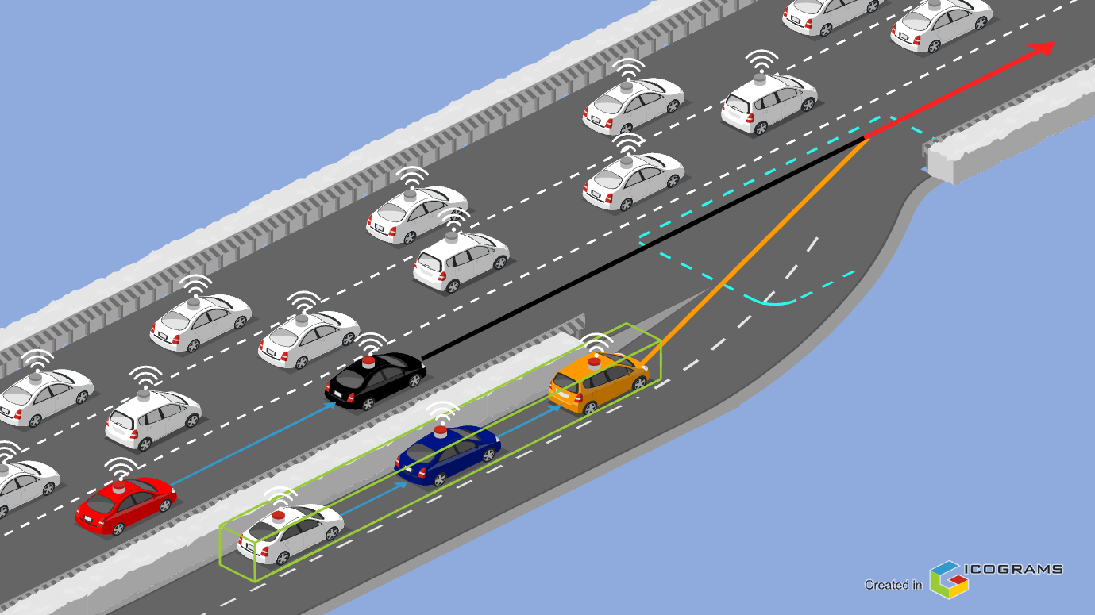
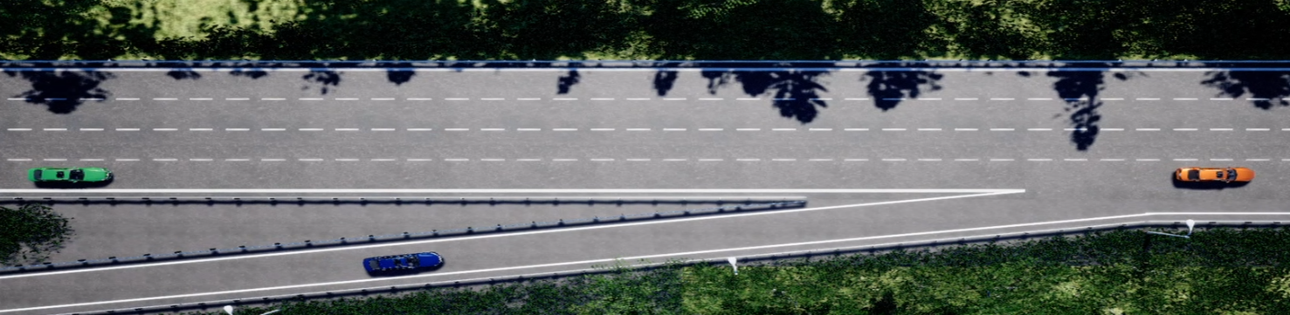
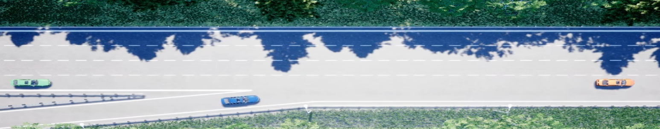


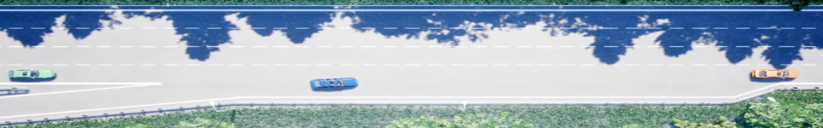
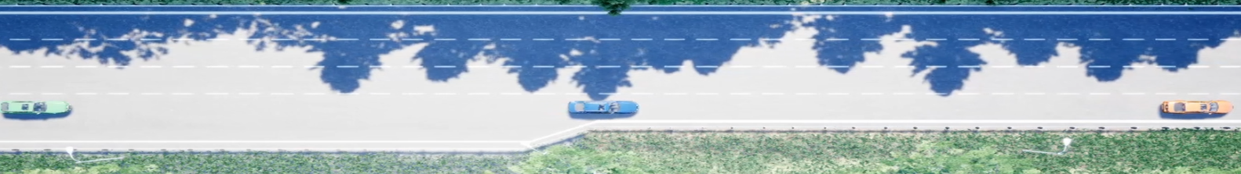
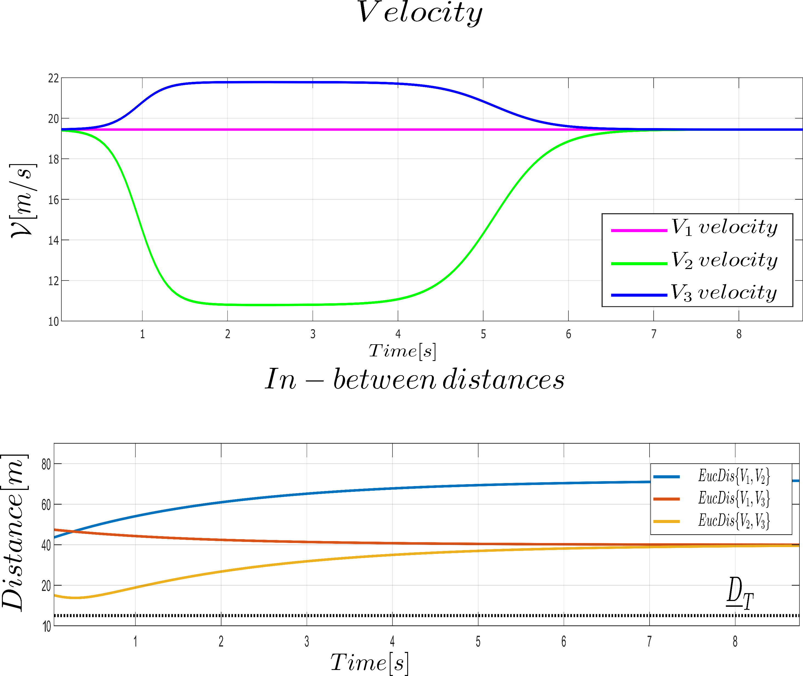
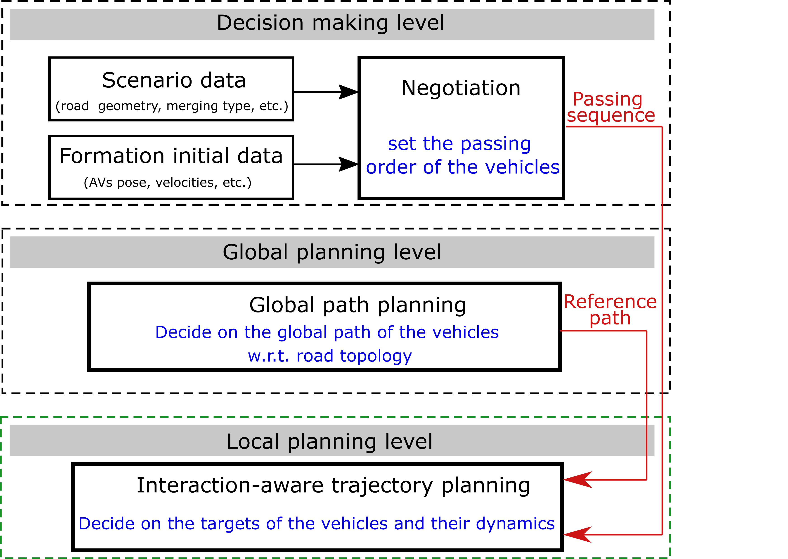

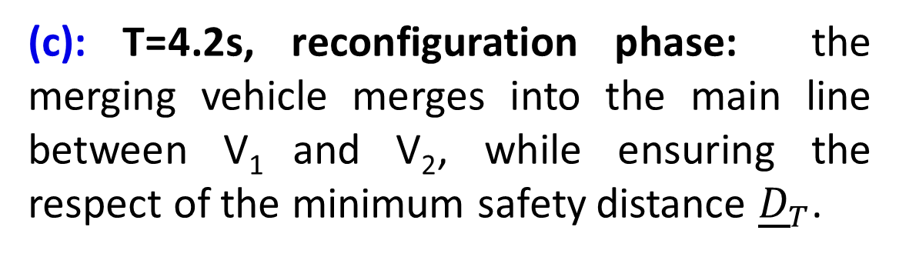
Safe and Smooth On-ramp Merging on Highway Strategy for Cooperative Automated Vehicles
Lyes Saidi¹, Lounis Adouane² and Reine Talj³
Laboratoire Heudiasyc, UMR CNRS 7253, Université de Technologie de Compiègne, France
Overall research context
Cooperative Automated Vehicles (CAVs) advantages address many areas: safety with accident reduction; health while improving passengers comfort; transportation time since it reduces road congestion; ecology with fuel efficiency among other advantages.
Among the objectives of the Ph.D thesis, addressing the on-ramp merging on highway complexity. In fact, the CAVs permit with the help of a
flexible formation modeling and control and a safe motion synchronization to envision a cooperative merging strategy.
Scenario study: cooperative on-ramp merging
Cooperative on-ramp merging for CAVs
(a)
CAV
CAV
Risky zone
V₂
V₁
CAV
Merging zone
V₃
CAV
Reference trajectory
(a): T=0s, initial configuration: the vehicles V₁
and V₂ are in the main line. V₃ aims to merge
into the main line. The three vehicles are part
of a triangular formation.
(b): T=2s, reconfiguration phase: V₃ enters the merging zone. A reconfiguration from a triangular shape toward a linear one is being performed.
Safety distance
Connected Automated Vehicle
Platoon navigation
CAV
Equipped with localization and perception modules along with V2V Communication.
Road congestion
Due to unnecessary speed changes and inefficient traffic management.
Figure 1: On-ramp merging on highway
(c): T=4.2s, reconfiguration phase: the merging vehicle merges into the main line between V₁ and V₂, while ensuring the respect of the minimum safety distance ${\underline{D}}_{T}$.
(d): T=7s, platoon formation: the three vehicles navigate through the main line in a linear formation.
Cooperative merging strategy
Decision making level: decide on a safe and efficient passing sequence of the CAVs through the merging zone (cf. Figure 1).
Global planning level: decide on the global path of the CAVs w.r.t. their initial position and their destination, the road geometry, etc.
Local planning level: decide on the local trajectory of the CAVs w.r.t. their passing sequence and their reference global path.
(a)
(b)
(d)
(c)
(a)
(b)
(c)
(d)
Figure 3: Velocity and in-between distance profile of each vehicle
Perspectives
Figure 2: The overall architecture of the cooperative merging strategy
Include vehicle’s dynamics on the proposed solution.
Implement the cooperative merging strategy in the laboratory’s vehicles.
Journées du Comité Technique Automatique et Transport Terrestre (CT ATT) 2022
Contacts: 1: Lyes.Saidi@hds.utc.fr 2: lounis.Adouane@hds.utc.fr 3: Reine.Talj@hds.utc.fr

