Slide 1



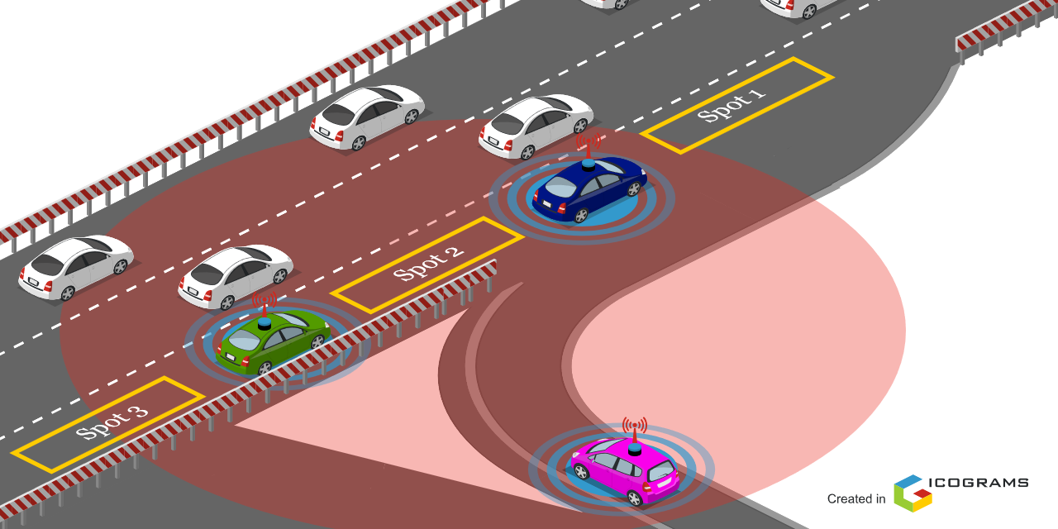

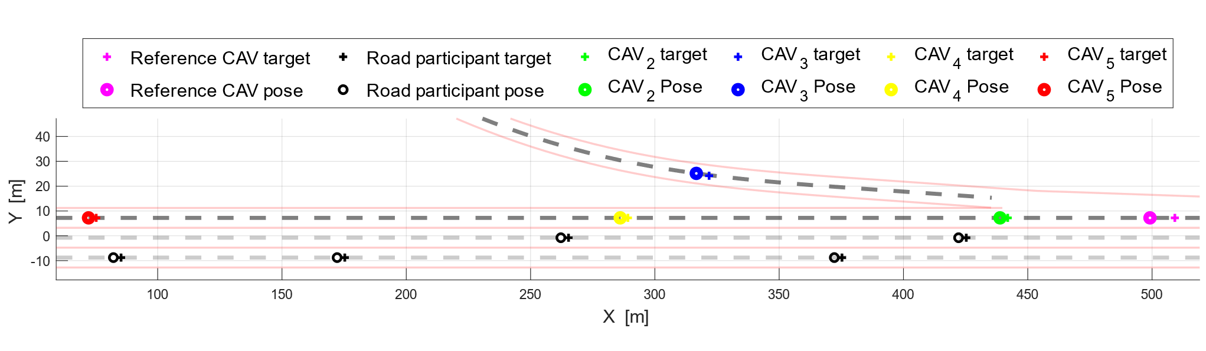
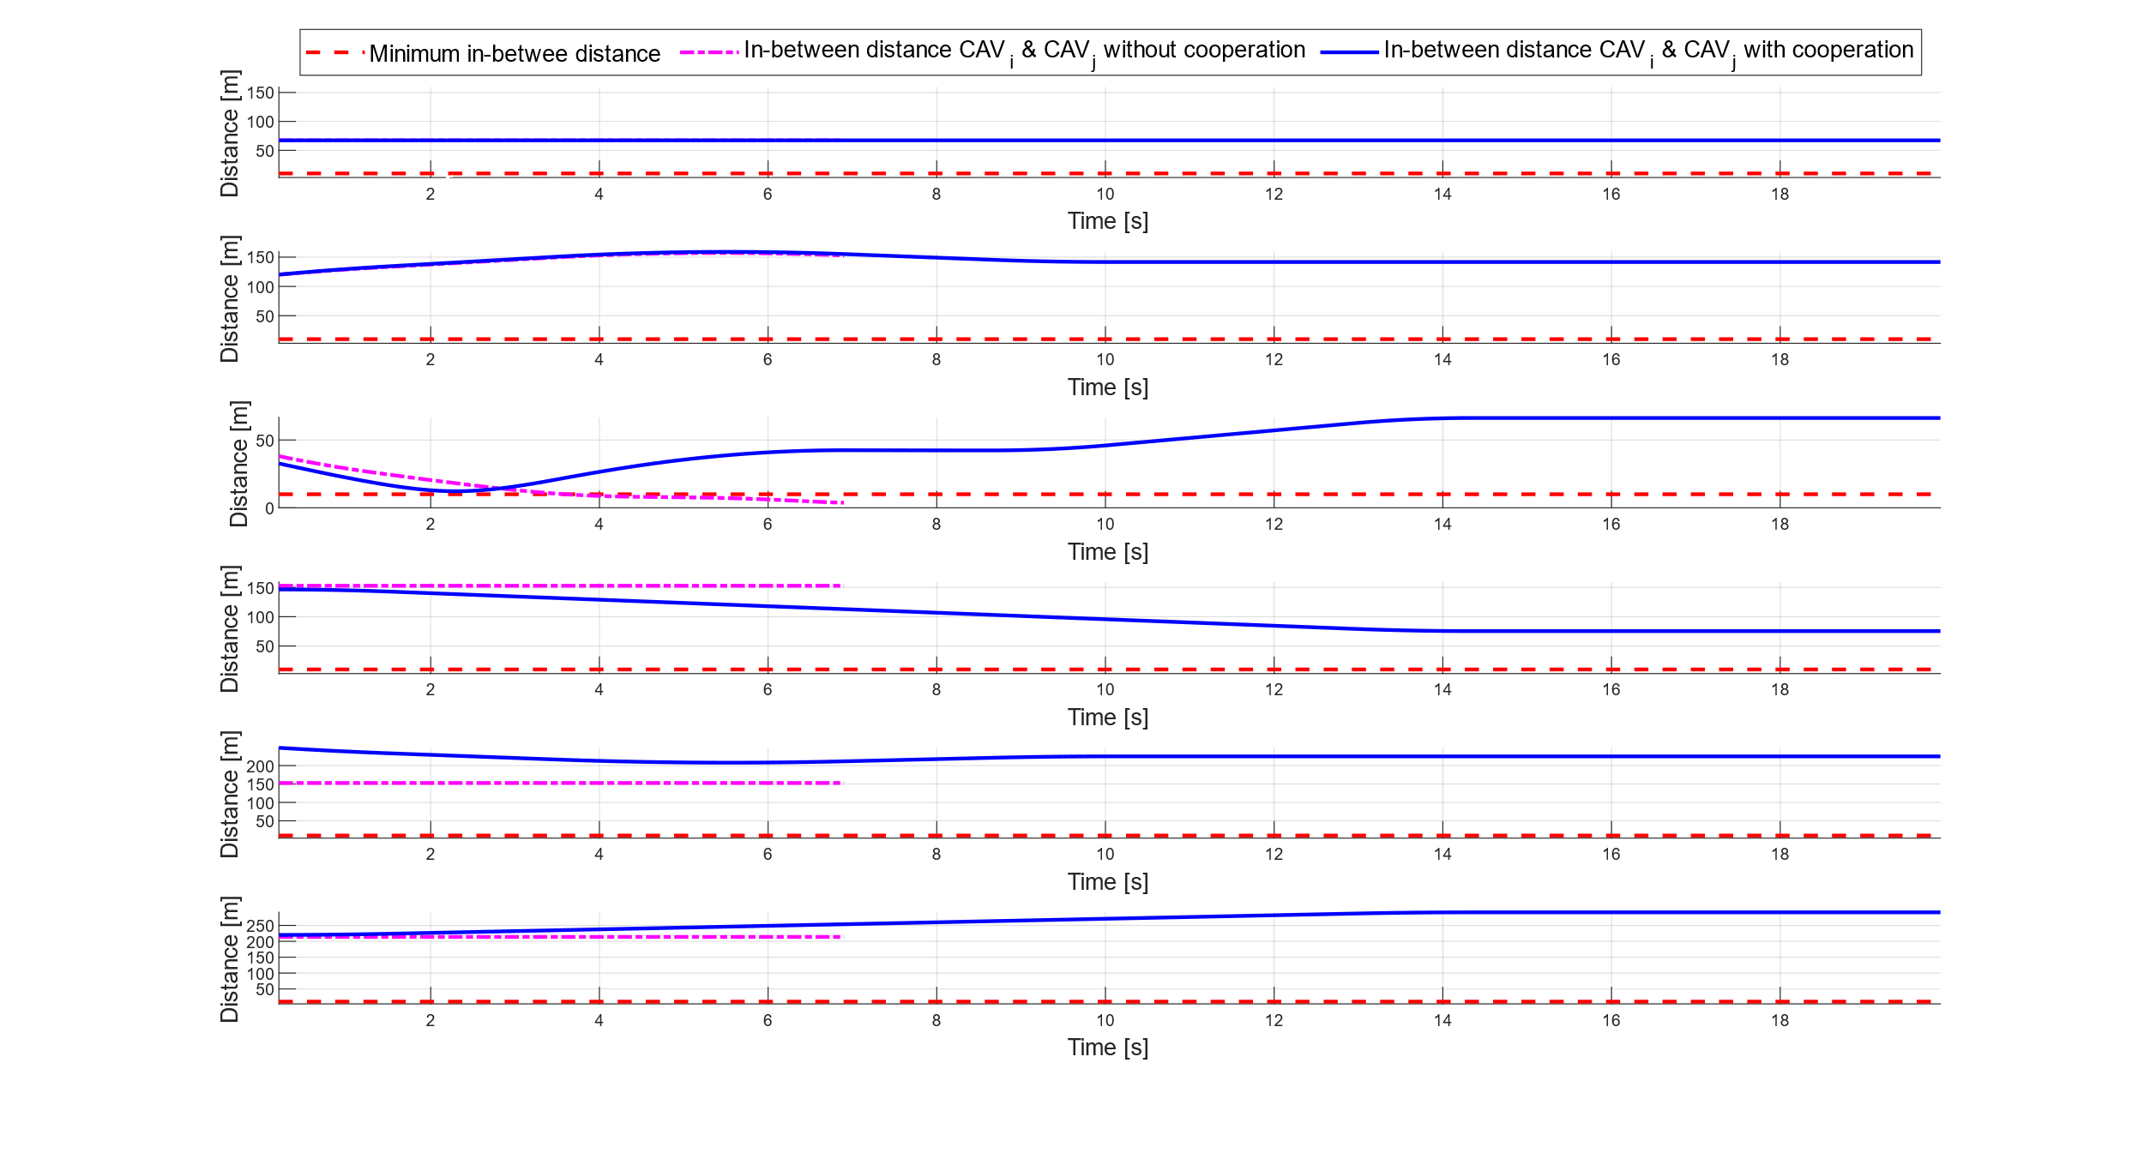

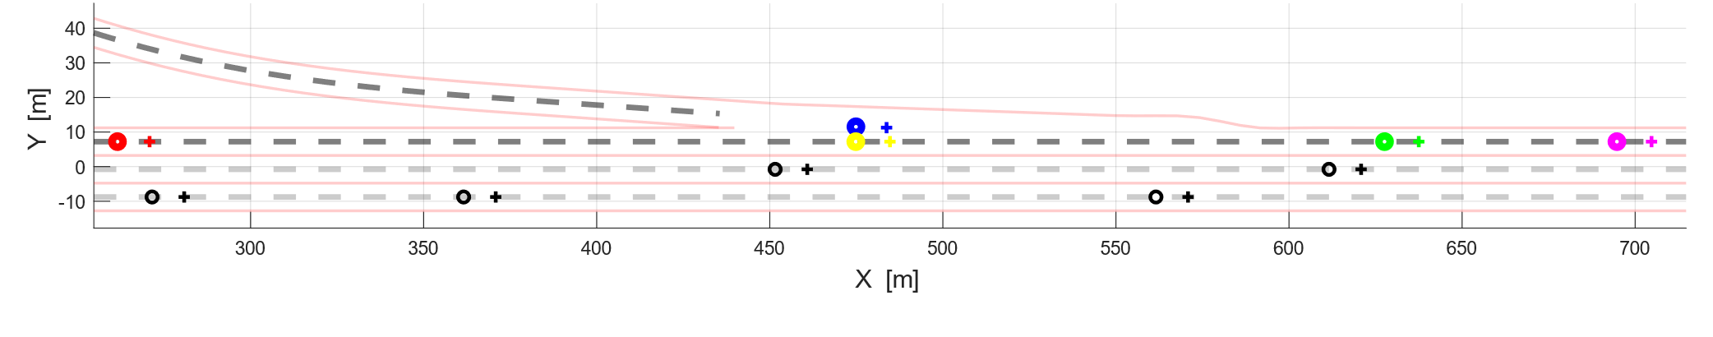
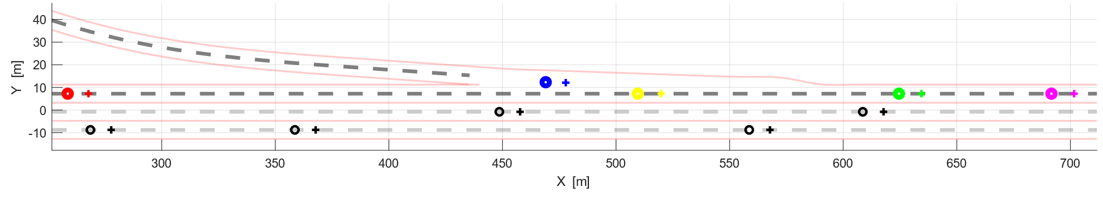
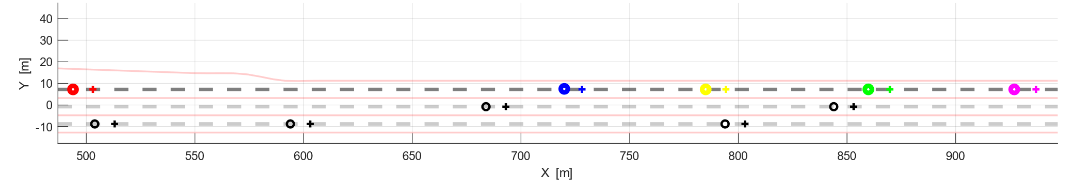




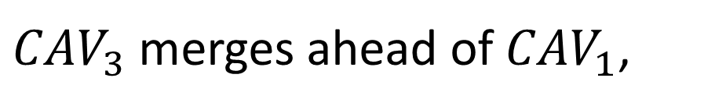






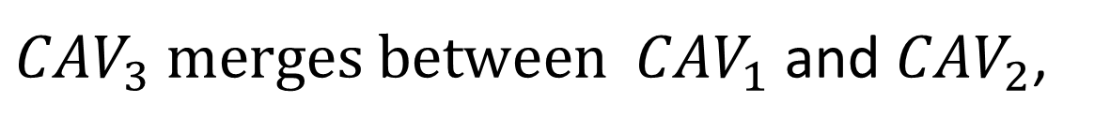



Cooperative Decision-Making for Safe On-Ramp Merging on Highway for Connected Automated Vehicles
Lyes Saidi, Lounis Adouane and Reine Talj
Laboratoire Heudiasyc, UMR CNRS 7253, Université de Technologie de Compiègne, France
On-ramp merging based on cooperative decision-making
Cooperative Automated Vehicles (CAVs) advantages address many areas: safety with accident reduction; health while improving passengers’ comfort; transportation time since it reduces road congestion; ecology with fuel efficiency among other advantages.
Our work aims to develop a cooperative decision-making level part of the architecture in Figure 2 to guarantee the safety requirement in the case of on-ramp merging on highway (Cf. Figure 1). The CAVs under the communication range of the Road Side Unit (RSU) in Figure 1 are put into a formation using the virtual structure formalism in [2]. A formation reconfiguration algorithm based on the Constrained Optimal Reconfiguration matrix (CORM) [1] is used to reconfigure the formation according to the passing sequence selected by Cooperative decision-making level.
Risk assessment and management
Environment
Decision making level
$${CAV}_{1}$$
Perception module
Map
information
Global path planning
Generates the global
reference path of the CAV.
It includes:
Environment constraints,
Road topology (e.g., links),
Velocity limitations,
Traffic signs, etc.
Multi-mode safe and cooperative
decision-making
$${CAV}_{2}$$
$$V_{2}$$
RSU
Behavior selection level
Vector
map
Map
matching
CAV pose
and velocity
Behavior activation
Passing
sequence
Initial Virtual Structure
$${CAV}_{3}$$
Sensor
uncertainty
Nominal
mode
Cooperation
mode
Fig 1. On-ramp merging on highway performed by CAVs.
Localization module
Passing
sequence
Scenario data
Passing sequence selection:
Ego CAV
information
Surrounding
CAVs information
CORM
Spot 1
${CAV}_{3}$ merges ahead of ${CAV}_{1}$,
Communication (RSU)
Selected passing
sequence
Spot 2
${CAV}_{3} merges between$ ${CAV}_{1}$ and ${CAV}_{2}$,
$$υ, δ$$
$$T_{d}, v$$
Spot 3
${CAV}_{3} merges after$ ${CAV}_{2}.$
$$X_{CAV_{i}}$$
CAV model
Control law
Fig 2. Overall architecture of the proposed safe cooperative on-ramp merging on highway.
Simulation results
The following simulation results present the cooperation importance to solve a conflicting situation (collision) in the case of on-ramp merging on highway.
Euclidian inter-vehicles distances
Initial Virtual Structure
RSU
(a)
(b.2)
(b.1)
(c)
$$i=1, j=2$$
(a): T=0s, initial configuration of the formation, the CAVs under the communication range of the RSU form a formation using the virtual structure formalism in [1] [2] in the presence of a cooperation protocol between the vehicles.
$$i=2, j=3$$
Collision
Collision
$$i=3, j=4$$
(b.1): T=3,6s, snapshot of the on-ramp merging scenario performed without cooperation, during the reconfiguration phase, the safety requirement can not be ensured resulting in a collision between CAV₃ and CAV₄.
$$i=2, j=4$$
$$i=3, j=5$$
(b.2): T=3,6s, snapshot of the on-ramp merging scenario performed with cooperation, thanks to the cooperative decision making (Cf. Figure 2), the CAV3 merges between CAV4 and CAV5. According to the decided passing sequence the formation was reconfigured during the merging maneuver safely using the CORM algorithm [1]. Consequently, the collision between CAV₃ and CAV₄ is avoided.
$$i=4, j=5$$
Desired linear–platoon Virtual structure
References:
Fig 4. Resulting Euclidian inter-vehicles distances with and without cooperation.
(c): T=14s, snapshot of the on-ramp merging scenario at the end of the formation reconfiguration, the virtual structure of the formation is reshaped from the initial shape to the desired linear-platoon shape.
[1] L. Saidi, L. Adouane and R. Talj, "CORM: Constrained Optimal Reconfiguration Matrix for Safe On-Ramp Cooperative Merging
of Automated Vehicles," IEEE 25th International Conference on Intelligent Transportation Systems (ITSC), Macau, China, 2022.
Fig 3. Snapshots during the on-ramp merging on highway with and without cooperation.
[2] J. Vilca, L. Adouane, and Y. Mezouar, “Stable and flexible multivehicle navigation based on dynamic inter-target distance matrix,” IEEE Transactions on Intelligent Transportation Systems, vol. 20, no. 4, pp. 1416–1431, 2019.
International Symposium on the Verification of Autonomous Mobile Systems (VAMS)
Contacts: Lyes.Saidi@hds.utc.fr lounis.Adouane@hds.utc.fr Reine.Talj@hds.utc.fr

Slide 2
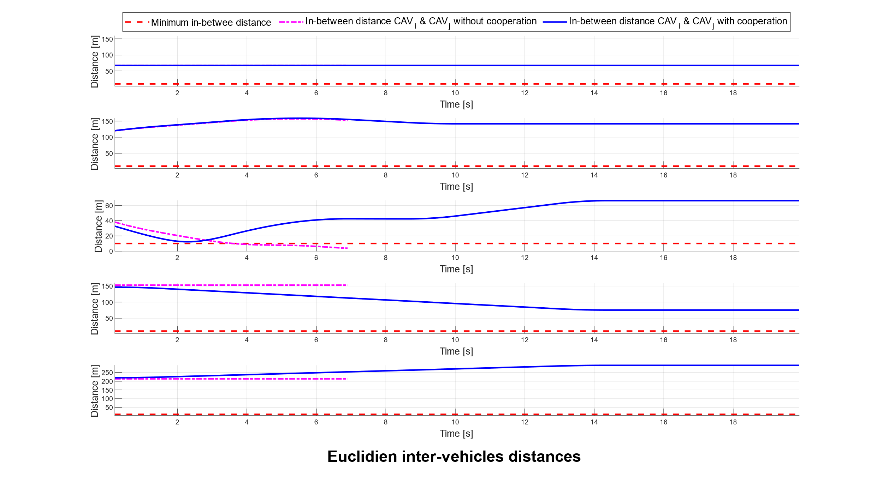





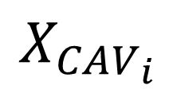
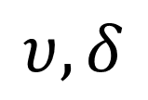

Safe and Smooth On-ramp Merging on Highway Strategy for Cooperative Automated Vehicles
Lyes Saidi¹, Lounis Adouane² and Reine Talj³
Laboratoire Heudiasyc, UMR CNRS 7253, Université de Technologie de Compiègne, France
Overall research context
Cooperative Automated Vehicles (CAVs) advantages address many areas: safety with accident reduction; health while improving passengers comfort; transportation time since it reduces road congestion; ecology with fuel efficiency among other advantages.
Among the objectives of the Ph.D thesis, addressing the on-ramp merging on highway complexity. In fact, the CAVs permit with the help of a
flexible formation modeling and control and a safe motion synchronization to envision a cooperative merging strategy.
Risk assessment and management
Environment
Decision making level
Perception module
Map
information
Global path planning
Generates the global reference path of the CAV.
It includes:
Environment constrains,
Road topology (e.g., links),
Velocity limitations,
Traffic signs, etc.
Multi-mode safe and efficient
cooperative on-ramp merging on highway
Behavior selection level
Energy consumption, travel time, etc
Vector
map
Map
matching
CAV pose
and velocity
Behavior activation
Sensor
uncertainty
Nominal
mode
Cooperation
mode
Localization module
Passing
sequence
Ego CAV
information
Surrounding
CAVs information
E-CORM
Communication
$$X_{CAV_{i}}$$
CAV model
$$υ, δ$$
$$T_{d}, v$$
Control law
RSU
(a)
(b.2)
(b.1)
(c)
$$i=1, j=2$$
(a): T=0s, initial configuration of the formation, the CAVs under the communication range of the Road Side Unit (RSU) form a formation using the virtual structure formalism in (citer itsc22) in the presence of a cooperation protocol between the vehicles.
(a)
(b.2)
(b.1)
(c)
$$i=2, j=3$$
Collision
(a)
(b.2)
(c)
$$i=3, j=4$$
(b.1)
Collision
(b.1): T=7s, snapshot of the on-ramp merging scenario performed without cooperation, without cooperation during the reconfiguration phase, the safety requirement can not be ensured resulting in a collision between CAV₃ and CAV₄.
(a)
(b.1)
(c)
$$i=2, j=4$$
(b.2)
(c)
$$i=4, j=5$$
(a)
(b.1)
(b.2)
(b.2): T=7s, snapshot of the on-ramp merging scenario performed with cooperation, thanks to cooperation the formation virtual structure was reconfigured during the merging maneuver safely. Consequently, the collision between CAV₃ and CAV₄ is solved.
(c): T=14s, snapshot of the on-ramp merging scenario at the end of the formation reconfiguration, the virtual structure of the formation is reshaped from the initial shape to the desired linear-platoon shape.
Journées du Comité Technique Automatique et Transport Terrestre (CT ATT) 2022
Contacts: 1: Lyes.Saidi@hds.utc.fr 2: lounis.Adouane@hds.utc.fr 3: Reine.Talj@hds.utc.fr

