Slide 1

RT-RRT*: A Real-Time Path Planning
Sai Dinesh Gelam
Gowtham Chintalapati

Slide 2
INTRODUCTION
Path planning is a critical component in a wide range of applications, from autonomous robotics to dynamic simulations in computer games. Traditional path planning algorithms often struggle with dynamic environments where obstacles, goals, and the agent's position continuously change.
To address these challenges, the paper introduces a novel real-time path planning algorithm named RT-RRT* (Real-Time Rapidly-exploring Random Trees) using both Bi-RRT and RRT.
This algorithm is an enhancement of the well-established RRT* algorithm, which is known for its efficiency in static environments.

Slide 3
Approach
Key to RT-RRT*'s approach is its online tree rewiring strategy, which allows the tree's root to shift in alignment with the agent's movement.
Paper: Naderi, K., Rajamäki, J., & Hämäläinen, P. (2015). "RT-RRT*: A Real-Time Path Planning Algorithm Based On RRT*." In Proceedings of the ACM Symposium on Interactive 3D Graphics and Games (MIG '15), November 16 – 18, 2015, Paris, France (pp. Page Range). ACM. DOI: http://dx.doi.org/10.1145/2822013.2822036. ISBN 978-1-4503-3991-9/15/11.
Our work demonstrates Dynamic path planning done by two methods.
1) localized planning at vicinity of obstacles leaving the main path intact.
2) Global path planning at the vicinity of obstacles.

Slide 4
What is RRT* ?
RRT* is an sampling based algorithm used for optimal path planning in robotics and motion planning problems.
It is an extension of the Rapidly Exploring Random Tree (RRT) algorithm, enhancing it to find optimal paths.
Unlike RRT, RRT* minimizes the cost of the paths found, aiming to find the shortest and most efficient path.
It optimizes the tree structure by rewiring edges and nodes, iteratively improving the quality of the solution.

Slide 5
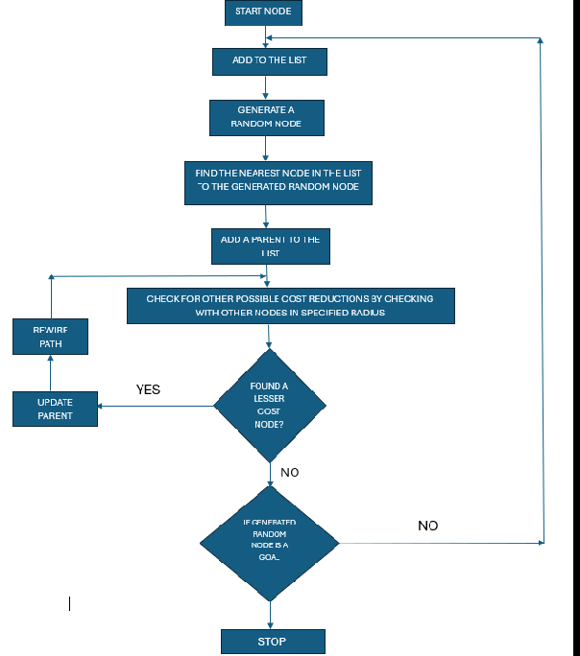
Work Flow of RRT*

Slide 6
Problem – Dynamic Obstacles

Slide 7
General implementation for Dynamic obstacles – Method 1
A general path planning can be used for a environment with dynamically moving obstacles as flows.
To generate a path for the first instance of the path and start moving the generated path
Whenever the agent reached the vicinity of obstacles at a node, the start point can be updated and can generate a complete new tree from a new start point to the goal point

Slide 8
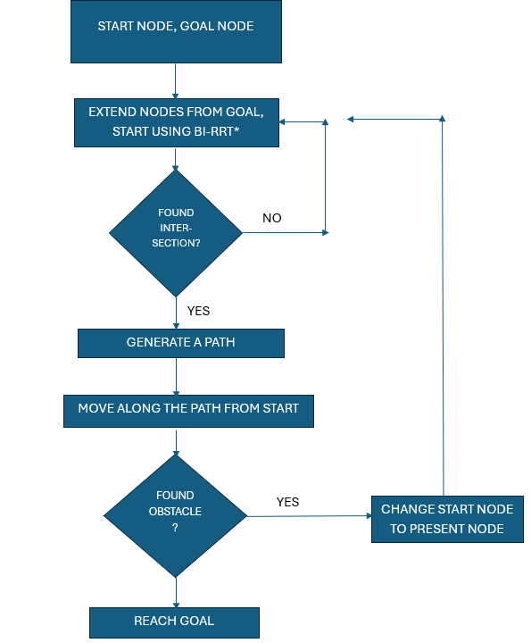
Work Flow of Method -1

Slide 9
Simulation Results of Method -1

Slide 10
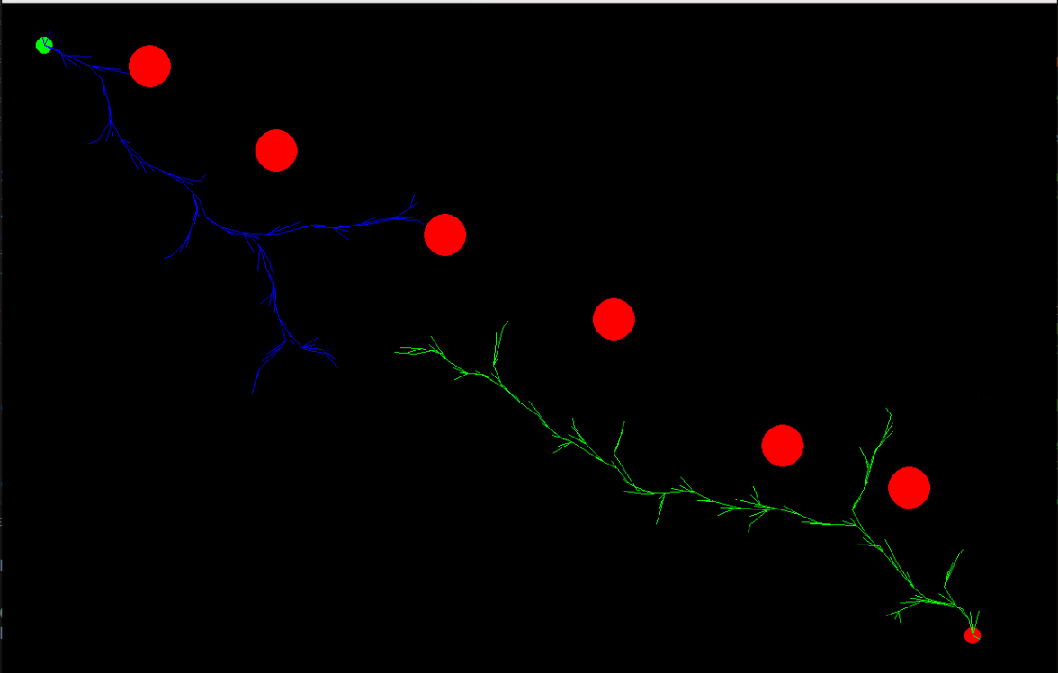
Tree growth from Start and Goal nodes

Slide 11
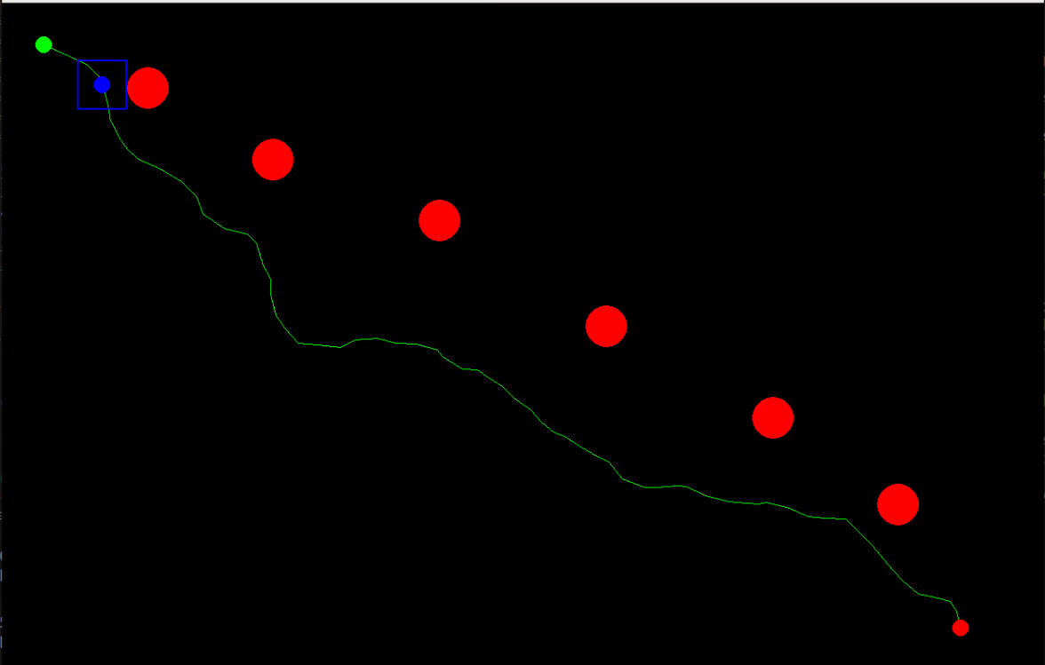
Generation of path from both the start and goal node trees

Slide 12
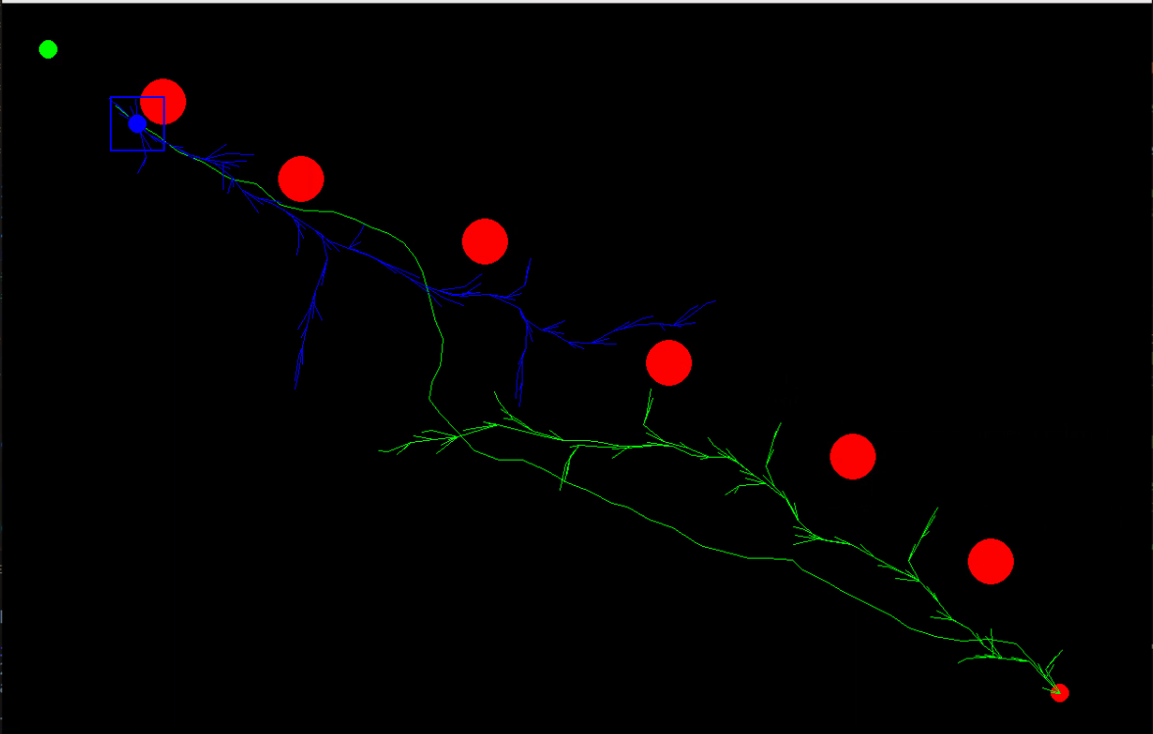
Finding entirely anew path at a vicinity of obstacle

Slide 13
Simulation Video Method -1
Video -Method 1
Ctrl + Click on the above hyper link to see the video
Or enter this Url : https://drive.google.com/file/d/16kKuAqTcrp17v3cHIHhjDzt39v-g8Y6e/view?usp=sharing

Slide 14
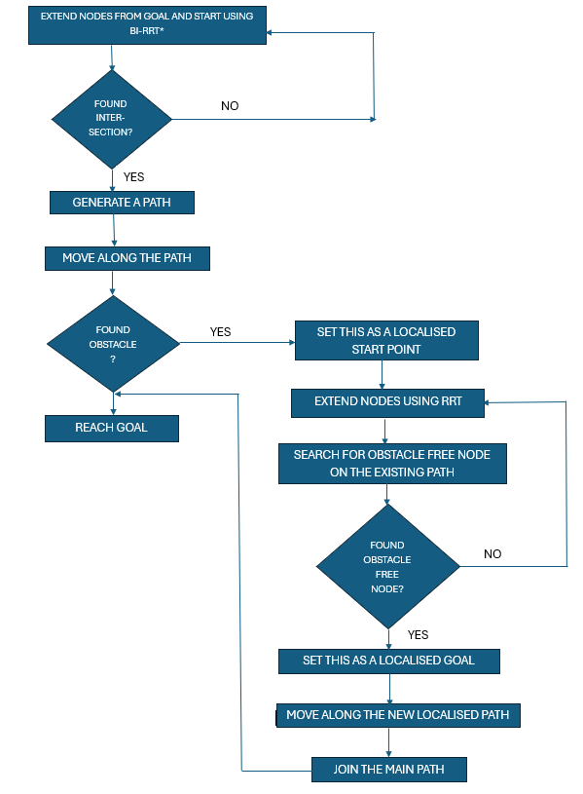
Method -2 Work Flow

Slide 15
Simulation Results of Method -2

Slide 16
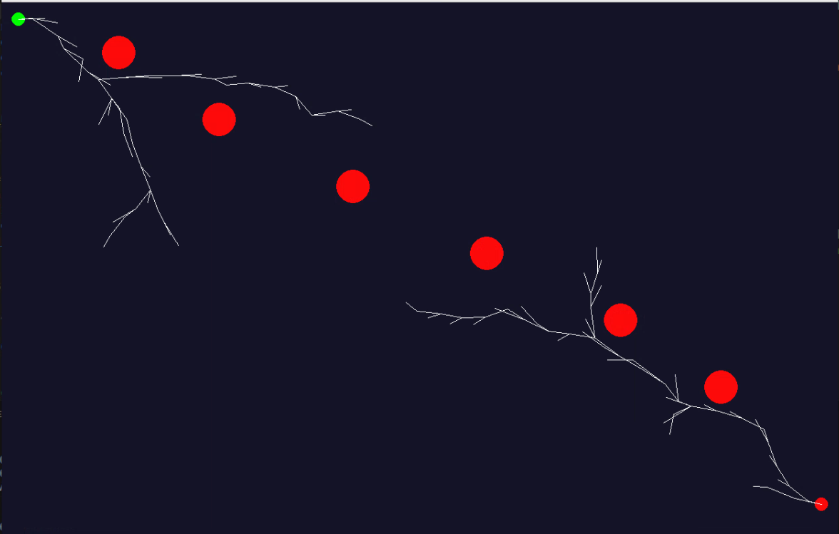
Tree growth from Start and Goal nodes

Slide 17
Generation of path from both the start and goal node trees

Slide 18
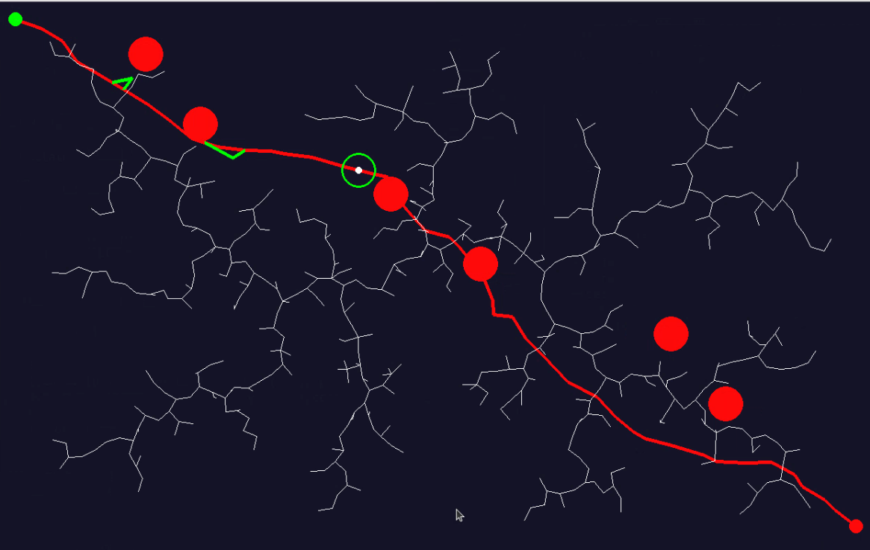
Finding a sub path (localized path) using RRT when in the vicinity of obstacle

Slide 19
Simulation Video Method -2
Video -Method 2
Ctrl + Click on the above hyper link to see the video
Or enter this Url : https://drive.google.com/file/d/14d8gx1zpygx0cc_l2CSFEfac-yncNxJs/view?usp=sharing

Slide 20
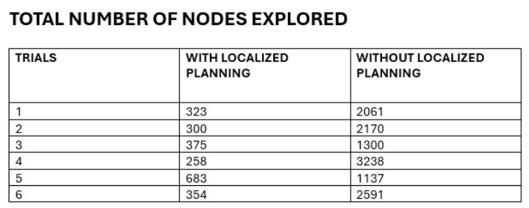
Conclusions and Comparison between Method-1 and Method 2
The Method – 2 with localized path planning as tremendously decreased the number of nodes explored, hence computational efforts, during the solving for path in dynamically changing environment.

Slide 21
Problems faced
To merge both RRT and RRT* to find the local paths and eventually learned over time
To animate and create dynamically moving obstacles.

Slide 22
Future Work
Adaptation to Larger and Unbounded Environments:
Extending the algorithm to effectively handle unbounded environments or extremely large areas would broaden its applicability, particularly in outdoor robotics such as drones or autonomous vehicles that operate over large areas.
Robustness to Highly Dynamic Environments:
Further development could aim to enhance the algorithm's robustness in environments with highly unpredictable or extremely dynamic obstacles, such as in disaster response scenarios or military applications.
Integration with Machine Learning:
Machine learning could be utilized to predict environmental changes or to optimize path planning based on historical data, enhancing the algorithm’s predictive capabilities and adaptiveness.

Slide 23
Thank You - Group 52

