Slide 1
Software Testing
ISTQB / ISEB
Know the Certifications

Slide 2
Contents
A little bit of testing
Certification and how it works
Tester certification and how it has developed
Where we are now
Where we plan to go

Slide 3
A Little Test
Which of the following is true of software testing?
  It reduces risk and adds quality to software products
  It should happen between development and release
  It is expensive and adds little value
  It requires extensive domain knowledge

Slide 4
Risk Based Testing
Testing Strategy
Priority 1
Priority 2
Priority 3
Priority 4
Probability
of
Failure
Cost of failure/value of requirement

Slide 5
Whole Life Cycle Testing
Requirements
Acceptance Test
Testing here ensures the
product will be what we wanted
Testing here
defines the
product quality
System Specification
System Test
Testing here
confirms the
product quality
System Design
Integration Test
Testing here
directly affects
the product quality
Unit Design
Unit Test

Slide 6
Cost Effective Testing
Highest risk/highest value
Each test adds maximum value by:
confirming high value requirements are met
identifying problems in high risk areas
Risk is reduced/value is assured
Threshold
Completion criteria
Acceptable quality outcome
Any uncompleted tests add less value than
those already completed. Testing is always
the best that could be achieved in the time
Lowest risk/lowest value

Slide 7
Structured Testing
Requirements are prioritised and completion criteria set
Static testing identifies specification issues
Systematic ‘black box’ techniques explore functionality
Systematic ‘white box’ techniques explore structure
Review
Achievement of completion criteria is evaluated
Release

Slide 8
Why Certification?
Business needs to know why and how software testing can help them
Users pressed into user acceptance testing need to know how to add value
Professional testers need to understand how to be more effective
Potential entrants to testing need to have a sound basic understanding

Slide 9
ISEB / ISTQB
Information Systems Examination Board
Projects and Business Change
Project management
Business analysis
Solution Development and
Delivery
Software testing
Systems development and architecture
Infrastructure Assets and Service Management
IT service management
Assets and infrastructure management
Legal, Compliance and Security
IT legal compliance
IT security

Slide 10
Tester Certification
Foundation as an entry point with no barriers to entry
Practitioner for testers with some experience
Specialist for experienced testers who want to demonstrate their advanced knowledge and skills
All underpinned by accredited training
to ISEB / ISTQB approved syllabuses

Slide 11
The Foundation Dilemma
BENEFITS
Vocabulary
Common understanding
Shared values
BUT
Most developers not included
Managers do not understand what testers can do
RESULT
Frustration

Slide 12

Reaching for the sky
Practitioner
Foundation

Slide 13
Exam Quality
Questions and exam papers set and/or reviewed by a selected panel
Markers approved and trained
Moderation by sample papers (and possibly by seeded papers)
Final exam moderation before results are released
Feedback to unsuccessful candidates

Slide 14
Internationalisation
ISTQB formed in 2002 to foster international co-operation
ISTQB Foundation syllabus launched in 2005 and adopted by ISEB to replace the ISEB syllabus
ISTQB has attracted a large number of countries and continues to expand but most have no experience of certification schemes

Slide 15
A Brief History
Testing Certifications
2002
Certification
ISTQB
1998
BS 7925
ISEB Foundation
2002
ISEB Practitioner

Slide 16
A Brief History of Testing:
The International Dimension
2002
Certification
ISTQB
1998
2005
BS 7925
ISEB Foundation
ISTQB Foundation
2002
ISEB Practitioner

Slide 17
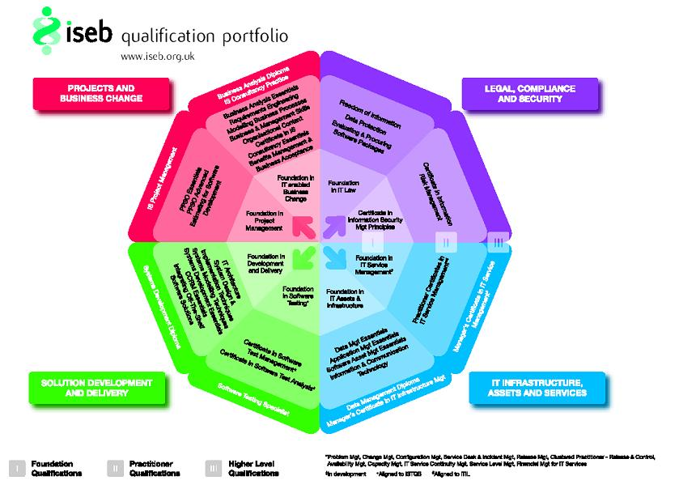
A Brief History of
Testing Certifications:
Where we are today
Certification
ISTQB
1998
2005
BS 7925
ISEB Foundation
ISTQB Foundation
2007
General
2002
2007
ISEB Practitioner
ISTQB Advanced
Analyst
Manager
2006

Slide 18
ISEB Portfolio Alignment

