Slide 1
Tool support for testing (CAST)
Chapter 6
Software Testing
ISTQB / ISEB Foundation Exam Practice
1 Principles
2 Lifecycle
3 Static testing
4 Dynamic test
techniques
5 Management
6 Tools

Slide 2
Contents
1
2
3
ISTQB / ISEB Foundation Exam Practice
4
5
6
Tool support
Types of CAST tool
Why capture/replay is not test automation
Automating and testing are separate skills
Best practice

Slide 3
Testing tool classification
Requirements testing tools
Static analysis tools
Test design tools
Test data preparation tools
Test running tools - character-based, GUI
Comparison tools
Test harnesses and drivers
Performance test tools
Dynamic analysis tools
Debugging tools
Test management tools
Coverage measurement

Slide 4
Where tools fit
Req Anal
Acc Test
Requirements
testing
Performance
measurement
Function
Sys Test
Test running
Comparison
Test design
Design
Int Test
Test harness
& drivers
Test data
preparation
Debug
Dynamic
analysis
Static
analysis
Code
Comp. Test
Coverage
measures
Test management tools

Slide 5
Requirements testing tools
Automated support for verification and validation of requirements models
  consistency checking
  animation
Tool information available from:
Ovum Evaluates Software Testing Tools (subscription service)
CAST Report, 1999
World Wide Web

Slide 6
Static analysis tools
Provide information about the quality of software
Code is examined, not executed
Objective measures
  cyclomatic complexity
  others: nesting levels, size

Slide 7
Test design tools
Generate test inputs
  from a formal specification or CASE repository
  from code (e.g. code not covered yet)

Slide 8
Test data preparation tools
Data manipulation
  selected from existing databases or files
  created according to some rules
  edited from other sources

Slide 9
Test running tools 1
Interface to the software being tested
Run tests as though run by a human tester
Test scripts in a programmable language
Data, test inputs and expected results held in test repositories
Most often used to automate regression testing

Slide 10
Test running tools 2
Character-based
  simulates user interaction from dumb terminals
  capture keystrokes and screen responses
GUI (Graphical User Interface)
  simulates user interaction for WIMP applications (Windows, Icons, Mouse, Pointer)
  capture mouse movement, button clicks, and keyboard inputs
  capture screens, bitmaps, characters, object states

Slide 11
Comparison tools
Detect differences between actual test results and expected results
  screens, characters, bitmaps
  masking and filtering
Test running tools normally include comparison capability
Stand-alone comparison tools for files or databases

Slide 12
Test harnesses and drivers
Used to exercise software which does not have a user interface (yet)
Used to run groups of automated tests or comparisons
Often custom-build
Simulators (where testing in real environment would be too costly or dangerous)

Slide 13
Performance testing tools
Load generation
  drive application via user interface or test harness
  simulates realistic load on the system & logs the number of transactions
Transaction measurement
  response times for selected transactions via user interface
Reports based on logs, graphs of load versus response times

Slide 14
Dynamic analysis tools
Provide run-time information on software (while tests are run)
  allocation, use and de-allocation of resources, e.g. memory leaks
  flag unassigned pointers or pointer arithmetic faults

Slide 15
Debugging tools
Used by programmers when investigating, fixing and testing faults
Used to reproduce faults and examine program execution in detail
  single-stepping
  breakpoints or watchpoints at any statement
  examine contents of variables and other data

Slide 16
Test management tools
Management of testware: test plans, specifications, results
Project management of the test process, e.g. estimation, schedule tests, log results
Incident management tools (may include workflow facilities to track allocation, correction and retesting)
Traceability (of tests to requirements, designs)

Slide 17
Coverage measurement tools
Objective measure of what parts of the software structure was executed by tests
Code is instrumented in a static analysis pass
Tests are run through the instrumented code
Tool reports what has and has not been covered by those tests, line by line and summary statistics
Different types of coverage: statement, branch, condition, LCSAJ, et al

Slide 18
Content
1
2
3
ISTQB / ISEB Foundation Exam Practice
4
5
6
Tool support
Types of CAST tool
Why capture/replay is not test automation
Automating and testing are separate skills
Best practice

Slide 19
Advantages of recording manual tests
documents what the tester actually did
  useful for capturing ad hoc tests (e.g. end users)
  may enable software failures to be reproduced
produces a detailed “script”
  records actual inputs
  can be used by a technical person to implement a more maintainable automated test
ideal for one-off tasks
  such as long or complicated data entry

Slide 20
Captured test scripts
will not be very understandable
  it is a programming language after all!
  during maintenance will need to know more than can ever be ‘automatically commented’
will not be resilient to many software changes
  a simple interface change can impact many scripts
do not include verification
  may be easy to add a few simple screen based comparisons

Slide 21
Compare seldom vs. compare often
Robust Tests
Sensitive Tests
Susceptibility to changes
Implementation effort
Miss faults
Failure analysis effort
Storage space

Slide 22
Too much sensitivity = redundancy
Three tests,
each changes
a different field
If all tests are
robust, the
unexpected
change is
missed
Test output
If all tests are
sensitive, they
all show the
unexpected change
Unexpected
change occurs
for every test

Slide 23
Automated verification
there are many choices to be made
  dynamic / post execution, compare lots / compare little, resilience to change / bug finding effective
scripts can soon become very complex
  more susceptible to change, harder to maintain
there is a lot of work involved
  speed and accuracy of tool use is very important
usually there is more verification that can
(and perhaps should) be done
  automation can lead to better testing (not guaranteed!)

Slide 24
Content
1
2
3
ISTQB / ISEB Foundation Exam Practice
4
5
6
Tool support
Types of CAST tool
Why capture/replay is not test automation
Automating and testing are separate skills
Best practice

Slide 25
Effort to automate
The effort required to automate any one test varies greatly
  typically between 2 and 10 times the manual test effort
and depends on:
  tool, skills, environment and software under test
  existing manual test process which may be:
    unscripted manual testing
    scripted (vague) manual testing
    scripted (detailed) manual testing

Slide 26
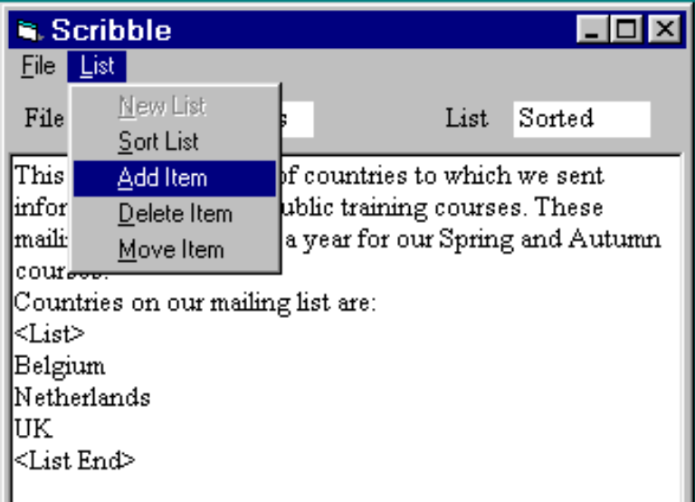
Unscripted manual testing
“Try this”
Step 4: check
it worked OK
Wizzo
Computer
“Try that”
“What about ...”
“What if ...”
Step 1: identify
conditions
to test
Step 2: think
up specific
inputs
Step 3: enter the inputs

Slide 27
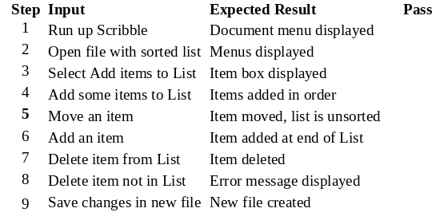
Scripted (vague) manual testing
Step 4: check
it worked OK
Wizzo
Computer
Step 1: read
what to do
Step 2: think
up specific
inputs
Step 3: enter the inputs

Slide 28
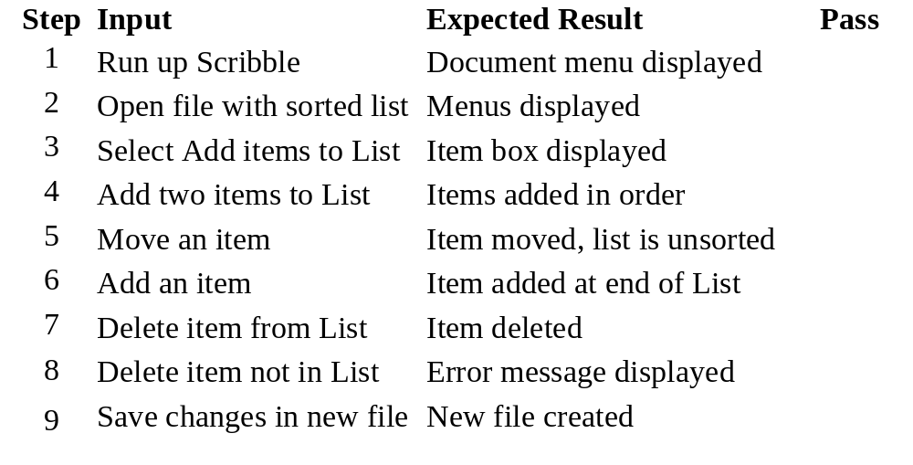
A vague manual test script

Slide 29
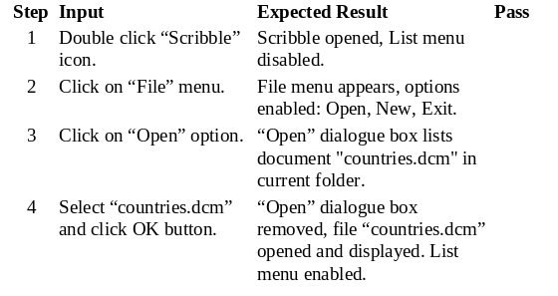
Scripted (detailed) manual testing
Step 3: check
it worked OK
Wizzo
Computer
Step 1: read
what to do
Step 2: enter the inputs

Slide 30
Content
1
2
3
ISTQB / ISEB Foundation Exam Practice
4
5
6
Tool support
Types of CAST tool
Why capture/replay is not test automation
Automating and testing are separate skills
Best practice

Slide 31
Don’t automate too much long term
as the test suite grows ever larger, so do the maintenance costs
  maintenance effort is cumulative, benefits are not
the test suite takes on a life of its own
  testers depart, others arrive, test suite grows larger nobody knows exactly what they all do … dare not throw away tests in case they’re important
inappropriate tests are automated
  automation becomes an end in itself

Slide 32

Maintain control
keep pruning
  remove dead-wood: redundant, superceded, duplicated, worn-out
  challenge new additions (what’s the benefit?)
measure costs & benefits
  maintenance costs
  time or effort saved, faults found?

Slide 33
Invest
commit and maintain resources
  “champion” to promote automation
  technical support
  consultancy/advice
scripting
  develop and maintain library
  data driven approach, lots of re-use

Slide 34
Tests to automate
run many times
  regression tests
  mundane
expensive to perform manually
  time consuming and necessary
  multi-user tests, endurance/reliability tests
difficult to perform manually
  timing critical
  complex / intricate
Automate

Slide 35
Tests not to automate
not run often
  if no need (rather than expensive to run manually)
  one off tests (unless several iterations likely and build cost can be minimised)
not important
  will not find serious problems
usability tests
  do the colours look nice?
some aspects of multi-media applications
Automate

Slide 36
Summary: Key Points
1
2
3
ISTQB / ISEB Foundation Exam Practice
4
5
6
Tool support
There are many different types of tool support for testing, covering all areas of the life cycle.
Automation requires planning and up-front effort
Identify and adopt best practice

