Slide 1

Learn Software Testing &
Prepare for ISTQB Foundation Certification Exam
>>>>>>>>>>>>>>>>>>>>>> www.softwaretestinggenius.com <<<<<<<<<<<<<<<<<<<<<<

Slide 2
Contents
Part - 1: Quality
Part - 2: Software Testing & Development Models
Part - 3: Different Stages of SDLC with STLC
Part - 4: Testing Techniques
Part - 5: Types of Testing
Part - 6: Testing Life Cycle
Part - 7: Defects Management
Part - 8: Test Automation
>>>>>>>>>>>>>>>>>>>>>> www.softwaretestinggenius.com <<<<<<<<<<<<<<<<<<<<<<

Slide 3
Part 1: Quality
Quality has two elements
  QA - Quality Assurance
  QC - Quality Control
>>>>>>>>>>>>>>>>>>>>>> www.softwaretestinggenius.com <<<<<<<<<<<<<<<<<<<<<<

Slide 4
What is Quality ?
Quality from the
  Customer’s Viewpoint Fitness for use, or other customer needs
  Producer’s Viewpoint Meeting requirements
>>>>>>>>>>>>>>>>>>>>>> www.softwaretestinggenius.com <<<<<<<<<<<<<<<<<<<<<<

Slide 5
Quality Function
Software quality includes activities related to both
  Process, and the
  Product
Quality Assurance is about the work process
Quality Control is about the product
>>>>>>>>>>>>>>>>>>>>>> www.softwaretestinggenius.com <<<<<<<<<<<<<<<<<<<<<<

Slide 6
What is Quality Assurance?
Quality assurance activities are work process oriented.
They measure the process, identify deficiencies, and suggest improvements.
The direct results of these activities are changes to the process.
These changes can range from better compliance with the process to entirely new processes.
The output of quality control activities is often the input to quality assurance activities.
Audits are an example of a QA activity which looks at whether and how the process is being followed. The end result may be suggested improvements or better compliance with the process.
>>>>>>>>>>>>>>>>>>>>>> www.softwaretestinggenius.com <<<<<<<<<<<<<<<<<<<<<<

Slide 7
What is Quality Control?
Quality control activities are work product oriented.
They measure the product, identify deficiencies, and suggest improvements.
The direct results of these activities are changes to the product.
These can range from single-line code changes to completely reworking a product from design.
They evaluate the product, identify weaknesses and suggest improvements.
Testing and reviews are examples of QC activities since they usually result in changes to the product, not the process.
QC activities are often the starting point for quality assurance (QA) activities.
>>>>>>>>>>>>>>>>>>>>>> www.softwaretestinggenius.com <<<<<<<<<<<<<<<<<<<<<<

Slide 8
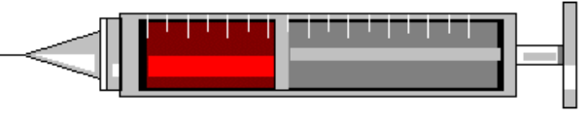

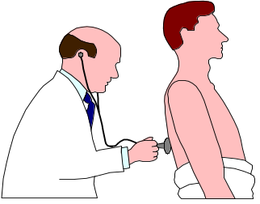

Prevention and Detection
Prevention is better than cure . . .
. . . but not everything can be prevented!
Prevention
Detection
Cure
>>>>>>>>>>>>>>>>>>>>>> www.softwaretestinggenius.com <<<<<<<<<<<<<<<<<<<<<<

Slide 9
QA and QC Broad Difference
QA
Assurance
Process
Preventive
Quality Audit
QC
Control
Product
Detective
Testing
>>>>>>>>>>>>>>>>>>>>>> www.softwaretestinggenius.com <<<<<<<<<<<<<<<<<<<<<<

Slide 10



Quality... it’s all about the End-User
Does this software product work as advertised?
  Functionality, Performance, System & User Acceptance ... Testing
Will the users be able to do their jobs using this product?
  Installability, Compatibility, Load/Stress ... Testing
Can they bet their business on this software product?
  Reliability, Security, Scalability ... testing
>>>>>>>>>>>>>>>>>>>>>> www.softwaretestinggenius.com <<<<<<<<<<<<<<<<<<<<<<

Slide 11
Real World Software Testing
>>>>>>>>>>>>>>>>>>>>>> www.softwaretestinggenius.com <<<<<<<<<<<<<<<<<<<<<<

Slide 12
Part 2: Testing
Testing
  What is testing
  Objectives of Testing
>>>>>>>>>>>>>>>>>>>>>> www.softwaretestinggenius.com <<<<<<<<<<<<<<<<<<<<<<

Slide 13
What is Testing?
Definition:
Testing is process of trying to discover every conceivable fault or weakness in a work product.
Testing is a process of executing a program with the intent of finding an error.
A good test is one that has a high probability of finding an as yet undiscovered error.
A successful test is one that uncovers an as yet undiscovered error
>>>>>>>>>>>>>>>>>>>>>> www.softwaretestinggenius.com <<<<<<<<<<<<<<<<<<<<<<

Slide 14
What is Testing?
Testing is a process used to identify the correctness, completeness and quality of developed computer software. Testing, apart from finding errors, is also used to test performance, safety, fault-tolerance or security.
Software testing is a broad term that covers a variety of processes designed to ensure that software applications function as intended, are able to handle the volume required, and integrate correctly with other software applications.
>>>>>>>>>>>>>>>>>>>>>> www.softwaretestinggenius.com <<<<<<<<<<<<<<<<<<<<<<

Slide 15
What are the “right” things to test?
Are you testing an entire product or some components?
Which functions are critical for a product?
Which functions are highly visible when they fail?
Which functions have been highly error-prone?
Which functions are most often used?
Which functions are changed most often / recently?
Which functions suffered turnover of employees?
Where is high geographic distribution of work?
Which functions require new skills / technology?
Looks Impossible to do it all!
>>>>>>>>>>>>>>>>>>>>>> www.softwaretestinggenius.com <<<<<<<<<<<<<<<<<<<<<<

Slide 16
What is objective of Testing?
Objective of testing is to find all possible bugs (defects) in a work product
Testing should intentionally attempt to make things go wrong to determine if things happen when they shouldn't or things don't happen when they should.
>>>>>>>>>>>>>>>>>>>>>> www.softwaretestinggenius.com <<<<<<<<<<<<<<<<<<<<<<

Slide 17
Setting up criteria for testing
Criteria can be at phase level
Entry Criteria
  Parallelism Vs Ready for use
Exit Criteria
  Completeness Vs Risk of release
Suspension Criteria
  Show stopper bugs
  Crossing a threshold number of bugs
  Developers producing a new version making the old one redundant
Resumption Criteria
  Above hurdles being cleared
>>>>>>>>>>>>>>>>>>>>>> www.softwaretestinggenius.com <<<<<<<<<<<<<<<<<<<<<<

Slide 18
General Testing Principles
Testing shows presence of Defect
Exhaustive Testing is Impossible
Early Testing
Defect Clustering
Pesticide Paradox
Testing is context dependent
Absence-of-error fallacy
>>>>>>>>>>>>>>>>>>>>>> www.softwaretestinggenius.com <<<<<<<<<<<<<<<<<<<<<<

Slide 19
Summary
Identify defects
  when the software doesn’t work
Verify that it satisfies specified requirements
  verify that the software works
>>>>>>>>>>>>>>>>>>>>>> www.softwaretestinggenius.com <<<<<<<<<<<<<<<<<<<<<<
Notes:
Let's talk about testing
What is it?
Why do we do it?
The process of evaluating software to verify that it satisfies specified requirements and to detect errors
It is generally believed that software can never be made perfect.
Testing is necessary because the existence of faults in software is inevitable.
Consequently, we test software to find as many faults as we can to ensure that a high quality product with a minimum of faults is delivered. Identifying defects is testing team’s primary responsibility. However there is another important responsibility that is verifying, the application’s functionality meet the user requirements.

Slide 20
Mature view of software testing
A mature view of software testing is to see it as a process of reducing the risk of software failure in the field to an acceptable level [Bezier 90].
>>>>>>>>>>>>>>>>>>>>>> www.softwaretestinggenius.com <<<<<<<<<<<<<<<<<<<<<<

Slide 21
What exactly Does a Software Tester Do?
The Goal of a software tester is to find defects
And find them as early as possible.
>>>>>>>>>>>>>>>>>>>>>> www.softwaretestinggenius.com <<<<<<<<<<<<<<<<<<<<<<

Slide 22
What does testing mean to testers?
Testers hunt errors
  Detected errors are celebrated - for the good of the work product
Testers are destructive - but creatively so
  Testing is a positive and creative effort of destruction
Testers pursue errors, not people
  Errors are in the work product, not in the person who made the mistake
Testers add value
  by discovering errors as early as possible
>>>>>>>>>>>>>>>>>>>>>> www.softwaretestinggenius.com <<<<<<<<<<<<<<<<<<<<<<

Slide 23
How testers do it?
By examining the user’s requirements, internal structure and design, functional user interface etc
By executing the code, application software executable etc
>>>>>>>>>>>>>>>>>>>>>> www.softwaretestinggenius.com <<<<<<<<<<<<<<<<<<<<<<

Slide 24
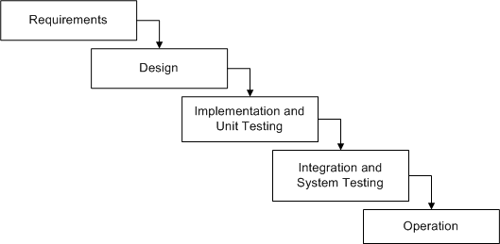
Waterfall Model for Testing
>>>>>>>>>>>>>>>>>>>>>> www.softwaretestinggenius.com <<<<<<<<<<<<<<<<<<<<<<

Slide 25
Advantages of Waterfall Model
Simple and easy to use.
Easy to manage due to the rigidity of the model – each phase has specific deliverables and a review process.
Phases are processed and completed one at a time.
Works well for smaller projects where requirements are very well understood.
>>>>>>>>>>>>>>>>>>>>>> www.softwaretestinggenius.com <<<<<<<<<<<<<<<<<<<<<<

Slide 26
Disadvantages of Waterfall Model
Adjusting scope during the life cycle can kill a project
No working software is produced until late during the life cycle.
High amounts of risk and uncertainty.
Poor model for complex and object-oriented projects.
Poor model where requirements are at a moderate to high risk of changing.
>>>>>>>>>>>>>>>>>>>>>> www.softwaretestinggenius.com <<<<<<<<<<<<<<<<<<<<<<

Slide 27
Disadvantages of Waterfall Model
It is a process of establishing requirements, designing, building and testing a system, done as a series of smaller development
Increment produced by Iteration is tested at several levels as part of its development
Regression testing is important after all iterations
Verification and verification can be carried outs on each iteration
>>>>>>>>>>>>>>>>>>>>>> www.softwaretestinggenius.com <<<<<<<<<<<<<<<<<<<<<<

Slide 28
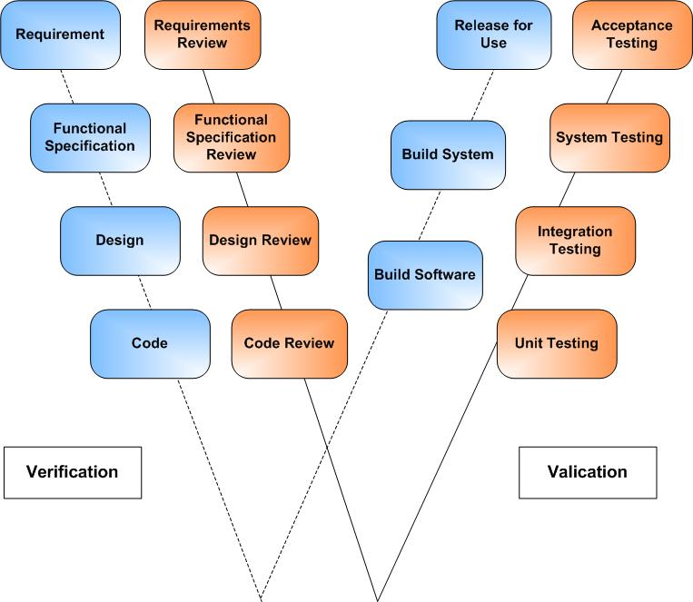
W-Model for Testing

Slide 29
Advantages of W - Model
Simple and easy to use.
Each phase has specific deliverables.
Higher chance of success over the waterfall model due to the development of test plans early on during the life cycle.
Works well for small projects where requirements are easily understood.
>>>>>>>>>>>>>>>>>>>>>> www.softwaretestinggenius.com <<<<<<<<<<<<<<<<<<<<<<

Slide 30
Disadvantages of W - Model
Very rigid, like the waterfall model.
Little flexibility and adjusting scope is difficult and expensive.
Software is developed during the implementation phase, so no early prototypes of the software are produced.
Model doesn’t provide a clear path for problems found during testing phases.
>>>>>>>>>>>>>>>>>>>>>> www.softwaretestinggenius.com <<<<<<<<<<<<<<<<<<<<<<

Slide 31
Part 3: Different stages of SDLC with STLC
Stages of SDLC with STLC
>>>>>>>>>>>>>>>>>>>>>> www.softwaretestinggenius.com <<<<<<<<<<<<<<<<<<<<<<

Slide 32
Different stages of SDLC with STLC
Stage-1 Requirement Gathering
  DA: Defining requirements to establish specifications is the first step in the development of software.
  TA: Reviewing the requirements e.g the requirements should not have ambiguous words like (may or may not). It should be clear and concise.
>>>>>>>>>>>>>>>>>>>>>> www.softwaretestinggenius.com <<<<<<<<<<<<<<<<<<<<<<

Slide 33
Different stages of SDLC with STLC
Stage-2 Functional Specification
  DA: It describes the product’s behaviors as seen by an external observer, and contains the technical information and data needed for the design. The functional specification defines what the functionality will be
  TA: In order to make the functional specifications accurate we have review our functional specifications.
>>>>>>>>>>>>>>>>>>>>>> www.softwaretestinggenius.com <<<<<<<<<<<<<<<<<<<<<<

Slide 34
Different stages of SDLC with STLC
Stage-3 Design
  DA: The software specifications are transformed in to design models that describe the details of the data structures, system architecture, interface and the components.
  TA: Each design product is reviewed for quality before moving the next phase of the software development.
>>>>>>>>>>>>>>>>>>>>>> www.softwaretestinggenius.com <<<<<<<<<<<<<<<<<<<<<<

Slide 35
Different stages of SDLC with STLC
Stage-4 Code
  DA: In this phase the designs are translated into code.
  TA: Code review is a process of verifying the source code. Code review is done the find and fix the defects that are overlooked in the initial development phase, to improve overall quality of code.
>>>>>>>>>>>>>>>>>>>>>> www.softwaretestinggenius.com <<<<<<<<<<<<<<<<<<<<<<

Slide 36
Different stages of SDLC with STLC
Stage-5 Building Software
  DA: In this phase we build different software units and integrate them one by one to build single software.
  TA: Unit testing & Integration testing
>>>>>>>>>>>>>>>>>>>>>> www.softwaretestinggenius.com <<<<<<<<<<<<<<<<<<<<<<

Slide 37
Different stages of SDLC with STLC
Stage-6 Building system
  DA: After the software has been build we have the whole system considering all the non-functional requirements like installation procedure, configuration etc.
  TA: System testing & Acceptance testing
>>>>>>>>>>>>>>>>>>>>>> www.softwaretestinggenius.com <<<<<<<<<<<<<<<<<<<<<<

Slide 38
Different stages of SDLC with STLC
Stage-7 Release for use
  After the whole product has been developed and the required level of quality has been achieved and the software is release for the actual use of the customers.
>>>>>>>>>>>>>>>>>>>>>> www.softwaretestinggenius.com <<<<<<<<<<<<<<<<<<<<<<

Slide 39
Part 4: Testing Techniques
  Testing Techniques
  Verification and Validation
>>>>>>>>>>>>>>>>>>>>>> www.softwaretestinggenius.com <<<<<<<<<<<<<<<<<<<<<<

Slide 40
Verification
Reviews
Walkthrough
Inspection
>>>>>>>>>>>>>>>>>>>>>> www.softwaretestinggenius.com <<<<<<<<<<<<<<<<<<<<<<

Slide 41
Verification “What to Look For?”
Find all the missing information
  Who
  What
  Where
  When
  Why
  How
>>>>>>>>>>>>>>>>>>>>>> www.softwaretestinggenius.com <<<<<<<<<<<<<<<<<<<<<<

Slide 42
Peer Review
Simply giving a document to a colleague and asking them to look at it closely which will identify defects we might never find on our own.
>>>>>>>>>>>>>>>>>>>>>> www.softwaretestinggenius.com <<<<<<<<<<<<<<<<<<<<<<

Slide 43
Walkthrough
Informal meetings, where participants come to the meeting;and the author gives the presentation.
Objective:
  To detect defects and become familiar with the material
Elements:
  A planned meeting where only the presenter must prepare
  A team of 2-7 people, led by the author
  Author usually the presenter.
Inputs:
  Element under examination, objectives for the walkthroughs applicable standards.
Output:
  Defect report
>>>>>>>>>>>>>>>>>>>>>> www.softwaretestinggenius.com <<<<<<<<<<<<<<<<<<<<<<
Notes:
Rather than simply reading the program or using error checklists. The participants “play computer”. The person designated as the tester comes to the meeting armed with small set of paper test cases – representative sets of inputs (and expected outputs) for the program or module. During the meeting, each test case is mentally executed. That is the test data are walked through the logic of the program. The state of the program (i.e. the values of the variables) is monitored on paper or a blackboard.
Of course, the test cases must be simple in nature and few in number, because people “execute” programs at a rate that is many orders of magnitude slower than a machine. Hence, the test cases themselves do not play a critical role, rather, they serve as a vehicle for getting started for questioning the programmer about his or her logic and assumptions. In most walkthroughs, more errors are found during the process of questioning the programmer than are found during the process of questioning the programmer than are found directly by the test cases themselves.
As in the inspection, the attitude of the participants is crucial. Comments should be directed toward the program rather than the programmer. In other words, errors are not viewed as weaknesses in the person who committed them. Rather, they are viewed as being inherent in the difficulty of program development and as a result of the as-yet primitive nature of current programming methods.
The walkthrough should have a follow-up process similar to that described for the inspection process. Also, the side effects observed from inspections (identification of error-prone sections and education in errors, style, and techniques) also apply to the walkthrough process.

Slide 44
Inspection
Formal meeting, characterized by individual preparation by all participants prior to the meeting.
Objectives:
  To obtain defects and collect data.
  To communicate important work product information .
Elements:
  A planned, structured meeting requiring individual preparation by all participants.
  A team of people, led by an impartial moderator who assure that rules are being followed and review is effective.
  Presenter is “reader” other than the author.
  Other participants are inspectors who review,
  Recorder to record defects identified in work product
>>>>>>>>>>>>>>>>>>>>>> www.softwaretestinggenius.com <<<<<<<<<<<<<<<<<<<<<<

Slide 45
Checklists : the verification tool
An important tool specially in formal meetings like inspections
They provide maximum leverage on on verification
There are generic checklists that can be applied at a high level and maintained for each type of inspection
There are checklists for requirements,functional design specifications, internal design specifications, for code
>>>>>>>>>>>>>>>>>>>>>> www.softwaretestinggenius.com <<<<<<<<<<<<<<<<<<<<<<

Slide 46
Validation Strategies
There are two main strategies for validating software
  White Box testing
  Black Box testing
>>>>>>>>>>>>>>>>>>>>>> www.softwaretestinggenius.com <<<<<<<<<<<<<<<<<<<<<<
Notes:
The following are lesser used methods
Cause effect graphing
Syntax testing
State transition testing
Graph matrix

Slide 47
Validation Strategies
White Box Testing
  Deals with the internal logic and structure of the code
  The tests are written based on the white box testing strategy incorporate coverage of the code written, branches, paths, statements and internal logic of the code etc.
  Normally done the developers
>>>>>>>>>>>>>>>>>>>>>> www.softwaretestinggenius.com <<<<<<<<<<<<<<<<<<<<<<
Notes:
The following are lesser used methods
Cause effect graphing
Syntax testing
State transition testing
Graph matrix

Slide 48
White Box testing Methods
White Box Testing can be done by:
  Data Coverage
  Code Coverage
>>>>>>>>>>>>>>>>>>>>>> www.softwaretestinggenius.com <<<<<<<<<<<<<<<<<<<<<<
Notes:
The following are lesser used methods
Cause effect graphing
Syntax testing
State transition testing
Graph matrix

Slide 49
White Box testing Methods
Date Coverage
  Data flow is monitored or examined through out the program. E.g. watch window we use to monitor the values of the variables and expressions.
>>>>>>>>>>>>>>>>>>>>>> www.softwaretestinggenius.com <<<<<<<<<<<<<<<<<<<<<<
Notes:
The following are lesser used methods
Cause effect graphing
Syntax testing
State transition testing
Graph matrix

Slide 50
White Box testing Methods
Code Coverage
  It’s a process of finding areas of a program not exercised by a set of test cases,
  Creating additional test cases to increase coverage
  Code coverage can be implemented using basic measure like, statement coverage, decision coverage, condition coverage and path coverage
>>>>>>>>>>>>>>>>>>>>>> www.softwaretestinggenius.com <<<<<<<<<<<<<<<<<<<<<<
Notes:
The following are lesser used methods
Cause effect graphing
Syntax testing
State transition testing
Graph matrix

Slide 51
Validation Strategies
Black Box Testing
  Does not need any knowledge of internal design or code
  Its totally based on the testing for the requirements and functionality of the work product/software application.
  Tester is needed to be thorough with the requirement specifications of the system and as a user, should know how the system should behave in response to the particular action.
>>>>>>>>>>>>>>>>>>>>>> www.softwaretestinggenius.com <<<<<<<<<<<<<<<<<<<<<<
Notes:
The following are lesser used methods
Cause effect graphing
Syntax testing
State transition testing
Graph matrix

Slide 52
Black Box testing Methods
The following are commonly used Black Box methods :
  Equivalence partitioning
  Boundary-value analysis
  Error guessing
>>>>>>>>>>>>>>>>>>>>>> www.softwaretestinggenius.com <<<<<<<<<<<<<<<<<<<<<<
Notes:
The following are lesser used methods
Cause effect graphing
Syntax testing
State transition testing
Graph matrix

Slide 53
Equivalence Partitioning
An equivalence class is a subset of data that is representative of a larger class.
Equivalence partitioning is a technique for testing equivalence classes rather than undertaking exhaustive testing of each value of the larger class.
>>>>>>>>>>>>>>>>>>>>>> www.softwaretestinggenius.com <<<<<<<<<<<<<<<<<<<<<<

Slide 54
Equivalence Partitioning
If we expect the same result from two tests, you consider them equivalent. A group of tests from an equivalence class if,
  They all test the same thing
  If one test catches a bug, the others probably will too
  If one test doesn’t catch a bug, the others probably won’t either
>>>>>>>>>>>>>>>>>>>>>> www.softwaretestinggenius.com <<<<<<<<<<<<<<<<<<<<<<

Slide 55
Equivalence Partitioning
For example, a program which edits credit limits within a given range ($10,000-$15,000) would have three equivalence classes:
  Less than $10,000 (invalid)
  Between $10,000 and $15,000 (valid)
  Greater than $15,000 (invalid)
>>>>>>>>>>>>>>>>>>>>>> www.softwaretestinggenius.com <<<<<<<<<<<<<<<<<<<<<<

Slide 56
Equivalence Partitioning
Partitioning system inputs and outputs into ‘equivalence sets’
  If input is a 5-digit integer between 10,000 and 99,999 equivalence partitions are <10,000, 10,000-99,999 and >99,999
The aim is to minimize the number of test cases required to cover these input conditions
>>>>>>>>>>>>>>>>>>>>>> www.softwaretestinggenius.com <<<<<<<<<<<<<<<<<<<<<<

Slide 57
Equivalence Partitioning
Equivalence classes may be defined according to the following guidelines:
  If an input condition specifies a range, one valid and two invalid equivalence classes are defined.
  If an input condition requires a specific value, then one valid and two invalid equivalence classes are defined.
  If an input condition is Boolean, then one valid and one invalid equivalence class are defined.
>>>>>>>>>>>>>>>>>>>>>> www.softwaretestinggenius.com <<<<<<<<<<<<<<<<<<<<<<

Slide 58
Equivalence Partitioning Summary
Divide the input domain into classes of data for which test cases can be generated.
Attempting to uncover classes of errors.
Based on equivalence classes for input conditions.
An equivalence class represents a set of valid or invalid states
An input condition is either a specific numeric value, range of values, a set of related values, or a Boolean condition.
Equivalence classes can be defined by:
If an input condition specifies a range or a specific value, one valid and two invalid equivalence classes defined.
If an input condition specifies a Boolean or a member of a set, one valid and one invalid equivalence classes defined.
Test cases for each input domain data item developed and executed.
>>>>>>>>>>>>>>>>>>>>>> www.softwaretestinggenius.com <<<<<<<<<<<<<<<<<<<<<<

Slide 59
Boundary value analysis
“Bugs lurk in corners and congregate at boundaries…”
Boris Beizer
>>>>>>>>>>>>>>>>>>>>>> www.softwaretestinggenius.com <<<<<<<<<<<<<<<<<<<<<<

Slide 60
Boundary value analysis
A technique that consists of developing test cases and data that focus on the input and output boundaries of a given function.
In same credit limit example, boundary analysis would test:
  Low boundary plus or minus one ($9,999 and $10,001)
  On the boundary ($10,000 and $15,000)
  Upper boundary plus or minus one ($14,999 and $15,001)
>>>>>>>>>>>>>>>>>>>>>> www.softwaretestinggenius.com <<<<<<<<<<<<<<<<<<<<<<

Slide 61
Boundary value analysis
Large number of errors tend to occur at boundaries of the input domain
BVA leads to selection of test cases that exercise boundary values
BVA complements equivalence partitioning. Rather than select any element in an equivalence class, select those at the ''edge' of the class
Examples:
For a range of values bounded by a and b, test (a-1), a, (a+1), (b-1), b, (b+1)
If input conditions specify a number of values n, test with (n-1), n and (n+1) input values
Apply 1 and 2 to output conditions (e.g., generate table of minimum and maximum size)
>>>>>>>>>>>>>>>>>>>>>> www.softwaretestinggenius.com <<<<<<<<<<<<<<<<<<<<<<

Slide 62
Example: Loan application
2-64 chars.
Customer Name
Account number
Loan amount requested
Term of loan
Monthly repayment
Term:
Repayment:
Interest rate:
Total paid back:
6 digits, 1st
non-zero
£500 to £9000
1 to 30 years
Minimum £10

Slide 63
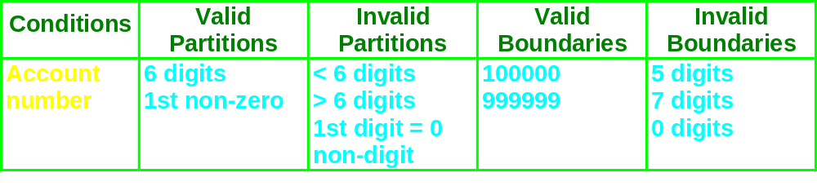
Account number
valid: non-zero
First character:
invalid: zero
Number of digits:
5
6
7
invalid
invalid
valid
>>>>>>>>>>>>>>>>>>>>>> www.softwaretestinggenius.com <<<<<<<<<<<<<<<<<<<<<<

Slide 64
Error Guessing
Based on the theory that test cases can be developed based upon the intuition and experience of the Test Engineer
For example, in an example where one of the inputs is the date, a test engineer might try February 29,2000 or 9/9/99
>>>>>>>>>>>>>>>>>>>>>> www.softwaretestinggenius.com <<<<<<<<<<<<<<<<<<<<<<

Slide 65
Error Guessing
Error guessing is an ad hoc approach, based on intuition and experience, to identify tests that are considered likely to expose errors
The basic idea is to make a list of possible errors or error prone situations and then develop tests based on the list.
E.g. Where one of the input is the date, a test engineer may try February 29, 2000
A=B/C What if C is 0?
>>>>>>>>>>>>>>>>>>>>>> www.softwaretestinggenius.com <<<<<<<<<<<<<<<<<<<<<<

Slide 66
Part 5: Various Types of Testing
Validation Activities
Validation is done at two levels
  Low Level
    Unit testing
    Integration Testing
  High Level
    Function Testing
    System Testing
    Acceptance Testing
>>>>>>>>>>>>>>>>>>>>>> www.softwaretestinggenius.com <<<<<<<<<<<<<<<<<<<<<<

Slide 67
Unit Testing
  Searches for defect and verifies the functionality of software, depending upon the context of the development
  It includes testing of functional and non-functional characteristics
  It occurs with access to code being tested and with the support of development environment
  Defects are fixed as soon as they are found with out formally recording incident
  If test cases are prepared and automated before coding, it is termed as test-first approach or test-driven development.
>>>>>>>>>>>>>>>>>>>>>> www.softwaretestinggenius.com <<<<<<<<<<<<<<<<<<<<<<

Slide 68
Integration Testing
Integration testing tests interface between components, interaction to different parts of system.
Greater the scope of Integration, more it becomes to isolate failures to specific component or system, which may leads to increased risk.
Integration testing should normally be integral rather than big bang, in order to reduce the risk of late defect discovery
Non functional characteristics (e.g. performance) may be included in Integration Testing
>>>>>>>>>>>>>>>>>>>>>> www.softwaretestinggenius.com <<<<<<<<<<<<<<<<<<<<<<

Slide 69
Function Testing
It is used to detect discrepancies between a program’s functional specification and the actual behavior of an application.
The goal of function testing is to verify whether your product meets the intended functional specifications laid out the development documentation.
When a discrepancy is detected, either the program or the specification is incorrect.
All the black box methods are applicable to function based testing
>>>>>>>>>>>>>>>>>>>>>> www.softwaretestinggenius.com <<<<<<<<<<<<<<<<<<<<<<

Slide 70
System Testing
It is concerned with the behavior of whole system as defined by the scope of development project
It includes both functional and non-functional requirement of system
System testing falls within the scope of black box testing.
On building the entire system, it needs to be tested against the system specification.
An Independent testing team may carry out System Testing
>>>>>>>>>>>>>>>>>>>>>> www.softwaretestinggenius.com <<<<<<<<<<<<<<<<<<<<<<

Slide 71
System Testing Types
Usability testing
Performance Testing
Load Testing
Stress Testing
Security Testing
Configuration Testing
Compatibility Testing
Installability Testing
Recovery Testing
Availability Testing
Volume Testing
>>>>>>>>>>>>>>>>>>>>>> www.softwaretestinggenius.com <<<<<<<<<<<<<<<<<<<<<<

Slide 72
Usability Testing
The typical aim of usability testing is to cause the application to fail to meet its usability requirements so that the underlying defects can be identified, analyzed, fixed, and prevented in the future.
Performance Testing
Performance testing is testing to ensure that the application response in the limit set by the user.
Stress Testing
Subject the system to extreme pressure in a short span.
E.g Simultaneous log-on of 500 users
  Saturation load of transactions
>>>>>>>>>>>>>>>>>>>>>> www.softwaretestinggenius.com <<<<<<<<<<<<<<<<<<<<<<

Slide 73
Configuration Testing
Configuration testing is the process of checking the operation of the software you are testing with all these various types of hardware.
Compatibility Testing
The purpose of compatibility testing is to evaluate how well software performs in a particular hardware, software, operating system, browser or network environment.
>>>>>>>>>>>>>>>>>>>>>> www.softwaretestinggenius.com <<<<<<<<<<<<<<<<<<<<<<

Slide 74
Acceptance Testing
Acceptance testing may assess the system readiness for deployment and use
The goal is to establish confidence in the system, parts of system or non-functional characteristics of the system
Following are types of Acceptance Testing:
  User Acceptance Testing
  Operational Testing
  Contract and Regulation Acceptance Testing
  Alpha and Beta Testing
>>>>>>>>>>>>>>>>>>>>>> www.softwaretestinggenius.com <<<<<<<<<<<<<<<<<<<<<<

Slide 75
Objectives of Different Types of Testing
In development Testing, main objective is to cause as many failures as possible.
In Acceptance Testing, main objective is to confirm that system work as expected.
In Maintenance Testing, main objective is to make sure that no new errors have been introduced.
In Operational testing, main objective may be to access system characteristics such as reliability and availability.
>>>>>>>>>>>>>>>>>>>>>> www.softwaretestinggenius.com <<<<<<<<<<<<<<<<<<<<<<

Slide 76
Other Testing Types
Other than validation activities like unit, integration, system and acceptance we have the following other types of testing
Mutation testing
Progressive testing
Regression testing
Retesting
Localization testing
Internationalization testing
>>>>>>>>>>>>>>>>>>>>>> www.softwaretestinggenius.com <<<<<<<<<<<<<<<<<<<<<<

Slide 77
Mutation testing
Mutation testing is a process of adding known faults intentionally, in a computer program to monitor the rate of detection and removal, and estimating the umber of faults remaining in the program. It is also called Be-bugging or fault injection.
>>>>>>>>>>>>>>>>>>>>>> www.softwaretestinggenius.com <<<<<<<<<<<<<<<<<<<<<<

Slide 78
Progressive Testing and Regressive Testing
Most test cases, unless they are truly throw-away, begin as progressive test cases and eventually become regression test cases for the life of the product.
Regression Testing
Regression testing is not another testing activity
It is a re-execution of some or all of the tests developed for a specific testing activity for each build of the application
Verify that changes or fixes have not introduced new problems
It may be performed for each activity (e.g. unit test, function test, system test etc)
>>>>>>>>>>>>>>>>>>>>>> www.softwaretestinggenius.com <<<<<<<<<<<<<<<<<<<<<<

Slide 79
Regression Test
Testing software that has been tested before.
  Why?
    Peripheral testing for bug fixes
    Retesting the old version functionality with the new version
Retesting
Why retest?
  Because any software product that is actively used and supported must be changed from time to time, and every new version of a product should be retested
>>>>>>>>>>>>>>>>>>>>>> www.softwaretestinggenius.com <<<<<<<<<<<<<<<<<<<<<<

Slide 80
Localization Testing
The process of adapting software to a specific locale, taking into account, its language, dialect, local conventions and culture is called localization.
Internationalization Testing
The process of designing an application so that it can be adapted to various languages and regions without engineering changes.
>>>>>>>>>>>>>>>>>>>>>> www.softwaretestinggenius.com <<<<<<<<<<<<<<<<<<<<<<
Notes:
A smoke test or build verification test is a subset (usually automated) of a full test that broadly exercises parts of the application to determine whether further testing is worth or not.
Smoke testing is also called Sanity testing.
During this phase the application is tested for the stability or to be more precise to check if the application is not "insane".
A smoke test is a small set of tests to determine the sanity of the build. The system integrator should do this test before the build is distributed to the group. Ie: you plug everything together and see if it 'smokes'.
In software testing, smoke test is run right after a new build has been installed. It is used to verify that build versions are correct; that the build itself is complete and that all major functions still work.

Slide 81
Test Types : The Target of Testing
Testing of functions (functional testing)
  It is the testing of “what” the system does
  Functional testing considers external behavior of the system
  Functional testing may be performed at all test levels
Testing of software product characteristics (non-functional testing)
  It is the testing of “How” the system works
  Nonfunctional testing describes the test required to measure characteristics of systems and s/w that can be quantified on varying scale
  Non-functional testing may be performed at all levels
>>>>>>>>>>>>>>>>>>>>>> www.softwaretestinggenius.com <<<<<<<<<<<<<<<<<<<<<<

Slide 82
Test Types : The Target of Testing
Testing of software structure/architecture (structural testing)
  Structural testing is used in order to help measure the thoroughness of testing through assessment of coverage of a type of structure
  Structural testing may be performed at all levels.
Testing related to changes (confirmation and regression testing)
  When a defect is detected and fixed then the software should be retested to confirm that the original defects has been successfully removed. This is called Confirmation testing
  Regression Testing is the repeated testing of an already tested program, after modification, to discover any defects as a result of changes.
  Regression Testing may be performed at all levels.
>>>>>>>>>>>>>>>>>>>>>> www.softwaretestinggenius.com <<<<<<<<<<<<<<<<<<<<<<

Slide 83
Part-6 : Software Development & STLC
Software Development and Software Testing Life Cycle
Test Planning
It is the process of defining a testing project such that it can be properly measured and controlled
It includes test plan, test strategy, test requirements and testing resources
>>>>>>>>>>>>>>>>>>>>>> www.softwaretestinggenius.com <<<<<<<<<<<<<<<<<<<<<<

Slide 84
Parts of Test Planning
Preparing
A Test
Plan
Comm’n
Mgmt
Scope
Mgmt
Start
Here
Risk
Mgmt
Deciding
Test
Strategy
Test
Planning
Test Script
And
Scheduling
Setting
Entry / Exit
Criteria
Identifying
Test
Deliverables
Identifying
Skill sets /
Trng
Identifying
Env needs
>>>>>>>>>>>>>>>>>>>>>> www.softwaretestinggenius.com <<<<<<<<<<<<<<<<<<<<<<

Slide 85
Test Design
It is the process of defining test procedures and test cases that verify that the test requirements are met
Specify the test procedures and test cases that are easy to implement, easy to maintain and effectively verify the test requirements.
>>>>>>>>>>>>>>>>>>>>>> www.softwaretestinggenius.com <<<<<<<<<<<<<<<<<<<<<<

Slide 86
Test Design Techniques
During Test Design, the test basis documentation is analyzed in order to determine what to test i.e test condition
A test condition is defined as an item that could be verified by one or more test cases
Test case consist of a set of input values, execution preconditions, expected results and expected post conditions; are developed and described by using test design techniques
Expected results should ideally be defined prior to test execution
Test cases are put in an executable order, this is test procedure specification
If tests are run using test execution tool, the sequence of actions is specified in a test script
The test procedures and automated test scripts are subsequently formed into a test execution schedule
>>>>>>>>>>>>>>>>>>>>>> www.softwaretestinggenius.com <<<<<<<<<<<<<<<<<<<<<<

Slide 87
Categories of Test Design Techniques
  Specification (White-box) Based techniques
    Models, either formal or informal; are used for the specification of problem to be solved
    From these models test cases can be derived systematically
  Structure (Black-box) Based techniques
    Information about how the software is constructed is used to derive the test cases
    The extent of coverage of the software can be measured for existing test cases and further test cases can be derived systematically
  Experienced Based techniques
    The knowledge and experience of people are used to derive test cases
    Knowledge about likely defects and their distribution
>>>>>>>>>>>>>>>>>>>>>> www.softwaretestinggenius.com <<<<<<<<<<<<<<<<<<<<<<

Slide 88
Categories of Test Design Techniques
Specification based/White Box techniques
  Equivalence Partitioning
  Boundary value analysis
  Decision Table (Cause and Effect) Testing
  Use case Testing
Structure/Black Box based techniques
  Code Coverage
  Branch Coverage
  Statement Coverage
100% decision coverage guarantees 100% statement coverage,
but not vice-versa
>>>>>>>>>>>>>>>>>>>>>> www.softwaretestinggenius.com <<<<<<<<<<<<<<<<<<<<<<

Slide 89
Test Management
Test Planning is a continuous activity and is performed in all the life cycle processes and activities
Test Planning activities includes:
  Defining the overall approach
  Integrating and coordinating the testing activities into software life cycle activities
  Assigning resources for different tasks defined
  Defining the amount, level of detail, structure and templates for test documentation
  Selecting metrics for monitoring and controlling test preparation
  Making decisions about what to test, what roles will perform the test activities, when and how test activities should be done, how the test results will be evaluated and when to stop the testing
>>>>>>>>>>>>>>>>>>>>>> www.softwaretestinggenius.com <<<<<<<<<<<<<<<<<<<<<<

Slide 90
Test Management
Exit Criteria – Defines when to stop testing
Exit criteria may consist of
  Thoroughness measures, such as coverage of code, functionality or risk
  Estimates of defect density or reliability measures
  Cost
  Residual risk
  Schedules such as those based on time to market
>>>>>>>>>>>>>>>>>>>>>> www.softwaretestinggenius.com <<<<<<<<<<<<<<<<<<<<<<

Slide 91
Risk and Testing
Risk is defined as “combination of likelihood and its impact it would have on the user.
The level of risk will be determined by the likelihood of an adverse event happening and the impact
Risk associated with testing can be classified in two categories:
Project Risk: The risks that surround the project’s capability to deliver its objective
Product Risk: Potential failures in the software or system are known as product risk, as they are a risk to the quality of the product
>>>>>>>>>>>>>>>>>>>>>> www.softwaretestinggenius.com <<<<<<<<<<<<<<<<<<<<<<

Slide 92
Project Risk Objectives
  Suppliers Issues
    Failure of a third party
    Contractual Issues
  Organizational Factors
    Skill and staff shortage
    Personal and training issues
    Potential issues, such as problem with testers communication, failure to follow up the information found in Testing
    Improper attitude towards testing
  Technical Issues
    Problem in defining the right requirement
    The extent that requirements can be met given existing constraints
    Quality of design, code and tests
>>>>>>>>>>>>>>>>>>>>>> www.softwaretestinggenius.com <<<<<<<<<<<<<<<<<<<<<<

Slide 93
Product Risk Objectives
Product Risks Objective
  Error prone software delivered
  Potential that the software/hardware could cause harm to company/individual
  Poor software characteristics
  Software that does not perform its intended functions
A risk based approach to testing provides proactive opportunities to reduce the levels of product risks, starting in the initial stages of project
>>>>>>>>>>>>>>>>>>>>>> www.softwaretestinggenius.com <<<<<<<<<<<<<<<<<<<<<<

Slide 94
Test Development
It is the process of creating test procedures and test cases that verify the test requirements
Automated Testing using Tools
Manual Testing
>>>>>>>>>>>>>>>>>>>>>> www.softwaretestinggenius.com <<<<<<<<<<<<<<<<<<<<<<

Slide 95
Test Basis
The basis of test is the source material (of the product under test) that provide the stimulus for the test. In other words, it is the area targeted as the potential source of an error:
Requirements-based tests are based on the requirements document
Function-based tests are based on the functional design specification
Internal-based tests are based on the internal design specification or code.
Function-based and internal-based tests will fail to detect situations where requirements are not met. Internal-based tests will fail to detect errors in functionality
>>>>>>>>>>>>>>>>>>>>>> www.softwaretestinggenius.com <<<<<<<<<<<<<<<<<<<<<<

Slide 96
Test
An activity in which a system or component is executed under specified conditions, the result are observed or recorded, and an evaluation is made of some aspect of the system or component.
A set of one or more test cases.
>>>>>>>>>>>>>>>>>>>>>> www.softwaretestinggenius.com <<<<<<<<<<<<<<<<<<<<<<

Slide 97
Two basic requirements for all validation tests
Definition of result
  A necessary part of a test case is a definition of the expected output or result.
Repeatability
>>>>>>>>>>>>>>>>>>>>>> www.softwaretestinggenius.com <<<<<<<<<<<<<<<<<<<<<<

Slide 98
Use Case
To arrive at use cases, review the requirement statements; extract noun and verb pairs as use case "candidates".
  Following are few use case candidates.
  Ø Organize photos into galleries
  Ø Review thumbnails
  Ø Expand thumbnail
  Ø Contact photographer
  Ø Upload photos
  Ø Include bio and contact info
One use case is expanded into "actors" and "steps" to give you a feel for the level of detail in a use case.
>>>>>>>>>>>>>>>>>>>>>> www.softwaretestinggenius.com <<<<<<<<<<<<<<<<<<<<<<
Notes:
SEI definition for defect
Have the group take 5 min’s and write down there definition.
Write some of these on the board, or read them out load.
There’s really not 1 exact definition that applies to all aspects of quality.
There’s really not 1 exact definition that applies to all aspects of quality.

Slide 99
Use Case
Actor
Step
Photographer
Selects photo to be uploaded.
Photographer
Selects gallery that photo should be uploaded to or creates a new gallery.
Photographer
Provides photo details such as camera, f-stop, shutter speed, focal length and artistic comments.
Photographer
Reviews posting.
Photographer
Changes or approves the posting.
Photographer
Reviews posting on website.
Photographer
Changes or deletes posting, if necessary.
Notes:
SEI definition for defect
Have the group take 5 min’s and write down there definition.
Write some of these on the board, or read them out load.
There’s really not 1 exact definition that applies to all aspects of quality.
There’s really not 1 exact definition that applies to all aspects of quality.

Slide 100
Use Case
Following matrix can be used to "trace" requirement statements to this use case.
Requirement ID
Use Case
SRS0006
Upload Photos
The above trace-ability matrix tells that the use case "Upload Photos" satisfies the requirement SR0006 (Easy to upload photos, create galleries and enter info about the photo).
>>>>>>>>>>>>>>>>>>>>>> www.softwaretestinggenius.com <<<<<<<<<<<<<<<<<<<<<<
Notes:
SEI definition for defect
Have the group take 5 min’s and write down there definition.
Write some of these on the board, or read them out load.
There’s really not 1 exact definition that applies to all aspects of quality.
There’s really not 1 exact definition that applies to all aspects of quality.

Slide 101
Use Case
Actor
Step
Rqt ID
Photographer
Selects photo to be uploaded.
SRS0006
Photographer
Selects gallery that photo should be uploaded to or creates new gallery.
SRS0006
Photographer
Provides photo details such as camera, f-stop, shutter speed, focal length and artistic comments.
SRS0006
Photographer
Reviews posting.
SRS0006
Photographer
Changes or approves the posting.
SRS0006
Photographer
Reviews posting on website.
SRS0006
Photographer
Changes or deletes posting, if necessary.
SRS0006
Notes:
SEI definition for defect
Have the group take 5 min’s and write down there definition.
Write some of these on the board, or read them out load.
There’s really not 1 exact definition that applies to all aspects of quality.
There’s really not 1 exact definition that applies to all aspects of quality.

Slide 102
Test Case
A set of test inputs, execution conditions, and expected results developed for a particular objective
The smallest entity that is always executed as unit, from beginning to end
A test case is a document that describes an input, action, or event and an expected response, to determine if a feature of an application is working correctly
A test case should contain particulars such as test case identifier, test case name, objective, test conditions/setup, input data requirements, steps, and expected results
Test case may also include prerequisites
>>>>>>>>>>>>>>>>>>>>>> www.softwaretestinggenius.com <<<<<<<<<<<<<<<<<<<<<<

Slide 103
Test Case
A "test case" is another name for "scenario". It is a particular situation to be tested, the objective or goal of the test script. For example, in an ATM banking application, a typical scenario would be: "Customer deposits cheque for $1000 to an account that has a balance of $150, and then attempts to withdraw $200".
Every Test Case has a goal; that is, the function to be tested. Quite often the goal will begin with the words "To verify that ..." and the rest of the goal is a straight copy of the functional test defined in the Traceability Matrix. In the banking example above, the goal might be worded as "To verify that error message 63 ('Insufficient cleared funds available') is displayed when the customer deposits a cheque for $1000 to an account with a balance of $150, and then attempts to withdraw $200".
>>>>>>>>>>>>>>>>>>>>>> www.softwaretestinggenius.com <<<<<<<<<<<<<<<<<<<<<<

Slide 104
Test Case Components
The structure of test cases is one of the things that stays remarkably the
same regardless of the technology being tested. The conditions to be tested
may differ greatly from one technology to the next, but you still need to know
three basic things about what you plan to test:
ID #: This is a unique identifier for the test case. The identifier does not imply
a sequential order of test execution in most cases. The test case ID can also
be intelligent. For example, the test case ID of ORD001 could indicate a test
case for the ordering process on the first web page.
Condition: This is an event that should produce an observable result. For example, in an e-commerce application, if the user selects an overnight shipping option, the correct charge should be added to the total of the transaction. A test designer would want to test all shipping options, with each option giving a different amount added to the transaction total.
>>>>>>>>>>>>>>>>>>>>>> www.softwaretestinggenius.com <<<<<<<<<<<<<<<<<<<<<<

Slide 105
Test Case Components
Procedure: This is the process a tester needs to perform to invoke the condition and observe the results. A test case procedure should be limited to the steps needed to perform a single test case.
Expected Result: This is the observable result from invoking a test condition. If you can’t observe a result, you can’t determine if a test passes or fails. In the previous example of an e-commerce shipping option, the expected results would be specifically defined according to the type of shipping the user selects.
Pass/Fail: This is where the tester indicates the outcome of the test case. For the purpose of space, I typically use the same column to indicate both "pass" (P) and "fail" (F). In some situations, such as the regulated environment, simply indicating pass or fail is not enough information about the outcome of a test case to provide adequate documentation. For this reason, some people choose to also add a column for "Observed Results."
>>>>>>>>>>>>>>>>>>>>>> www.softwaretestinggenius.com <<<<<<<<<<<<<<<<<<<<<<

Slide 106
Sample Business rule
Defect Number Cross-reference: If you identify a defect in the execution of a test case, this component of the test case gives you a way to link the test case to a specific defect report.
A customer may select one of the following options for shipping when ordering products. The shipping cost will be based on product price before sales tax and the method of shipment according to the table below.
If no shipping method is selected, the customer receives an error message, "Please select a shipping option." The ordering process cannot continue until the shipping option has been selected and confirmed.
>>>>>>>>>>>>>>>>>>>>>> www.softwaretestinggenius.com <<<<<<<<<<<<<<<<<<<<<<
Notes:
http://www.riceconsulting.com/web_test_cases.htm

Slide 107
Characteristics of a Good Test
An excellent test case satisfies the following criteria:
  It has a reasonable probability of catching an error
  It is not redundant
  It’s the best of its breed
  It is neither too simple nor too complex
>>>>>>>>>>>>>>>>>>>>>> www.softwaretestinggenius.com <<<<<<<<<<<<<<<<<<<<<<

Slide 108
Test Execution
It is the process of running a set of test procedures against target software build of the application under test and logging the results.
Automation
Test Evaluation
It is the process of reviewing the results of a test to determine if the test criteria are being met.
>>>>>>>>>>>>>>>>>>>>>> www.softwaretestinggenius.com <<<<<<<<<<<<<<<<<<<<<<

Slide 109
What should our overall validation
strategies be?
Requirements-based tests should employ the black-box strategy. User requirements can be tested without knowledge of the internal design specification or the code.
Function-based tests should employ the black-box strategy. Using the functional-design specification to design function-based tests is both necessary and sufficient.
Internal-based tests must necessarily employ the white-box strategy. Tests can be formulated by using the functional design specification.
>>>>>>>>>>>>>>>>>>>>>> www.softwaretestinggenius.com <<<<<<<<<<<<<<<<<<<<<<

Slide 110
Part 7: Defect Management
What is definition of defect?
A flaw in a system or system component that causes the system or component to fail to perform its required function. - SEI
A defect, if encountered during execution, may cause a failure of the system.
>>>>>>>>>>>>>>>>>>>>>> www.softwaretestinggenius.com <<<<<<<<<<<<<<<<<<<<<<

Slide 111
The purpose of finding defects
The purpose of finding defects is to get them fixed
The prime benefit of testing is that it results in improved quality. Bugs get fixed
Why do defects occurs
There are various reasons for the occurance of the faults; it may be due to
  Poor documentation
  Ambiguous or unclear requirements
  Lack of programming skills
  Due to increase in work pressure and assigned deadlines
>>>>>>>>>>>>>>>>>>>>>> www.softwaretestinggenius.com <<<<<<<<<<<<<<<<<<<<<<

Slide 112
Status associated with a defect
New: When a bug is found/revealed for the first time, the software tester communicates it to his/her team leader in order to confirm if that is a valid bug. After getting confirmation from the test lead the software tester logs the bug and the status of “New” is assigned to the bug.
Assigned: after the bug is reported as “New” it comes to the development team. The development team verifies if the bug is valid. If the bug is valid, development leader assigns it to a developer to fix it and a status of “assigned” is assigned to it.
Open: Once the developer starts working on the bug, he/she changes the status of the bug to “Open” to indicate that he/she is working on it to find a solution.
>>>>>>>>>>>>>>>>>>>>>> www.softwaretestinggenius.com <<<<<<<<<<<<<<<<<<<<<<

Slide 113
Status associated with a defect
Fixed: Once the developer makes necessary changes in the code, he/she marks the bug as “Fixed” and passes it over to the development Lead in order to pass it to the testing team.
Pending retest: After the bug is fixed, it is passed back to the testing team to get retested and the status of “Pending Retest” is assigned to it.
Retest: The testing team leader changes the status of the bug, which is previously marked with “Pending Retest” to “Retest” and assigns it to a tester for retesting.
Closed: After the bug is assigned a status of Retest, it is again tested. If the problem is solved, the tester closes it and mark it with “closed” status.
Reopen
Rejected

Slide 114

Defect Discovery
Defect Discovery Process
>>>>>>>>>>>>>>>>>>>>>> www.softwaretestinggenius.com <<<<<<<<<<<<<<<<<<<<<<

Slide 115

Defect Resolution
Defect Resolution Process
>>>>>>>>>>>>>>>>>>>>>> www.softwaretestinggenius.com <<<<<<<<<<<<<<<<<<<<<<

Slide 116
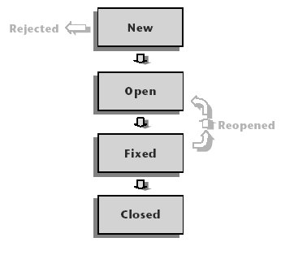
Defect Life Cycle
>>>>>>>>>>>>>>>>>>>>>> www.softwaretestinggenius.com <<<<<<<<<<<<<<<<<<<<<<

Slide 117
Defect Life Cycle
When a tester reports a Defect, it is tracked through the following stages: New, Open, Fixed, and Closed. A defect may also be Rejected, or Reopened after it is fixed. A defect may be Deferred for a look at a later point of time.
By default a defect is assigned the status New.
A quality assurance or project manager reviews the defect, and determines whether or not to consider the defect for repair. If the defect is refused, it is assigned the status Rejected.
If the defect is accepted, the quality assurance or project manager determines a repair priority, changes its status to Open, and assigns it to a member of the development team.
>>>>>>>>>>>>>>>>>>>>>> www.softwaretestinggenius.com <<<<<<<<<<<<<<<<<<<<<<

Slide 118
Defect Life Cycle
A developer repairs the defect and assigns it the status Fixed.
Tester retests the application, making sure that the defect does not recur. If the defect recurs, the quality assurance or project manager assigns it the status Reopened.
If the defect is actually repaired, it is assigned the status Closed.
>>>>>>>>>>>>>>>>>>>>>> www.softwaretestinggenius.com <<<<<<<<<<<<<<<<<<<<<<

Slide 119
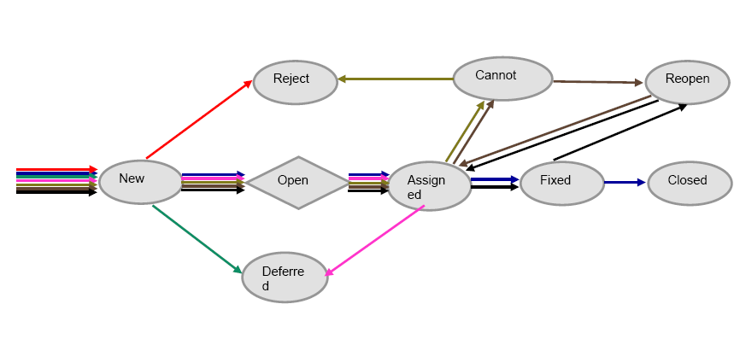
Defect Life Cycle Paths
>>>>>>>>>>>>>>>>>>>>>> www.softwaretestinggenius.com <<<<<<<<<<<<<<<<<<<<<<

Slide 120
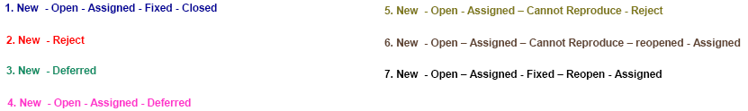
Defect Life Cycle Paths
>>>>>>>>>>>>>>>>>>>>>> www.softwaretestinggenius.com <<<<<<<<<<<<<<<<<<<<<<

Slide 121
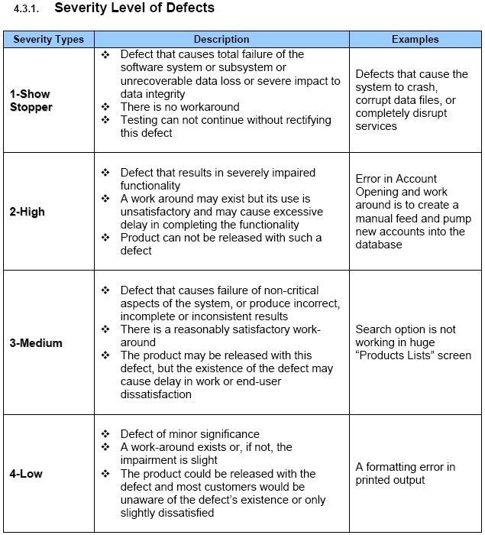
Defect Classification
>>>>>>>>>>>>>>>>>>>>>> www.softwaretestinggenius.com <<<<<<<<<<<<<<<<<<<<<<

Slide 122
Defect Classification
>>>>>>>>>>>>>>>>>>>>>> www.softwaretestinggenius.com <<<<<<<<<<<<<<<<<<<<<<

Slide 123

How many testers do we need to
change a light bulb?
None. Testers just noticed that the room was dark.
Testers don't fix the problems, they just find them
>>>>>>>>>>>>>>>>>>>>>> www.softwaretestinggenius.com <<<<<<<<<<<<<<<<<<<<<<

Slide 124
What Do You Do When You Find a defect?
Report a defect
The point of writing Problem Reports is to get bugs fixed.
>>>>>>>>>>>>>>>>>>>>>> www.softwaretestinggenius.com <<<<<<<<<<<<<<<<<<<<<<
Notes:
Effective tester looks to the effect of the bug report, and tries to write it in a way that gives each bug its best chance of being fixed. Also, a bug report is successful if it enables an informed business decision. Sometimes, the best decision is to not fix the bug. The excellent bug raises the issue and provides sufficient data for a good decision.

Slide 125
Some typical defect report fields
Summary
Date reported
Detailed description
Assigned to
Severity
Detected in Version
Priority
System Info
Status
Reproducible
Detected by
Screen prints, logs, etc.
>>>>>>>>>>>>>>>>>>>>>> www.softwaretestinggenius.com <<<<<<<<<<<<<<<<<<<<<<

Slide 126
Who reads the defect reports?
Project Manager
Executives
Development
Customer Support
Marketing
Quality Assurance
Any member of the Project Team
>>>>>>>>>>>>>>>>>>>>>> www.softwaretestinggenius.com <<<<<<<<<<<<<<<<<<<<<<
Notes:
Let the group answer this

Slide 127
Part 8: Test Automation
Principles of Test Automation 1: Choose carefully what to automate
Automate tests that absolutely cannot be done manually (e.g., stress test)
Automate those tests that are part of the regression bed / smoke test
Automate tests that are run repeatedly (e.g., tests that are run at least 20 times over the next quarter)
Automate tests with no manual intervention
Automate tests for standards (e.g., JDBC compliance)
Automate tests that are covering areas “static” but important areas
Automate tests that are covering areas “static” but important areas
>>>>>>>>>>>>>>>>>>>>>> www.softwaretestinggenius.com <<<<<<<<<<<<<<<<<<<<<<

Slide 128
Principles of Test Automation
# 1: Choose carefully what to automate
Part 8: Test Automation
Automate tests for highly visible areas
Minimize automating change-prone areas
Between GUI and non-GUI portion automation, go for automating non-GUI portions first
Automate tests for dependencies to catch ripple effects early
Automate areas where multiple combos are possible (pros and cons)
Automate areas that are re-usable
Automate “easy areas” to show low hanging fruits
>>>>>>>>>>>>>>>>>>>>>> www.softwaretestinggenius.com <<<<<<<<<<<<<<<<<<<<<<

Slide 129
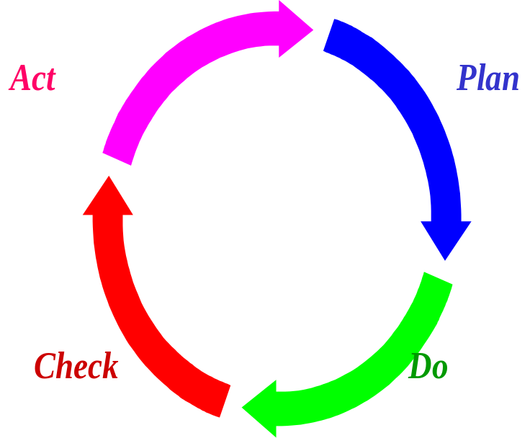
Principles of Test Automation
# 2: Ensure Automation Covers Full Circle
Corrective Action Implementation
Automatic Rollover to next runs
Incorporation into Regression
Test Planning
Automation Planning
Test Capture
Test Execution
Results Comparison
Automatic Analysis
Fish Bone Diagrams
Problem Identification
>>>>>>>>>>>>>>>>>>>>>> www.softwaretestinggenius.com <<<<<<<<<<<<<<<<<<<<<<

Slide 130
Principles of Test Automation
# 3: Choose Proper Automation Tool
Compatibility to Platform
Portability across platforms
Integration with TCDB, DR and SCM
2-way mapping to source code (may not be possible in services)
Scripting Language
Compatible to Multiple Programming Environments
Configurability
Test Case Reusability
Selective Execution
Smart Comparison
Reliable Support
Current documentation
>>>>>>>>>>>>>>>>>>>>>> www.softwaretestinggenius.com <<<<<<<<<<<<<<<<<<<<<<

Slide 131
Principles of Test Automation
# 4: Plan for Infrastructure
Resources for Installation
Resources for ongoing execution
People Resources
>>>>>>>>>>>>>>>>>>>>>> www.softwaretestinggenius.com <<<<<<<<<<<<<<<<<<<<<<

Slide 132
Principles of Test Automation
# 5: Account for Gestation Period
Training
Development
Testing the Tests
Sync-ing with product version changes
>>>>>>>>>>>>>>>>>>>>>> www.softwaretestinggenius.com <<<<<<<<<<<<<<<<<<<<<<

Slide 133
Principles of Test Automation
# 6: Run a Trial & Calibrate the Tool
Start small
Don’t try to automate everything at the same time
Allow time for evolving standards
>>>>>>>>>>>>>>>>>>>>>> www.softwaretestinggenius.com <<<<<<<<<<<<<<<<<<<<<<

Slide 134
Test Automation Components
Test cases
Config File
Scenarios
Read
Execute
Read
Tools
Execute
Test Framework
Write
Results
Modify
Reports/
Metrics
Write
Report Generator
Read
>>>>>>>>>>>>>>>>>>>>>> www.softwaretestinggenius.com <<<<<<<<<<<<<<<<<<<<<<

Slide 135
Process of Test Automation
Reqmts
Test reqmts
Planning
Test planning
Design
Test Design
Coding
Test Execution
The V - Model of Software Development
>>>>>>>>>>>>>>>>>>>>>> www.softwaretestinggenius.com <<<<<<<<<<<<<<<<<<<<<<

Slide 136
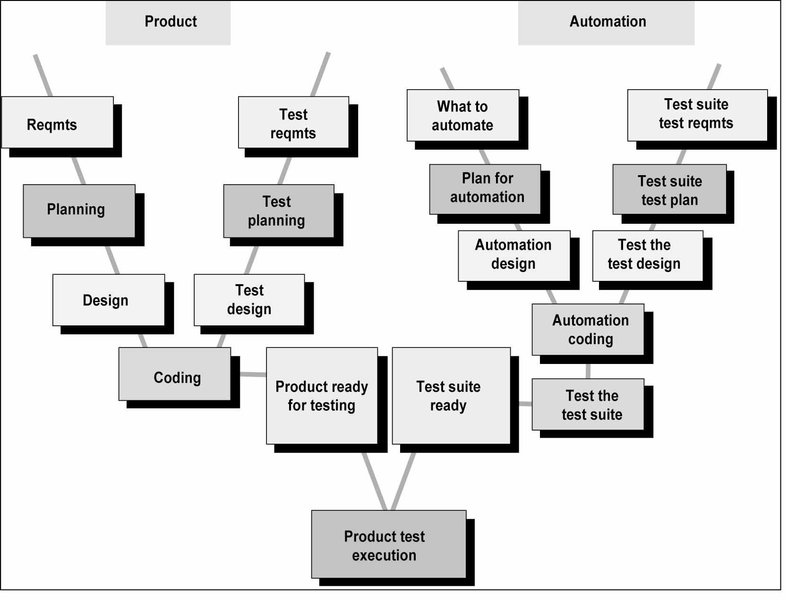
Process of Test Automation
The W - Model
of Test Automation
>>>>>>>>>>>>>>>>>>>>>> www.softwaretestinggenius.com <<<<<<<<<<<<<<<<<<<<<<

Slide 137
Process of Test Automation
The work on automation should go in parallel with product development
The requirements for automation spans over to multiple phases for multiple releases like the product requirements
The automation can be carried out in parallel with test design
Sometimes the test cases need to be modified to suit the automation requirements; where automation exist the test cases need not be elaborate
Where a dedicated team exist for automation, the schedule for automation can be independent of product releases, with some (tested) deliverables marked for each product release
>>>>>>>>>>>>>>>>>>>>>> www.softwaretestinggenius.com <<<<<<<<<<<<<<<<<<<<<<

Slide 138
Common Experiences in Test Automation
There are plenty of tools available and rarely does one tool meet all the requirements
The test tools are expensive (both in upfront costs and running costs)
Test tools also require good amount of training and only few vendors available for training
Training may not always keep pace with new versions of the tools
Test tools expect the users to learn new language/scripts and may not use standard languages/scripts
Deploying a test tool requires equal amount of effort as deploying a new product in a company – never underestimate the effort and pain involved!
>>>>>>>>>>>>>>>>>>>>>> www.softwaretestinggenius.com <<<<<<<<<<<<<<<<<<<<<<

Slide 139
Common Experiences in Test Automation
Migrating from one test tool to another may be difficult and requires good amount of effort
Test tools are one generation behind and may not provide backward / forward compatibility (eg. JAVA SDK support)
Good number of test tools requires their libraries linked with product binaries – Causes portions of the testing to be repeated after those libraries are removed (eg. Performance)
Test tools are not 100% cross platform – They are supported only on some platforms and the sources generated from these tools may not be compatible on other
Developing sharewares/public domain test tools may not get same amount of participation/involvement/support as of standards/products (eg. As against Linux)
>>>>>>>>>>>>>>>>>>>>>> www.softwaretestinggenius.com <<<<<<<<<<<<<<<<<<<<<<

Slide 140
Common Experiences in Test Automation
The experiences
Test tools may not go through same amount of evaluation for new requirements (eg Year 2000, 508)
The test tools increases the system requirements and requires the H/W and S/W to be upgraded at compile/run-time
The test tools are capable of testing only the product, not the impact because of the product/test tool to the system or network
Good number of test tools can’t differentiate between a product failure and the test suite failure – Causing increased analysis time and manual testing
>>>>>>>>>>>>>>>>>>>>>> www.softwaretestinggenius.com <<<<<<<<<<<<<<<<<<<<<<

Slide 141
Common Experiences in Test Automation
The experiences
The test tools may not provide good degree of trouble shooting / debug/error messages to help in analysis – Resulting in increased “printf”/log messages in the test suite
The test tools determine the results based on messages and screen co-ordinates at run-time – Intelligence needed to proactively find out the changes
>>>>>>>>>>>>>>>>>>>>>> www.softwaretestinggenius.com <<<<<<<<<<<<<<<<<<<<<<

Slide 142
Common Pitfalls in Test Automation
Automation shouldn’t be considered as stop-gap arrangement to engage test engineers (when no test execution, do automation!). Test Automation, like any other project, should start with the end in mind
A separate team in the organization looking at automation requirements, tool evaluation and developing generic test suites would add more value (may not always apply to testing services organization)
Automation doesn’t stop with automating the test cases alone. The test suite needs to be linked with other tools for increased effectiveness (e.g., Test case database, Defect filing, auto mails, preparing automatic reports, etc)
Automation doesn’t stop with recording & playing back the user commands; Automated tool should be intelligent enough to say what was expected, why a test case failed and give manual steps to reproduce the problem
>>>>>>>>>>>>>>>>>>>>>> www.softwaretestinggenius.com <<<<<<<<<<<<<<<<<<<<<<

Slide 143
Thank You
>>>>>>>>>>>>>>>>>>>>>> www.softwaretestinggenius.com <<<<<<<<<<<<<<<<<<<<<<

