Slide 1
TEAM
DATA ANALYTICS

Slide 2
ATTENDANCE SYSTEM BASED ON
DATA ANALYTICS

Slide 3

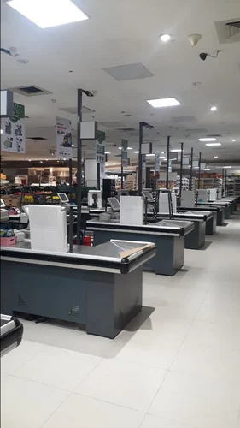
Superstore Analysis Project
Welcome to the Superstore Analysis Project. This presentation will cover the details of the project, from the agenda to the solution and results. Let's begin.

Slide 4

Agenda
Introduction
2
Analysis
1
Learn about the background of the project and how it was conducted.
Explore the data insights uncovered and how they can impact business outcomes.
3
Implementation
Discover how these insights were put into practice and the positive results they yielded.

Slide 5
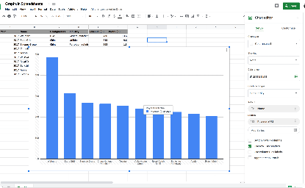
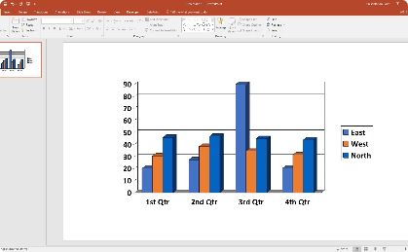

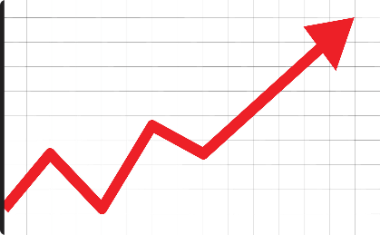
Project Overview
Data Analysis
The Data
The Process
The Goal
We analyzed historical sales data to identify patterns and trends over time.
The data analyzed includes sales, customer demographics, store locations, and product categories to find patterns and trends.
The team used data modeling techniques and various software to extract, clean, and analyze the data.
To provide insights to the stakeholders on store performance and customer behaviors to improve sales and customer satisfaction.

Slide 6
Who are the End Users?
Store Managers
Marketing team
Executives
They can use the insights to make informed decisions on product assortments, pricing strategies, and marketing campaigns.
They can use the insights to develop targeted promotions and advertising campaigns to improve customer engagement and loyalty.
They can use the insights to make informed decisions on resource allocation, expansion plans, and overall business strategy.

Slide 7
Solution and Presentation
1
The Solution
The team created interactive dashboards and reports to present the findings in a clear and meaningful way.
2
The Presentation
The team presented the findings to the stakeholders in an engaging and informative manner, highlighting key insights and recommendations.
3
The Impact
The stakeholders were impressed with the analysis and the actionable insights. They implemented several recommendations and observed a significant improvement in sales and customer satisfaction.

Slide 8
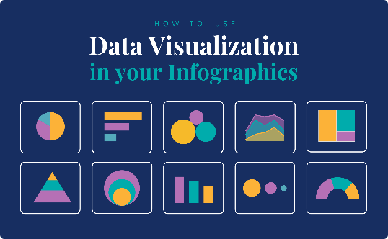

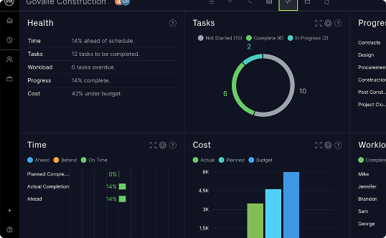
Wow in System
Data Visualization
Collaboration
User Experience
The team used dynamic and interactive charts, graphs, and maps to present the data in a visually compelling way.
The team used agile methodologies and frequent feedback sessions with the stakeholders to keep the project on track and ensure alignment with the end goals.
The team focused on creating a seamless and intuitive user experience for the stakeholders to access and interact with the data.

Slide 9
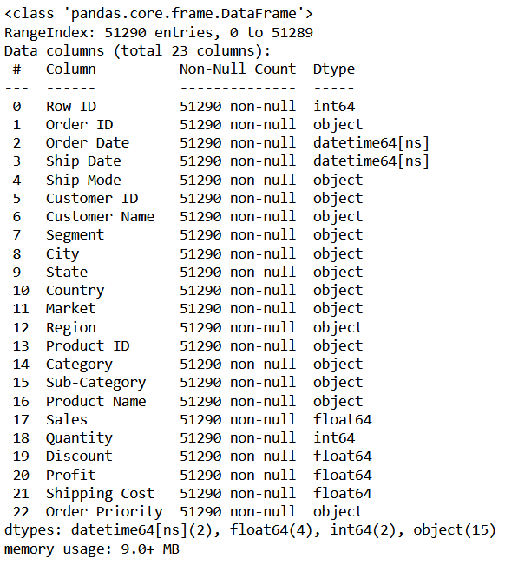
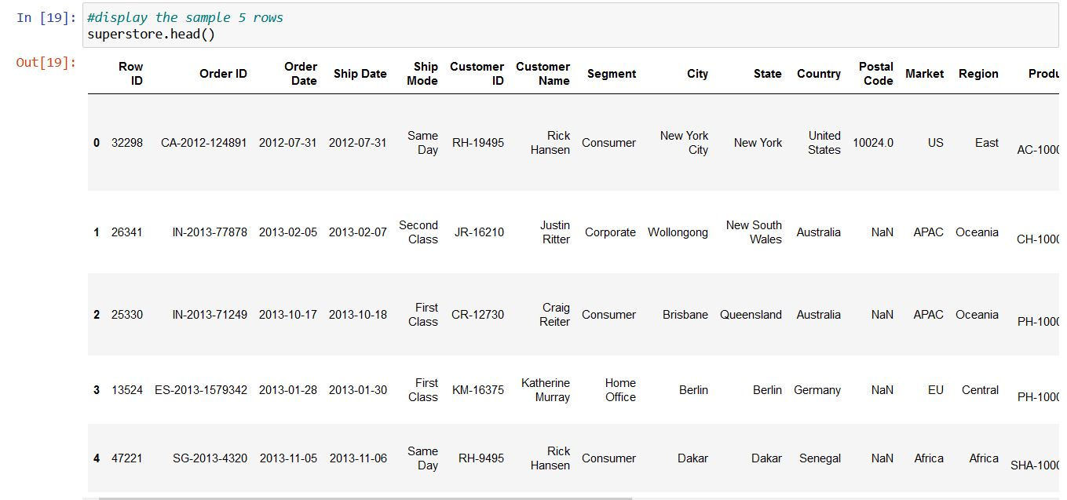
Modelling

Slide 10
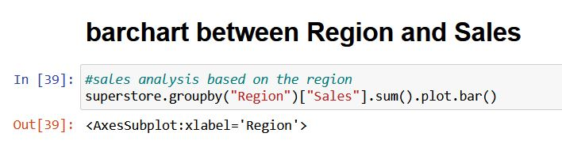
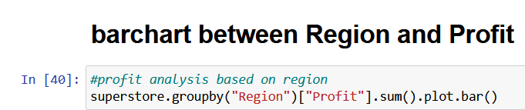
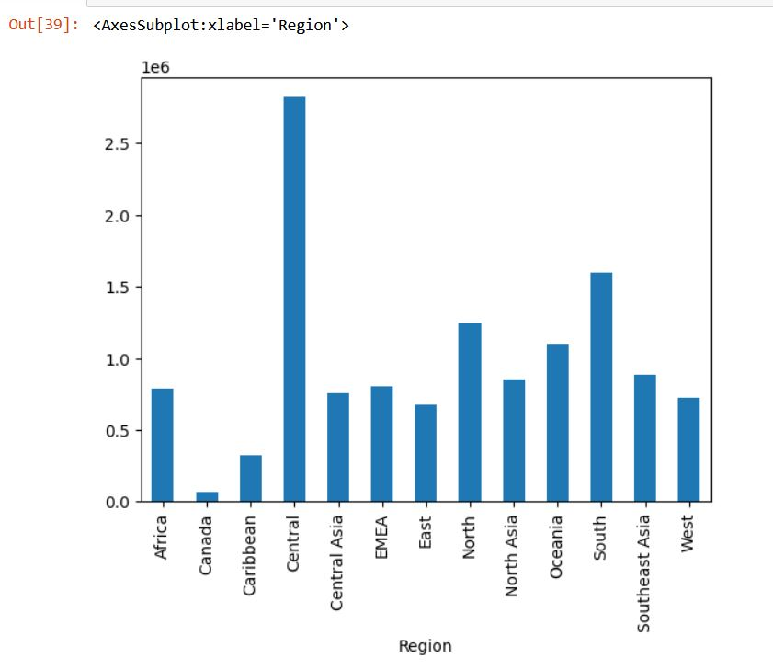
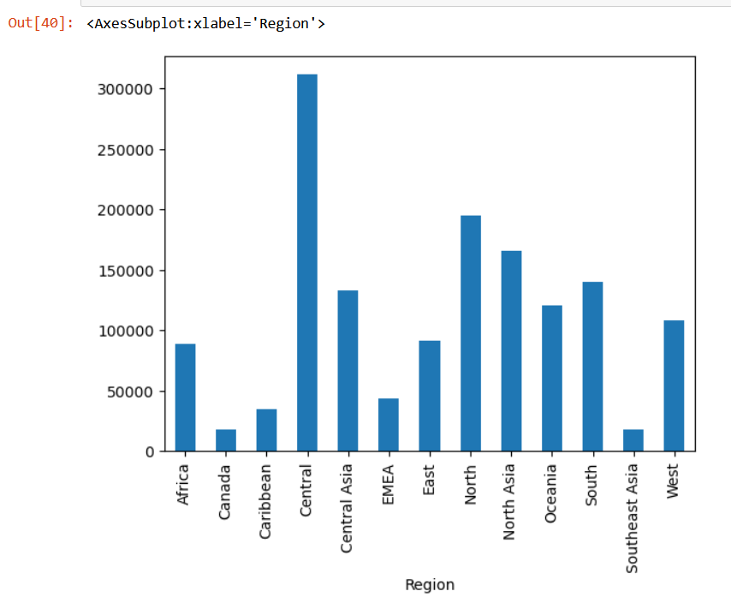
Modelling

Slide 11
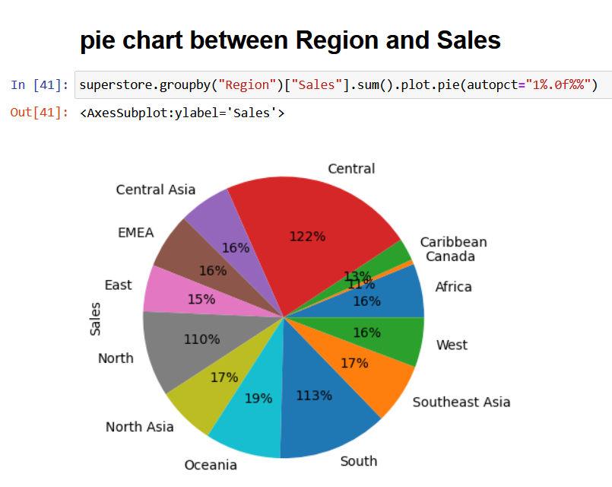
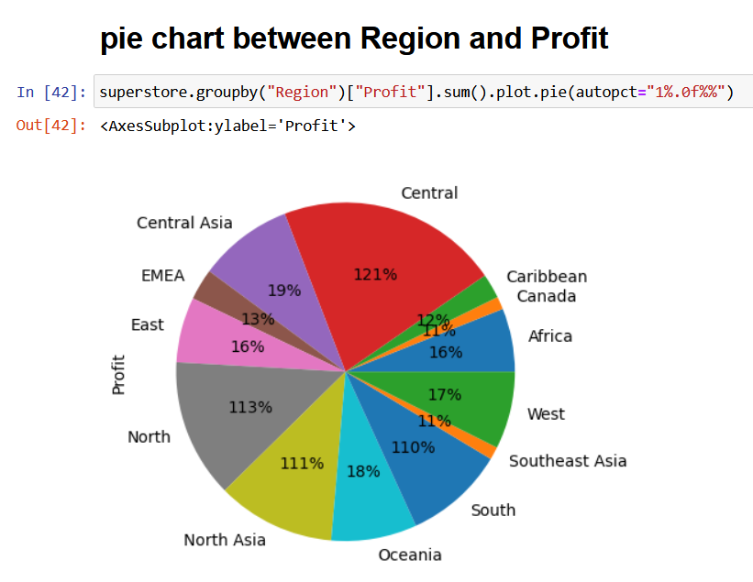
Modelling

Slide 12
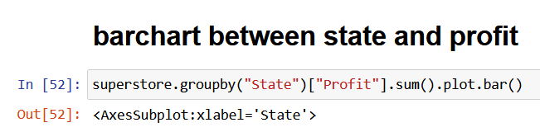
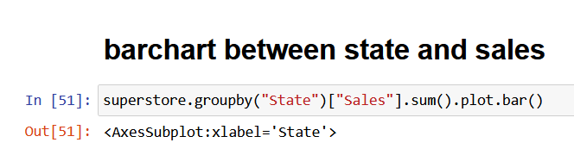
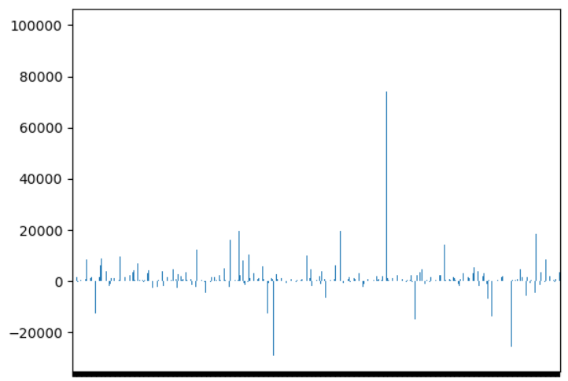
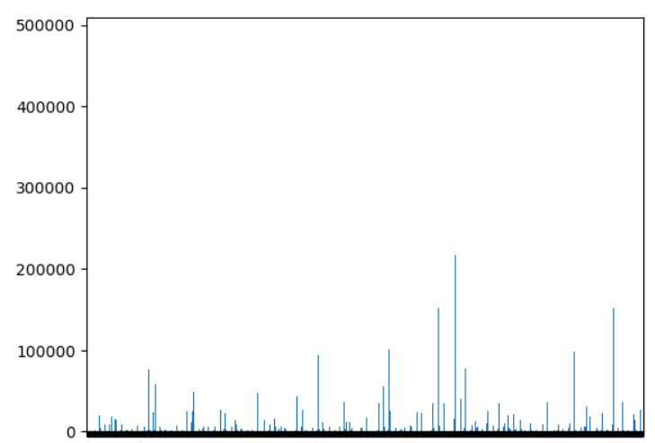
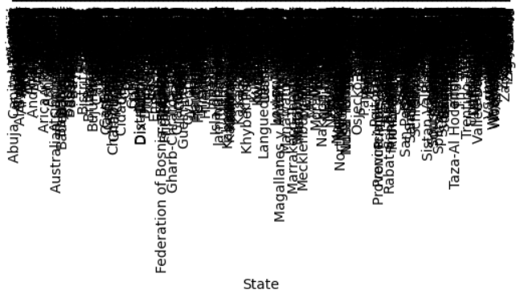
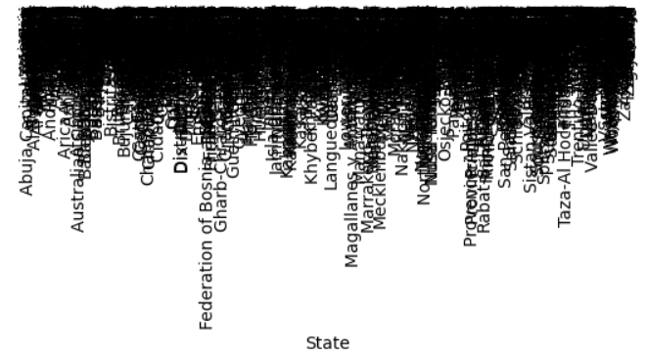
Modelling

Slide 13
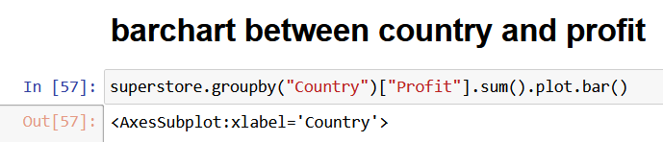
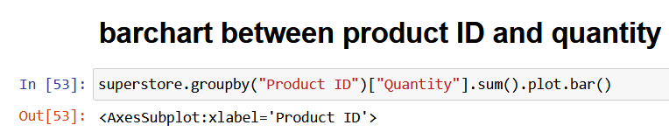
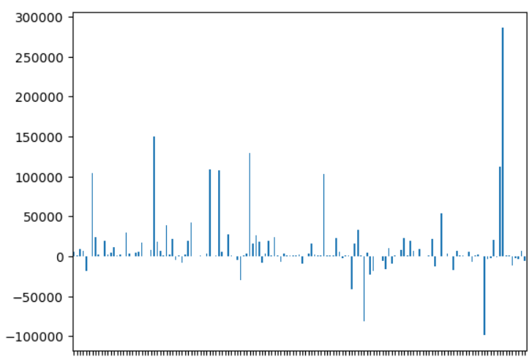
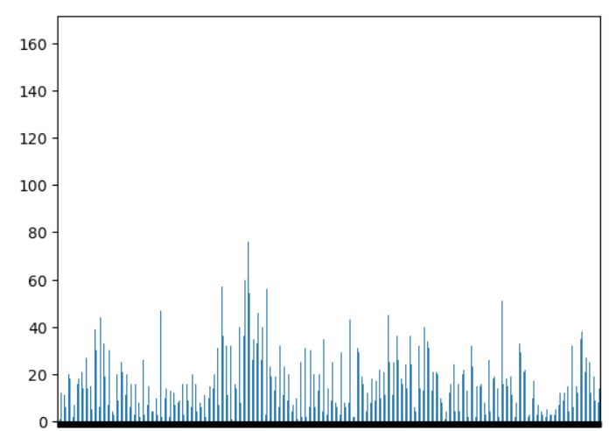
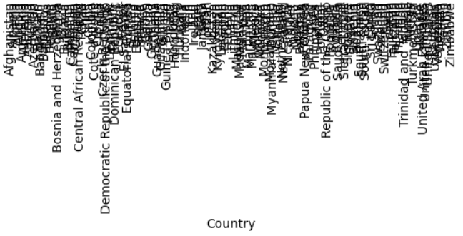

Modelling

Slide 14
Results
Revenue Increase
Sales Analysis
Customer Analysis
The team identified the top performing product categories and store locations, and provided recommendations on optimizing product assortments and pricing strategies.
The team identified the key customer segments and provided insights on their shopping behaviors and preferences, which can help improve customer engagement and loyalty.
Our analysis resulted in a 24% increase in revenue for the Superstore, stemming from the implementation of our recommendations.

Slide 15
LINKS
DATA SET
https://powerbidocs.com/wp-content/uploads/2019/11/Global-Superstore.csv
PROJECT SOURCE CODE
http://localhost:8888/notebooks/superstore.ipynb

Slide 16
Thank You!
Thank you for your attention and interest in the Superstore Analysis Project. We hope this presentation has provided you valuable insights.
NAME: GUBBALA SAIDIVYA
AICTE ID:STU646269c6aff041684171206
EMAIL ID:gsaidivya007@gmail.com

